Slide 1

fmriprep
HBIC Cogneuro workgroup
A Robust Preprocessing Pipeline for fMRI Data
Notes:
2024-06-20
revision 1.0

Slide 2

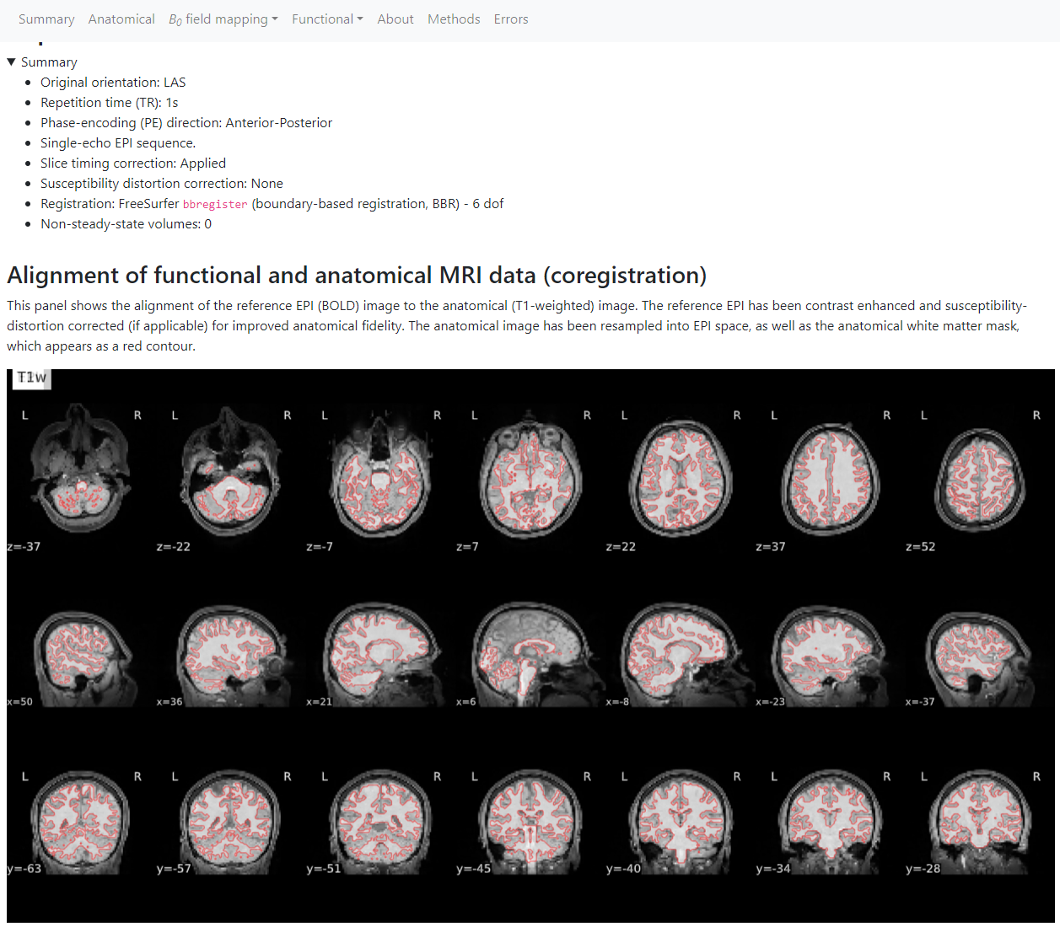


Introduction To fMRIPrep
Robust: Determines appropriate processing steps based on annotated input data
Standardization: Consistent preprocessing across different datasets and computing environments
Quality Control: Automated and comprehensive error reporting
Community-Driven: Regular updates and wide adoption in the field
BIDS integration: Outputs BIDS-Derivative dataset enabling access to the environment of BIDS Apps
Notes:
Standardization
It’s common when starting a new study to copy and edit the processing pipeline from a previous study. This can inadvertently carry over hard-coded values or other decisions that may have applied to one experiment but not another.
Software packages and their dependencies vary over time and across environments – windows, mac, linux. fMRIPrep is distributed as a docker container, which is a self-contained environment with consistent versions of AFNI, FSL, Java, Python, etc.. If you use the same container to process data on two different computers at two different times, you will get the same output.
Quality Control
fMRIPrep outputs comprehensive visual reports to help identify preprocessing issues
It provides boilerplate preprocessing methods text that you can – and should – copy & paste directly into a manuscript. Accurate reporting of preprocessing decisions is a significant issue in fMRI, but fMRIPrep standardizes this for you.
Community Driven
This is part of a broader trend in open-source collaborative research methods. fMRIPrep has a public github that users have already used to expand its functionality to include support for multi-echo BOLD, Lesion masking, output formats, among other changes.
BIDS
BIDS is the Brain Imaging Data Structure, which seeks to standardize how an imaging dataset is structured and documented. This not only removes a significant obstacle to data sharing and replicability, it also enables standardization of data processing and analysis tools. fMRIPrep is just one BIDS App in this ecosystem, and it relies on the documentation that you provide and characteristics of the data to determine the appropriate preprocessing pipeline.
fMRIPrep outputs its data in a BIDS compliant way, allowing you to plug it directly into other BIDS Apps for nuisance variable regression, functional connectivity analysis, etc.

Slide 3
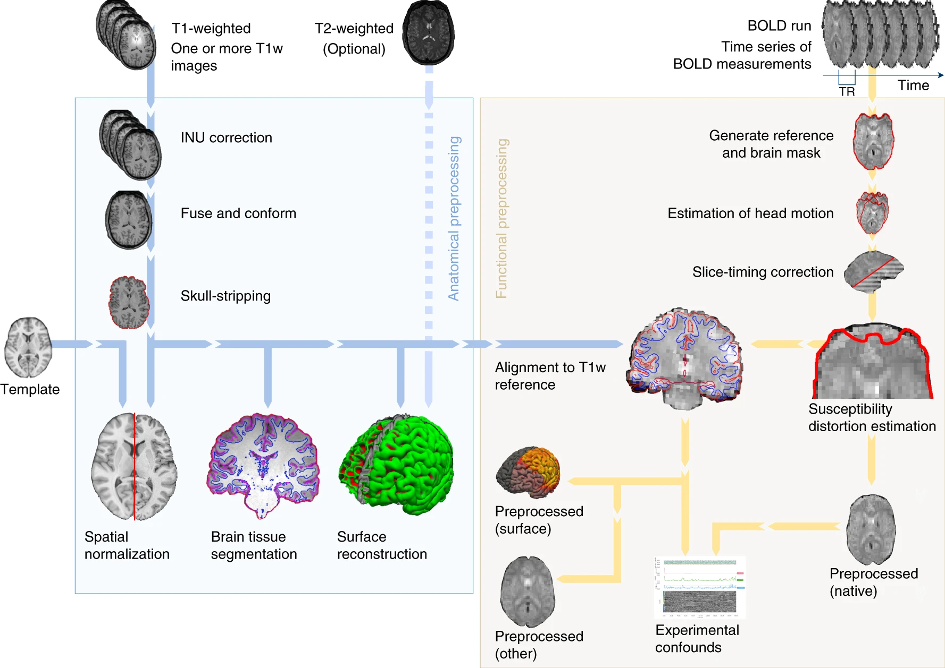
fMRIPREP METHOD

Slide 4
ANATOMICAL preprocessing
Intensity non-uniformity bias field correction (ANTs)
Skull stripping (ANTs)
Volume-based spatial normalization (MNI152NLin2009cAsym) through nonlinear registration (ANTs)
Segmentation (GM, WM, CSF) using FSL fast
Surface Reconstruction (FreeSurfer recon-all)
Refine ANTs brain mask with a freesurfer derived one
Notes:
See https://fmriprep.org/en/stable/workflows.html
Construct an average image by conforming all T1w images to RAS orientation and a common voxel size, and averaging them into a single reference template
Correct each T1w image for intensity non-uniformity (INU) with ANTs’ N4BiasFieldCorrection
Skull-strip the T1w reference image using ANTs’ antsBrainExtraction.sh (atlas-based extraciton)
Spatial normalization to standard spaces using ANTs’ antsRegistration in a multiscale, mutual-information based, nonlinear registration scheme.
Brain tissue segmentation using FSL fast
Surface reconstruction from T1w/T2w structural images using FreeSurfer:
Basic reconstruction (autorecon1) with T1w and T2w structural images; skip skull-stripping
Import the previously calculated brainmask from ANTs
Resume reconstruction using the T2w image to assist in finding the pial surface, if available.
Replace the original brain mask (from antsBrainExtraction.sh) with a refined one that derives from the Freesurfer aseg.mgz file

Slide 5
Functional Preprocessing
Generate reference volume
Head motion estimation using mcflirt (FSL)
Slice-timing correction using 3dTShift (AFNI)
Susceptibility distortion correction (SDCFlows)
Co-registration to T1w reference using bbregister (FreeSurfer)
Resampling to standard space
multi-echo T2*-driven combination (tedana)
Confounding time-series calculation:
Framewise displacement, DVARS, global signal (CSF, WM, whole brain)
Physiological regressors (compcor temporal and anatomical CompCor)
Motion and GS timeseries expanded to temporal derivatives and quadratics
Confound time series saved to file for motion correction after fMRIPrep
Notes:
See https://fmriprep.org/en/stable/workflows.html
Generate reference volume
Head motion estimation (transformation matrices + six rotation/translation parameters) using mcflirt (FSL), before slice-timing correction
Slice-timing correction, realigned to the middle of each TR using AFNI 3dTShift
Susceptibility distortion correction using acquired fieldmaps to correct for phase-encoding shifts in EPI (SDCFlows)
Boundary-based co-registration to T1w reference (?h.white surfaces from recon-all) using bbregister (FreeSurfer), configured with six degrees of freedom. Alternatively, FSL flirt with the BBR cost function is run if FreeSurfer is disabled.
Resampling to standard space. All transformations (head-motion, SDC, co-registration to T1w, anatomical-to-standard) concatenated and applied in one step
Tedana T2* workflow to optimally combine multi-echo data. T2* and S0 estimated by nonlinear regression (curvefit)
framewise displacement (FD) and DVARS calculated using Nipype following definitions by Power et al. 2014
Global signals extracted within CSF, WM, and whole-brain masks
Physiological regressors for component-based noise correction (CompCor)
Temporal derivatives and quadratic terms for head-motion and global signal

Slide 6
fmriprep outputs
Sample QA Report: https://fmriprep.org/en/stable/_static/SampleReport/sample_report.html
Anatomical Derivatives:
T1w, T2w preprocessed images
Brain mask, CSF/GM/WM masks
Standard <> native space transforms
Freesurfer surface files
Native <> fsnative Freesurfer space transforms
Notes:
https://fmriprep.org/en/stable/_static/SampleReport/sample_report.html
https://fmriprep.org/en/stable/outputs.html#anatomical-derivatives sub-<subject_label>/
anat/
sub-<subject_label>[_space-<space_label>]_desc-preproc_[T1w, T2w].nii.gz
sub-<subject_label>[_space-<space_label>]_desc-brain_mask.nii.gz
sub-<subject_label>[_space-<space_label>]_dseg.nii.gz
sub-<subject_label>[_space-<space_label>]_label-[CSF, GM, WM]_probseg.nii.gz
sub-<subject_label>_from-MNI152NLin2009cAsym_to-T1w_mode-image_xfm.h5
sub-<subject_label>_from-T1w_to-MNI152NLin2009cAsym_mode-image_xfm.h5
sub-<subject_label>_hemi-[LR]_white.surf.gii
sub-<subject_label>_hemi-[LR]_midthickness.surf.gii
sub-<subject_label>_hemi-[LR]_pial.surf.gii
sub-<subject_label>_hemi-[LR]_desc-reg_sphere.surf.gii
sub-<subject_label>_hemi-[LR]_space-fsLR_desc-reg_sphere.surf.gii
sub-<subject_label>_hemi-[LR]_space-fsLR_desc-msmsulc_sphere.surf.gii
sub-<subject_label>_from-fsnative_to-T1w_mode-image_xfm.txt
sub-<subject_label>_from-T1w_to-fsnative_mode-image_xfm.txt Freesurfer derivatives saved to <output_dir>/sourcedata/freesurfer

Slide 7
fmriprep outputs
Sample QA Report: https://fmriprep.org/en/stable/_static/SampleReport/sample_report.html
Anatomical Derivatives:
T1w, T2w preprocessed images
Brain mask, CSF/GM/WM masks
Standard <> native space transforms
Freesurfer surface files
Native <> fsnative Freesurfer space transforms
Functional Derivatives: (T1w and standard space)
BOLD preprocessed image
Brain mask
Head-motion correction reference and transform
Coregristration reference and transform
Fieldmap transform
FreeSurfer surfaces (fsnative & fsaverage) and segmentations
Confound timeseries
Notes:
https://fmriprep.org/en/stable/_static/SampleReport/sample_report.html
https://fmriprep.org/en/stable/outputs.html#functional-derivatives
sub-<subject_label>/
func/
sub-<subject_label>_task-<task_label>_run-<run_index>_space-<space_label>_desc-brain_mask.nii.gz
_space-<space_label>_desc-preproc_bold.nii.gz
_desc-hmc_boldref.nii.gz
_from-orig_to_boldref_mode-image_desc-hmc_xfm.nii.gz
_desc-coreg_boldref.nii.gz
_from-boldref_to-T1w_mode-image_desc-coreg_xfm.txt
_from-boldref_to-TOPUP_mode-image_xfm.nii.gz
_from-boldref_to-auto000XX_mode-image_xfm.txt
_space-T1w_desc-aparcaseg_dseg.nii.gz
_space-T1w_desc-aseg_dseg.nii.gz
_hemi-[LR]_space-<space_label>_bold.func.gii
_desc-confounds_timeseries.tsv
_desc-confounds_timeseries.json
https://fmriprep.org/en/stable/outputs.html#confound-regressors-description

Slide 8
next steps
“A BIDS App is a container image capturing a neuroimaging pipeline that takes a BIDS-formatted dataset as input. Each BIDS App has the same core set of command-line arguments, making them easy to run and integrate into automated platforms.” (Gorgolewski et al. 2017)
https://bids-apps.neuroimaging.io/about/ BIDS App website
https://journals.plos.org/ploscompbiol/article?id=10.1371/journal.pcbi.1005209 BIDS Apps article
fMRIprep output follows the BIDS-Derivatives specification, allowing it to be used as input to additional BIDS Apps for further processing or data analysis
XCP-D: resting state functional connectivity. Takes an fMRIprep output folder directly as input https://xcp-d.readthedocs.io/en/latest/index.html
Task-based: continue with 1st-level analysis in AFNI incorporating task timing and nuisance variable regression. https://andysbrainbook.readthedocs.io/en/latest/OpenScience/OS/fMRIPrep_Demo_5_1stLevelAnalysis.html
NB: If you use AFNI’s 3dConvolve/3dREMLfit to model your data, set the -stim_times_subtract option equal to TR/2 when creating the matrix using 3dDeconvolve to account for slice timing correction set to the middle of the TR by fMRIPrep. https://reproducibility.stanford.edu/slice-timing-correction-in-fmriprep-and-linear-modeling/
Notes:
XCP-D: https://xcp-d.readthedocs.io/en/latest/index.html XCP-D picks up right where fMRIprep ends, directly consuming the outputs of fMRIPrep. XCP-D leverages the BIDS and NiPreps frameworks to automatically generate denoised BOLD images, parcellated time series, functional connectivity matrices, and quality assessment reports.
XCP-D is designed for resting-state or pseudo-resting-state functional connectivity analyses. XCP-D derivatives may be useful for seed-to-voxel and ROI-to-ROI functional connectivity analyses, as well as decomposition-based methods, such as ICA or NMF.
For task-based designs, continue with 1st and 2nd level GLMs in your preferred fMRI software package

Slide 9
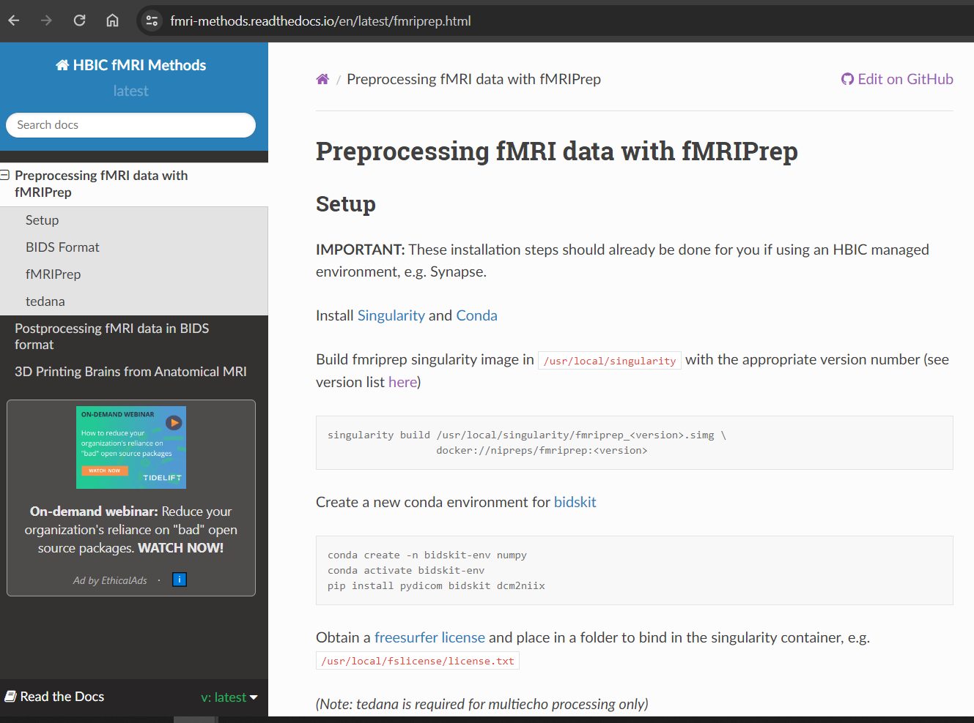
Getting Started
Guide: https://fmri-methods.readthedocs.io/en/latest/fmriprep.html
Install Docker/Singularity and fMRIprep container not necessary if running on Synapse
Convert dataset to BIDS format
Run fMRIprep container on data
Notes:
fMRIprep and bidskit are installed on Synapse and available for use.
Synapse access guide: https://hbic-computing.readthedocs.io/en/latest/synapse_access.html

Slide 10
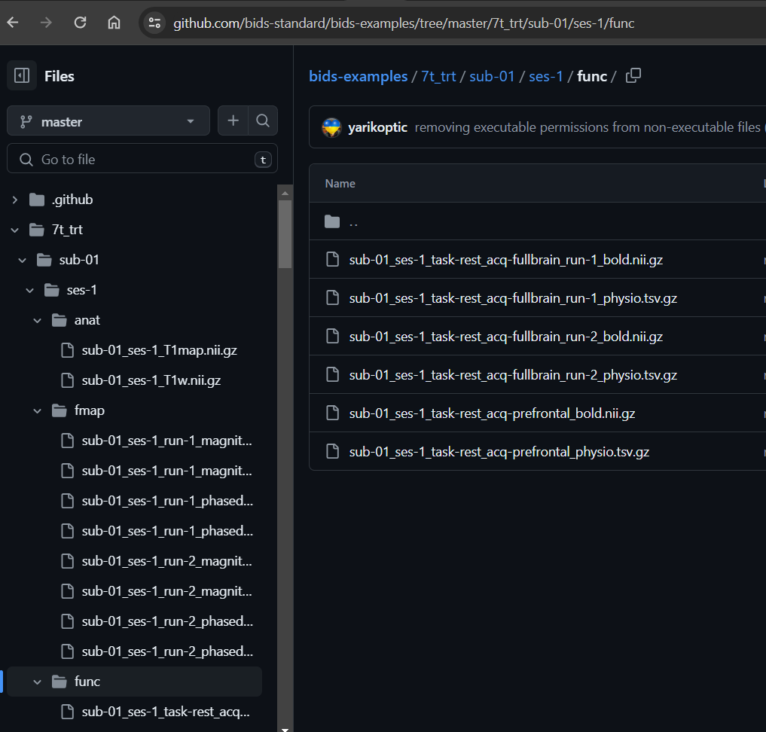
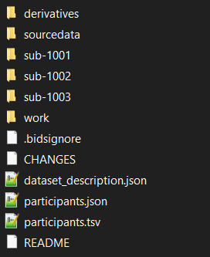
bids: brain imaging data structure
BIDS is a standardized format for organizing and annotating neuroimaging data. Several tools exist to facilitate conversion of a raw dataset to BIDS.
Example datasets: https://bids-standard.github.io/bids-examples/#mri
Notes:
BIDS Resources
https://reproducibility.stanford.edu/bids-tutorial-series-part-1a/
https://bids-specification.readthedocs.io/en/stable/introduction.html
https://bids-standard.github.io/bids-starter-kit/tutorials/annotation.html
https://bids-standard.github.io/bids-examples/#mri
https://andysbrainbook.readthedocs.io/en/latest/OpenScience/OS/BIDS_Overview.html
https://bids.neuroimaging.io/
BIDS enforces a standardized folder hierarchy, file naming conventions, and metadata.
A single project folder may contain: a sourcedata folder with raw data, sub-XXXX folders containing annotated unprocessed data readable by BIDS Apps, a derivatives folder containing preprocessed or analyzed data, a dataset_description.json file detailing authors, license, funding, doi, etc., and participants.json and participants.tsv files that list participant characteristics e.g. age, group, condition.

Slide 11
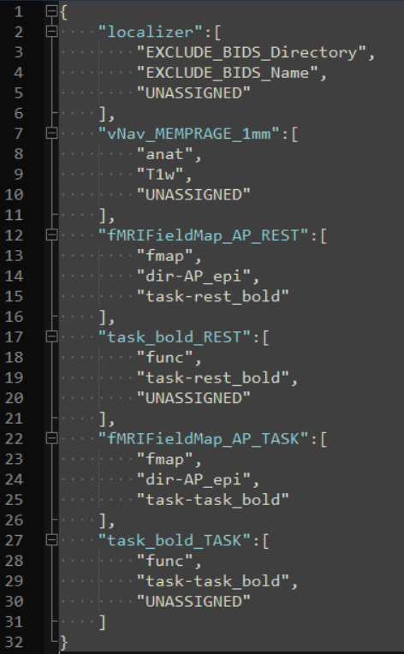
bidsKIT
https://github.com/jmtyszka/bidskit/blob/master/docs/QuickStart.md
Create a folder for your dataset containing the single folder ‘sourcedata,’ containing raw data organized by participant, session, and scan run.
run bidskit within the project folder. This will scan sourcedata and create a translator text file for you to edit before performing the actual BIDS conversion.
After annotating the protocol_translator.json file, run bidskit a second time to apply the conversion
myproject/sourcedata/1001/T1/1/[DICOM Images]
/2/[DICOM Images]
/T2/1/[DICOM Images]
/1002/T1/1/[DICOM Images]
/2/[DICOM Images]
conda activate bidskit-env
cd /path/myproject
bidskit
bidskit
Notes:
BIDSKIT https://github.com/jmtyszka/bidskit/blob/master/docs/QuickStart.md
Within sourcedata, create a folder for each participant. Within the participant folder, create a folder for each session (i.e., timepoint T1/T2/T3, or modality MRI/EEG). Within the session folder, create a folder for each scanning run that contains the DICOM images. If you do not want to organize by session, use the –no-sessions flag at the end of your command (i.e., bidskit –no-sessions ) in both the first and second bidskit calls.
The first-pass conversion by bidskit will create a translator text file that you will edit to aid in creating the BIDS-compliant structure. This step only needs to be done once per project. After activating the bidskit-env conda environment, you can run bidskit from the data directory (i.e., the folder that contains the sourcedata subfolder).
Navigate to /path/myproject/code and open Protocol_Translator.json for editing in a text editor. Make use of BIDS documentation to aid in editing this file to assign appropriate BIDS purpose directory names (anat, func, fmap, etc.) and BIDS-compliant filename suffixes. The blue text contains the Series Description names from the DICOMs. These must be unique for each run or BIDSKIT will not be able to distinguish between runs. e.g., if you have two filedmaps that apply to two different runs, label them accordingly.

Slide 12
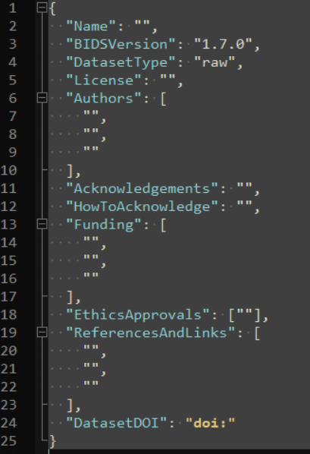

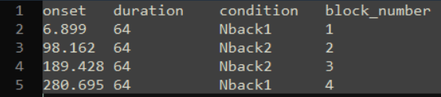
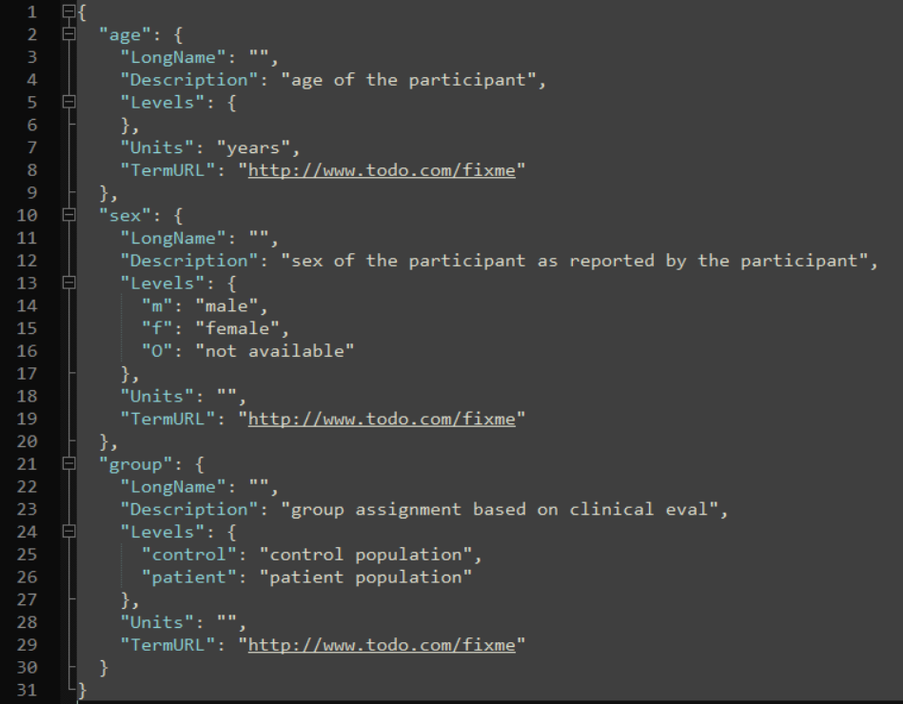
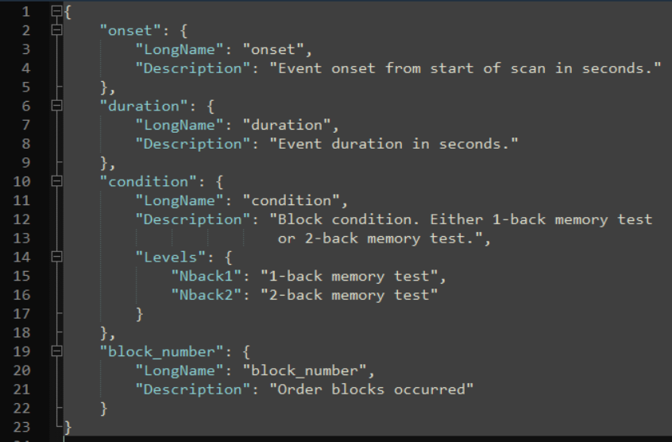
additional configuration
dataset_description.json
participants.tsv
sub-XXXX_task-TASK_events.tsv
participants.json
sub-XXXX_task-TASK_events.json
Notes:
dataset_description.json and the participants.json *.tsv files do not need to be completed before running fMRIprep, but are useful means of recording dataset characteristics and necessary before sharing data.
If you have task-based designs, you will need to complete any /path/myproject/sub-XXXX/ses-X/func/*_events.tsv template files with task timing information.
The .json sidecar files are intended to be human and machine readable annotations of codes and variable names used in the accompanying .tsv files.

Slide 13
running on synapse
Tell singularity to run the fmriprep container...
on your dataset...
and to put output data here.
Don’t pass the user’s environment to fMRIprep,
but do pass the Freesurfer license file.
BIDS-App requires a participant/group parameter (always participant for fmriprep)
Keep a working directory to resume crashes from
Use a custom /tmp directory (if the system /tmp is too small)
export APPTAINERENV_FS_LICENSE=/opt/fslicense/license.txt
singularity run --cleanenv --bind \ /usr/local/fslicense:/opt/fslicense,$HOME/tmp:/tmp \
/usr/local/singularity/fmriprep_23.2.0.simg \
$HOME/path/to/bidsdata $HOME/path/to/bidsdata/derivatives \
participant \
-w /tmp/work
Many additional fMRIprep parameters available
https://fmriprep.org/en/stable/usage.html#execution-and-the-bids-format
--me-output-echos (multiecho processing)
--fd-spike-threshold (default 0.5mm)
--dvars-spike-threshold (default 1.5)
--longitudinal
Notes:
Use the --cleanenv flag to avoid passing environment variables, like the user’s FSL installation instead of the container’s FSL.
fMRIprep does not come with a FreeSurfer license – pass it to the container by creating an APPTAINERENV_FS_LICENSE variable. The option --bind /usr/local/fslicense:/opt/fslicense will map the contents of /usr/local/fslicense on the host (where the file actually resides) to the path /opt/fslicense within the container (where fMRIPrep will look for it, that is, the path specified by FS_LICENSE).
fMRIPrep makes extensive use of a temporary directory, /tmp for intermediate files. But /tmp may not have sufficient disk space allotted, causing the processing job to halt and error before completing. To remedy this, map a different location on the host system that is unrestricted in size to /tmp, e.g. $HOME/tmp:/tmp. ATTENTION: Clear this custom tmp directory regularly when you no longer need the intermediate working files!
If fMRIPrep aborts partway through, you can rerun it from where it stopped by using the -w option and passing the work directory from the failed attempt.

Slide 14
documentation
https://hbic-computing.readthedocs.io/en/latest/index.html Access to Synapse and KUMC resources
https://fmri-methods.readthedocs.io/en/latest/index.html fMRI analysis method overviews and guides for running on Synapse
https://fmriprep.org/en/stable/index.html fMRIPrep developper documentation
https://github.com/jmtyszka/bidskit/blob/master/docs/QuickStart.md BIDSKIT developper documentation

