Slide 1

CILogon
Campus Authentication to CyberInfrastructure
Jim Basney jbasney@cilogon.org
This material is based upon work supported by the National Science Foundation under grant number 0943633. Any opinions, findings, and conclusions or recommendations expressed in this material are those of the author(s) and do not necessarily reflect the views of the National Science Foundation.

Slide 2
Outline
Goals
Demo
Levels of Assurance and Accreditation
Challenges
Lessons Learned
Conclusions

Slide 3
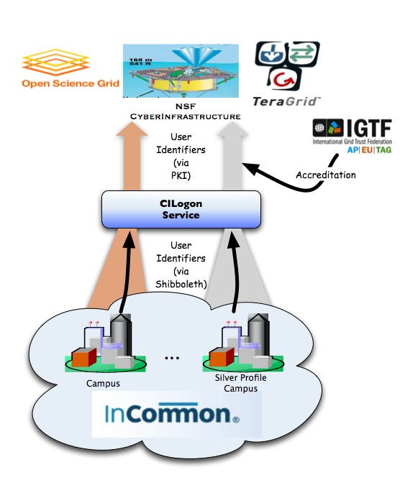
CILogon Goals
Facilitate campus login to NSF CI
Leverage researchers’ existing identities at their home institution
Ease identity management for researchers and CI providers
Bridge from:
Identity credentials issued by research institutions participating in the InCommon Federation using Shibboleth/SAML web browser single sign-on
Bridge to:
X.509 certificates that satisfy the requirements of NSF CI projects

Slide 4
Demo
https://cilogon.org

Slide 5
Levels of Assurance
Strength of:
Tokens / Credentials / Verifiers / Assertions
Registration and identity proofing
Authentication Protocols / Mechanisms
Examples:
NIST SP 800-63 Levels 1-4
InCommon Identity Assurance (Bronze, Silver)
IGTF Classic, MICS, SLCS

Slide 6
NIST SP 800-63 Levels
No ID proofing; basic strength of authentication
Basic ID proofing + single factor remote network authentication
Strong ID proofing + multi-factor remote network authentication
In-person ID proofing + FIPS 140-2 Level 2 hardware cryptographic tokens

Slide 7
InCommon Silver
Identity management policies and procedures differ across InCommon members
InCommon Silver Identity Assurance Profile defines common standards for identity vetting, system management and security, recordkeeping, revocation, audits, and name management
Pilot adoption underway by InCommon members
http://incommon.org/assurance
Target: consistency with NIST SP 800-63 LOA 2

Slide 8
IGTF Profiles
Classic
In-person ID proofing; max 13 month certificates; encrypted private keys
Member Integrated Credential Service (MICS)
In-person ID proofing via IDM system; max 13 month certificates; encrypted private keys
Short Lived Credential Service (SLCS)
Basic ID proofing; max 1 Msec (11.5 day) certificates; unencrypted private keys

Slide 9
CILogon LOA
CILogon Silver CA
InCommon Silver identity proofing (SAML)
Pursuing IGTF/TAGPMA accreditation
CILogon Basic CA
InCommon identity proofing (as is) (SAML)
University campuses plus ProtectNetwork
CILogon OpenID CA
No ID proofing
Self-asserted identities
800-63 Level 1 possible: ICAM OpenID 2.0 Profile

Slide 10
Accreditation – InCommon Silver
Independent audit
External contractor or internal auditor
Using checklist in Silver Profile
Audit report reviewed by InCommon
InCommon publishes list of Silver IdPs

Slide 11
Accreditation - TAGPMA
Publish Certificate Policy and Certification Practices Statement (CP/CPS) according to RFC 3647
Present CA to regional IGTF policy management authority – The Americas Grid PMA (TAGPMA)
Checklist-based review by TAGPMA of CA’s policies and operations
Vote for acceptance by TAGPMA members
Submit CA certificate for inclusion in TERENA Academic CA Repository (TACAR)

Slide 12
Challenges (So Far)
TAGPMA/IGTF accreditation
Adoption of InCommon
Adoption of InCommon Silver
Attribute release by InCommon identity providers
Service highly valued by user but not organization
Few users across many campuses
Hope: uApprove and user consent based release

Slide 13
Lessons Learned (So Far)
Desire for end-to-end command-line functionality
Dissatisfaction with browser login once per day/week
Support for login from remote SSH sessions
Hope: SAML ECP, Moonshot
Desire for host/service certificates
Desire for long-lived certificates

Slide 14
Related Work
Europe: TERENA Certificate Service for national federations (Denmark, Finland, Netherlands, Norway, Sweden, and more)
Switzerland: SWITCH SLCS CA for SWITCHaai federation
Germany: DFN-SLCS CA for DFN-AAI federation
UK: SARoNGS Credential Translation Service for UK Access Management federation
US: TeraGrid Federated Login (go.teragrid.org)

Slide 15
Upcoming Event
Workshop on
Federated Identity for CyberInfrastructure
Co-located with the
2010 Internet2 Fall Member Meeting
November 4-5, 2010 in Atlanta, Georgia
http://workshops.cilogon.org/2010

Slide 16
Thanks

Slide 17
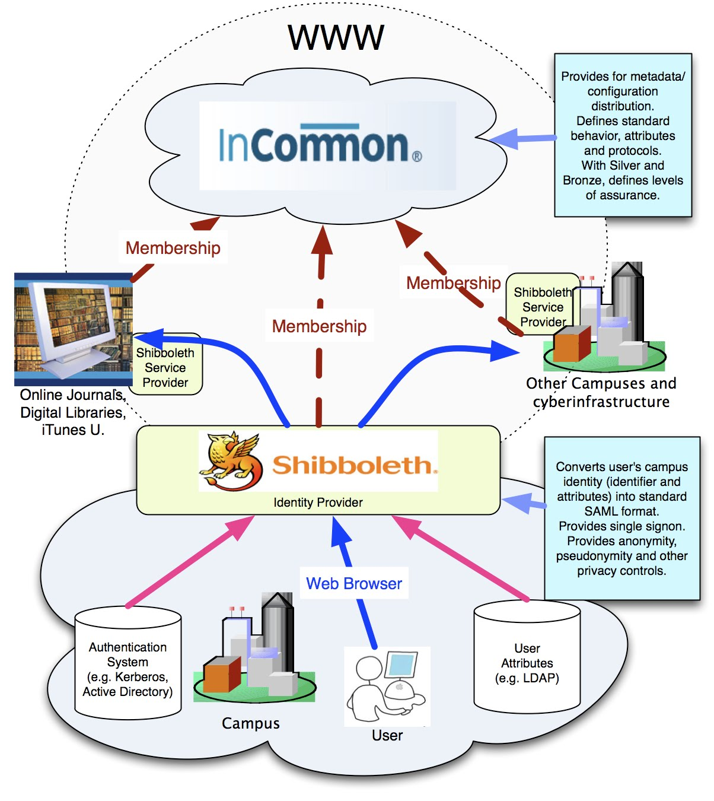
Federated Identity

