Slide 1


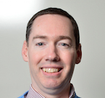
CILogon
Jim Basney jbasney@ncsa.Illinois.edu

Slide 2
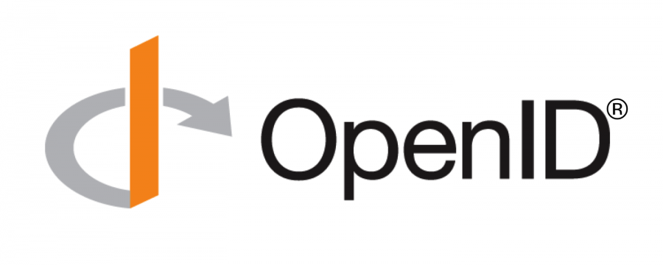



Tokens for Science
CILogon
OpenID Connect (OIDC) ID Tokens (e.g., SCiMMA) containing user attributes and group memberships from the research community (via COmanage) and from the researcher's home institution (via InCommon)
SciTokens (e.g., LIGO) containing authorization scope values determined by per client/subscriber policy
WLCG Tokens (e.g., Fermilab) support for wlcg.groups and storage.*|compute.* scopes
GA4GH Passports (e.g., Australian BioCommons) support for AffiliationAndRole, AcceptedTermsAndPolicies, ResearcherStatus, ControlledAccessGrants, and LinkedIdentities
https://www.cilogon.org/jwt

Slide 3
Capability-based authorization for distributed scientific computing
Using the OAuth and JWT standards for distributed authorization
Using well-supported security libraries/frameworks
Implementing the Principle of Least Privilege
Migrate from identity-based authorization (grid-mapfile) to capability-based authorization (audience & scope)
https://scitokens.org/

Slide 4
Open Source
Python library | https://github.com/scitokens/scitokens
C++ library | https://github.com/scitokens/scitokens-cpp
Java client and server | https://github.com/scitokens/scitokens-java
HTCondor CredMon | https://github.com/htcondor/scitokens-credmon
SciTokens SSH | https://github.com/XSEDE/oauth-ssh/tree/master/server#scitokens
CVMFS | https://github.com/cvmfs-contrib/cvmfs-x509-helper
dCache | https://github.com/dCache/dcache
NGINX | https://github.com/scitokens/nginx-scitokens
XRootD | https://github.com/xrootd/xrootd/tree/master/src/XrdSciTokens
https://scitokens.org/

Slide 5
SciAuth: Deploying Interoperable and Usable Authorization Tokens to Enable Scientific Collaborations
Transformation underway for authentication and authorization in NSF cyberinfrastructure: from X.509 user certificates to JSON Web Tokens (JWTs)
Building on prior work from SciTokens
An opportunity to realize security benefits:
Apply the principle of least privilege
Improved support for federated identities (InCommon)
Improved support for attribute, role, and capability-based authorization
Reduce reliance on coarse-grained identity-based authorization (impersonation)
Build on well-supported, widely-used JWT libraries
With coordination across science projects (LIGO, OSG, WLCG, etc.)
For interoperability across infrastructures
With common approaches to integration with science software and workflows
Working together to maintain/improve reliability/security throughout the transition and beyond
https://sciauth.org/

Slide 6
SciAuth: Timeline
Jan 2018: Globus Toolkit
end of support
Jun 2019: HTCondor 8.9.2 released with SciTokens support
Aug 2018: SciTokens support added to CVMFS
Sep 2019: WLCG Common JWT Profiles published
Dec 2020: SciTokens support integrated into XRootD
2021: LIGO SciTokens Pilot
2022: OSG retiring GSI
2023: WLCG retiring GSI
2018
2019
2020
2021
2022
2023
XSEDE 2.0
LHC Run 3
LIGO O4
IceCube Upgrade
PATh
IRIS-HEP
SciTokens
SciAuth

Slide 7

SciTokens for LIGO
Dedicated https://cilogon.org/ligo token issuer
Migrating to https://cilogon.org/igwn soon
vault.ligo.org server for token management
HTCondor token management for workflows
Target applications:
OSDF/CVMFS/XRootD, GWDataFind, DQSegDB, GraceDB

Slide 8
Authorization Policies
scope(s) | group(s)
read:/frames gwdatafind.read dqsegdb.read gracedb.read | Communities:LSCVirgoLIGOGroupMembers gw-astronomy:KAGRA-LIGO:members
write:/frames | Services:XRootD:SciTokens:write-frames:authorized
dqsegdb.create | Communities:LVC:SegDB:SegDBWriter

Slide 9
Current Status
CVMFS HTCondor access in operation
GraceDB & GWDataFind support implemented and being deployed
DQSegDB support under development
Robot support under development
Bi-weekly coordination calls to prepare for tokens in next LIGO Observing Run (O4) - March 2023

Slide 10
Current Challenges
Issuer key rotation
Refresh token rotation
Various use cases for token exchange
Policies for dynamic client registration
High Availability, scalability, and token lifetimes

Slide 11
This material is based upon work supported by the National Science Foundation under Grant No. 2114989. Any opinions, findings, and conclusions or recommendations expressed in this material are those of the author(s) and do not necessarily reflect the views of the National Science Foundation.

