Slide 1
InCommon and TeraGrid Campus Champions
Jim Basney
jbasney@ncsa.uiuc.edu

Slide 2
Outline
InCommon Overview
TeraGrid and InCommon
InCommon and NSF CyberInfrastructure

Slide 3
InCommon Overview

Slide 4
InCommon Federation
InCommon is the federation for U.S. research and education, providing higher education and their commercial and non-profit partners with a common trust framework for access to online resources.
Notes:
InCommon is the higher education and research federation in the U.S.
InCommon serves as the trust agent for all participants.

Slide 5
About InCommon
Through InCommon, campuses leverage their identity databases to allow for the use of one set of credentials to access multiple resources.
Online service providers no longer need to maintain user accounts.
Identity providers manage the levels of their users' privacy and information exchange.
InCommon uses SAML-based authentication and authorization systems (such as Shibboleth®) to enable scalable, trusted collaborations among its community of participants.
Notes:
Privacy, security and scalability are the heart of the benefits of InCommon and a federated identity management approach.

Slide 6
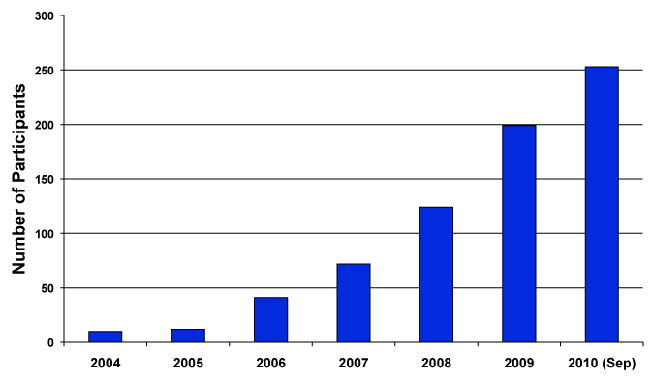
InCommon Participants Year-by-Year
253 InCommon Participants (Sept. 2010)
Almost 5 million end-users (faculty, staff, students)
Notes:
As September 2010, InCommon has 253 participants, including 180 colleges and universities.

Slide 7
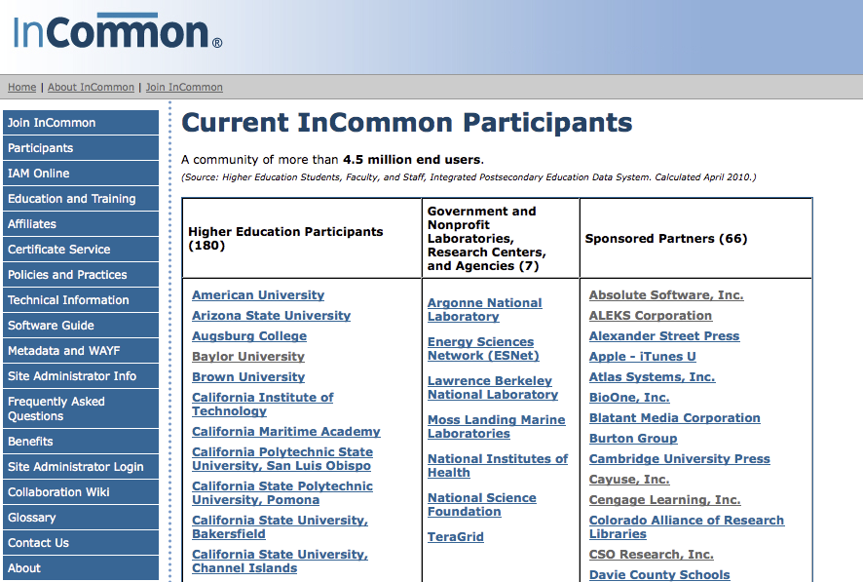
www.incommonfederation.org/participants
Notes:
InCommon participants include colleges and universities, government and non-profit research facilities and agencies, and sponsored partners – non-profit and for-profit entities that offer federated services.

Slide 8
Federated Resources Resources available via InCommon are many and diverse
Business Functions
Benefits
Asset management
Talent management
Visas & INS compliance
Mobile alerts
Travel management
Energy management
Surveys and market analysis
Learning and Research
Journals
Databases and analytical tools
Multi-media access
Homework labs
Quiz tools
Plagiarism detection
Software downloading
Alcohol awareness education
Student travel discounts
Transportation and ride-share services.
Strong support from key higher education partners, such as: Microsoft, Apple, National Student Clearinghouse, NSF, NIH, Gov-affiliated Labs
Notes:
Federated resources offered by InCommon participants affect many campus business and academic functions. There are a number of HR and student services applications, as well as learning management systems, and library databases.

Slide 9
TeraGrid and InCommon

Slide 10
Notes:
First the researcher visits the home page and selects his or her campus from the identity provider drop-down.
In case the researcher’s campus is not available, he or she can login via ProtectNetwork.

Slide 11
Notes:
Next the researcher logs in at the home institution’s login page.
The University of Illinois login page is shown here as an example.

Slide 12
(one-time only)
Notes:
Then, on the first login only, the researcher also logs in to TeraGrid to bind the campus and TeraGrid identities (on the left).
The researcher can later delete bindings via the web app (on the right).

Slide 13
Notes:
After login, the researcher is presented with options to download a certificate to the desktop or launch Java applets for remote login and file transfer using the certificate for authentication.

Slide 14
Notes:
Choosing to download a credential to the desktop launches a simple Java Web Start application (from the GridShib project – shown on the left) to generate a keypair, issue a certificate request to the server, receive a signed certificate in return, and store them to the desktop.
The GSI-SSHTerm Applet supports remote login via the browser, including X11 forwarding.

Slide 15
TeraGrid InCommon Support: Status
Available at https://go.teragrid.org since Sep 2009
Supporting logins from >30 institutions
Issued >1000 certificates so far
Work in progress:
Integrate with TeraGrid User Portal (https://portal.teragrid.org)
CILogon Project (https://cilogon.org)
Provide certificates to all InCommon members (not just TeraGrid users)
Other possible future work for TeraGrid:
Phase out TeraGrid passwords
Attribute-based authorization
Support for OpenID

Slide 16
InCommon and NSF CyberInfrastructure

Slide 17
New Service: cilogon.org
No TeraGrid account required
Delivers certificates to desktop or browser
Available certificate lifetimes: from 1 hour to 13 months
3 Certification Authorities:
Silver: InCommon Silver IDs
Basic: any InCommon IDs
OpenID: any OpenIDs
Available now!

Slide 18
Roadmap for using NSF CI with InCommon
A practical guide under development now
Your input is desired!
For current draft, visit: https://spaces.internet2.edu/display/nsfciinc

Slide 19
Thanks!
Questions? Comments?
Contact: jbasney@illinois.edu

