Slide 1

CILogon
Federated Access to US CyberInfrastructure
Jim Basney jbasney@illinois.edu
This material is based upon work supported by the National Science Foundation under grant number 0943633. Any opinions, findings, and conclusions or recommendations expressed in this material are those of the author(s) and do not necessarily reflect the views of the National Science Foundation.

Slide 2
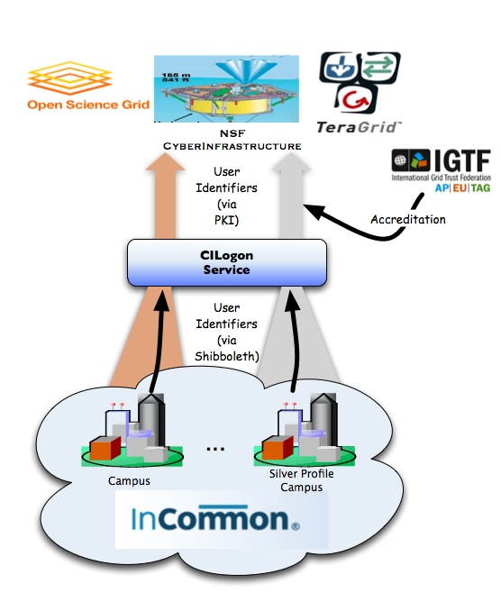
CILogon Project Goal
Enable campus logon to CyberInfrastructure (CI)
Use researchers’ existing security credentials at their home institution
Ease credential management for researchers and CI providers

Slide 3
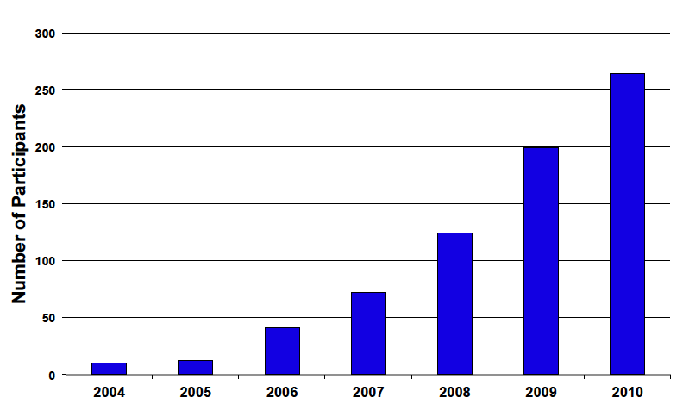
InCommon is the federation for U.S. research and education, providing higher education and their commercial and non-profit partners with a common trust framework for access to online resources.
264 InCommon Participants
Almost 5 million end-users (faculty, staff, students)
Notes:
InCommon is the higher education and research federation in the U.S.
InCommon serves as the trust agent for all participants.

Slide 4
A Roadmap for Using NSF Cyberinfrastructure with InCommon
A helpful guide for CI projects
http://incommon.org/nsfroadmap

Slide 5
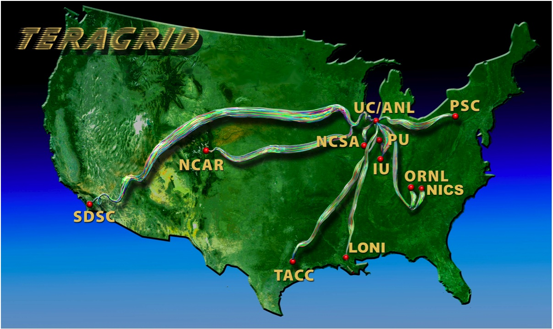
Prior Work: go.teragrid.org
Campus login to TeraGrid
35 campuses so far
Relies on TeraGrid identity vetting
In production since September 2009
1000+ certificates issued so far to 65+ users
IGTF accredited
Integration with portal.teragrid.org underway
IDtrust 2010 paper: “Federated Login to TeraGrid” (http://middleware.internet2.edu/idtrust/2010/)
Notes:
The NSF-funded TeraGrid combines leadership class resources at eleven partner sites.
TeraGrid serves over 4,500 researchers from over 300 US campuses.
ID vetting by peer review (like PRACE).

Slide 6
New Service: cilogon.org
No TeraGrid account required
Supports InCommon and OpenID authentication
Delivers certificates to desktop, browser, and portals
Available certificate lifetimes: from 1 hour to 13 months
Supports close integration with CI projects
Available now!
FAQ: www.cilogon.org/faq

Slide 7
CILogon Portal Delegation
Grid Portals and Science Gateways provide web interfaces to CI
Portals/Gateways need certificates to access CI on researchers’ behalf
CILogon Delegation Service allows researchers to approve certificate issuance to portals (via OAuth)
www.cilogon.org/portal-delegation
Web Browser
authenticate & approve
access
CILogon
Portal
request certificate
access
CI

Slide 8
An OAuth Service for Issuing Certificates to Science Gateways for TeraGrid Users
Jim Basney and Jeff Gaynor {jbasney,gaynor}@illinois.edu
National Center for Supercomputing Applications
University of Illinois at Urbana-Champaign
This material is based upon work supported by the National Science Foundation under grant number 0932251.
Notes:
Presented at TeraGrid’11, July 18-21, 2011, Salt Lake City, UT, http://www.teragrid.org/tg11/.

Slide 9
Goals
Support use of individual TeraGrid accounts via gateways
Independent of support for gateway community accounts
For more accurate accounting, greater resource access
Avoid disclosing TeraGrid user passwords to gateways
Avoid risk to long-lived credentials (i.e., user passwords)
Use TeraGrid passwords only on systems operated by TeraGrid
Use standard security protocols: TLS, OAuth
More trustworthy
Ease of integration for gateway developers
Notes:
Mark Miller (CIPRES science gateway) provided example of use of both community & individual accounts.

Slide 10
Current Approach
New Approach
+

Slide 11
Benefits
Security WG concerns about password disclosure to external science gateway sites are addressed
Science Gateways can support individual TeraGrid account access via standard protocols
Resource Providers can support user access via gateways using existing certificate-based interfaces
Users can access their individual TeraGrid accounts via gateways using their TeraGrid Portal login

Slide 12
OAuth Example
Photo Sharing Service (Server)
Authenticate & Grant Access to Photos
2
Web User (Resource Owner)
Token
3
6
5
Token
Photos
4
Token
Photo Printing Service (Client)
1
Request Access to Photos
Notes:
OAuth provides a method for clients to access server resources on behalf of a resource owner. It provides a process for end-users to authorize third-party access to their server resources without sharing their credentials (typically, a username and password pair), using user-agent redirections.

Slide 13
Current Approach
New Approach

Slide 15
Distributed Web Security for Science Gateways
Jim Basney (NCSA) Rion Dooley (TACC) Jeff Gaynor (NCSA) Suresh Marru (IU) Marlon Pierce (IU)
This material is based upon work supported by the National Science Foundation under grant number 1127210.

Slide 16
Science Gateway Security Project
Primary Deliverable: A standards-compliant OAuth service implementation to securely delegate, deliver, and renew credentials to science gateways on a user's behalf.
Including optional MyProxy integration
Including client libraries and modules for web frameworks
Timeline:
August 2011: Project Start
February 2012: Initial MyProxy OAuth release
August 2012: Initial release of general software components
August 2013: Feature complete software releases
August 2014: Final software releases

Slide 17
Current Approach
New Approach

Slide 18
Certificate Delegation via OAuth (Option A)

Slide 19
Certificate Delegation via OAuth (Option B)

Slide 20
Integration with External Authentication
LDAP/Kerberos
SAML/OpenID

Slide 21
Science Gateway Security Project
Other planned OAuth deliverables
Secure access to gateway REST services
Authorizing access to services via OAuth tokens instead of certs
Certificate renewal
Using OAuth refresh tokens
Community engagement
UltraScan, iPlant, GridChem/ParamChem
XSEDE, Globus Online

