Slide 1
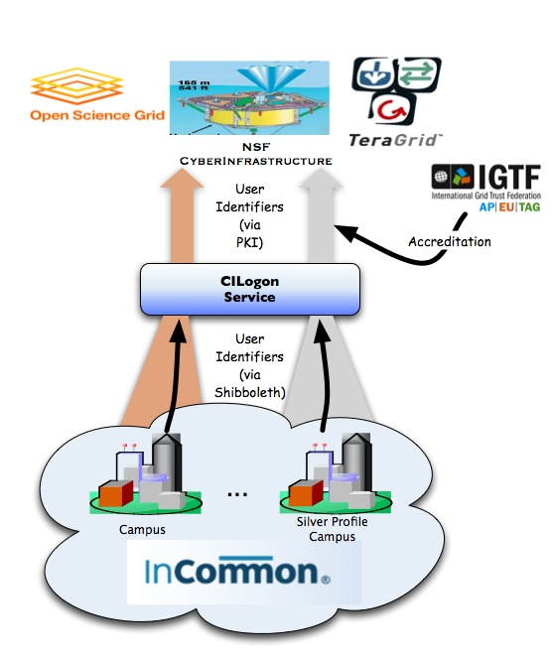
R&S Value to CILogon
CILogon’s Goal: Enable campus logon to cyberinfrastructure (CI)
Our attribute release challenge:
CI used by researchers across many campuses
Example: DataONE users from 105 InCommon campuses. 17 of them released attributes to CILogon a year ago. Now 35 do. Not 105 yet…
R&S provides a scalable approach to attribute release for SPs like CILogon ☺

Slide 2
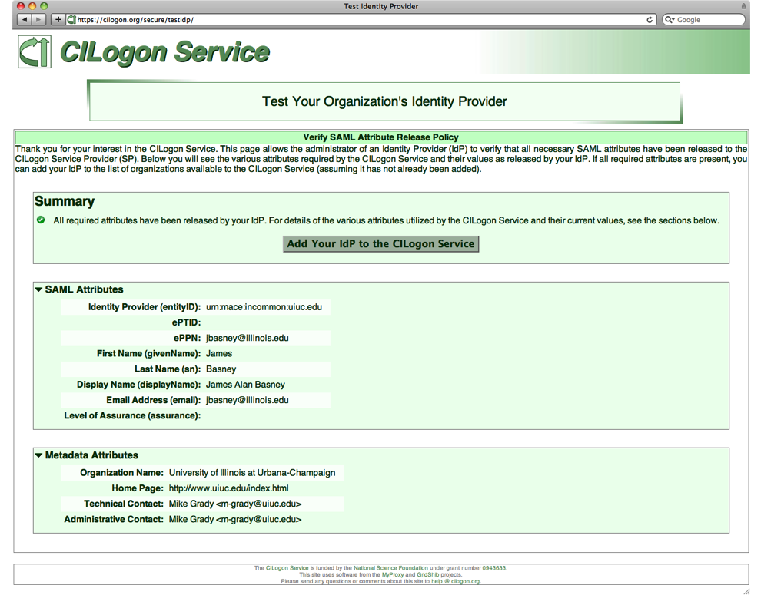
User Experience
User’s federated logon needs to work the first time
Can’t wait for IdP attribute release policy changes
R&S helps with this! ☺
For now, CILogon continues to require self-service IdP test before IdP is listed
Tag R&S participating IdPs in metadata?
Users can optionally request an IdP to be added
CILogon also supports Google and ProtectNetwork

