Slide 1



Science Gateway Security Recommendations
Jim Basney jbasney@illinois.edu
Von Welch vwelch@indiana.edu
This material is based upon work supported by the National Science Foundation under grant numbers 1127210 and 1234408.
Notes:
Presented at Science Gateway Institute Workshop, September 27, 2013, Indianapolis, Indiana.
http://sciencegateways.org/upcoming-events/ieee-workshop-september-2013/

Slide 2
Science Gateway Security Concerns
Confidentiality of pre-publication research data
Integrity of research results
Availability of services
Provide trustworthy service to researchers
Maintain trust of resource providers
Use resources in compliance with policies
Each science gateway is unique
Assess risks to determine appropriate mitigations
Risk = Likelihood x Impact
Notes:
Risk = Likelihood (threats, vulnerabilities) * Impact (technical, business)

Slide 3
Science Gateway Risk Factors
small, closely-knit user community
public data (sky survey data)
internal resources
focused functionality
large, distributed, open user community
sensitive data (personal health info)
external resources
wide range of user capabilities
less risk
more risk

Slide 4
Science Gateways and Resource Providers
Deployment models include:
Dedicated: Resources managed by science gateway
Science Gateway sets its own policies
Example: Rosetta Online Server That Includes Everyone (ROSIE)
Transparent: Providing a new interface to existing resources
Users have accounts on existing resources
Example: TeraGrid Visualization Gateway
Tiered: Science Gateway manages resource allocation
Science Gateway manages its own users
Using community account / robot certificate at resource provider
May send per-user attributes to resource providers
Examples: CIPRES, GENIUS

Slide 5
TeraGrid Science Gateway AAAA Model (2005)
http://dx.doi.org/10.1145/1838574.1838576

Slide 6
Existing Security Recommendations
Virtual Organization Portal Policy (EGI-InSPIRE SPG, 2010)
Securing Science Gateways (Hazlewood and Woitaszek, 2011)

Slide 7
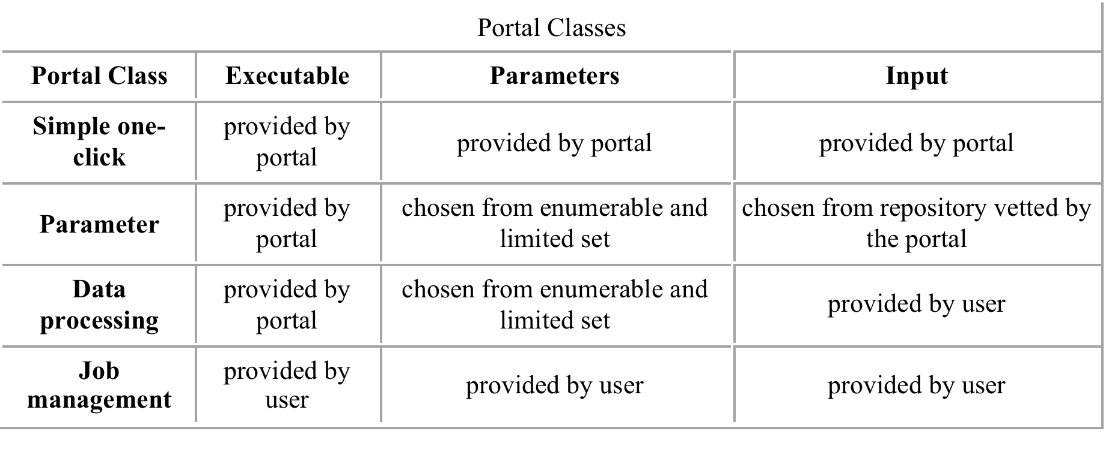
VO Portal Policy (EGI-InSPIRE SPG, 2010)
General Conditions
Limit job submission rate • Audit logging
Assist in security incident investigations
Securely store passwords, private keys, and user data
https://documents.egi.eu/document/80
Notes:
EGI-InSPIRE Security Policy Group
Requirements on user identification increase from top to bottom.

Slide 8
TeraGrid: Securing Science Gateways (Hazlewood and Woitaszek, 2011)
Recommendations:
Per-user accounting
Limiting access at resource providers (restricted shell, grid interfaces)
Separating per-user data from shared software and data
Individual accounts for science gateway developers
Short-lived certificates for remote access
http://doi.acm.org/10.1145/2016741.2016781
Notes:
They survey the security policies across 10 resource provider sites and implementations across 20 science gateways.

Slide 9
Science Gateway User Authentication
Why authenticate users?
Access to external resources
Personalization
Maintaining state across sessions
Accounting / tracking usage
How to authenticate users?
Outsourced: federated identities, identity as a service
Internal: password DB managed by science gateway
Notes:
IDaaS examples: Janrain, 9STAR, Globus Nexus, XSEDE

Slide 10
Federated User Authentication
Avoid managing user passwords!
SAML: campus identities
OpenID/OAuth: public identities
Enables two-factor authentication

Slide 11
Passwords
If your science gateway needs to handle user passwords:
Protect passwords from online attack
Use HTTPS
Block brute-force attacks (e.g., Fail2Ban)
Protect passwords from offline attack
Store password hashes
Use a strong hashing algorithm, with per-password salt
Use existing password hashing implementation
e.g., PHP password_hash()
http://security.blogoverflow.com/2013/09/about-secure-password-hashing/

Slide 12
Science Gateway Operational Security
Prevent (eliminate) threats (when possible)
Detect security incidents
Respond effectively to security issues
Goal: manage risks
First Step: Early communication with local security staff
Provide security services (monitoring, scanning, logging, etc.)
Identify security policies and best practice recommendations tailored to your local environment
Establish relationships now in case of security incident later

Slide 13
Basic Operational Security Checklist
Prevent
Detect
Software patching
Control admin access
Vulnerability scanning
Firewalls
Physical security
File integrity checking
Intrusion detection
Log monitoring
Centralized logging
Secure backups
Respond/Recover

Slide 14

Continuous Software Assurance
The Software Assurance Market Place (SWAMP) is a DHS S&T sponsored open facility to become operational in January 2014. It is driven by the goal to expand the adoption of software assurance (SwA) by software developers.
The SWAMP will enable you to:
Identify new (possible) defects in your software every time you commit a change
Identify new (possible) defects in a software/library/module you are using every time a new version is released
Track the SwA practices of your project
While protecting your privacy and the confidentiality of your data.
http://continuousassurance.org

Slide 15



Science Gateway Security: Community Resources
http://trustedci.org/help
http://sciencegatewaysecurity.org/discussion
http://xsede.org/gateways

