Slide 1
TeraGrid Science Gateway AAAA Model: Implementation and Lessons Learned
Jim Basney
NCSA
University of Illinois
jbasney@illinois.edu
Von Welch
Independent Consultant
Champaign, IL
von@vonwelch.com
Nancy Wilkins-Diehr
San Diego Supercomputer Center
University of California, San Diego
wilkinsn@sdsc.edu

Slide 2
Goal
Re-visit 2005 paper
Von Welch, Jim Barlow, James Basney, Doru Marcusiu, Nancy Wilkins-Diehr, "A AAAA model to support science gateways with community accounts," Concurrency and Computation: Practice and Experience, Volume 19, Issue 6, March 2007. http://dx.doi.org/10.1007/s10586-007-0033-8
AAAA (4A):
Authentication, Authorization, Auditing & Accounting
Discuss implementation experience, evolution of the model, and lessons learned

Slide 3
Science Gateway AAAA Model
Users access compute resources through a web portal (Science Gateway), rather than directly
Gateway submits requests to its “community account” on TeraGrid resources
Benefits:
Gateways handle user enrollment
Gateway users don’t need TeraGrid accounts
Enrollment process tailored to the user community / usage model
Support a large community of users without overwhelming TeraGrid allocations
Notes:
Community Certificate is like Robot Certificate mentioned by Christophe.

Slide 4
Authentication/Authorization Modes
Transitive
User authenticates to gateway and gateway authenticates to compute resource
Resource provider has no knowledge of the user’s identity
Gateway is responsible for authorization of individuals
Authorization Credentials
Include user identity in the credentials used by the gateway to authenticate to resource providers
Enables per-user accounting and authorization by the resource provider
For example: RP could “blacklist” an individual gateway user

Slide 5
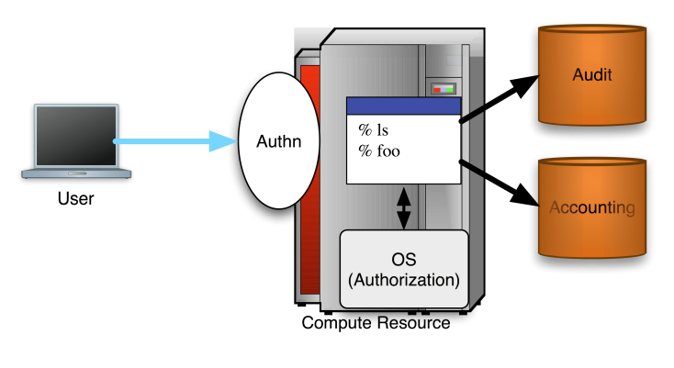
Traditional User Access Model

Slide 6
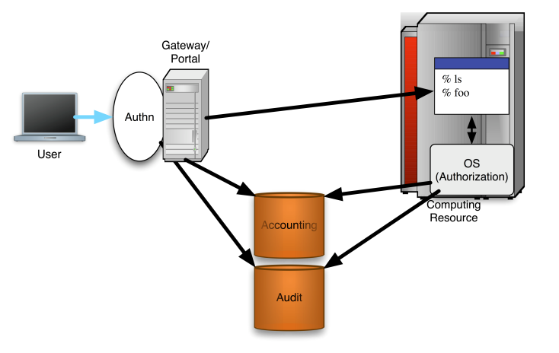
Science Gateway AAAA Model (2005)
Notes:
Transitive Mode.
Note proposed central collection of audit and accounting information.

Slide 7
Science Gateway AAAA Model (2010)
Notes:
Authorization Credentials Mode.
Note support for SSH.

Slide 8
Implementation Experience
Started with Transitive Mode
Each gateway has community credentials
No central collection of audit/accounting information
No resource provider changes required
Migrating to Authorization Credentials Mode
Motivated by NSF requirements for per-user accounting
Gateway adds user identity information to community credential
Creating a separate proxy credential per user session
Resource providers install updated software to extract user identity information (for GRAM4, GRAM5, and SSH+qsub)
Backward Compatible: Existing software simply ignored the additional information in the credential
RPs send user identity information to TeraGrid Central Database using the AMIE protocol

Slide 9
Implementation Details: Gateways
Gateway implements local security (per TG-10)
Control the jobs that run in the community account
Maintain a user registry
Locally collect usage information / logs
Add user identity info to community credential
Create a unique proxy certificate for each user session
Use GridShib SAML Tools to insert SAML assertion containing user attributes into the proxy certificate
Required: user identifier (may be anonymous)
Optional: user email address, client IP address
Notes:
TG-10: TG Community Account Policy

Slide 10
Implementation Details: RPs
No changes required to support Transitive Mode
To support Authorization Mode:
GRAM4: Install GridShib for Globus Toolkit
Full support for accounting, audit, and authorization
GRAM5: Gateway attribute support included
Only accounting+audit support, not authorization
SSH: gateway-submit-attributes script
GridFTP: no changes, user attributes not captured
Gateway user attributes stored in GRAM Audit DB
AMIE processing modified:
Retrieve attributes from GRAM Audit DB and include in Notify Project Usage packets to TGCDB

Slide 11
Implementation Status
7 out of 16 gateways completed
6 in progress; 3 waiting for SSH support
4 RPs have deployed the GRAM4 support with AMIE modifications
GRAM5 testing underway
SSH support (gateway-submit-attributes script) will be included with GRAM5 CTSS packages
Notes:
AMIE modifications just need to be done once.

Slide 12
Lessons Learned (1)
Avoid technology dependencies
Initially targeted only GRAM4 Java web services
Later added GRAM5 and SSH+qsub support
Understand participant motivations
Keep it simple for gateways and RPs to deploy
Gateways and RPs do the work but don’t receive the primary benefits
Budget time for software change management
It can take months to deploy new software at TG RPs
Software provided to TG GIG for packaging
GIG releases CTSS packages
RPs install and test packages
RPs move installations to “production”

Slide 13
Lessons Learned (2)
Accept a “good enough” solution
Initial Transitive model is working surprisingly well
Keep it simple
Spent too much time on SAML complexities
Focus on core requirement of counting gateway users
No SAML used for SSH+qsub support (gateway-submit-attributes)
Blacklisting less important
No strong motivation yet for this capability in practice
Gateway security incidents to-date impacted entire gateway rather than an individual gateway user

Slide 14
Lessons Learned (3)
Design for incremental deployment
Gateways and resource providers upgraded at different times to support authorization credentials
Backward compatibility was essential
Web portal-based gateways work well
Provide a user-friendly interface to a limited set of applications
Meets policy for restricted access to community accounts
Direct command-line or desktop access to community accounts is problematic

Slide 15
Conclusion
Nearing completion of deployment effort
Moving from Transitive Mode to Authorization Credentials Mode
To collect usage information for individual gateway users
Relying on GRAM Audit DB across GRAM4, GRAM5, and SSH
Required a collaborative effort
Thanks to Tom Scavo, Terry Fleury, Jon Siwek, Stu Martin, Joe Bester, Eric Blau, JP Navarro, Michael Shapiro, and others…
Thanks to gateway developers and RP administrators

Slide 16
Thanks
For more details:
jbasney@illinois.edu
http://teragridforum.org/mediawiki/index.php?title=Science_Gateway_Credential_with_Attributes
Informal F2F: today 5:30-6:30 in Brighton 4

