Slide 1
Federated Logon to NSF CyberInfrastructure
Jim Basney jbasney@illinois.edu www.cilogon.org
This material is based upon work supported by the National Science Foundation under grant numbers 0503697, 0850557, and 0943633. Any opinions, findings, and conclusions or recommendations expressed in this material are those of the authors and do not necessarily reflect the views of the National Science Foundation.
This material is based upon work supported by the National Science Foundation under grant number 0503697. Any opinions, findings, and conclusions or recommendations expressed in this material are those of the author(s) and do not necessarily reflect the views of the National Science Foundation.
This material is based upon work supported by the National Science Foundation under grant number 0503697. Any opinions, findings, and conclusions or recommendations expressed in this material are those of the author(s) and do not necessarily reflect the views of the National Science Foundation.
Notes:
Presented during InCommon CAMP (June 22, 2010).

Slide 2
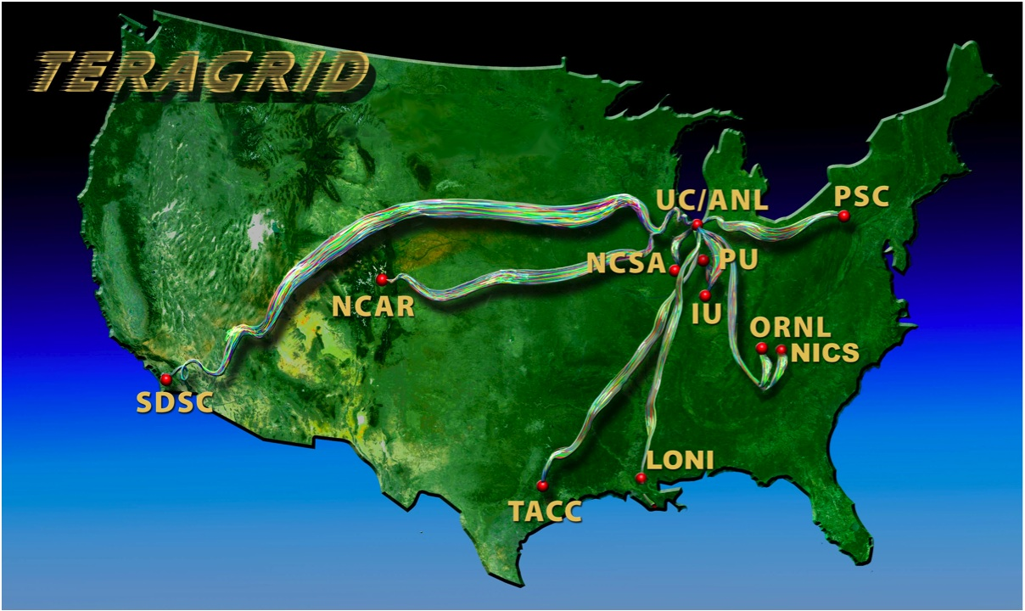
TeraGrid
Notes:
The NSF-funded TeraGrid combines leadership class resources at eleven partner sites.
TeraGrid serves over 4,500 researchers from over 300 US campuses.

Slide 3








CyberInfrastructure Examples
and many more…
Notes:
Many national and international cyberinfrastructure (CI) projects supporting research and education.
Federated IDM eases the burden on CI users and providers.

Slide 4
https://go.teragrid.org
https://cilogon.org
Notes:
We need certificates to support today’s CI usage models.

Slide 5
Self-Service Workflow for IdPs
Notes:
Similar to educause, I think.

Slide 6
Identity Assurance
International Grid Trust Federation (www.igtf.net)
Forum for setting standards for authentication across national and international scientific collaborations
Standards adopted by TeraGrid and Open Science Grid
InCommon Silver Identity Assurance Profile
http://www.incommonfederation.org/assurance/
Maps well to IGTF standards
Enabling federated access to NSF CyberInfrastructure can be one of many motivations for implementing InCommon Silver on your campus

Slide 7
For more information
jbasney@illinois.edu
https://cilogon.org
https://go.teragrid.org

