Slide 1


Managing Security Credentials
Jim Basney
Senior Research Scientist
jbasney@ncsa.uiuc.edu
NCSA Private Sector Program Annual Meeting
May 16-18, 2005

Slide 2

Talk Outline
Discuss NCSA’s work on
credential usability and security
Projects:
  Online credential repositories
  Hardware security tokens
Application areas:
  NCSA production systems
  Grids (TeraGrid, NEESgrid, etc.)
  Illinois emergency responders

Slide 3
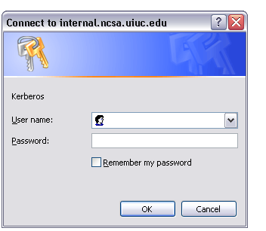
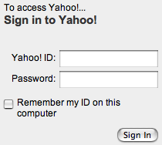
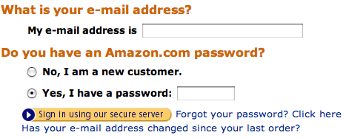
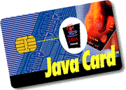



Security Credentials
Something you know (passwords)
Something you have (hardware tokens)
Something you are (biometrics)

Slide 4
Credential Usability
Ease of enrollment
Re-issuance
  Lost tokens
  Deleted key files
  Forgotten passwords
Software / hardware compatibility
Single sign-on
  Across software systems and security realms

Slide 5
Credential Security
Risks
  Password or private key disclosure
  Token theft
  Cryptographic attacks
  Social engineering attacks
Detection
  Report missing hardware token
  System monitoring and auditing

Slide 6
Protecting Long-Lived Secrets
Short-lived session credentials
  Web browser cookies
  Kerberos tickets
  X.509 Proxy Certificates (RFC 3820)
Tamper-resistant cryptographic tokens
  One Time Passwords
  Smartcards
  Hardware Security Modules
  Trusted Computing platforms

Slide 7

Online Credential Repositories
Make credentials easily (and securely!) available over the network
Provide control and monitoring over credential use
  Different configurations are possible
  to provide desired security properties
NCSA projects:
  MyProxy
  SACRED

Slide 8


MyProxy
An online X.509 credential repository
  Encrypted keys stored on MyProxy server
  Clients retrieve X.509 proxy certificates
  Authentication methods: password, certificate, Kerberos, PAM (OTP, LDAP, etc.)
Store proxy
MyProxy client
MyProxy server
Credential
repository
Retrieve proxy
Proxy delegation over private
TLS channel
http://myproxy.ncsa.uiuc.edu/

Slide 9
PKI Overview
Public Key Cryptography
  Sign with private key,
  verify signature with public key
  Encrypt with public key,
  decrypt with private key
Key Distribution
  Who does a public key belong to?
  Certification Authority (CA) verifies user’s identity and signs certificate
  Certificate is a document that binds the user’s identity to a public key
Authentication
  Signature [ h ( random, … ) ]
Issuer: CA
Subject: CA
signs
Issuer: CA
Subject: Jim

Slide 10
Proxy Credentials
CA
RFC 3820: Proxy Certificate Profile
Associate a new private key and certificate with existing credentials
Use short-lived, unencrypted credentials for multiple authentications in a session
  Restricted lifetime in certificate limits vulnerability of unencrypted key
Delegate credentials without transferring private keys
signs
User
signs
Proxy
A
signs
Proxy
B

Slide 11
Proxy Delegation
Delegator
Delegatee
2
1
Proxy
certificate
request
Generate
new key pair
3
Sign new
proxy certificate
4
Proxy
Proxy
Proxy

Slide 12
MyProxy Security
Users retrieve short-lived credentials
  Generating new proxy keys for every session
Keys encrypted with user-chosen passwords
  Server enforces password quality
  Passwords are not stored
Dedicated server less vulnerable than desktop and general-purpose systems
  Professionally managed, monitored, locked down
All server operations logged to syslog
Caveat: Private key database is an attack target
  Compare with status quo

Slide 13
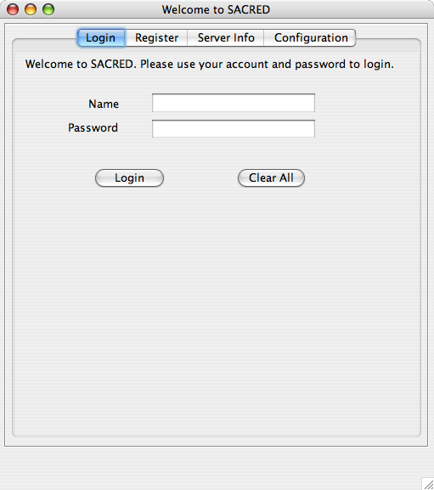


Securely Available Credentials
Standards-based online credential repository
  SACRED protocol RFC 3767
Open Source implementation
Mozilla email and browser integration in progress
  S/MIME email signatures and encryption
  HTTPS web authentication
http://sacred.sf.net/

Slide 14
One Time Password Tokens
Protect against stolen passwords
Hardware token generates OTP
Synchronized with OTP server
  Sequential
  Time-based
  Challenge-response
Deployment underway for NCSA systems
  Administrators
  Some private sector partners
Part of NCSA’s multi-tiered authentication strategy

Slide 15
Cross-Realm OTP
Do I need an OTP token for each site?
  RADIUS proxy servers for remote login
    ESnet Radius Authentication Fabric (RAF) Federation for DOE Grids (http://www.es.net/raf/)
  RSA Authentication Service for RSA SecureID
Do I lose single sign-on?
  Use OTP to obtain session credentials
    Kerberos tickets from KDC
    Proxy credentials from MyProxy

Slide 16
NCASSR PKI Testbed
Equipment:
  Servers, laptops, workstations, and PDAs
  Contact and contactless smartcards and readers
  Secure co-processors for credential servers
  Fingerprint readers
Supporting:
  ITTF smartcard credentialing project
  Hardware-secured credential repositories
  Smartcard authentication for grids and HPC

Slide 17

Illinois Terrorism Task Force
Misson
  Created May 2000 to implement a comprehensive coordinated strategy for domestic preparedness in the state of Illinois, bringing together agencies, organizations, and associations representing
  all disciplines in the war against terrorism.
Members include:
  American Red Cross
  Associated Fire Fighters of Illinois
  FBI
  Illinois Governor’s Office
  Illinois State Police
  U.S. Attorney’s Office
  FEMA (Region V)
http://www.illinoishomelandsecurity.org/ittf/

Slide 18
ITTF Credentialing Project
Goal: Pre-issue credentials to incident responders for identification and tracking at the incident perimeter
  Smartcards printed with photo ID
  Electronic authentication includes:
    Fingerprint biometric
    Identity certificate issued by State of Illinois PKI
      Cross-certified with Federal Bridge CA
    Signed certifications (team, weapons, hazmat)

Slide 19

ITTF Credentialing Project
5,000 initial credentials for pilot project
Plan to grow to 100,000 credentials
  Every Illinois firefighter, police officer, EMT
  Pre-certified volunteers (Red Cross, etc.)
Designed for general-purpose use state-wide
  Secure building and computer system access
  Interoperability with Federal standards
Partners:
UIC

Slide 20
Thanks!
Any questions?
For more info:
jbasney@ncsa.uiuc.edu
http://www.ncsa.uiuc.edu/~jbasney/

