Slide 1
Using the MyProxy Online Credential Repository
Jim Basney
National Center for Supercomputing Applications
University of Illinois
jbasney@ncsa.uiuc.edu

Slide 2
What is MyProxy?
Independent Globus Toolkit add-on since 2000
  Included in Globus Toolkit 4.0
A service for securing private keys
  Keys stored encrypted with user-chosen password
  Keys never leave the MyProxy server
A service for retrieving proxy credentials
A commonly-used service for grid portal security
  Integrated with OGCE, GridSphere, and GridPort

Slide 3
PKI Overview
Public Key Cryptography
  Sign with private key,
  verify signature with public key
  Encrypt with public key,
  decrypt with private key
Key Distribution
  Who does a public key belong to?
  Certification Authority (CA) verifies user’s identity and signs certificate
  Certificate is a document that binds the user’s identity to a public key
Authentication
  Signature [ h ( random, … ) ]
Issuer: CA
Subject: CA
signs
Issuer: CA
Subject: Jim

Slide 4
Proxy Credentials
CA
RFC 3820: Proxy Certificate Profile
Associate a new private key and certificate with existing credentials
Short-lived, unencrypted credentials for multiple authentications in a session
  Restricted lifetime in certificate limits vulnerability of unencrypted key
Credential delegation (forwarding) without transferring private keys
signs
User
signs
Proxy
A
signs
Proxy
B

Slide 5
Proxy Delegation
Delegator
Delegatee
1
2
Generate
new key pair
Proxy certificate request
3
Sign new
proxy certificate
4
Proxy
Proxy
Proxy

Slide 6
MyProxy System Architecture
MyProxy client
Store proxy
MyProxy server
Retrieve proxy
Proxy delegation over private
TLS channel
Credential
repository

Slide 7

MyProxy: Credential Mobility
Obtain certificate
tg-login.ncsa.teragrid.org
ca.ncsa.uiuc.edu
Store proxy
myproxy.teragrid.org
tg-login.caltech.teragrid.org
Retrieve proxy
tg-login.sdsc.teragrid.org
tg-login.uc.teragrid.org

Slide 8
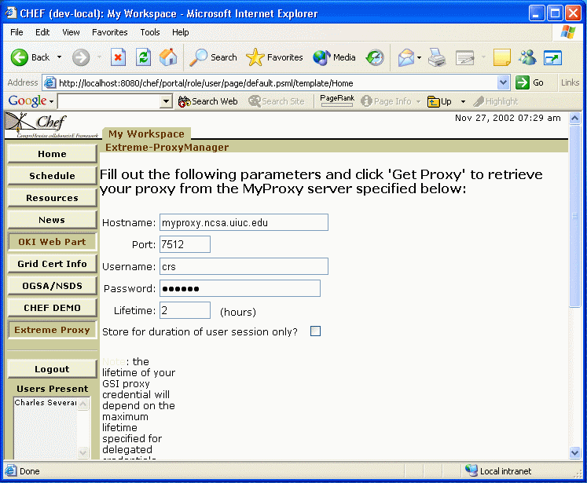


MyProxy and Grid Portals
MyProxy server
Portal
Login
Fetch proxy
GridFTP server
Access data

Slide 9

MyProxy: User Registration
Registration portal
Obtain user
certificate
Certificate authority
Request account
Set username/password
Load user’s
credentials
Login with
username/password
Grid
portal
Retrieve
proxy
MyProxy server
PURSE: Portal-based User Registration Service
ESG
GAMA: Grid Account Management Architecture

Slide 10
MyProxy: Key Upload/Download
Provides ability to store and retrieve keys and certificates directly over the network
  Encrypted keys transferred over
  SSL/TLS encrypted channel
  In contrast to using proxy delegation
Allows storing end-entity credentials
Key retrieval must be explicitly enabled
by server administrator and key owner

Slide 11
Credential Renewal
Long-lived jobs or services need credentials
  Task lifetime is difficult to predict
Don’t want to delegate long-lived credentials
  Fear of compromise
Instead, renew credentials as needed during the job’s lifetime
  Renewal service provides a single point of monitoring and control
Renewal policy can be modified at any time
  Disable renewals if compromise is detected or suspected
  Disable renewals when jobs complete

Slide 12


MyProxy: Credential Renewal
Submit job
Condor-G /
Renewal Service
Submit job
Globus
gatekeeper
Refresh proxy
Retrieve
proxy
MyProxy server
Daniel Kouril and Jim Basney, "A Credential Renewal Service for Long-Running Jobs," 6th IEEE/ACM International Workshop on Grid Computing (Grid 2005), Seattle, WA, November 13-14, 2005.

Slide 13
MyProxy Authentication
Key Passphrase
X.509 Certificate
  Used for credential renewal
Pluggable Authentication Modules (PAM)
  Kerberos password
  One Time Password (OTP)
  Lightweight Directory Access Protocol (LDAP) password
Simple Authentication and Security Layer (SASL)
  Kerberos ticket (SASL GSSAPI)

Slide 14


One Time Passwords (OTP)
Protect against stolen passwords
Hardware token generates OTP
Authenticate with OTP alone or
combined with key passphrase
Tested with CryptoCard tokens at NCSA
Compatible with existing MyProxy clients

Slide 15
Managing Trust Roots
Address challenge of keeping trust root configuration up-to-date across machines
  CA certificates and CRLs
User’s trust roots can differ from site’s
myproxy-logon -T
  Synchronizes contents of ~/.globus/certificates with MyProxy server

Slide 16

MyProxy CA
MyProxy server issues short-lived certificates to authenticated clients
  Leverage MyProxy authentication mechanisms
  Compatible with existing MyProxy clients
Avoid managing long-lived user keys
Server can function as both CA and repository
  Issue certificate if no credentials found for user
Coming soon!

Slide 17
MyProxy and Pubcookie
Coming soon!
Combine web and grid single sign-on
  Authenticate to MyProxy with Pubcookie granting cookie
Pubcookie Login Server
Verify login
Campus Authentication Server
Redirect to authenticate
and obtain granting cookie
Browser
Web Application Server
Retrieve proxy
MyProxy server
Jonathan Martin, Jim Basney, and Marty Humphrey, "Extending Existing Campus Trust Relationships to the Grid through the Integration of Pubcookie and MyProxy," 2005 International Conference on Computational Science (ICCS 2005), Emory University, Atlanta, GA, May 22-25, 2005.

Slide 18
MyProxy Security
Keys encrypted with user-chosen passwords
  Server enforces password quality
  Passwords are not stored
Dedicated server less vulnerable than desktop and general-purpose systems
  Professionally managed, monitored, locked down
Users retrieve short-lived credentials
  Generating new proxy keys for every session
All server operations logged to syslog
Caveat: Private key database is an attack target
  Compare with status quo

Slide 19
Hardware-Secured MyProxy
Protect keys in tamper-resistant cryptographic hardware
MyProxy Server
Proxy request
IBM 4758
Retrieve proxy
Proxy certificate
PKCS#11
Experimental
M. Lorch, J. Basney, and D. Kafura, "A Hardware-secured Credential Repository for Grid PKIs," 4th IEEE/ACM International Symposium on Cluster Computing and the Grid (CCGrid), April 2004.

Slide 20
MyProxy CoG Clients
Commodity Grid (CoG) Kits
  Provide portable (Java, Python, and Perl)
  MyProxy client tools & APIs
  Windows support
For more information:
  http://www.cogkit.org/

Slide 21
MyProxy Commands
myproxy-init: store proxy
myproxy-logon: retrieve proxy
myproxy-info: query stored credentials
myproxy-destroy: remove credential
myproxy-change-pass-phrase:
change password encrypting private key
myproxy-store: store credential
myproxy-retrieve: retrieve credential

Slide 22
MyProxy Installation (Unix)
Included in GT 4.0
  $ make gsi-myproxy; make install
As an add-on component to GT 3.x
  $ gpt-build myproxy*.tar.gz <flavor>
Set $MYPROXY_SERVER environment variable to myproxy-server hostname
  $ export MYPROXY_SERVER=myproxy.ncsa.uiuc.edu
Set Globus Toolkit environment
  $ . $GLOBUS_LOCATION/etc/globus-user-env.sh
Client installation/configuration complete!

Slide 23
MyProxy Server Administration
Install server certificate and CA certificate(s)
Configure /etc/myproxy-server.config policy
  Template provided with examples
Optionally:
  Configure password quality enforcement
  Install cron script to delete expired credentials
Install boot script and start server
  Example boot script provided
Use myproxy-admin commands to manage server
  Reset passwords, query repository, lock credentials

Slide 24
MyProxy Server Policies
Who can store credentials?
  Restrict to specific users or CAs
  Restrict to administrator only
Who can retrieve credentials?
  Allow anyone with correct password
  Allow only trusted services / portals
Maximum lifetime of retrieved credentials
server-wide
and
per-credential

Slide 25
MyProxy Server Replication
Primary/Secondary model (like Kerberos)
  If primary is down, fail-over to secondary for credential retrieval
  Store, delete, and change passphrase on primary only
  Client-side fail-over under development
Simple configuration
  Run myproxy-replicate via cron
  Alternatively, use rsync over ssh
Coming soon!

Slide 26
MyProxy and Standards
MyProxy protocol specification submitted to GGF recommendations track
  Currently under steering group review
MyProxy uses:
  IETF RFC 2246: Transport Layer Security (TLS) Protocol Version 1.0
  IETF RFC 3820: Internet X.509 PKI Proxy Certificate Profile
  DCE RFC 86.0: Pluggable Authentication Modules (PAM)
  IETF RFC 2222: Simple Authentication and Security Layer (SASL)

Slide 27
Related Work
GT4 Delegation Service
  Protocol based on WS-Trust and WSRF
UVA CredEx
  WS-Trust credential exchange service
SACRED (RFC 3767) Credential Repository
  http://sacred.sf.net/
Kerberized Online CA (KX.509/KCA)
  Kerberos -> PKI
Kerberos PKINIT
  PKI -> Kerberos

Slide 28
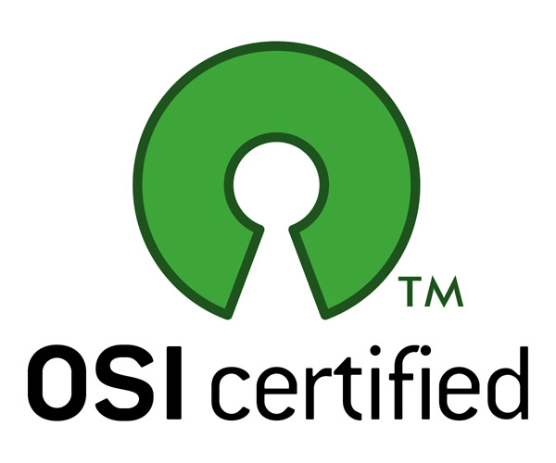
MyProxy Community
MyProxy is an open source, community project
  Many contributions from outside NCSA
myproxy-users@ncsa.uiuc.edu mailing list
Bug tracking: http://bugzilla.ncsa.uiuc.edu/
Anonymous CVS access
  :pserver:anonymous@cvs.ncsa.uiuc.edu:/CVS/myproxy
Contributions welcome!
  Feature requests, bug reports, patches, etc.

Slide 29
Thank you!
Questions/Comments?
Contact:
jbasney@ncsa.uiuc.edu

