Slide 1
The MyProxy Online Credential Repository
Jim Basney
NCSA
jbasney@ncsa.uiuc.edu

Slide 2
What is MyProxy?
A new component in Globus Toolkit 4.0
  Independent Globus Toolkit add-on since 2000
A repository for storing long-lived private keys
  Keys encrypted with user-chosen password
  Keys never leave MyProxy server
A service for retrieving proxy credentials
  Supporting mobility, delegation, and renewal
A commonly-used service for grid portal security
  Integrated with OGCE, GridSphere, and GridPort

Slide 3
MyProxy System Architecture
MyProxy client
Store proxy
MyProxy server
Retrieve proxy
(over private TLS channel)
Credential
repository

Slide 4
Proxy Delegation
CA
Server
Client
signs
User
Cert
User
Generate new key pair
signs
Proxy certificate request
Sign proxy certificate with
private key
Proxy
A
signs
Proxy
Proxy
Proxy
B

Slide 5

MyProxy: Credential Mobility
Obtain certificate
tg-login.ncsa.teragrid.org
ca.ncsa.uiuc.edu
Store proxy
myproxy.teragrid.org
tg-login.caltech.teragrid.org
Retrieve proxy
tg-login.sdsc.teragrid.org
tg-login.uc.teragrid.org

Slide 6

MyProxy: Credential Renewal
Condor-G
Globus
gatekeeper
Submit job
Submit job
Refresh proxy
MyProxy server
Fetch proxy

Slide 7
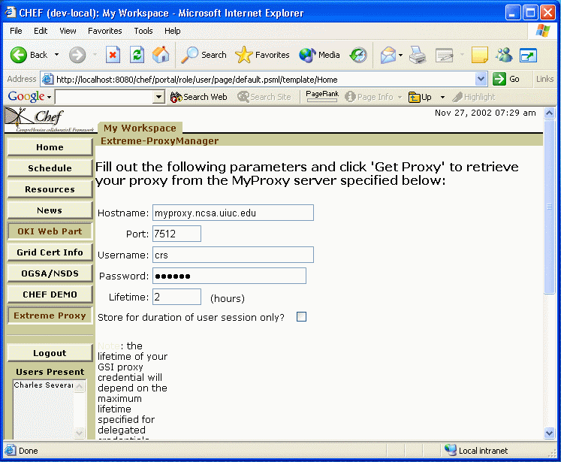

MyProxy and Grid Portals
MyProxy server
CHEF portal
Login
Fetch proxy
GridFTP server
Access data

Slide 8

MyProxy: User Registration
Registration portal
Obtain user
certificate
Certificate authority
Request account
Set username/password
Load user’s
credentials
Login with
username/password
Grid
portal
Retrieve
proxy
MyProxy server
ESG

Slide 9
MyProxy Installation (Unix)
As an add-on component to GT 3.x
  $ gpt-build myproxy*.tar.gz <flavor>
Set $MYPROXY_SERVER environment variable to myproxy-server hostname
  $ export MYPROXY_SERVER=myproxy.ncsa.uiuc.edu
Set Globus Toolkit environment
  $ . $GLOBUS_LOCATION/etc/globus-user-env.sh
Client installation/configuration complete!

Slide 10
MyProxy Commands
myproxy-init: store proxy
myproxy-get-delegation: retrieve proxy
myproxy-info: query stored credentials
myproxy-destroy: remove credential
myproxy-change-pass-phrase:
change password encrypting private key

Slide 11
MyProxy Server Administration
Install server certificate
Configure /etc/myproxy-server.config policy
  Template provided with examples
Optionally:
  Configure password quality enforcement
  Install cron script to delete expired credentials
Install boot script and start server
  Example boot script provided
Use myproxy-admin commands to manage server
  Reset passwords, query repository, lock credentials

Slide 12
MyProxy CoG Clients
Commodity Grid (CoG) Kits
  Provide portable (Java and Python)
  MyProxy client tools & APIs
  Support Windows
For more information:
  http://www.cogkit.org/

Slide 13
MyProxy Community Support
myproxy-users@ncsa.uiuc.edu mailing list
Bug tracking: http://bugzilla.ncsa.uiuc.edu/
Anonymous CVS access
  :pserver:anonymous@cvs.ncsa.uiuc.edu:/CVS/myproxy
Contributions welcome!
  Feature requests, bug reports, patches, etc.

Slide 14
Thank you!
Contact:
http://myproxy.ncsa.uiuc.edu/
jbasney@ncsa.uiuc.edu
Questions/Comments?

