Slide 1
Managing Credentials with MyProxy
Jim Basney
National Center for Supercomputing Applications
University of Illinois
jbasney@ncsa.uiuc.edu

Slide 2
What is MyProxy?
A service for managing X.509 PKI credentials
  A credential repository and certificate authority
An Online Credential Repository
  Issues short-lived X.509 Proxy Certificates
  Long-lived private keys never leave the server
An Online Certificate Authority
  Issues short-lived X.509 End Entity Certificates
Supporting multiple authentication methods
  Passphrase, Certificate, PAM, SASL, Kerberos
Open Source Software
  Included in Globus Toolkit 4.0 and CoG Kits
  C, Java, Python, and Perl clients available

Slide 3
MyProxy Logon
Authenticate to retrieve PKI credentials
  End Entity or Proxy Certificate
  Trusted CA Certificates
  Certificate Revocation Lists (CRLs)
MyProxy maintains the user’s PKI context
  Users don’t need to manage long-lived credentials
  Enables server-side monitoring and policy enforcement (ex. passphrase quality checks)
  CA certificates & CRLs updated automatically at login

Slide 4
MyProxy Authentication
Key Passphrase
X.509 Certificate
  Used for credential renewal
Pluggable Authentication Modules (PAM)
  Kerberos password
  One Time Password (OTP)
  Lightweight Directory Access Protocol (LDAP) password
Simple Authentication and Security Layer (SASL)
  Kerberos ticket (SASL GSSAPI)

Slide 5
MyProxy Online Credential Repository
Stores X.509 End Entity and Proxy credentials
  Private keys encrypted with user-chosen passphrases
  Credentials may be stored directly or via proxy delegation
  Users can store multiple credentials from different CAs
Access to credentials controlled by user and administrator policies
  Set authentication requirements
  Control whether credentials can be retrieved directly or
  if only proxy delegation is allowed
  Restrict lifetime of retrieved proxy credentials
Can be deployed for a single user, a site, a virtual organization, a resource provider, a CA, etc.

Slide 6

MyProxy Online Certificate Authority
Issues short-lived X.509 End Entity Certificates
  Leverages MyProxy authentication mechanisms
  Compatible with existing MyProxy clients
Ties in to site authentication and accounting
  Using PAM and/or Kerberos authentication
  “Gridmap” file maps username to certificate subject
    LDAP support under development
Avoid need for long-lived user keys
Server can function as both CA and repository
  Issues certificate if no credentials for user are stored

Slide 7
PKI Overview
Public Key Cryptography
  Sign with private key,
  verify signature with public key
  Encrypt with public key,
  decrypt with private key
Key Distribution
  Who does a public key belong to?
  Certification Authority (CA) verifies user’s identity and signs certificate
  Certificate is a document that binds the user’s identity to a public key
Authentication
  Signature [ h ( random, … ) ]
Issuer: CA
Subject: CA
signs
Issuer: CA
Subject: Jim

Slide 8
PKI Enrollment
CA
User
1
2
Generate
new key pair
CA
Certificate request
3
CA
Sign new
end entity certificate
4
User
User
User

Slide 9
Proxy Credentials
CA
RFC 3820: Proxy Certificate Profile
Associate a new private key and certificate with existing credentials
Short-lived, unencrypted credentials for multiple authentications in a session
  Restricted lifetime in certificate limits vulnerability of unencrypted key
Credential delegation (forwarding) without transferring private keys
signs
User
signs
Proxy
A
signs
Proxy
B

Slide 10
Proxy Delegation
Delegator
Delegatee
1
2
Generate
new key pair
Proxy certificate request
3
Sign new
proxy certificate
4
Proxy
Proxy
Proxy

Slide 11
MyProxy Repository
MyProxy client
Store proxy
MyProxy server
Retrieve proxy
Proxy delegation over
private TLS channel
Credential
repository

Slide 12
MyProxy Certificate Authority
MyProxy client
MyProxy server
Retrieve certificate
CA
Private TLS channel
PAM
Site Authentication Service

Slide 13

MyProxy: Credential Mobility
Obtain certificate
tg-login.ncsa.teragrid.org
ca.ncsa.uiuc.edu
Store proxy
myproxy.teragrid.org
Retrieve proxy
tg-login.purdue.teragrid.org
tg-login.ornl.teragrid.org
tg-login.sdsc.teragrid.org
tg-login1.iu.teragrid.org
tg-login.uc.teragrid.org
tg-login.psc.teragrid.org

Slide 14
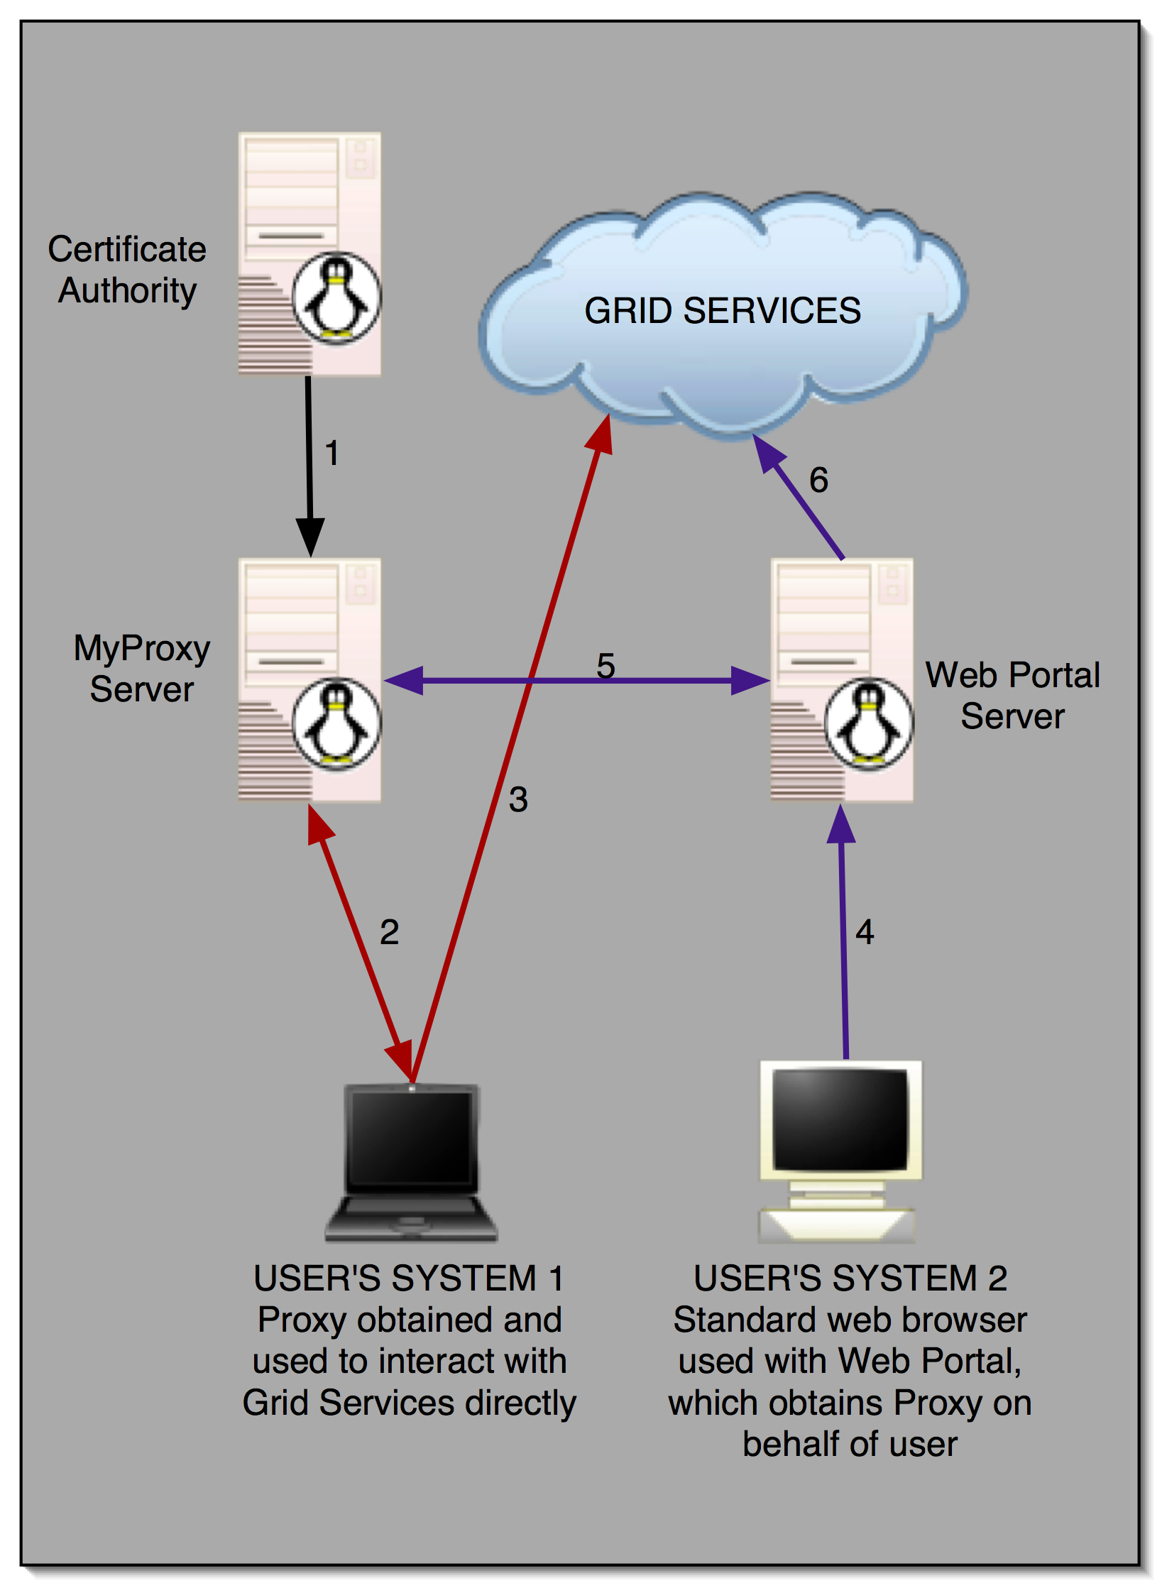


MyProxy and Grid Portals

Slide 15
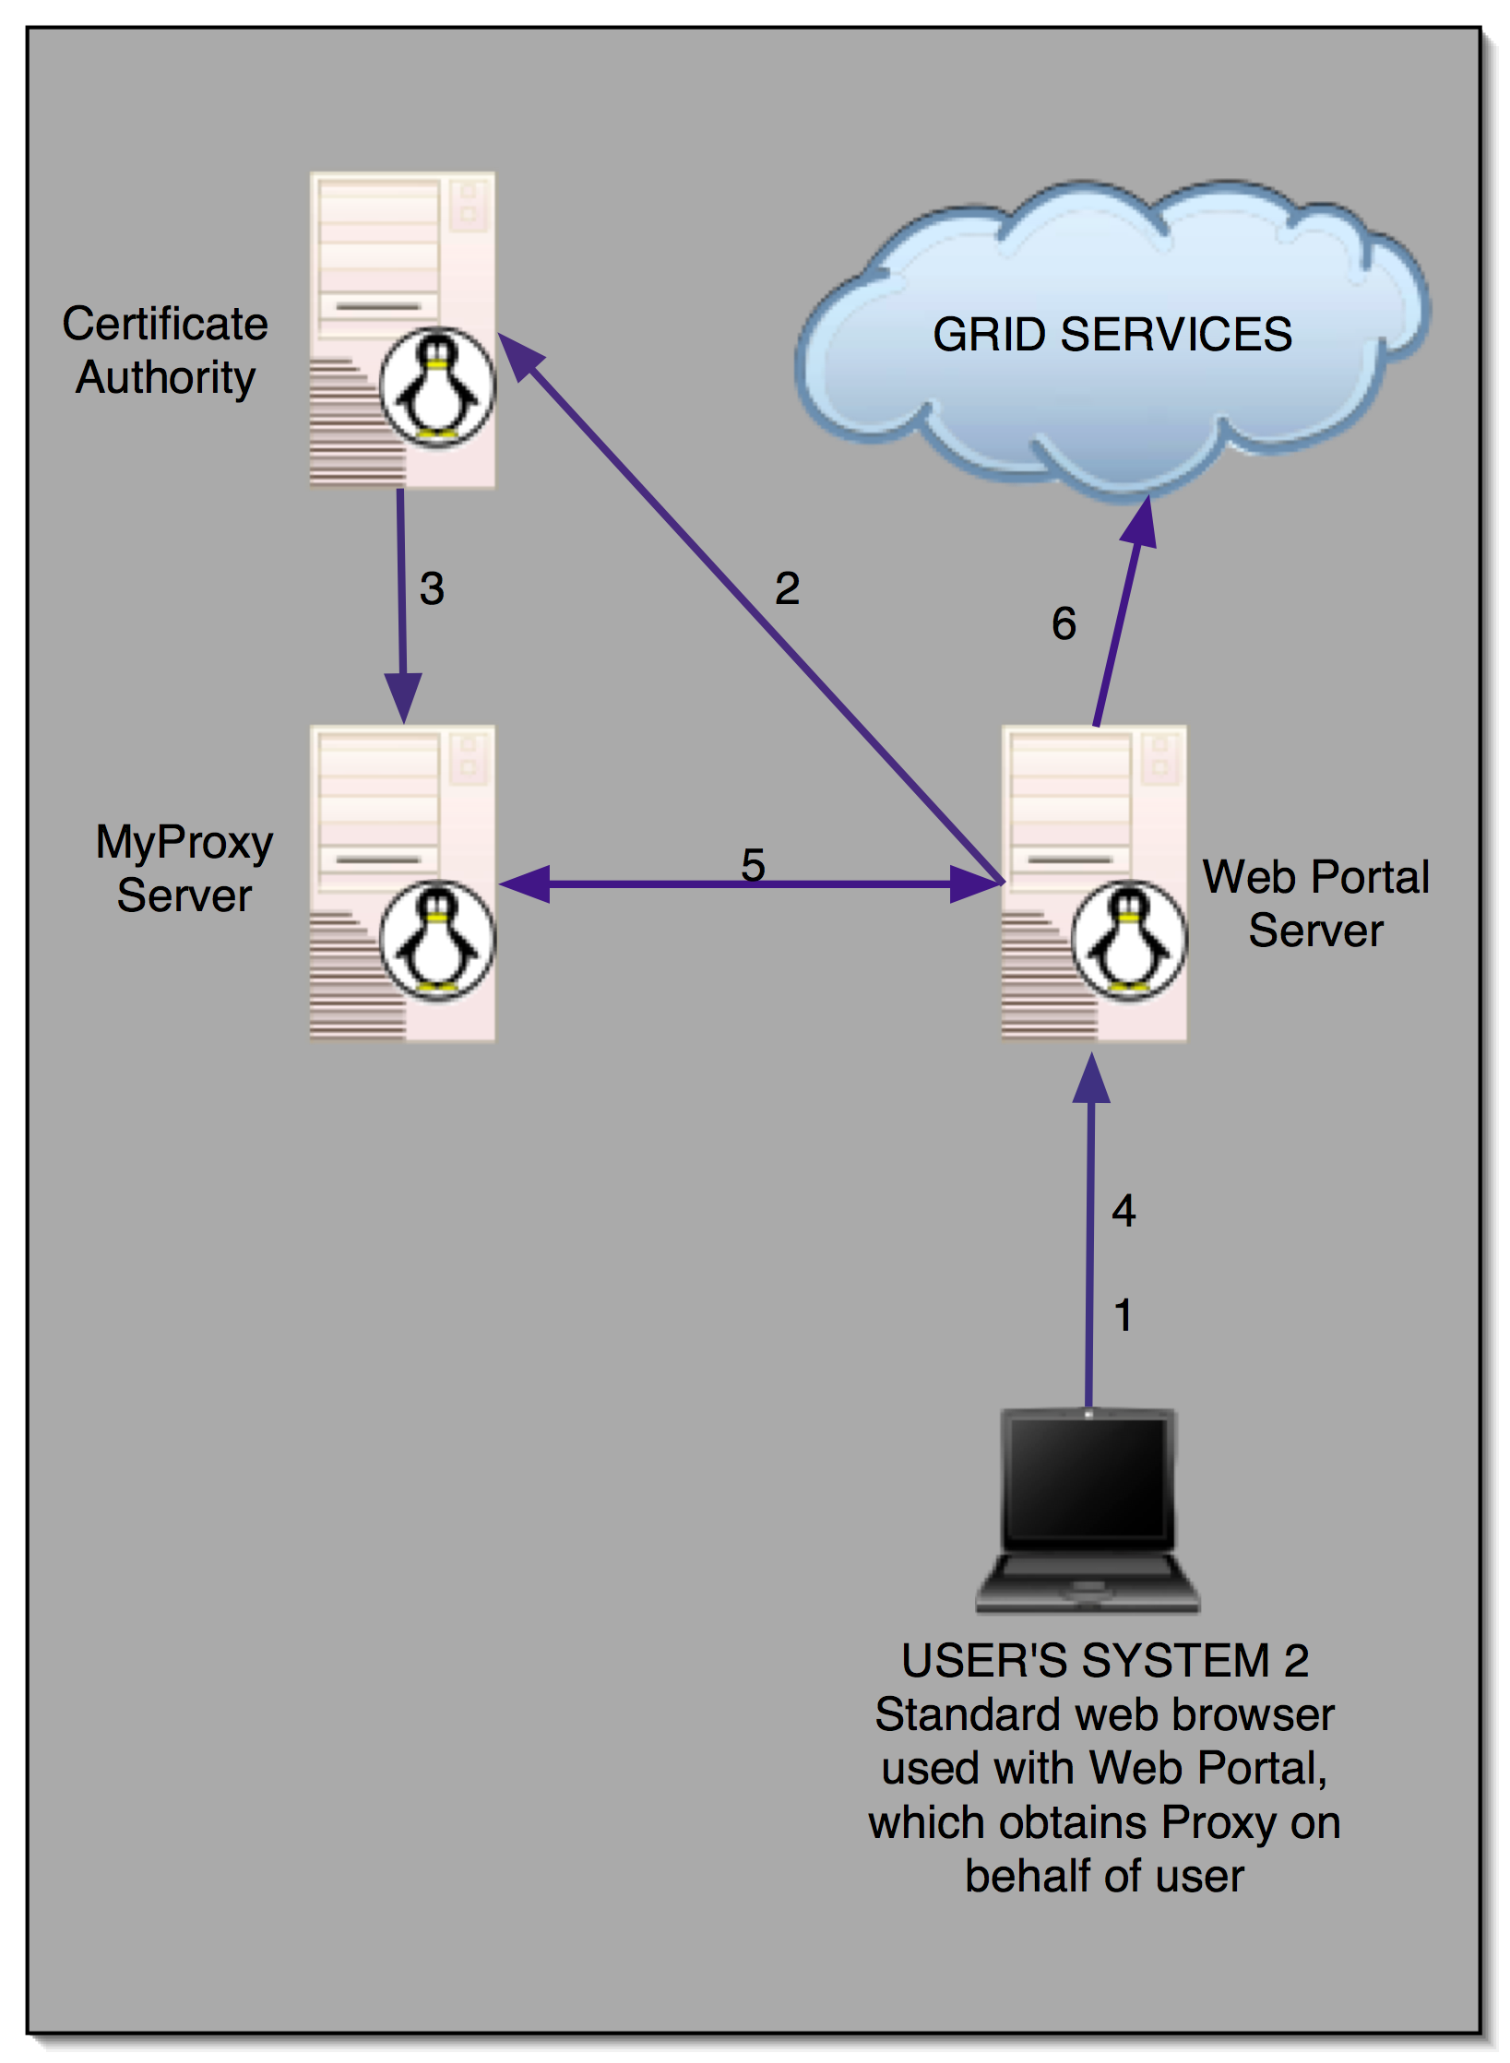



User Registration Portals
PURSE:
Portal-based User Registration Service
GAMA:
Grid Account Management Architecture
ESG

Slide 16
MyProxy: Key Upload/Download
Store and retrieve keys and certificates directly over the network
  Encrypted keys transferred over
  SSL/TLS encrypted channel
  In contrast to using proxy delegation
Allows storing end-entity credentials
Key retrieval must be explicitly enabled
by server administrator and key owner

Slide 17
Credential Renewal
Long-lived jobs or services need credentials
  Task lifetime is difficult to predict
Don’t want to delegate long-lived credentials
  Fear of compromise
Instead, renew credentials as needed during the job’s lifetime
  Renewal service provides a single point of monitoring and control
Renewal policy can be modified at any time
  Disable renewals if compromise is detected or suspected
  Disable renewals when jobs complete

Slide 18



MyProxy: Credential Renewal
Submit job
Condor-G /
Renewal Service
Submit job
Globus
gatekeeper
Refresh proxy
Retrieve
proxy
MyProxy server
Daniel Kouril and Jim Basney, "A Credential Renewal Service for Long-Running Jobs," 6th IEEE/ACM International Workshop on Grid Computing (Grid 2005), Seattle, WA, November 13-14, 2005.

Slide 19
MyProxy and Pubcookie
Coming soon!
Combine web and grid single sign-on
  Authenticate to MyProxy with Pubcookie granting cookie
Pubcookie Login Server
Verify login
Campus Authentication Server
Redirect to authenticate
and obtain granting cookie
Browser
Web Application Server
Retrieve proxy
MyProxy server
Jonathan Martin, Jim Basney, and Marty Humphrey, "Extending Existing Campus Trust Relationships to the Grid through the Integration of Pubcookie and MyProxy," 2005 International Conference on Computational Science (ICCS 2005), Emory University, Atlanta, GA, May 22-25, 2005.

Slide 20
Example: TeraGrid User Portal
Use TeraGrid-wide Kerberos username and password for portal authentication
  Obtain PKI credentials for resource access across TeraGrid sites via portal & externally
Plan to use MyProxy CA with Kerberos PAM authentication
  Leverage existing NCSA Online CA

Slide 21

Example: LTER Grid Pilot Study
Build a portal for environmental acoustics analysis
Leverage existing LDAP usernames and passwords for portal authentication
  Obtain PKI credentials for job submission and data transfer
  Using MyProxy PAM LDAP authentication
Long Term Ecological Research
Network Information System

Slide 22

Example: NERSC OTP PKI
Address usability issues for One Time Passwords
  Obtain session credentials using OTP authentication
Prototyping MyProxy CA with PAM Radius authentication
  ESnet Radius Authentication Fabric federates OTP authentication across sites
National Energy Research
Scientific Computing Center

Slide 23
MyProxy Security
Keys encrypted with user-chosen passwords
  Server enforces password quality
  Passwords are not stored
Dedicated server less vulnerable than desktop and general-purpose systems
  Professionally managed, monitored, locked down
Users retrieve short-lived credentials
  Generating new proxy keys for every session
All server operations logged to syslog
Caveat: Private key database is an attack target
  Compare with status quo

Slide 24
Hardware-Secured MyProxy
Protect keys in tamper-resistant cryptographic hardware
MyProxy Server
Proxy request
IBM 4758
Retrieve proxy
Proxy certificate
PKCS#11
Experimental
M. Lorch, J. Basney, and D. Kafura, "A Hardware-secured Credential Repository for Grid PKIs," 4th IEEE/ACM International Symposium on Cluster Computing and the Grid (CCGrid), April 2004.

Slide 25
MyProxy Server Administration
Install server certificate and CA certificate(s)
Configure /etc/myproxy-server.config policy
  Template provided with examples
Optionally:
  Configure password quality enforcement
  Install cron script to delete expired credentials
Install boot script and start server
  Example boot script provided
Use myproxy-admin commands to manage server
  Reset passwords, query repository, lock credentials

Slide 26
MyProxy Server Policies
Who can store credentials?
  Restrict to specific users or CAs
  Restrict to administrator only
Who can retrieve credentials?
  Allow anyone with correct password
  Allow only trusted services / portals
Maximum lifetime of retrieved credentials
server-wide
and
per-credential

Slide 27
MyProxy Server Replication
Primary/Secondary model (like Kerberos)
  If primary is down, fail-over to secondary for credential retrieval
  Store, delete, and change passphrase on primary only
  Client-side fail-over under development
Simple configuration
  Run myproxy-replicate via cron
  Alternatively, use rsync over ssh
Coming soon!

Slide 28
Related Work
GT4 Delegation Service
  Protocol based on WS-Trust and WSRF
UVA CredEx
  WS-Trust credential exchange service
SACRED (RFC 3767) Credential Repository
  http://sacred.sf.net/
Kerberized Online CA (KX.509/KCA)
  Kerberos -> PKI
Kerberos PKINIT
  PKI -> Kerberos

Slide 29
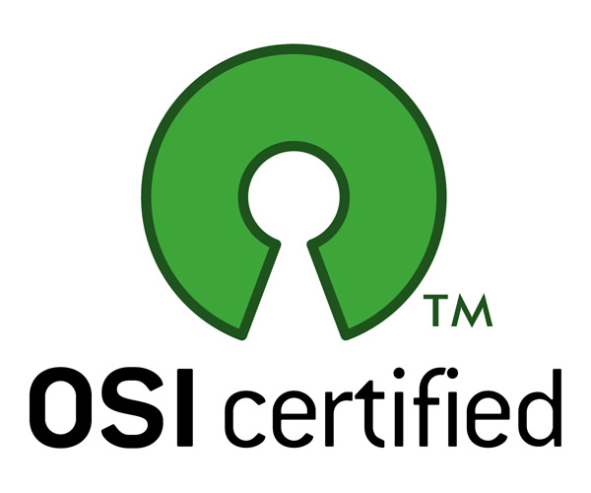
MyProxy Community
MyProxy is an open source, community project
  Many contributions from outside NCSA
myproxy-users@ncsa.uiuc.edu mailing list
Bug tracking: http://bugzilla.ncsa.uiuc.edu/
Anonymous CVS access
  :pserver:anonymous@cvs.ncsa.uiuc.edu:/CVS/myproxy
Contributions welcome!
  Feature requests, bug reports, patches, etc.
  Please report your experiences

Slide 30
Thank you!
Questions/Comments?
Contact:
jbasney@ncsa.uiuc.edu

