Slide 1
Managing Credentials on the TeraGrid with MyProxy
Jim Basney
Senior Research Scientist
National Center for Supercomputing Applications
University of Illinois at Urbana-Champaign
jbasney@ncsa.uiuc.edu

Slide 2
What is MyProxy?
A service for managing X.509 PKI credentials
  A credential repository and certificate authority
An Online Credential Repository
  Issues short-lived X.509 Proxy Certificates
  Long-lived private keys never leave the server
An Online Certificate Authority
  Issues short-lived X.509 End Entity Certificates
Supporting multiple authentication methods
  Passphrase, Certificate, PAM, SASL, Kerberos
Open Source Software
  Included in Globus Toolkit, VDT, and CoG Kits
  C, Java, Python, and Perl clients available
  Contributions from EDG, UVA, LBNL, and others

Slide 3
MyProxy and TeraGrid
MyProxy v3.4 clients in CTSS 3
myproxy.teragrid.org server
  Retrieve credentials with myproxy-logon
  Store credentials with myproxy-init
MyProxy-based authentication
  TeraGrid User Portal
  TeraGrid Ticket System
Software for Science Gateways
  Portal-based User Registration
  Web Single Sign-on

Slide 4
MyProxy Put
Client
MyProxy
Server
TLS handshake
certificate
username
proxy certificate chain
certificate request
password
policy
private key
keypair
cert chain
private key

Slide 5
MyProxy Get
Client
MyProxy
Server
TLS handshake
username
proxy certificate chain
certificate request
cert chain
password
private key
cert chain
X.509
private key
Grid
Service

Slide 6
TeraGrid User Portal
All TeraGrid users receive a Portal username and password
  Login to https://portal.teragrid.org/
  Portal obtains credentials for resource access
  Users can run myproxy-logon to obtain credentials directly from MyProxy
Uses MyProxy CA with Kerberos PAM
  TERAGRID.ORG Kerberos Realm
  Leverages existing NCSA Online CA

Slide 7
MyProxy CA with PAM
Grid
Service
X.509
MyProxy
Server
gridmap
P
A
M
Client/Portal
TLS handshake
certificate request
certificate
keypair
password
CA key
TGT
Kerberos
KDC

Slide 8
TeraGrid Ticket System
Uses MyProxy for certificate-based authentication
  Store a credential with myproxy-init
  Enter MyProxy password on Ticket System
  https://tickets.teragrid.org/
  Ticket System verifies certificate identity using TeraGrid grid-mapfile

Slide 9
TG Ticket System Authentication
myproxy-init
MyProxy
TLS handshake
username
proxy certificate chain
certificate request
certificate
password
cert chain
private key
private key
X.509
cert request
username
Tickets
password
cert
TLS handshake
Browser
username
password
cert
cert
key
key
gridmap

Slide 10
TeraGrid Science Gateways
Community interfaces to TG resources
  Web portals, desktop applications, etc.
Many different approaches to user authentication
MyProxy can assist with
  User registration
  Certificate management
  Single sign-on

Slide 11
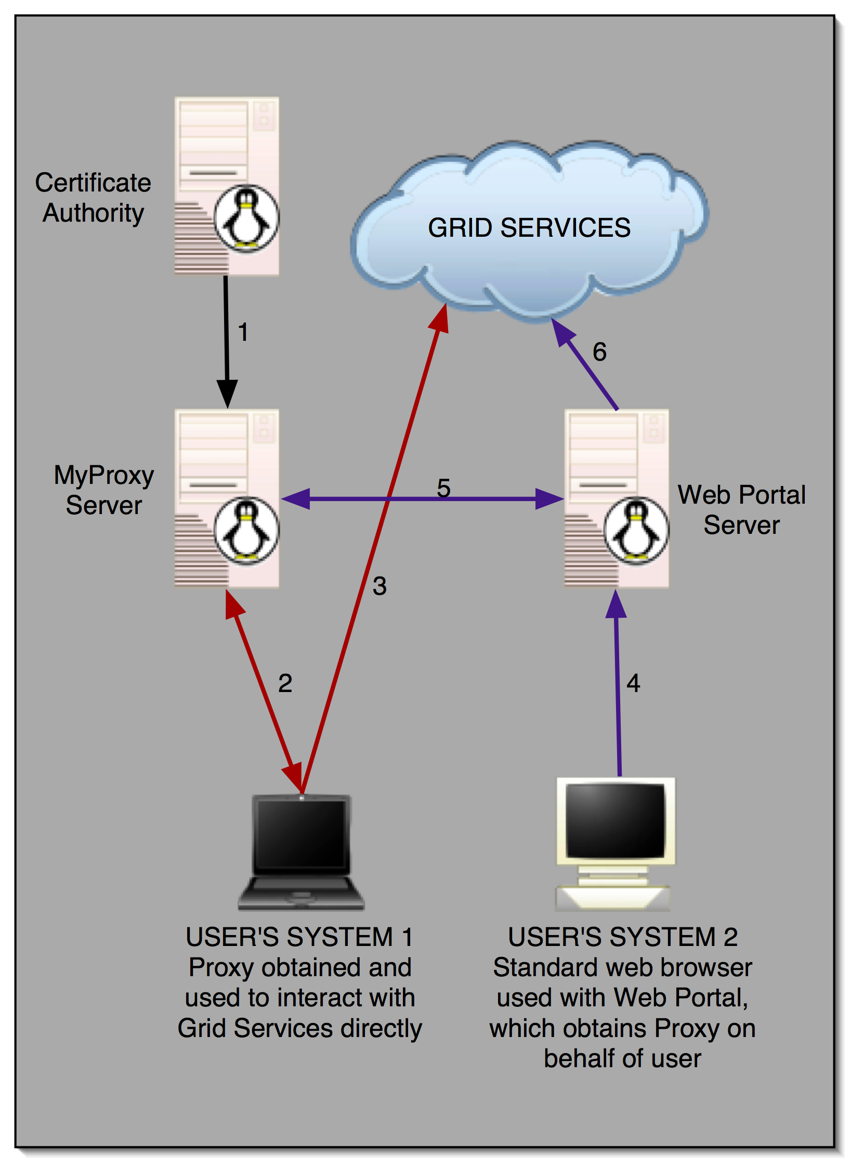


MyProxy and Grid Portals

Slide 12
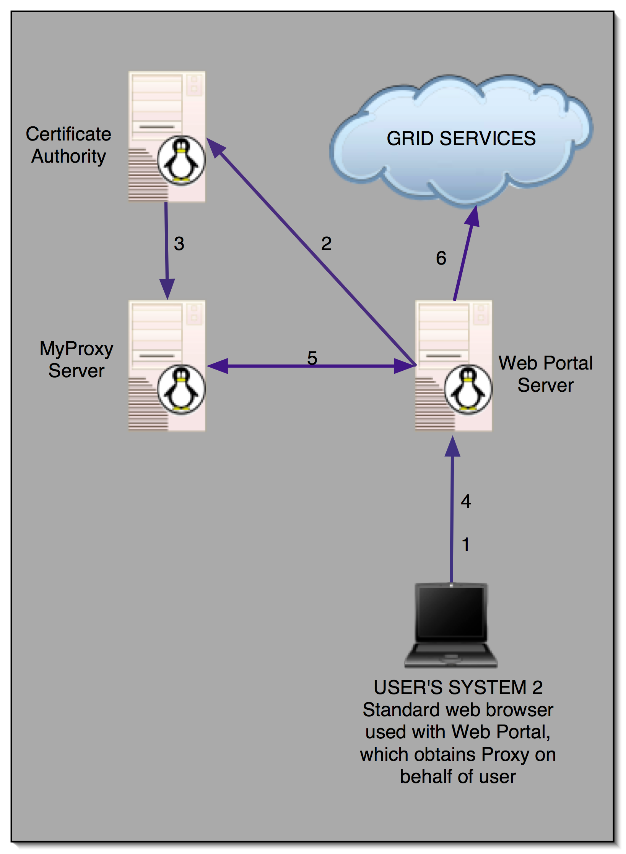
User Registration Portals
PURSE:
Portal-based User Registration Service
GAMA:
Grid Account Management Architecture
ESG

Slide 13
Trusted Portal
MyProxy
X.509
cert request
username
Portal
cert
TLS handshake
Browser
username
password
User
DB
cert
cert
key
key
X.509
Grid
Service

Slide 14
MyProxy and Web SSO
PURSE
password
password
cert
Pubcookie
Login Server
password
password
cookie
Browser
cookie
MyProxy
cookie
Portal A
cookie
cert
Grid
Service
cookie
X.509
X.509
cookie
Portal B
cert

Slide 15
SSO for Browser and Application
Browser
Authenticate
Portal
password_{random}
cert
JWS
cert
password_{random}
password_{random}
Application
MyProxy
Server
cert
password_{random}
X.509
Grid
Service

Slide 16
Password-based Delegation
Delegator
Delegatee
certificate
certificate
username
password_{random}
certificate
private key
certificate
private key
certificate
certificate
username
MyProxy
username
certificate
certificate
certificate request
certificate request
password_{random}
password_{random}
TLS handshake
certificate
certificate
TLS handshake
certificate
private key

Slide 17
Conclusion
MyProxy provides credential management services for TeraGrid
  myproxy.teragrid.org server
  TeraGrid User Portal and Ticket System authentication
MyProxy supports many credential management options for portals and web services
  Requests for new functionality are invited

Slide 18
Thank you!
Questions?
Comments?
For more information:
jbasney@ncsa.uiuc.edu
http://myproxy.ncsa.uiuc.edu/
http://www.globus.org/toolkit/security/myproxy/

