Slide 1
Using the MyProxy Online Credential Repository
Jim Basney
Senior Research Scientist
NCSA
jbasney@ncsa.uiuc.edu

Slide 2
What is MyProxy?
A new component in Globus Toolkit 4.0
  Independent Globus Toolkit add-on since 2000
A service for securing private keys
  Keys stored encrypted with user-chosen password
  Keys never leave the MyProxy server
A service for retrieving proxy credentials
  Supporting mobility, delegation, and renewal
A commonly-used service for grid portal security
  Integrated with OGCE, GridSphere, and GridPort

Slide 3
PKI Overview
Public Key Cryptography
  Sign with private key,
  verify signature with public key
  Encrypt with public key,
  decrypt with private key
Key Distribution
  User generates public/private key
  Certificate Authority (CA) verifies user’s identity and signs certificate binding identity to public key
Issuer: CA
Subject: CA
signs
Issuer: CA
Subject: Jim

Slide 4
Proxy Credentials
CA
RFC 3820: Proxy Certificate Profile
Associate a new private key and certificate with existing credentials
Short-lived, unencrypted credentials for multiple authentications in a session
Credential delegation (forwarding) without transferring private keys
signs
User
signs
Proxy
A
signs
Proxy
B

Slide 5
Proxy Delegation
Delegator
Delegatee
1
2
Generate
new key pair
Proxy certificate request
3
Sign new
proxy certificate
4
Proxy
Proxy
Proxy

Slide 6
MyProxy System Architecture
MyProxy client
Store proxy
MyProxy server
Retrieve proxy
delegation over private
TLS channel
Credential
repository

Slide 7

MyProxy: Credential Mobility
Obtain certificate
tg-login.ncsa.teragrid.org
ca.ncsa.uiuc.edu
Store proxy
myproxy.teragrid.org
tg-login.caltech.teragrid.org
Retrieve proxy
tg-login.sdsc.teragrid.org
tg-login.uc.teragrid.org

Slide 8

MyProxy: Credential Renewal
Condor-G
Globus
gatekeeper
Submit job
Submit job
Refresh proxy
MyProxy server
Fetch proxy

Slide 9
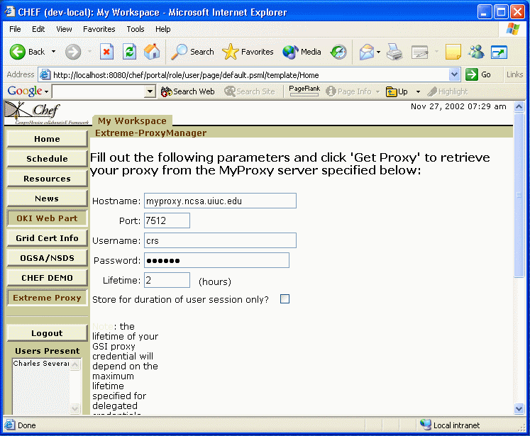

MyProxy and Grid Portals
MyProxy server
Portal
Login
Fetch proxy
GridFTP server
Access data

Slide 10

MyProxy: User Registration
Registration portal
Obtain user
certificate
Certificate authority
Request account
Set username/password
Load user’s
credentials
Login with
username/password
Grid
portal
Retrieve
proxy
MyProxy server
ESG
PURSE: Portal-based User Registration Service

Slide 11
MyProxy Installation (Unix)
As an add-on component to GT 2.x/3.x
  $ gpt-build myproxy*.tar.gz <flavor>
Set $MYPROXY_SERVER environment variable to myproxy-server hostname
  $ export MYPROXY_SERVER=myproxy.ncsa.uiuc.edu
Set Globus Toolkit environment
  $ . $GLOBUS_LOCATION/etc/globus-user-env.sh
Client installation/configuration complete!

Slide 12
MyProxy Commands
myproxy-init: store proxy
myproxy-get-delegation: retrieve proxy
myproxy-info: query stored credentials
myproxy-destroy: remove credential
myproxy-change-pass-phrase:
change password encrypting private key

Slide 13
MyProxy CoG Clients
Commodity Grid (CoG) Kits
  Provide portable (Java and Python)
  MyProxy client tools & APIs
  Windows support
For more information:
  http://www.cogkit.org/

Slide 14
MyProxy Server Administration
Install server certificate and CA certificate(s)
Configure /etc/myproxy-server.config policy
  Template provided with examples
Optionally:
  Configure password quality enforcement
  Install cron script to delete expired credentials
Install boot script and start server
  Example boot script provided
Use myproxy-admin commands to manage server
  Reset passwords, query repository, lock credentials

Slide 15
MyProxy Server Policies
Who can store credentials?
  Restrict to specific users or CAs
  Restrict to administrator only
Who can retrieve credentials?
  Allow anyone with correct password
  Allow only trusted services / portals
  Set server-wide and per credential
Maximum lifetime of retrieved credentials
  Set server-wide and per credential

Slide 16
MyProxy and SASL
MyProxy supports additional authentication mechanisms via SASL
One Time Passwords (SASL PLAIN with PAM)
  Protect against stolen passwords
  Hardware token generates OTP
  Authenticate with OTP plus MyProxy password
  Tested with CryptoCard tokens
Kerberos (SASL GSSAPI)
  Authenticate with Kerberos ticket
  plus MyProxy password

Slide 17
Hardware-Secured MyProxy
Protect keys in tamper-resistant cryptographic hardware
MyProxy Server
Proxy request
IBM 4758
Retrieve proxy
Proxy certificate
M. Lorch, J. Basney, and D. Kafura, "A Hardware-secured Credential Repository for Grid PKIs," 4th IEEE/ACM International Symposium on Cluster Computing and the Grid, April 2004.

Slide 18
Related Work
GT4 Delegation Service
  Protocol based on WS-Trust and WSRF
SACRED Credential Repository
  RFC 3767
Kerberized Online CA (KX.509/KCA)
  Kerberos -> PKI
PKINIT for Heimdal Kerberos
  PKI -> Kerberos

Slide 19
MyProxy Community
myproxy-users@ncsa.uiuc.edu mailing list
Bug tracking: http://bugzilla.ncsa.uiuc.edu/
Anonymous CVS access
  :pserver:anonymous@cvs.ncsa.uiuc.edu:/CVS/myproxy
Contributions welcome!
  Feature requests, bug reports, patches, etc.

Slide 20
Thank you! Obrigado!

