Slide 1
An OGSI CredentialManager Service
Jim Basney, Shiva Shankar Chetan, Feng Qin, Sumin Song, Xiao Tu
National Center for Supercomputing Applications,
University of Illinois
Marty Humphrey
Department of Computer Science, University of Virginia

Slide 2
Goals:
Implement an OGSI credential repository service
  Open Grid Services Infrastructure v1.0, June 2003
Leverage OGSI capabilities where possible
  Manage credentials with a stateful OGSI service
  Use OGSI/GT3 security mechanisms

Slide 3
MyProxy credential repository:
Secure credential storage
  Encrypted keys never leave repository
Convenient credential access
  Retrieve proxy credentials when/where needed
Flexible credential management
  Store multiple credentials with access policies
Implemented using GT2 GSI libraries
http://myproxy.ncsa.uiuc.edu/

Slide 4

Credential mobility:
Obtain certificate
tg-login.ncsa.teragrid.org
ca.ncsa.uiuc.edu
Store proxy
myproxy.teragrid.org
tg-login.caltech.teragrid.org
Retrieve proxy
tg-login.sdsc.teragrid.org
tg-login.uc.teragrid.org

Slide 5
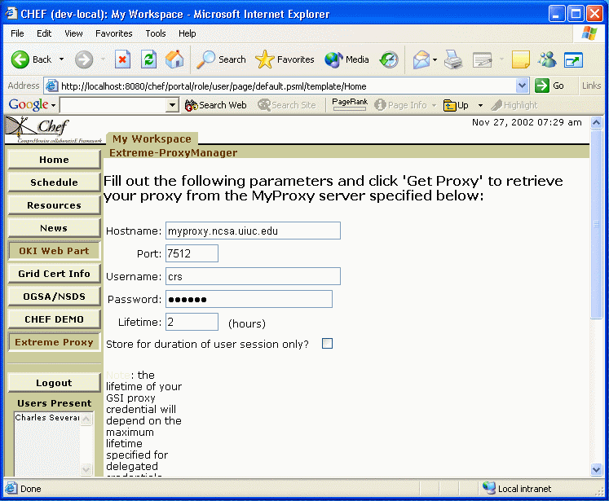

Grid portals:
MyProxy server
CHEF portal
Login
Fetch proxy
GridFTP server
Access data

Slide 6

Proxy renewal:
Workload management system
Globus
gatekeeper
Submit job
Submit job
Refresh proxy
MyProxy server
Fetch proxy

Slide 7

Long-term credential storage:
Request account
Accounting system
Obtain user’s
certificate
Certificate authority
Username, password
Load user’s
credentials
Retrieve proxy
MyProxy server
Change password

Slide 8
OGSI CredentialManager:
CredentialManager implemented using standard GridService methods plus getProxy() method
Credential information published via serviceData
Service implemented in ~500 LOC using GT3
  Compare with ~5000 LOC for GT2 MyProxy

Slide 9
Storing a credential:
WS-SecureConversation
with GSI proxy delegation
createService(l, e)
Client
CredentialManagerFactoryService
e, p
instance
l = proxy lifetime
e = (name, password,
max. retrieve lifetime)
p = delegated GSI proxy
sd = (name, lifetime)
publish(sd)
IndexService

Slide 10
CredentialManager instance persistent properties:
Credential
  Private key, encrypted with user password
  Certificate chain
Credential name
Credential policies
  Maximum lifetime of retrieved proxies

Slide 11
Retrieving a credential:
GSH = query(name)
Client
IndexService
proxy cert = getProxy(c, p, l)
CredentialManager
instance
c = proxy cert request
p = password
l = requested proxy lifetime

Slide 12
CredentialManager operations:
MyProxy | OGSI CredentialManager
Store proxy in repository | Create persistent service instance containing proxy
Remove proxy from repository | Destroy service instance
Retrieve proxy by name and password | Locate instance by name using IndexService, then retrieve proxy

Slide 13
Access control:
MyProxy | OGSI CredentialManager
accepted_credentials | <service> <parameter name="authorization" value="gridmap"/> <parameter name="gridmap" value=”grid-mapfile.cmfs"/> </service>
authorized_retrievers | <service> <parameter name="instance-authorization" value="gridmap"/> <parameter name="instance-gridmap" value="grid-mapfile.cmi"/> </service>
Per-credential authorization | Per-instance authorization not provided

Slide 14
Credential renewal:
getStartedJobsSD()
ManagedJobFactoryService
findServiceData()
CredentialManager
ManagedJobService

Slide 15
Renewal implementation:
Store unencrypted credential with CredentialManager
CM periodically queries ManagedJobFactoryService for GSHs of ManagedJobService instance
CM then queries ManagedJobService service data for user credentials nearing expiration
  Modified ManagedJobService publishes credential info in service data
CM calls any method of ManagedJobService with delegation-enabled GT3 WS-SecureConversation to refresh credential

Slide 16
Password-enabled PKI:
passwords
good,
PKI bad?
Currently authenticate service via
SSL certificate, client via password
  Requires trusted PKI setup on client-side
Better to use a secure password-authenticated key exchange protocol (EKE, SPEKE, SRP, etc.)
  Avoids requirement of PKI setup on client side
  Need WS-Security bindings
One-time passwords even better!

Slide 17
Work in progress:
WSRF.NET prototyping
WS-Trust
IETF SACRED
  http://sacred.sf.net/

Slide 18
Questions?
For more information:
http://myproxy.ncsa.uiuc.edu/ogsa/
jbasney@ncsa.uiuc.edu
Thanks!

