Slide 1
Federated Environments and Incident Response:
The Worst of Both Worlds?
A TeraGrid Perspective
Jim Basney
Senior Research Scientist
National Center for Supercomputing Applications
University of Illinois at Urbana-Champaign
jbasney@ncsa.uiuc.edu
This material is based upon work supported by the National Science Foundation under Grant No. 0503697. Any opinions, findings, and conclusions or recommendations expressed in this material are those of the author(s) and do not necessarily reflect the views of the National Science Foundation.

Slide 2
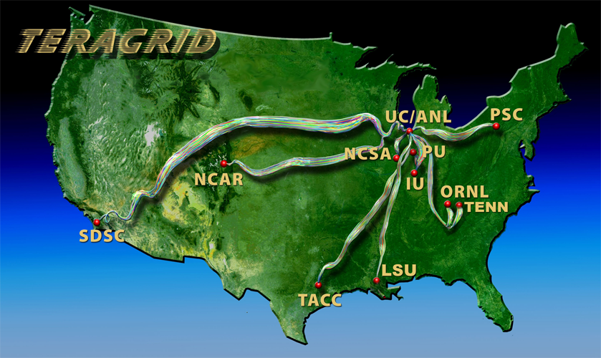
What is the TeraGrid?
NSF-funded facility to offer high end compute, data and visualization resources to the nation’s academic researchers
(7500+ registered users from 450+ organizations)
www.teragrid.org

Slide 3
TeraGrid Federations
TeraGrid Core Services
  TeraGrid Central Database (TGCDB)
  Manages accounts / allocations across resources / sites
  Centralized resource usage accounting
X.509 Public Key Infrastructure (PKI)
  International Grid Trust Federation (IGTF) (gridpma.org)
  Includes Certificate Authorities operating outside of TeraGrid
  Single sign-on across TeraGrid systems
TeraGrid membership in Shibboleth InCommon Federation (planned)
  Campus login to TeraGrid resources by researchers and students
TeraGrid Science Gateways Program
  Self-managed scientific communities
  Gateway acts as identity provider and resource broker

Slide 4
TeraGrid Risks of Primary Concern
Service disruption
  Account compromise interrupts access for account holder
  System compromise interrupts access for all account holders
Being the source of attacks on other systems
  High performance computers and networks used by attackers
  Spread of compromise via stolen credentials
Corruption / loss of scientific data
  Delay or invalidation of scientific results

Slide 5
TeraGrid Incident Response
Single point of contact
  help@teragrid.org
  1-866-907-2383
  24/7/365 response
Cross-site coordination for incident response
  Centralized ticket tracking system
  Emergency contact directory
  Secure teleconference lines
  Secure email lists

Slide 6
Secure Email List Service (SELS)
Being evaluated by TeraGrid Incident Response Team
Provides message-level security for emails exchanged on mailing lists
  Confidentiality, Integrity, and Authentication
Minimally trusted List Server
  List Server does not get access to email plaintext
  Proxy encryption techniques enable transformation of ciphertext
Developed with COTS and open-source components
  Integrated with GnuPG on subscriber side; no extra software to install
  Integrated with Mailman on server side with easy installation
Lists can be hosted by NCSA
sels.ncsa.uiuc.edu

Slide 7
Federated Identity & Incident Response
Network attacks across administrative boundaries
  Not a new problem but still a challenge!
  Coordination across organizational CSIRTs
    CERT/CC, US-CERT, REN-ISAC, FIRST
New challenge: Compromise of federated identity
React
  Disable access
  Revoke credentials
  Notify other service providers
  Contact identity provider
  Contact identity holder
Recover
  Re-credential identity holder
  Coordinate with identity provider
  Coordinate with service providers
  Restore accounts/systems
  Re-enable access
  Compromise can spill outside the federation

Slide 8
TG Requirements for Federated Identity
Ability to contact the Identity Provider
  Phone number
  Email address
  Public key (PGP, S/MIME)
Ability to block unwanted user behavior
  Persistent user identifier
Ability to directly contact the user
  Email address and/or phone number
Notes:
Taken from requirements gathering process for TG Science Gateway program.

Slide 9
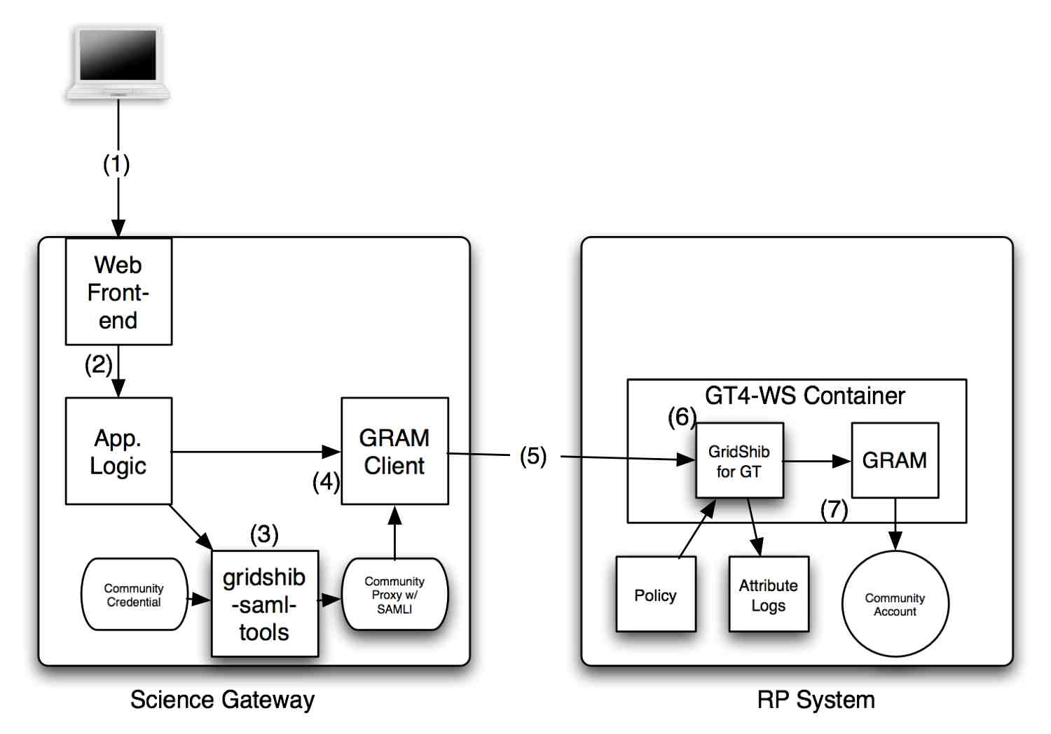
TeraGrid Science Gateways
Use SAML assertion to convey user identifier and email address
gridshib.globus.org

Slide 10
Proposed Discussion Topics
Support from identity providers for incident response
  Preparation
  Timely and secure communication
  Prompt credential revocation
  Confirmation of credential reset / re-issuance
  Assistance with incident investigation
  Audit records and system logs
Effective communication and coordination
  Should incident responders contact users directly?
  Can the identity provider help to coordinate?
Value for incident response of a persistent user identifier
  Facilitates blacklisting
  eduPersonPrincipalName? eduPersonTargetedID?

