Slide 1
Building and Maintaining a Trustworthy Grid
Jim Basney
jbasney@ncsa.uiuc.edu
Notes:
Abstract: A successful grid is built and operated on a foundation of trust. Researchers trust the grid to provide the resources they need, when they need them, while maintaining their security and privacy. Resource providers trust the grid to facilitate appropriate use of their valuable systems, while not making them less stable or more vulnerable to attack. Building and maintaining a trustworthy grid is a distributed, collaborative effort. This talk will discuss community best practices for credentialing, software vulnerability handling, and incident response that aim to deliver a trustworthy grid.

Slide 2
Outline
Introductions
  NCSA, TeraGrid, and Open Science Grid
A Trustworthy Grid
Credentialing
  International Grid Trust Federation
Software Vulnerability Handling
  Globus Security Committee
Incident Response
Conclusions
Building and Maintaining a Trustworthy Grid (4 August 2008)

Slide 3
Outline
Introductions
  NCSA, TeraGrid, and Open Science Grid
A Trustworthy Grid
Credentialing
  International Grid Trust Federation
Software Vulnerability Handling
  Globus Security Committee
Incident Response
Conclusions
Building and Maintaining a Trustworthy Grid (4 August 2008)

Slide 4
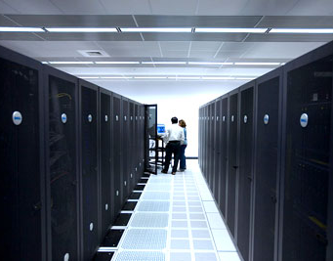
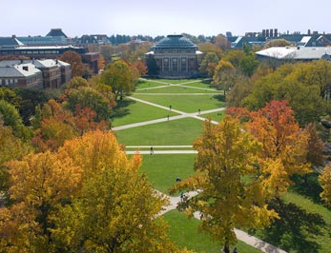

NCSA is…
World leader in deploying supercomputers and providing scientists with the software and expertise needed to:
  Fuel scientific discoveries
  Advance the state-of-the-art in engineering
Unique partnership among the University of Illinois, state of Illinois, and US federal government
Home to more than 300 computing experts and students
Key partner in the US National Science Foundation’s TeraGrid
Home to Blue Waters, expected to be the most powerful computer for open scientific research when it comes online in 2011
Building and Maintaining a Trustworthy Grid (4 August 2008)

Slide 5
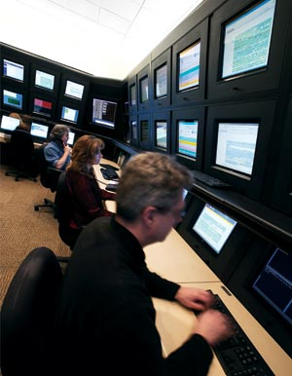
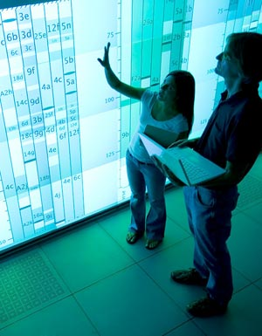
NCSA provides…
More than 140 teraflops of computing power
Consulting for 2,000 users nationwide
Software and tools
New insights into data through visualizations and data mining tools
Educational programs for grade school through graduate school and beyond
Cyberenvironments that help researchers use our systems
Cybersecurity training and tools for cybercrime investigations
Building and Maintaining a Trustworthy Grid (4 August 2008)

Slide 6
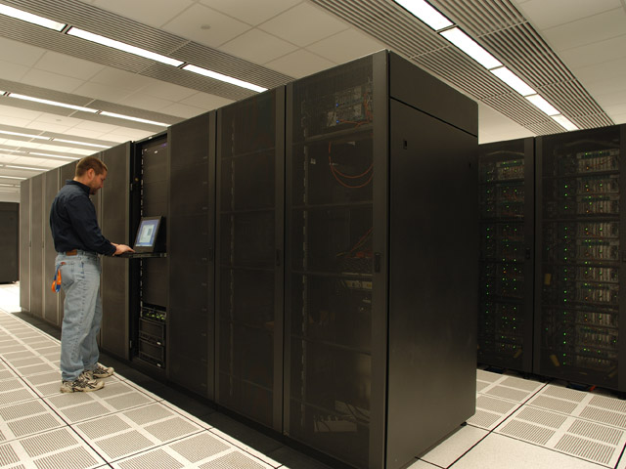
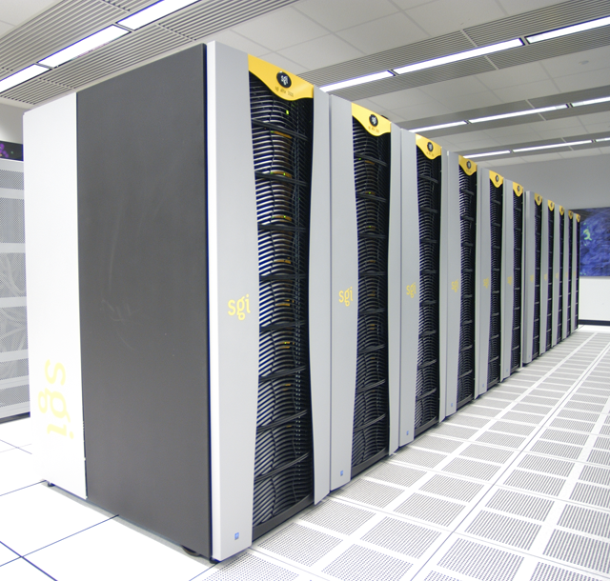
NCSA’s current computing power
5 production systems
More than 140 teraflops
About 2,000 users nationwide
Researchers receive time at no cost through peer review
Building and Maintaining a Trustworthy Grid (4 August 2008)
Notes:
140 teraflops = 140 TRILLION calculations per second

Slide 7
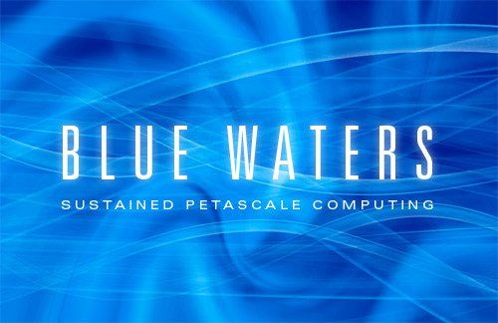
Blue Waters
Will come online in 2011
Hundreds of times more powerful than today’s supercomputers
  Number of calculations per second sustained on real-world applications
  Amount of memory available
  Ability to analyze massive quantities of data
Collaborators:
  University of Illinois/NCSA
  IBM
  Great Lakes Consortium
  for Petascale Computation
Building and Maintaining a Trustworthy Grid (4 August 2008)
Notes:
Petascale: sustain 1 QUADRILLION (million billion) calculations per second
Leverages $300 million investment in IBM technology by DARPA
Three years of development, followed by five years of operations. Blue Waters will come online in 2011 and be retired or upgraded in 2016
$208m over 4.5 years from NSF for development.

Slide 8

The Blue Waters Project
Will enable unprecedented science and engineering advances
Supports:
  Application development
  System software development
  Interaction with business and industry
  Educational programs
Includes Petascale Application Collaboration Teams that will help researchers:
  Port, scale, and optimize existing applications
  Create new applications
Building and Maintaining a Trustworthy Grid (4 August 2008)

Slide 9
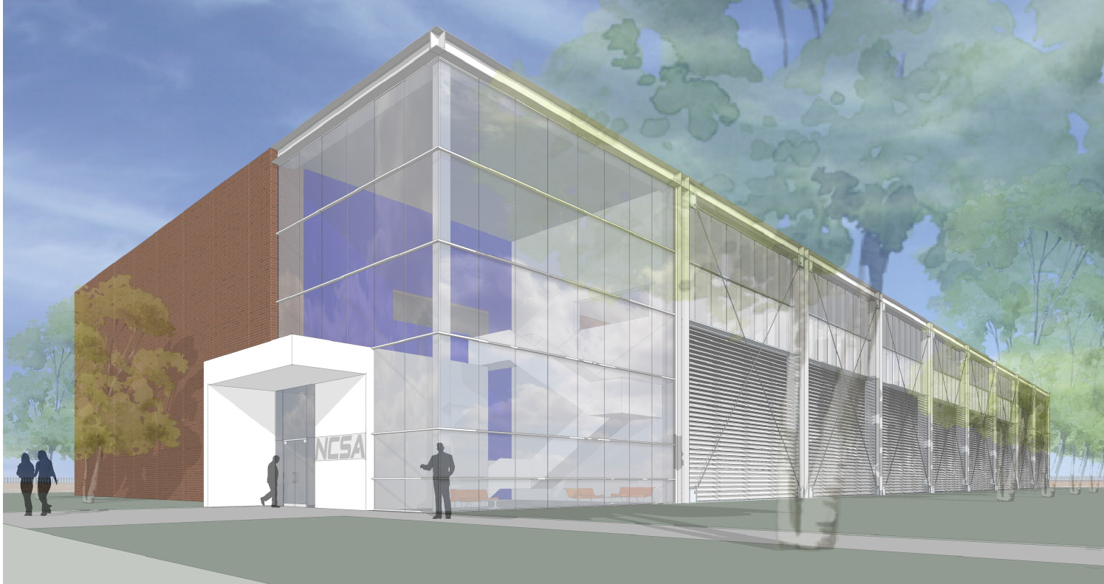
Petascale Computing Facility
Future home of Blue Waters and other NCSA hardware
88,000 square feet, 20,000 square foot machine room
Water-cooled computers are 40 percent more efficient
Onsite cooling towers save even more energy
Building and Maintaining a Trustworthy Grid (4 August 2008)
Notes:
To compare PCF and our current machine room at ACB: ACB has 750 tons of chilled water capacity and 5 megawatts electrical capacity.
PC will have 5,400 tons of chilled water capacity and 24 megawatts electrical capacity.
Take advantage of an on-site tower to chill water for cooling the compute systems.
This will reduce energy consumption by using nature's natural cooling power to chill water during the cold winter months.
Use computational fluid dynamics models to precisely design the interior of the building to maximize the efficiency of the air conditioning system for air-cooled computing systems.
Take advantage of the campus' highly reliable electricity supply, avoiding the need for the standard back-up Uninterruptible Power Supply (UPS). Eliminating the UPS saves equipment costs, minimizes floor space used, and increases energy efficiency because systems that employ a UPS convert AC to DC and back, incurring substantial energy losses.
The new Petascale Computing Facility will cost $72.5 million; Illinois' governor has committed to $60 million of those costs.
Groundbreaking is expected in late 2008, with completion in late 2010.
The facility will achieve standard LEED certification. LEED Silver certification is the goal.
The facility will be at the corner of Oak and St. Mary’s in Champaign. It will house about 40 staff members.

Slide 10
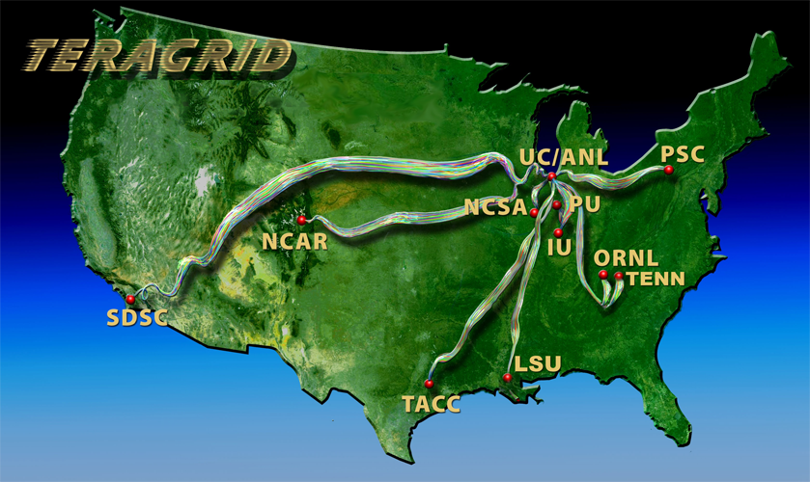
What is the TeraGrid?
NSF-funded facility to offer high end compute, data and visualization resources to the nation’s academic researchers
(7500+ registered users from 450+ organizations)
Building and Maintaining a Trustworthy Grid (4 August 2008)

Slide 11
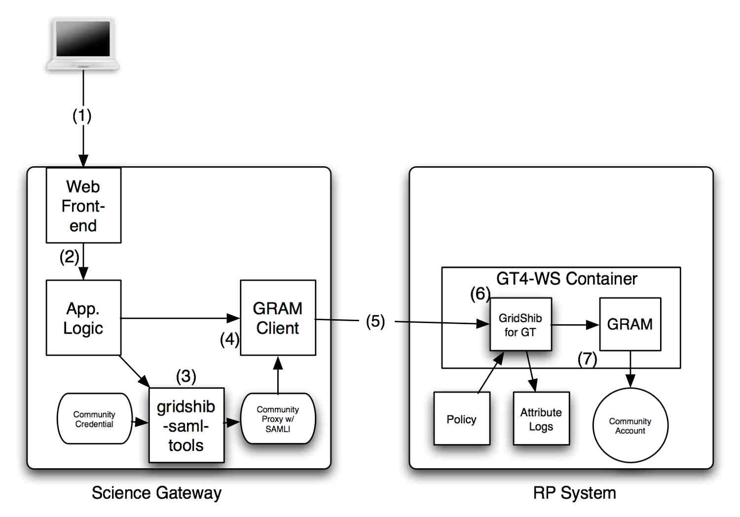
TeraGrid Science Gateways
gridshib.globus.org
Use SAML assertion to convey user identifier and email address
Building and Maintaining a Trustworthy Grid (4 August 2008)

Slide 12
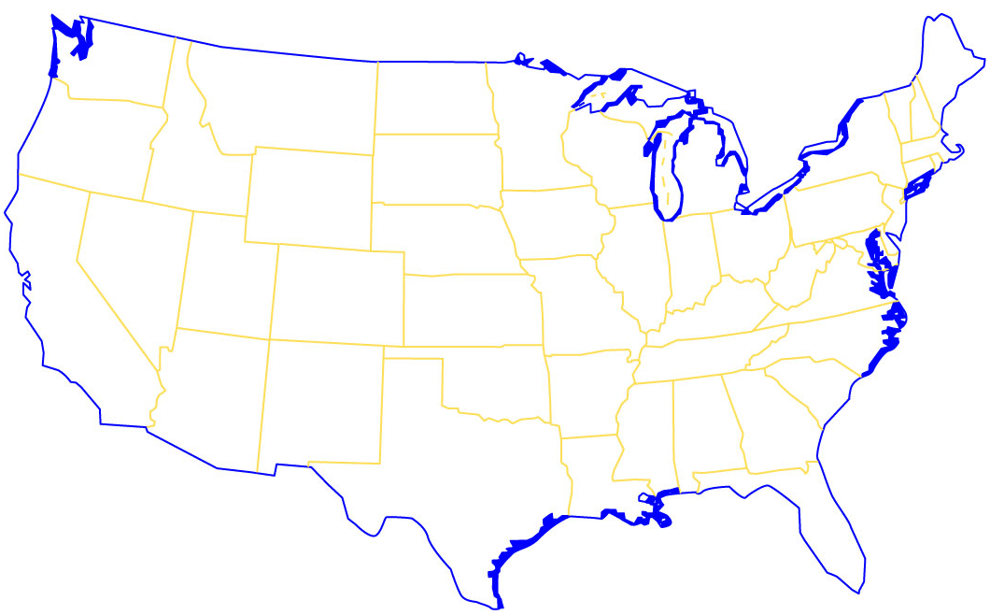

What is the Open Science Grid?
MCGILL
HARVARD
ALBANY
BU
BUFFALO
UWM
UMICH
WSU
CORNELL
BNL
WISC
MSU
IOWA STATE
FNAL
UIC
PSU
UNI
ANL
UCHICAGO
LEHIGH
NERSC
UNL
PURDUE
UIUC
IUPUI
NSF
STANFORD
KU
INDIANA
IU
UVA
VANDERBILT
ORNL
CALTECH
UCLA
UCR
UNM
OU
CLEMSON
SDSC
UMISS
TTU
UTA
LTU
SMU
LSU
UFL
(+Brazil, Mexico, Tawain, UK)
Building and Maintaining a Trustworthy Grid (4 August 2008)
Notes:
Close collaboration with EGEE/WLCG.
5 DOE Labs - BNL, Fermilab, NERSC, ORNL, SLAC. 65 Universities. 5 partner campus/regional grids.
>43,000 cores, 6 Petabyes disk cache, 10 Petabyes tape stores
15,000 CPU WallClock days/day. 1 petabyte data distributed/month.
100,000 application jobs/day. 20% cycles through resource sharing, opportunistic use.

Slide 13
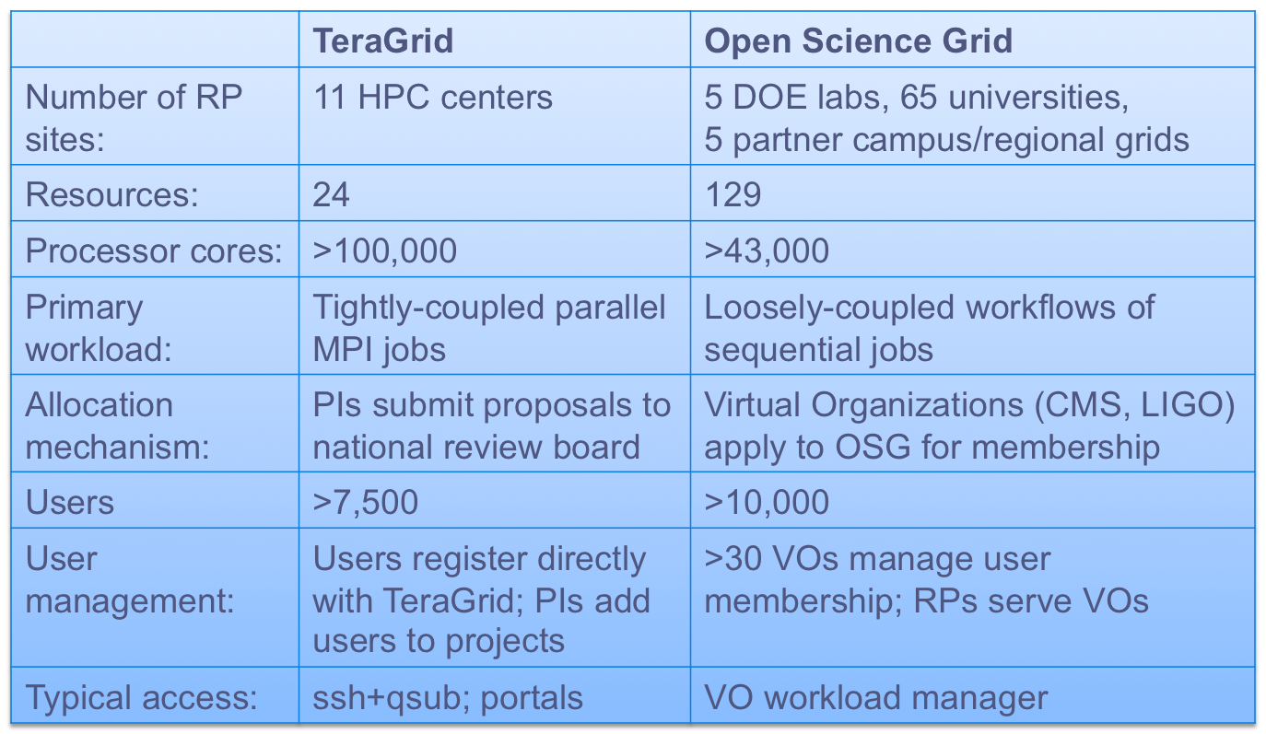
TeraGrid and Open Science Grid Compared
Building and Maintaining a Trustworthy Grid (4 August 2008)
Notes:
Capability and Capacity.
CERN Large Hadron Collider (LHC) Computing Grid (LCG) – CMS detector
LIGO = Laser Interferometer Gravitational-Wave Observatory – detecting gravitational waves
OSG is more distributed; OSG sites don’t all have dedicated operational security staff
VOs provide a level of indirection (scalability)
SSH access brings risks
Compare EGEE (Enabling Grids for E-sciencE) and DEISA (Distributed European Infrastructure for Supercomputing Applications)
Some jobs / users run across both TG and OSG.

Slide 14
Outline
Introductions
  NCSA, TeraGrid, and Open Science Grid
A Trustworthy Grid
Credentialing
  International Grid Trust Federation
Software Vulnerability Handling
  Globus Security Committee
Incident Response
Conclusions
Building and Maintaining a Trustworthy Grid (4 August 2008)

Slide 15
A Trustworthy Grid: Defined
Provides reliable service to researchers
  Avoids downtime caused by security issues
Maintains security and privacy of research data
Facilitates appropriate use of valuable systems
  Acceptable Use Policy, Resource Allocation Policies, etc.
Expands access to resources without making them less stable or more vulnerable to attack
  New connections enabled by the grid can also spread attacks – must be addressed by security policies and procedures
Building and Maintaining a Trustworthy Grid (4 August 2008)

Slide 16
A Trustworthy Grid: Challenges
Trust is distributed and interdependent
  CAs vouch for identities
  VOs and Science Gateways vouch for users
  Resources and services are interconnected
  Incident response crosses boundaries
Scaling to large numbers of users and resources
  Requires delegation of responsibility, automation of procedures
Complexity
  Impacts usability, manageability, auditability
  Makes problem diagnosis/response more difficult
Building and Maintaining a Trustworthy Grid (4 August 2008)

Slide 17
A Trustworthy Grid: Risks
Compromise of credentials by attackers
Compromise of services by attackers
Misuse of services by insiders
Misconfiguration of services by administrators
Hardware and software faults
Infrastructure failures (power, network, …)
Natural disasters
…
Building and Maintaining a Trustworthy Grid (4 August 2008)

Slide 18
A Trustworthy Grid: It’s All About People
As much as I like to talk about technology, the most important part is the people…
Face-to-face meetings remain critical
  Building consensus, mutual understanding, working relationships
  Both within and between groups/organizations
Setting standard policies and procedures
  While allowing them to evolve
Building support networks
  Troubleshooting and problem diagnosis
  Incident response coordination and information sharing
  Sharing best practices and experiences
Building and Maintaining a Trustworthy Grid (4 August 2008)

Slide 19
Outline
Introductions
  NCSA, TeraGrid, and Open Science Grid
A Trustworthy Grid
Credentialing
  International Grid Trust Federation
Software Vulnerability Handling
  Globus Security Committee
Incident Response
Conclusions
Building and Maintaining a Trustworthy Grid (4 August 2008)

Slide 20

Credentialing
Issuance of credentials to users and services is a prerequisite for secure online interactions
  Credentials prove/convey identity, attributes, memberships
Goals:
  Single sign-on, avoid juggling multiple credentials
  Usability, mobility, scalability
Options:
  Passwords
  Certificates
  Assertions
  Hardware tokens
Building and Maintaining a Trustworthy Grid (4 August 2008)

Slide 21

International Grid Trust Federation (IGTF)
A federation of regional Grid PKI Policy Management Authorities (PMAs)
  Asia Pacific Grid Policy Management Authority (APGridPMA)
  European Policy Management Authority for Grid Authentication in e-Science (EUGridPMA)
  The Americas Grid Policy Management Authority (TAGPMA)
Standards for Grid Certificate Authorities (CAs) facilitate world-wide use of grid certificates
IGTF PMAs review and audit of Grid CA operations
www.gridpma.org
Building and Maintaining a Trustworthy Grid (4 August 2008)
Notes:
The APAC CA (David Bannon), which serves BeSTGRID in NZ, is a member of the APGridPMA.

Slide 22
IGTF Profiles
Identity vetting
  Face-to-face identification of people using photo IDs
  Verifying authorization to request host/service certificate
Operation of CA systems
  Protection of CA private key
  Issuance of CRLs
  Logging
Credential management
  Private keys encrypted with strong passphrases
Interoperability
  Certificate extensions
  Namespace management
Building and Maintaining a Trustworthy Grid (4 August 2008)

Slide 23
IGTF Short Lived Credential Services
Translate a local site credential (LDAP, Kerberos) to a grid credential (certificate)
  Leverage existing site/organization identity management
  Leverage Shibboleth Federation
Short-lived: certificates valid for up to 11 days
  Local identity management updates propagate quickly
  Integrates with local site logon
Example: NCSA MyProxy CA
  http://myproxy.ncsa.uiuc.edu/
  http://ca.ncsa.uiuc.edu/
Building and Maintaining a Trustworthy Grid (4 August 2008)

Slide 24
IGTF Risk Assessment Team (RAT)
An IGTF subcommittee responsible for assessing risk and setting time deadlines for response and action by IGTF CAs for concerns and vulnerabilities
Recently established in reaction to Debian OpenSSL random number generator issue (CVE-2008-0166)
https://tagpma.es.net/wiki/bin/view/IGTF-RAT
Building and Maintaining a Trustworthy Grid (4 August 2008)

Slide 25

EUGridPMA Authorization Policy WG
Addressing policy and global trust issues related to grid authorization (AuthZ).
  Minimum requirements and best practice for the operation of a grid AuthZ attribute authority
  Minimum requirements and best practice for VO user and service membership management
  Accreditation of Attribute Authorities (AA)
  Accreditation of VOs and their membership management procedures
  Repositories and distribution of accredited AA roots of trust
  Technical details of attribute signing and trust validation
Building and Maintaining a Trustworthy Grid (4 August 2008)

Slide 26

Open Grid Forum CA Operations WG
Develops operational procedures and guidelines for cross-grid authentication
Produced GFD-C.125: Grid Certificate Profile
  Referenced by IGTF profiles
  Practical guidelines on certificate extensions, distinguished names, key lengths, etc.
  www.ogf.org
Building and Maintaining a Trustworthy Grid (4 August 2008)

Slide 27
Joint Security Policy Group (JSPG)
Prepares and maintains security policies for adoption by WLCG and EGEE
  Policies are adopted by other grids (such as OSG) for interoperability
  Members from other grids are welcome
Policies
  Approval of Certificate Authorities
  Virtual Organization Management
  Site Registration
  Incident Response
  Traceability and Logging
www.jspg.org
Building and Maintaining a Trustworthy Grid (4 August 2008)

Slide 28
Outline
Introductions
  NCSA, TeraGrid, and Open Science Grid
A Trustworthy Grid
Credentialing
  International Grid Trust Federation
Software Vulnerability Handling
  Globus Security Committee
Incident Response
Conclusions
Building and Maintaining a Trustworthy Grid (4 August 2008)

Slide 29
Software Vulnerability Handling
The landscape:
  Grid middleware combines software from many providers
  Grid software builds on existing open source software (OpenSSL, BouncyCastle, Apache)
  Open source development can bring developers together in an ad-hoc manner
  Grid software often outlives original development funding
  Individual software components are bundled into distributions (Globus Toolkit, Virtual Data Toolkit, EGEE gLite)
The need for coordination and collaboration:
  Writing good software advisories is hard
  Coordination with software distributors and grid administrators avoids patch/upgrade panic
Building and Maintaining a Trustworthy Grid (4 August 2008)

Slide 30

Globus Security Committee
Community process for handling potential security vulnerabilities in Globus software
  Provides a critical mass of responders
  Provides a consistent, documented process for vulnerability handling
  Participating grids have an opportunity to provide input before security advisories are publicly announced
http://dev.globus.org/wiki/SecurityCommittee
Building and Maintaining a Trustworthy Grid (4 August 2008)

Slide 31
Outline
Introductions
  NCSA, TeraGrid, and Open Science Grid
A Trustworthy Grid
Credentialing
  International Grid Trust Federation
Software Vulnerability Handling
  Globus Security Committee
Incident Response
Conclusions
Building and Maintaining a Trustworthy Grid (4 August 2008)

Slide 32
Incident Response
An incident is any real or suspected event that poses a real or potential threat to the integrity of services, resources, infrastructure, or identities.
Coordination:
  Site Computer Security Incident Response Teams (CSIRTs) are the responders on the scene
  Inform regional/national CSIRTs, Information Sharing and Analysis Centers (ISACs), and other coordinating groups
  Software providers consult and fix vulnerabilities
  CAs revoke compromised certificates
  RPs, VOs, Gateways disable accounts, apply patches, recover systems
Building and Maintaining a Trustworthy Grid (4 August 2008)

Slide 33
Incident Response: TeraGrid
TeraGrid Incident Response Team consists of CSIRT members from the 11 TeraGrid partner sites
Single point of contact
  help@teragrid.org
  +1 866 907 2383
  24/7/365 response
TeraGrid-wide accounts and services mean that coordinated response is essential
  Centralized ticket tracking system
  Emergency contact directory
  Secure teleconference lines
  Secure email lists
http://www.teragridforum.org/mediawiki/index.php?title=TeraGrid_Security_Playbook
Building and Maintaining a Trustworthy Grid (4 August 2008)

Slide 34
Incident Response: Open Science Grid
OSG Incident Response Team (IRT) consists of project security, operations, software, and executive staff
  Central team coordinates with VO and site security contacts
  Site CSIRTs not proactively engaged with OSG
Large VOs span EGEE and OSG
  Requires coordination with EGEE IRT
  Adoption of JSPG incident response policy
Single point of contact
  security@opensciencegrid.org
  +1 317 278 9699
  24/7/365 response
  https://twiki.grid.iu.edu/bin/view/Security/IncidentResponseProcess
Building and Maintaining a Trustworthy Grid (4 August 2008)

Slide 35

SELS: A Secure Email List Service
Used by TeraGrid incident response team
Provides message-level security for emails exchanged on mailing lists
  Confidentiality, Integrity, and Authentication
Minimally trusted List Server
  Novel feature: List Server does not get access to email plaintext
  Proxy encryption techniques enable transformation of ciphertext
Development with COTS and open-source components
  Integrated with GnuPG on subscriber side; no software to install
  Integrated with Mailman on server side with easy installation and setup
http://sels.ncsa.uiuc.edu/
Building and Maintaining a Trustworthy Grid (4 August 2008)

Slide 36
Conclusions
Trustworthy grids require a strong security community
  Groups: IGTF, JSPG, Globus Security Committee, OGF CAOPS
  Building on community standards and best practices
Trustworthy grids provide reliable service
  Security should enhance (not obstruct) quality of service
Different types of grids require different security practices
  Comparison between TeraGrid and Open Science Grid
Trustworthy grids rely on worldwide collaborations
  Software providers, resource providers, incident responders, credential providers, …, and most important: researchers who use the grid
Building and Maintaining a Trustworthy Grid (4 August 2008)

Slide 37
Thanks!
Stuart Broughton, Ian Town / University of Canterbury
Grid security experts around the world
TeraGrid and OSG staff
This material is based upon work supported by the United States National Science Foundation and Department of Energy. Any opinions, findings, and conclusions or recommendations expressed in this material are those of the author and do not necessarily reflect the views of the National Science Foundation or Department of Energy.
Building and Maintaining a Trustworthy Grid (4 August 2008)

