Slide 1
Leveraging the InCommon Federation to access the NSF TeraGrid
Jim Basney
Senior Research Scientist
National Center for Supercomputing Applications
University of Illinois at Urbana-Champaign
jbasney@ncsa.uiuc.edu
This material is based upon work supported by the National Science Foundation under Grant No. 0503697. Any opinions, findings, and conclusions or recommendations expressed in this material are those of the author(s) and do not necessarily reflect the views of the National Science Foundation.

Slide 2
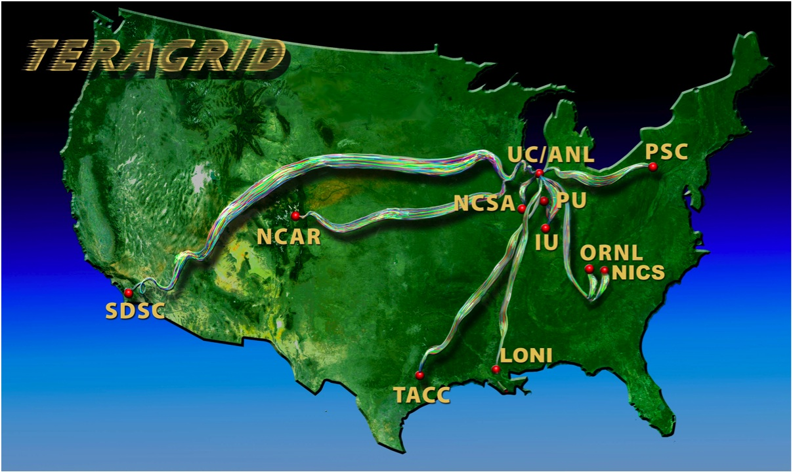
What is the TeraGrid?
NSF-funded facility to offer high end compute, data, and visualization resources to the nation’s academic researchers
www.teragrid.org
Notes:
7500+ registered users from 450+ organizations (primarily universities and research labs)
11 partner sites

Slide 3
TeraGrid Campus Integration
The TeraGrid project is working in many ways to better integrate with campuses to support research and education
  TeraGrid Campus Champions
  http://www.teragrid.org/eot/campuschamps.html
  TeraGrid Client Software
  http://teragridforum.org/mediawiki/index.php?title=TeraGrid_Client_Software
Authentication and Authorization is just one aspect of TeraGrid’s Campus Integration efforts
For more info about TeraGrid
Contact: help@teragrid.org
Internet2 Fall 2008 Member Meeting
Notes:
Campus Champions provide local support on campus for access to TeraGrid and feed campus requirements to the TeraGrid project.

Slide 4
TeraGrid and InCommon: Status
TeraGrid joined InCommon in July 2008
  TeraGrid will be an InCommon Resource Provider
  TeraGrid will not be an InCommon Credential Provider (at this time)
Shibboleth integration with TeraGrid User Portal (TGUP) will begin soon
  Today I’m presenting our plans
Internet2 Fall 2008 Member Meeting
Notes:
See: http://www.teragridforum.org/mediawiki/index.php?title=InCommon_Membership

Slide 5
TeraGrid Federations
TeraGrid Core Services
  Manage accounts and allocations across resources and sites
  Centralized resource usage accounting
  TeraGrid Central Database (TGCDB)
X.509 Public Key Infrastructure (PKI)
  International Grid Trust Federation (IGTF) (igtf.net)
  Includes Certificate Authorities operating outside of TeraGrid
  Enables single sign-on across TeraGrid systems and other grids
Internet2 Fall 2008 Member Meeting

Slide 6
TeraGrid Federations
TeraGrid Science Gateways Program
  Enables TeraGrid to scale to large user communities by outsourcing front-end user support
  Gateways are self-managed scientific communities
  Gateways act as identity provider and resource broker
InCommon Federation
  Facilitates campus login to TeraGrid resources by researchers and students
  Provides an integrated login experience between campus and TeraGrid services
Internet2 Fall 2008 Member Meeting

Slide 7
TeraGrid and InCommon: Goals
First Step: Campus login to TeraGrid User Portal
  Access administrative interfaces:
  Request Allocation, View Usage, List Accounts, Edit Profile, Register X.509 DNs, Add/Remove User
  Access TeraGrid resources:
  SSH Terminal, File Transfer
  Manage Training Accounts:
  Short-term student access using campus attributes
  Eliminate the need to distribute TeraGrid usernames and passwords in the classroom
Internet2 Fall 2008 Member Meeting
Notes:
This is a joint project between NCSA and the Texas Advanced Computing Center (TACC).
See: http://www.teragridforum.org/mediawiki/index.php?title=Shibbolized_TeraGrid_User_Portal_Plans

Slide 8
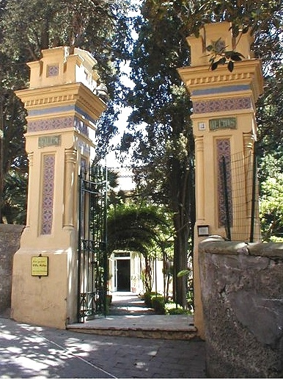
TeraGrid and InCommon: Goals
Next Step: Campus logins to TeraGrid Science Gateways
  Attribute-based access to community-focused interfaces
  Operated by the community
  Attributes used end-to-end from campus through gateway to TeraGrid resource providers and TeraGrid-wide accounting
Internet2 Fall 2008 Member Meeting

Slide 9
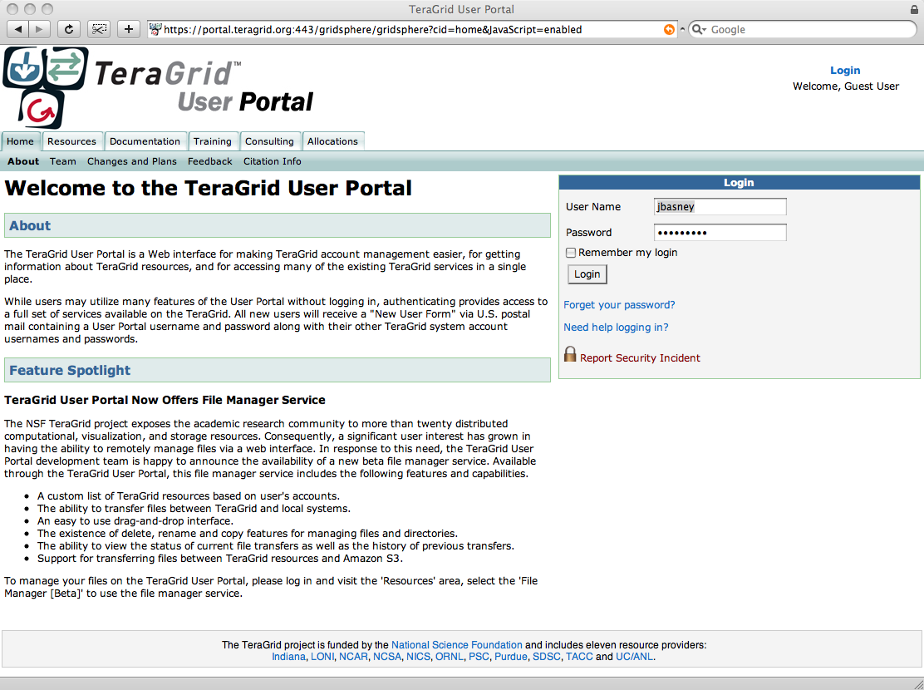
TeraGrid User Portal (TGUP)
Internet2 Fall 2008 Member Meeting
Notes:
About 70% of those who run TeraGrid jobs use the User Portal.
TGUP is developed and maintained by the Texas Advanced Computing Center (TACC), a TeraGrid partner.

Slide 10
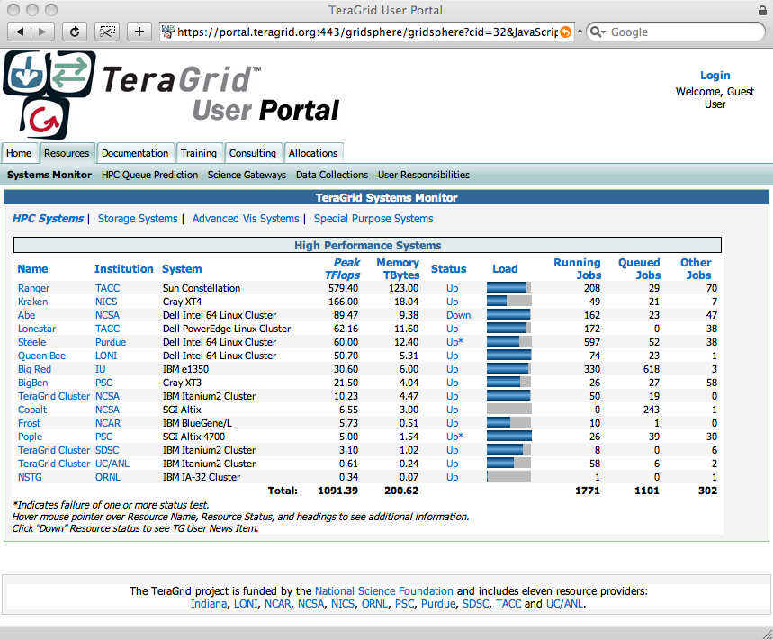
TGUP Systems Monitor
Internet2 Fall 2008 Member Meeting
Notes:
Most popular TG application. Doesn’t require login.

Slide 11
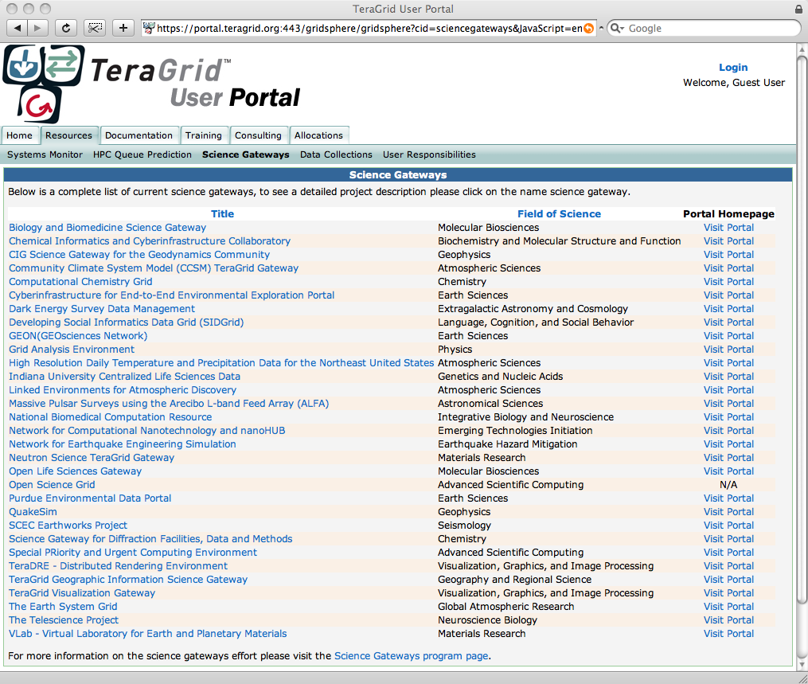
TGUP Science Gateways Listing
Internet2 Fall 2008 Member Meeting

Slide 12
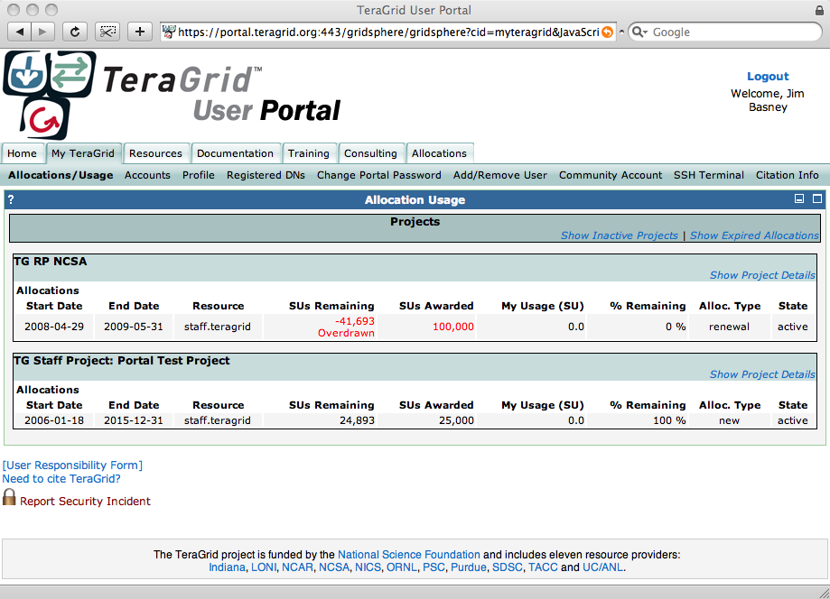
My TeraGrid: Usage
Internet2 Fall 2008 Member Meeting
Notes:
3rd most popular TGUP page.

Slide 13
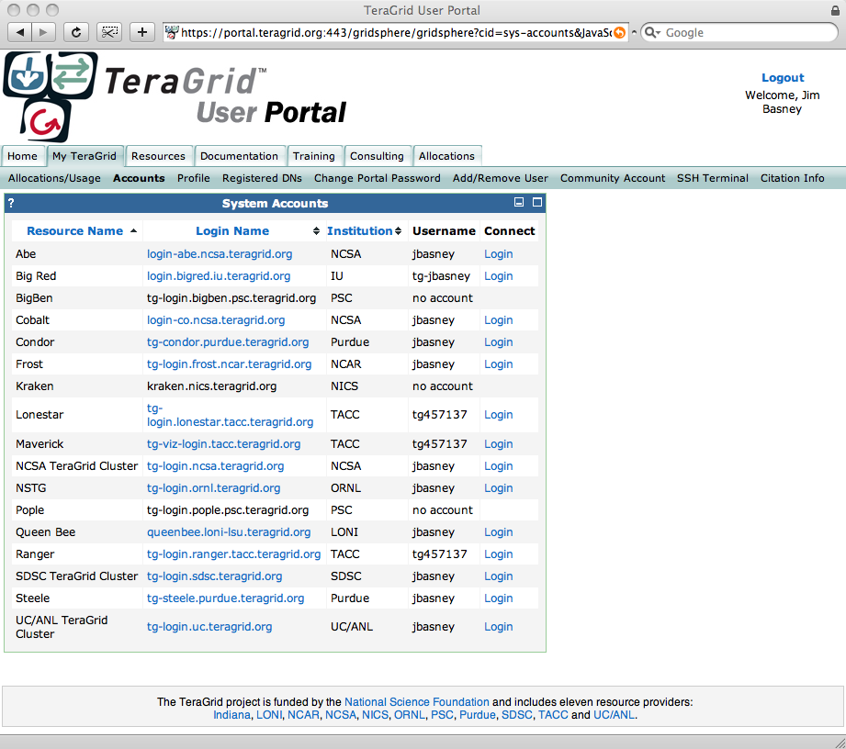
My TeraGrid: Accounts
Internet2 Fall 2008 Member Meeting

Slide 14
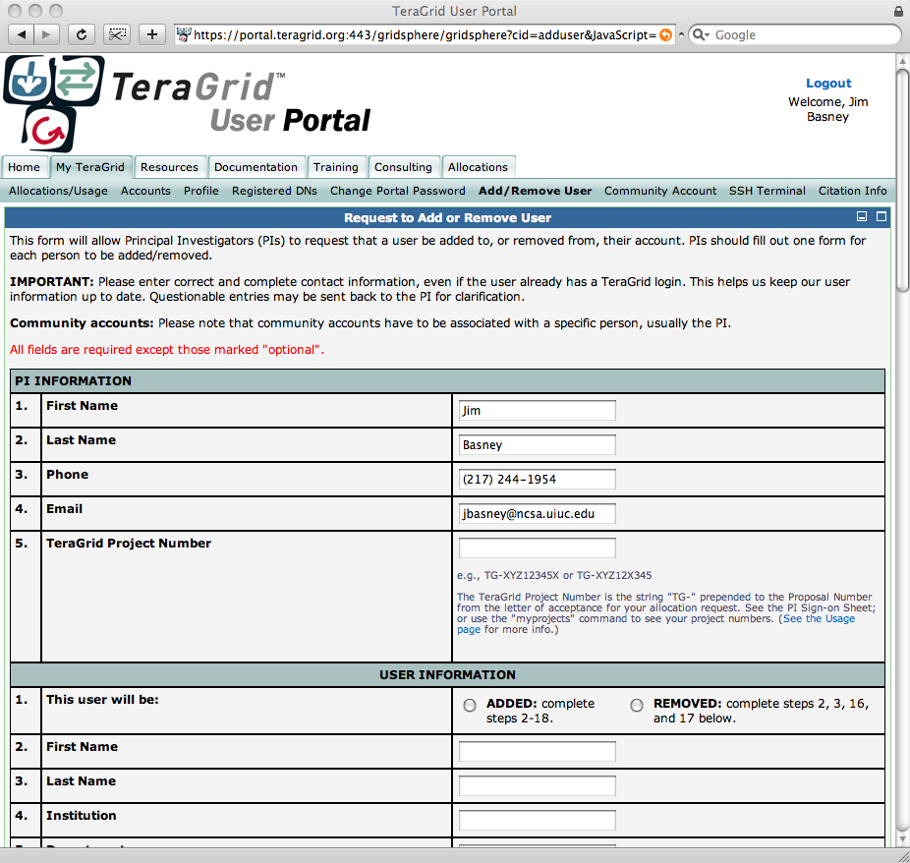
My TeraGrid: Add/Remove User
Internet2 Fall 2008 Member Meeting
Notes:
5th most popular page.

Slide 15
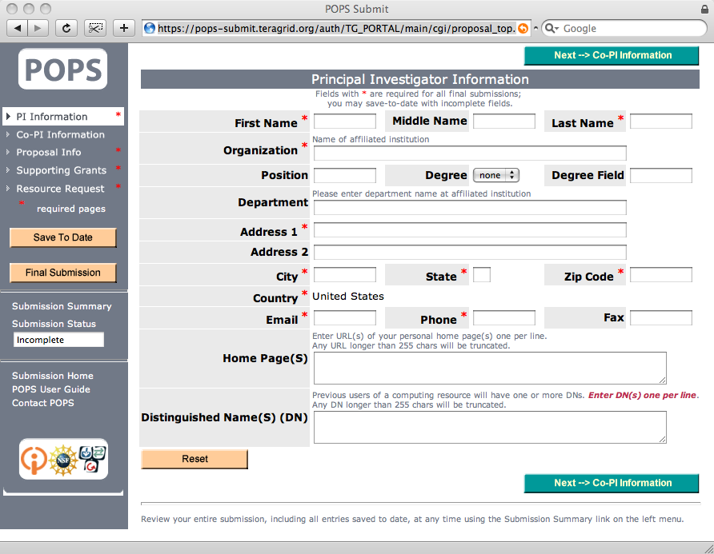
TG Proposal Submission
Internet2 Fall 2008 Member Meeting
Notes:
Could use InCommon attributes (legal name, contact info) to automatically populate this form.

Slide 16
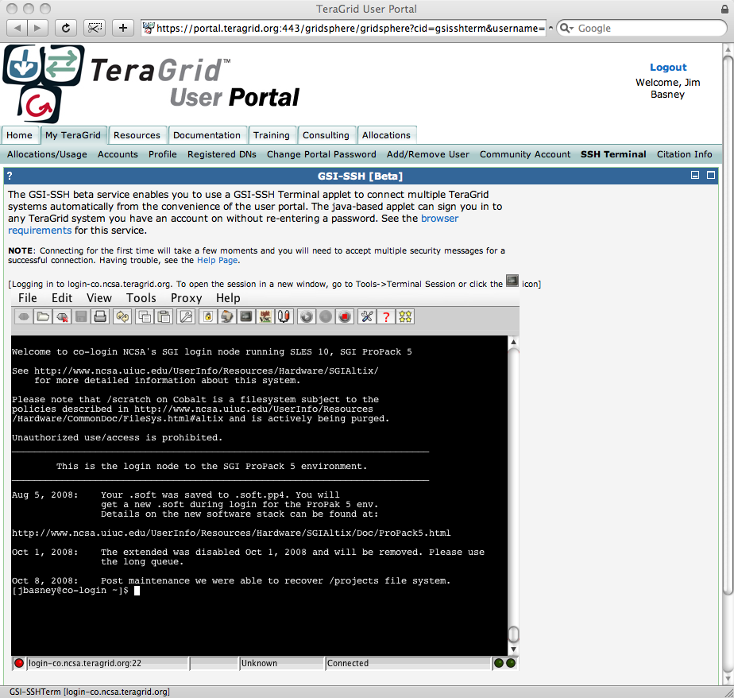
My TeraGrid: SSH Terminal
Internet2 Fall 2008 Member Meeting
Notes:
6th most popular TGUP application.

Slide 17
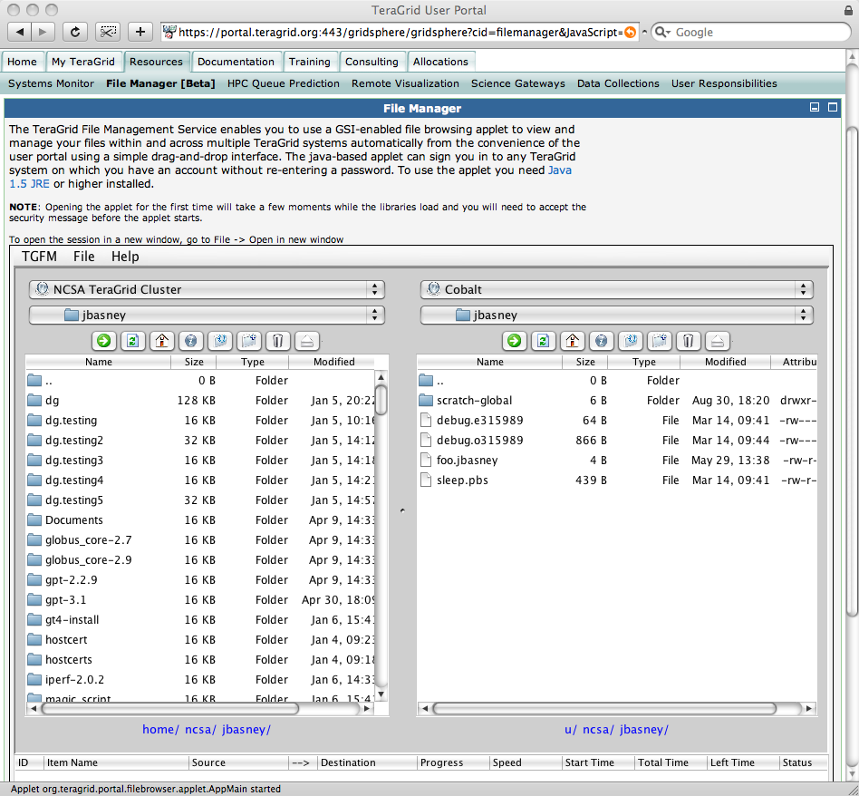
My TeraGrid: File Manager
Internet2 Fall 2008 Member Meeting

Slide 18
Approach: Account Linking
New User
  A new user authenticates to the TGUP via Shibboleth
  The user prepares and submits a proposal for TeraGrid resources
  If the proposal is approved, the user’s TeraGrid account is created with a link to his/her ePPN/ePTID
Result
  The user can access personalized TGUP functionality using campus Shibboleth authentication, without requiring a separate TGUP username and password
Internet2 Fall 2008 Member Meeting
Notes:
Proposal forms may be automatically populated with InCommon attributes (name, contact info).
eduPersonPerincipalName (ePPN)
An eduPerson attribute identifying a user using the form of "user@scope.”
eduPersonTargetedID (ePTID)
An eduPerson attribute which is a unique, non-reassignable identifier of the user which presents it.

Slide 19
Approach: Account Linking
Existing User
  An existing user authenticates to the TGUP via Shibboleth
  The TGUP prompts for the user’s TGUP username and password
  The user is given the option to link his/her ePPN/ePTID to his/her TeraGrid account
Result
  The user can access personalized TGUP functionality using campus Shibboleth authentication, without requiring a separate TGUP username and password
Internet2 Fall 2008 Member Meeting
Notes:
Will support linking multiple campus identifiers to a single TeraGrid account.
No campus identifier may be linked to multiple TeraGrid accounts.
Unlinking will also be supported.

Slide 20
Access to TeraGrid Resources
TeraGrid resources support PKI authentication
  Interfaces: GSISSH (remote login), GRAM (job submission), GridFTP (file transfer)
Approach:
  Automatically obtain PKI credentials based on Shibboleth authentication to TGUP
  Transparently use PKI credentials with TGUP SSH Terminal and File Manager
See
  GridShib CA: http://gridshib.globus.org/
  MyProxy CA: http://myproxy.ncsa.uiuc.edu/ca
Internet2 Fall 2008 Member Meeting

Slide 21
Summary
TeraGrid has joined InCommon
  To facilitate campus login to TeraGrid resources by researchers and students
First Step: Campus login to TeraGrid User Portal
Next Step: Campus login to Science Gateways
Thanks!
Contact: jbasney@ncsa.uiuc.edu
Internet2 Fall 2008 Member Meeting
Notes:
If you’re interested in being a beta tester, please contact me!

