Slide 1
Middleware for Production Grids
Jim Basney
Senior Research Scientist
Grid and Security Technologies
NCSA, University of Illinois
jbasney@ncsa.uiuc.edu

Slide 2
Basic Grid Services
Interactive login
Job submission and monitoring
File transfer
Resource information

Slide 3
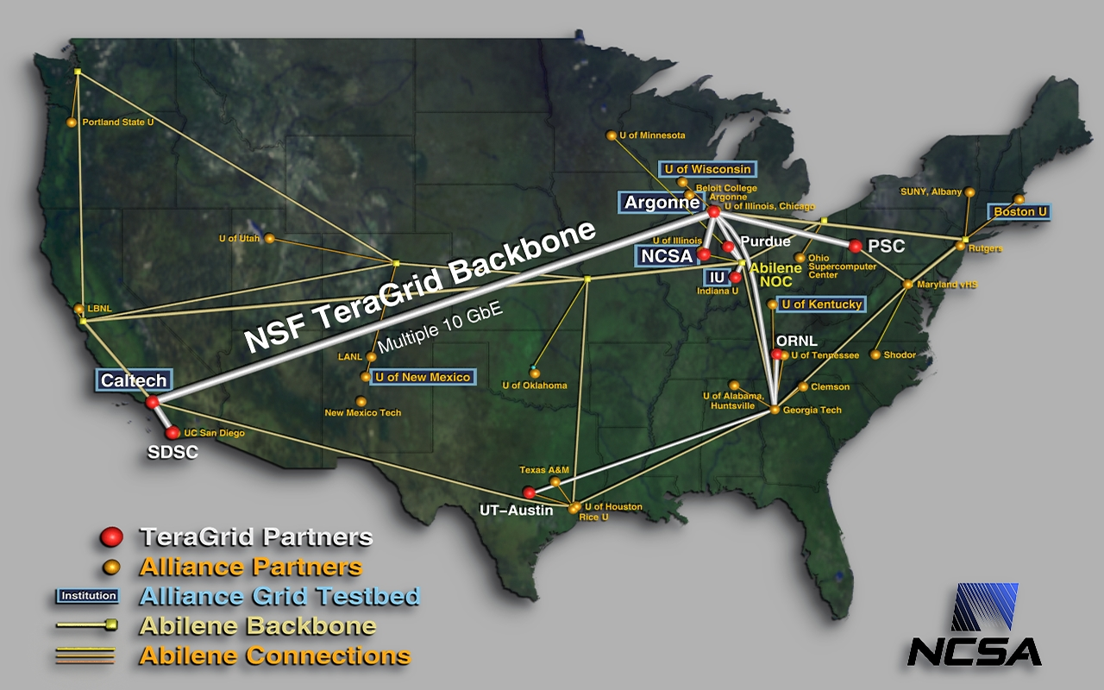
NCSA General-Purpose Grids
Notes:
NCSA Grid-building activities:
National Computational Science Alliance
Alliance Grid Testbed (formerly Grid-in-a-Box)
TeraGrid

Slide 4
A production grid is…
Usable
Dependable
Secure
Interoperable

Slide 5


NSF Middleware Initiative
Integrate, test, document, and support grid software
  Latest release includes
  Globus Toolkit, Condor-G, NWS, KX.509/KCA, GSISSH, MyProxy, MPICH-G2, GPT, Gridconfig, GridSolve, PyGlobus, UberFTP
8 site testbed evaluates releases
NMI also funds grid software development
http://www.nsf-middleware.org/
Notes:
NMI launched in late 2001.

Slide 6
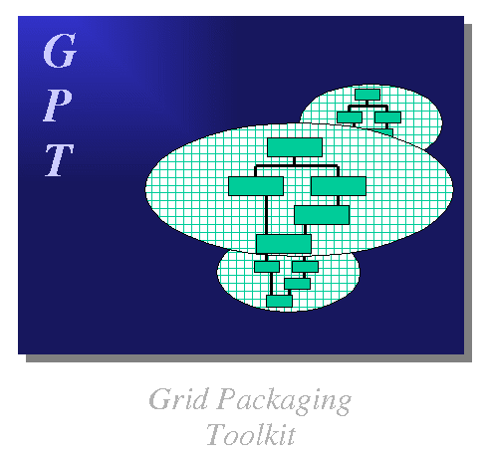
Grid Packaging Tools (GPT)
Portable package management
Toolkit approach
Source and binary packages
Dependency tracking
Package updates
Relocatable packages
http://www.gridpackagingtools.org/

Slide 7

GSI-enabled OpenSSH
GSI-authenticated login service with credential delegation
Packaged with GPT
Maintains compatibility with OpenSSH and Globus Toolkit
http://grid.ncsa.uiuc.edu/ssh/

Slide 8
Online Certificate Authorities
Globus Certificate Service
http://gcs.globus.org:8080/
Cacl
http://www.npaci.edu/CA/
KX.509/KCA
http://citi.umich.edu/projects/kerb_pki/

Slide 9
MyProxy Credential Repository
Secure credential storage
Improved usability
Flexible credential
management
http://myproxy.ncsa.uiuc.edu/

Slide 10
Account Management Information Exchange (AMIE)
Account management and usage reporting
Used in NCSA production grids
Development funded by NMI
Joint project with Boston University

Slide 11

GX-Map
A Globus grid-mapfile management tool
Allows users to add distinguished names to the grid-mapfile
  mapped only to that user’s account
Similar to adding SSH Authorized Keys
http://www.sdsc.edu/~kst/gx-map
“/C=US/O=NCSA/CN=Jim Basney” jbasney
“/C=US/O=NPACI/OU=SDSC/CN=Keith Thompson” kst
“/C=US/O=PSC/CN=dsimmel” dsimmel
“/DC=org/DC=doegrids/CN=Sandra Bittner " bittner
…
“/C=UK/O=eScience/CN=Joe User” juser

Slide 12
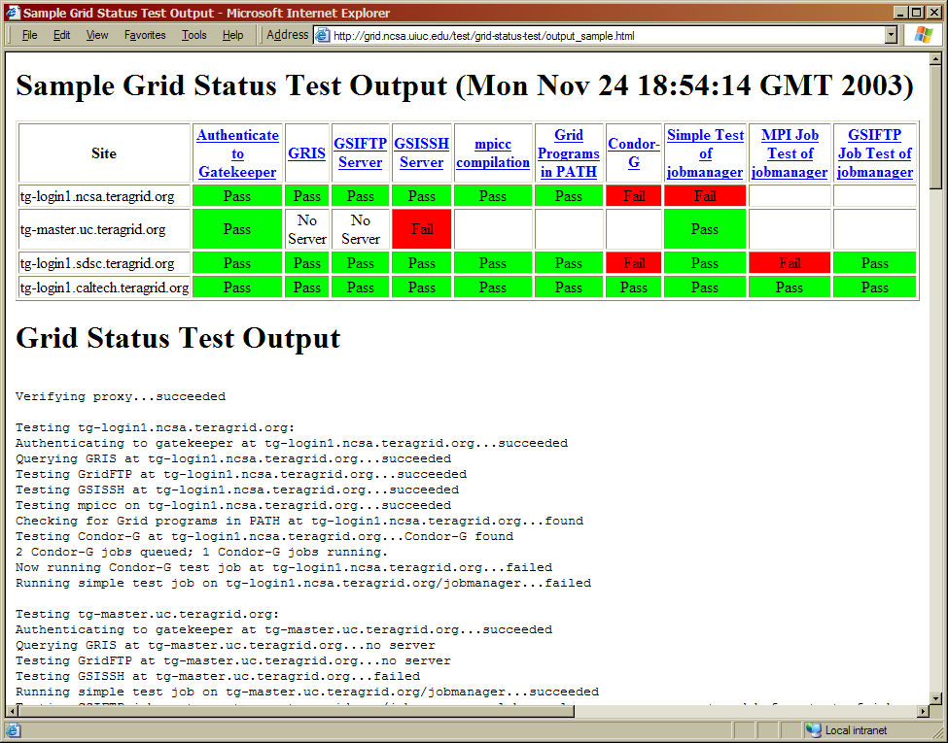
Grid Status Test
http://grid.ncsa.uiuc.edu/test/

Slide 13
Common Grid Problems
Service not running
Service misconfigured
Permission denied
Protocol incompatibility

Slide 14
Building a Grid
“A Grid is a system that coordinates resources that are not subject to centralized control using standard, open, general-purpose protocols and interfaces to deliver nontrivial qualities of service.” -- Ian Foster, GRIDToday, July 20, 2002.

