Slide 1
Deploying the TeraGrid PKI
Grid Forum Korea Winter Workshop
December 1, 2003
Jim Basney
Senior Research Scientist
National Center for Supercomputing Applications
University of Illinois
jbasney@ncsa.uiuc.edu

Slide 2
Grid-building Challenges
Many challenges in deploying Grids
  software compatibility
  resource discovery (information services)
  resource allocation
  accounting (charging for resource usage)
  performance optimization
  monitoring / support / helpdesk
  …

Slide 3
Managing Trust for Grid Single Sign-on
A major Grid deployment challenge
What CAs are trusted?
  Can a CA gain universal acceptance for single sign-on?
  What CA practices are acceptable?
  Use hierarchical CAs or cross-certification?
How do users obtain and manage credentials?
  user enrollment, certificate renewal, private key security, …
How are users authorized to use resources?
  How are ACLs and authorization services managed?
Consider the TeraGrid as a Case Study

Slide 4
Outline
TeraGrid Overview
Globus Security Infrastructure
  Authentication and Authorization
  Proxy Credentials
TeraGrid Online CAs
TeraGrid Single Sign-on
Grid-Mapfile Management
Credential Management

Slide 5
TeraGrid
Caltech: Data collection analysis
LEGEND
ANL: Visualization
0.4 TF IA-64
IA32 Datawulf
80 TB Storage
IA64
Sun
Cluster
Visualization
Cluster
IA32
Storage Server
Shared Memory
IA64
1.25 TF IA-64
96 Viz nodes
20 TB Storage
IA32
IA32
Disk Storage
Backplane Router
Extensible Backplane Network
LA
Hub
Chicago
Hub
30 Gb/s
40 Gb/s
30 Gb/s
30 Gb/s
30 Gb/s
30 Gb/s
4 TF IA-64
DB2, Oracle Servers
500 TB Disk Storage
6 PB Tape Storage
1.1 TF Power4
10 TF IA-64
128 large memory nodes
230 TB Disk Storage
3 PB Tape Storage
GPFS and data mining
6 TF EV68
71 TB Storage
0.3 TF EV7 shared-memory
150 TB Storage Server
EV7
Sun
IA64
EV68
IA64
Pwr4
Sun
SDSC: Data Intensive
NCSA: Compute Intensive
PSC: Compute Intensive
Notes:
20 TF computing power, almost 1PB online storage, 40 Gbps backbone network
Phase 1 coming online in January: 4 TF computing power, 800 Itanium processors running Linux, >0.25 PB online storage

Slide 6
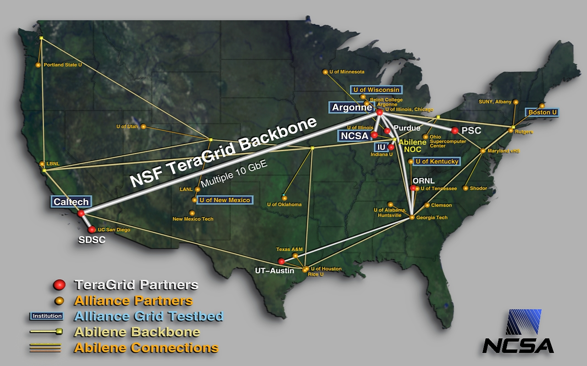
Additional TeraGrid Sites
Notes:
Another $10 million in NSF awards in September 2003 will add four additional sites to the partnership: Oak Ridge National Laboratory (ORNL), Oak Ridge, TN; Purdue University, West Lafayette, IN; Indiana University, Bloomington; and the Texas Advanced Computing Center (TACC) at The University of Texas at Austin.

Slide 7
Building Something New
One Organization
(merge institutions)
The TeraGrid
(A Grid hosting environment)
Very Loose Collaboration
(current situation)
One sysadmin team
One management team
Distributed machine room, centralized control
  e.g. Google data centers
Different MPIs
Hit-and-miss grid software:
  Globus version?
  Condor-G?
  MPICH-G2?
Unique development environment
Single development environment
Single software stack to learn
Develop here, run there
Run here, store there
Not a Grid
Applications are developed for the Grid because the barriers are low and the return large
Not a Grid, but with significant user investment, Grid applications can be developed

Slide 8
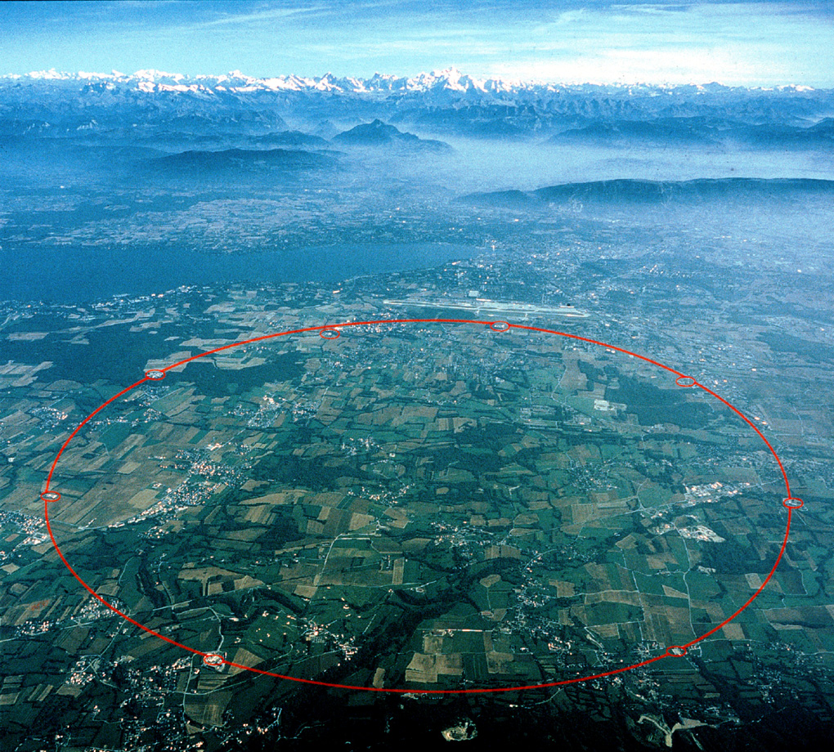
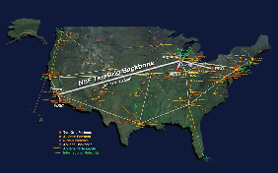
TeraGrid and CMS
Data and software testing challenge
  test and validate analysis software
    100,000,000 events
Testing approach
  particle-detector interaction simulator (CMSIM)
    energy deposition in the detector
  ORCA (Object Reconstruction for CMS Analysis)
    reconstruct QCD background sample
  tracks and reconstructed particles, ready for analysis
Computing, storage and networking
  1.1M SUs on the TeraGrid now
    400 processors through April 2005
  1M SUs on NCSA Platinum Pentium III cluster
  1.5M SUs on NCSA Tungsten Xeon cluster
  1 TB for production TeraGrid simulations
    400 GB for data collection on IA-32 cluster
http://cmsinfo.cern.ch/
Notes:
Compact Muon Solenoid, muon detection and measurement system for the Large Hadron Collider (LHC)
other detectors are ATLAS, LHCb, and ALICE
1 SU = 1 CPU hour

Slide 9



Globus Security Infrastructure
Credentials
  asymmetric public/private key pair
  X.509 certificate, signed by Certificate Authority, binds distinguished name to key pair
Authentication (Who are you?)
  proof of possession of private key
  verify CA signature on X.509 certificate
Authorization (What can you do?)
  based on distinguished name in certificate
  typically mapped to local account

Slide 10
GSI Mutual Authentication
Standard SSL/TLS Protocol
(summarized)
Client
Server
random_{c}
certificate_{s} + random_{s}
certificate_{c} + { secret }_{pubkeys}
+ signature_{c}[ h( random_{c}, random_{s}, … ) ]
{ h( secret ) }_{secret}

Slide 11
GSI Mutual Authorization
What is the client authorized to do on the server?
  typically set by grid-mapfile
Is the server trusted by the client?
  i.e., is the server authorized by the client?
  typically based on authenticated server identity matching the user’s request
Client must have the ability to verify server certificates
  must trust certificate of the CA that signed the server’s certificate
  must have correct system clock

Slide 12

How to Authorize Clients?
Access Control Lists
  ex. Globus grid-mapfile
  answer “Who can access this resource?”
  need to maintain many distributed ACLs
Capabilities
  ex. SAML, X.509 PMI, VOMS, Akenti, CAS
  answer “What can this person do?”
  don’t need to distribute ACL updates
  capability issuer maintains authorization database
GGF OGSA Authorization WG

Slide 13
What to Authorize?
 | Keys | Names
Examples: | SSH, PGP, SPKI | X.509 PKI, GSI
Trusted Third Party? | None | CA signs certificates
Cost of re-keying? | Update ACLs with new public key | Obtain new certificate
Names can be convenient to work with but…
Common names are not unique identifiers

Slide 14


Globus Proxy Credentials
New certificate and key pair
Proxy certificate signed by user’s long-term private key
  enter passphrase to decrypt private key
Certificate has short lifetime
Proxy private key remains unencrypted
Authenticate with proxy credentials for the remainder of the session
CA
signs
User
signs
Proxy

Slide 15
Proxy Delegation Protocol
CA
Delegator
Delegatee
signs
generate new key pair
Proxy
A
User
proxy certificate request
signs
sign certificate with proxy private key
Proxy
A
signs
Proxy
B
Proxy
B
Proxy
B

Slide 16
TeraGrid PKI
A single TeraGrid Certificate Authority is not feasible
  many sites already have a CA
  distributed model is preferable for Grids
TeraGrid PMA evaluates CA trust
  for interoperability, all TeraGrid sites should accept TeraGrid approved CAs
  TeraGrid PMA distributes trusted CA certificates to users and administrators

Slide 17
TeraGrid Online CAs
An Online CA allows users to authenticate and obtain PKI credentials immediately
  without requiring the user to visit a registration authority, fax a copy of an institutional ID, etc.
  without requiring the CA operator to manually approve each request
  leveraging the site’s existing relationship with its users
Online CAs can return long-term or short-term credentials:
  users contact the online CA infrequently to obtain / renew long-term (1+ year) certificates, or
  users contact the online CA daily to obtain short-term (12 hour) credentials
  TeraGrid includes examples of both types of online CAs

Slide 18

CACL
NCSA and SDSC have online CAs that return long-term credentials
  OpenSSL-based CACL online CA software developed at SDSC
  at NCSA, online CA recently replaced offline CA
Users login to NCSA or SDSC cluster and run a command to obtain 2-4 year credentials
  credentials stored in ~/.globus as usual
  requires users to manage their long-term key and certificate files
For more information:
  http://www.npaci.edu/CA/
  http://grid.ncsa.uiuc.edu/ca/

Slide 19

KCA
PSC runs a Kerberized online CA (KCA)
Users obtain short-term (12 hour) Kerberos tickets at login
KCA command allows users to authenticate with Kerberos ticket to obtain Globus credentials
  KCA credentials have short lifetime equal to Kerberos ticket lifetime
  stored unencrypted in /tmp to be used like Globus proxy credentials
No need to issue CRLs as there are no long-term certificates to revoke
For more information:
  http://www.citi.umich.edu/projects/kerb_pki/
  http://www.psc.edu/certificate-authority/

Slide 20

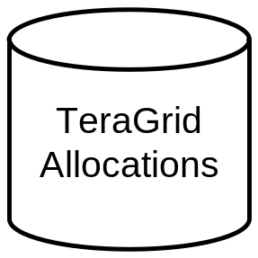
TeraGrid Account Creation
US National Science Foundation committees evaluate research proposals and allocate TeraGrid resources to scientists
Allocation info is entered into TeraGrid Accounting Database
Account creation requests sent to sites
  via TeraGrid Account Transaction System
Scientist receives account information in the mail
  includes username(s) and initial password(s) for the site(s)

Slide 21
TeraGrid Grid Single Sign-on
Users can access all TeraGrid resources using their Grid proxy credentials
  using GSISSH, GRAM, and GridFTP
  no need to remember different usernames and passwords
For users with no PKI certificate
  request a certificate from a TeraGrid CA
  TeraGrid Account Transaction System adds user’s distinguished name to grid-mapfiles (planned)
For users that already have a PKI certificate
  issuing CA must be trusted by TeraGrid sites
  gx-map command allows users to add additional distinguished names to grid-mapfiles

Slide 22

GX-Map
A Globus grid-mapfile management tool
Allows users to add distinguished names to the grid-mapfile
  mapped only to that user’s account
Similar to adding SSH Authorized Keys
For more information:
  http://www.sdsc.edu/~kst/gx-map
“/C=US/O=NCSA/CN=Jim Basney” jbasney
“/C=US/O=NPACI/OU=SDSC/CN=Keith Thompson” kst
“/C=US/O=PSC/CN=dsimmel” dsimmel
“/DC=org/DC=doegrids/CN=Sandra Bittner " bittner
…
“/C=UK/O=eScience/CN=Joe User” juser

Slide 23
Credential Management
TeraGrid users can store their credentials in an online MyProxy repository
  credentials encrypted with the user’s passphrase
  users can retrieve delegated proxy credentials from the online repository when/where needed
MyProxy provides credential mobility
  users need not manually copy certificate and key files between machines
  long-term keys protected on the MyProxy server
For more information:
  http://myproxy.ncsa.uiuc.edu/

Slide 24

Credential Renewal
Unsolved problem for TeraGrid
Long-lived tasks or services need credentials
  task lifetime is difficult to predict
Don’t want to delegate long-lived credentials
  fear of compromise
Instead, renew credentials as needed during the task’s lifetime
  renewal service provides a single point of monitoring and control
  renewal policy can be modified at any time
  for example, disable renewals if compromise is detected or suspected
Possible solutions using MyProxy
  EDG Proxy Renewal Service
  Condor-G with GRAM proxy refresh

Slide 25
Managing Multiple Credentials
Will a single identity credential per user suffice?
  Difficult to achieve trust in a single CA across many organizations
  Advanced services require authorization credentials
Pieces of a solution
  Credential negotiation protocols
  (WS-SecurityPolicy, …)
  Online credential services
Want to retain single sign-on and ease-of-use

Slide 26
Summary
TeraGrid has deployed a PKI for single sign-on via the Globus Security Infrastructure
  Online CAs (CACL, KCA)
  user control of grid-mapfile authorization (gx-map)
  online credential repository (MyProxy)
Ongoing work
  credential renewal
  managing multiple credentials
Thank you! Any questions?
Jim Basney <jbasney@ncsa.uiuc.edu>

