Slide 1
GSI Credential Management with MyProxy
GGF8 Production Grid Management RG Workshop
June 26, 2003
Jim Basney
jbasney@ncsa.uiuc.edu
http://myproxy.ncsa.uiuc.edu/

Slide 2
MyProxy
Online repository of encrypted GSI credentials
Provides authenticated retrieval of proxy credentials over the network
Improves usability
  Retrieve proxy credentials when/where needed without managing private key and certificate files
Improves security
  Long-term credentials stored encrypted on a well-secured server

Slide 3
MyProxy Software
Server and client tools available from http://myproxy.ncsa.uiuc.edu/
  GPT packages for Globus Toolkit 2.2 & 2.4
  Also included in NMI Release 3.0 at
  http://www.nsf-middleware.org/
Compatible client implementations also available in Commodity Grid Kits
  http://www.globus.org/cog/
Supported by Grid Portal toolkits
  Grid Portal Development Kit (GPDK): http://doesciencegrid.org/projects/GPDK/
  Grid Portal Toolkit (GridPort):
  https://gridport.npaci.edu/
  Xportlet:
  http://www.extreme.indiana.edu/xportlets/project/
OGSI development in progress

Slide 4
Grid Security Infrastructure
Credentials
  Asymmetric public/private key pair
  X.509 certificate, signed by Certificate Authority, binds identity to key pair
Authentication (Who are you?)
  Proof of possession of private key
  Verify CA signature on X.509 certificate
Authorization (What can you do?)
  Based on certificate identity
  Can be mapped to local Unix account

Slide 5
Credential Management
Enrollment: Initially obtaining credentials
Security: Protecting credentials (private keys)
Accessibility: Getting credentials when needed
Renewal: Handling credential expiration
Translation: Using existing credentials to obtain credentials for a new mechanism or realm
Delegation: Granting specific rights to others
Control: Monitoring and auditing credential use
Revocation: Handling credential compromise

Slide 6
Issuing Credentials via MyProxy
Generate credentials on user’s behalf and load into MyProxy repository
Distribute MyProxy usernames and passphrases
  Can use existing site usernames/passphrases
Private key never leaves MyProxy repository
  Proxy credentials delegated with configured max. lifetime
Revoke credentials by removing from repository
Provides a single point for focusing credential protection and usage monitoring
  Enforce password policies
Manage credentials on the user’s behalf
  Renew credentials before they expire
  Reset forgotten credential passphrase

Slide 7
Integrating MyProxy with CA
Using Globus SimpleCA
  myproxy-admin-adduser generates SimpleCA credentials and loads them into repository
Using existing CA
  Create credentials as usual
  Load with myproxy-admin-load-credential
MyProxy need not be the only method of credential issuance
  Can continue to issue credentials directly to experts to manage themselves

Slide 8


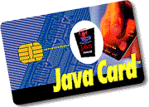
Alternatives: Smart Cards
An excellent solution but costly
  User-managed, portable credential storage
  Security analogous to car keys or credit cards
    Must be re-issued when lost or stolen
  Private keys stay in hardware
  Cards can be distributed with credentials pre-loaded
  Card standards are mature
  Costs are decreasing but still significant
    $20 readers, $2 cards
    Government ID card deployments
  Some support already in GSI libraries
MyProxy provides a “virtual smart card”
  When smart card support is not ubiquitous or is too expensive

Slide 9
Alternative: Online CAs
A good solution with low administrative costs
  User authenticates to online CA to obtain credentials immediately
    No manual administrative approval required
  Leverages existing authentication mechanisms (password, Kerberos, etc.)
  Signs long-term or short-term credentials:
    If long-term, then credentials are user-managed
    If short-term, credentials retrieved on demand, without need for user key management
  Examples: KCA and CACL
MyProxy can be more flexible
  Managing credentials from multiple CAs
  In the future, managing multiple types of credentials

Slide 10
Credential Accessibility with MyProxy
A MyProxy server can be deployed for a single user, a virtual organization, or a CA
Users can delegate proxy credentials to the MyProxy server for storage
  Can store multiple credentials with different names, lifetimes, and access policies
Then, they can retrieve stored proxies when needed using MyProxy client tools
  And allow trusted services to retrieve proxies
No need to copy certificate and key files between machines

Slide 11
Delegation to Grid Portals
Provide a web interface to Grid services
Require credentials to act on user’s behalf
Use MyProxy to delegate credentials to portal

Slide 12
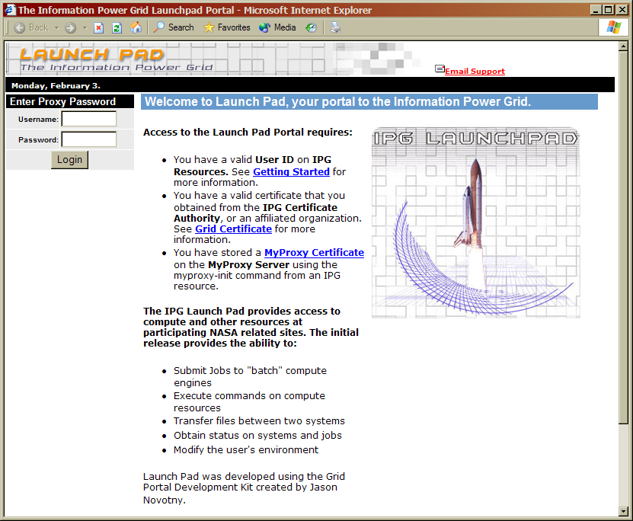
Delegation to Grid Portals
Load Credentials
Set Policies
Workstation
Username
Password
Username
Password
Proxy
Credential
Grid Portal
MyProxy
Server

Slide 13
Credential Renewal
Long-lived tasks or services need credentials
  Task lifetime is difficult to predict
Don’t want to delegate long-lived credentials
  Fear of compromise
Instead, renew credentials with MyProxy as needed during the task’s lifetime
  Provides a single point of monitoring and control
  Renewal policy can be modified at any time
    For example, disable renewals if compromise is detected or suspected
Integration with Condor-G in progress

Slide 14

Credential Renewal
Home
Remote
Submit
Jobs
Job
Broker
Launch Job
Resource
Manager
Refresh Credentials
Retrieve
Credentials
Refresh
Credentials
Enable
Renewal
MyProxy
Job

Slide 15
MyProxy
Provides a solution today for many GSI credential management issues
  Enrollment
  Private key security
  Accessibility
  Renewal
  Passphrase-based delegation
  Revocation and passphrase reset
Work in progress
  MyProxy OGSA Service
  MyProxy Auditing
  Credential Wallet for the Grid

Slide 16
MyProxy OGSA Service
Credential manager factory
Credential manager object leverages OGSI services
  Query credential info via service data query
  Remove credentials by destroying service instance
  Monitor credential access via service notifications
  Control credential access via standard service access control mechanisms
Goal: A lightweight credential management service that can be easily instantiated when needed
Good user interface is essential

Slide 17
MyProxy Auditing
Develop standard OGSA audit service to which the MyProxy server logs activity
Provide a secure query and notification interface
  Credential owners can monitor use of their credentials and detect unauthorized use
  Administrators can detect and investigate credential misuse

Slide 18
Credential Wallet for the Grid
Provides an interface to my credentials
  Multiple X.509 ID certificates, authorization credentials, CA certificates with CRLs
  Supports multiple authentication mechanisms
  Easily add, remove, modify credentials
  Control credential access policies
  Create authorization credentials for delegation
  Receive event notifications
Single sign-on unlocks wallet
  Grid protocols negotiate for required credentials
  Automatically retrieve needed credentials from wallet

Slide 19
Acknowledgements
MyProxy Team (2002-2003)
  NCSA: Shiva Shankar Chetan, Feng Qin, Zhenmin Li, Asita Anche, Vivek Sundaram, Praveen Appu
  UVA: Marty Humphrey, Shaun Arnold, Dhiraj Parashar
  Other authors/contributors: Jarek Gawor, Daniel Kouril, Jason Novotny, Miroslav Ruda, Benjamin Temko, Von Welch
Financial Support

