Slide 1
NCSA-IPG Collaboration Projects Overview
NASA IPG Workshop
February 6, 2003
Jim Basney
jbasney@ncsa.uiuc.edu
http://www.ncsa.uiuc.edu/~jbasney/

Slide 2
FY02 Deliverables
Grid Testbed
  Support for Grid computing between IPG and NCSA resources
    SGI Origin 2000 and Intel Linux clusters
Grid Infrastructure Support and Development
  GSI-enabled OpenSSH
  MyProxy Online Credential Repository

Slide 3
Grid Testbed Results
Support for Grand Challenge milestone
  Expedited NCSA account requests with grid-mapfile entries
  Resolved problems encountered with Grid services at NCSA
  Resolved compatibility issues
    GRAM, GSISSH, GridFTP, MDS
  Grid Information Services provided
    NCSA resources reporting to IPG GIIS

Slide 4

GSI-enabled OpenSSH Overview
Secure single sign-on for remote login (ssh) and file transfer (scp/sftp)
  Adds GSI authentication and delegation to standard OpenSSH software
  Co-exists with other SSH authentication mechanisms (password, host-based, ...)

Slide 5
GSISSH FY02 Results
NCSA supported since January 2002
Packaged with Grid Packaging Tools (GPT)
  Support for Globus Toolkit 2.0 & 2.2
Tracked OpenSSH releases
  3.0.2p1, 3.1p1, 3.2.3p1, 3.3p1, 3.4p1, 3.5p1
  Support for privilege separation added
Added GSI authentication over SSH1 protocol for backward-compatibility
Added implicit subject to login name mapping using grid-mapfile
  Don’t need to remember different usernames at different sites

Slide 6
MyProxy Overview
Online repository for Grid credentials
  Credentials encrypted with user’s passphrase
Allows Grid portals to retrieve credentials to act on your behalf
  Used by
Allows you to retrieve credentials when and where you need them
Allows trusted services to renew your credentials when needed

Slide 7
MyProxy FY02 Results
Packaged with Grid Packaging Tools (GPT)
  Support for Globus Toolkit 2.0 & 2.2
Added support for
  Users retrieving credentials directly
  Storing multiple credentials per user
  Per-credential access policies
  Encrypting credentials in the repository
  Credential renewal
Ongoing work
  Integration with Condor-G for credential renewal
  Single sign-on to Grid portals
  Support for storing long-term credentials with optional CA integration (myproxy-adduser)

Slide 8
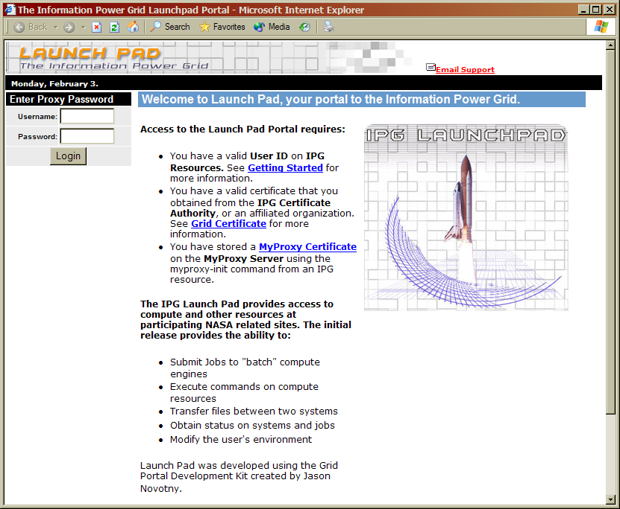
Using MyProxy with Grid Portals
MyProxy
Server
Grid Portal
Username
Password
Username
Password
Proxy
Credential
Drawbacks:
  Sends password to portal
  Separate sign-on to each Grid portal

Slide 9
Secure Portal Sign-on with MyProxy
MyProxy
Server
Visit portal
Redirect to MyProxy
MyProxy password-based login
Store MyProxy session cookie & redirect to portal with portal cookie
Portal authenticates with cookie
Portal retrieves credential
Grid Portal
5
6
4
2
3
4
1
User
Workstation

Slide 10
Web Single Sign-on with MyProxy
MyProxy
Server
Grid Portal
Visit another portal
Redirect to MyProxy
MyProxy login with session cookie
Redirect to portal with portal cookie
Portal authenticates with cookie
Portal retrieves credential
5
6
4
2
3
4
1
User
Workstation

Slide 11
Credential Renewal
Long-lived jobs need credentials
  Job lifetime is difficult to predict
Don’t want to delegate long-lived credentials
  Fear of compromise
Instead, renew credentials as needed during the job’s lifetime
  Renewal service provides a single point of monitoring and control
  Renewal policy can be modified at any time
  For example, disable renewals if compromise is detected or suspected

Slide 12

Credential Renewal
Home
Remote
Submit
Jobs
Job
Broker
Launch Job
Resource
Manager
Refresh Credentials
Retrieve
Credentials
Refresh
Credentials
MyProxy
Server
Enable
Renewal
Job

Slide 13
Enterprise Credential Repository
Credentials generated and stored in online repository at account creation time
  Users retrieve short-term credentials when needed
  Optionally allow experts to retrieve long-term credentials
Long-term credentials stored securely in repository
  Revoke credentials by removing from repository
  Long-term credentials can be automatically renewed
  Site-wide password policies can be enforced
  Monitor repository to detect credential compromise
Unlike online CA, separates credential creation and management for more flexibility

Slide 14
Managing Many Grid Credentials
Identity credentials
  Different mechanisms (X.509, Kerberos, .NET)
  Different authorities (CAs, KDCs)
  Different purposes (authentication, signing, encryption)
  Different roles (project-based, security levels)
Authorization credentials
  X.509 attribute certificates
  SAML/XACML/XrML assertions
Trusted credentials
  CA certificates and policies
  Other certificates and public keys (SSH, PGP)

Slide 15
Credential Wallet
User interface to credential management
  Add, remove, or modify credentials
  Associate policies with credentials
  Create authorization credentials
  Receive notification of events
One-stop credential access point
  Single sign-on unlocks credentials for a session
  Retrieve short-term credentials into web browser
  Contains pointers to available credential services
Manage credentials on my behalf
  Example: credential renewal

