Slide 1
MyProxy NMI Integration
Jim Basney, NCSA
Marty Humphrey, University of Virginia
http://myproxy.ncsa.uiuc.edu/

Slide 2
MyProxy is an online repository for grid credentials.
Secure credential storage
Convenient credential access
Flexible credential management

Slide 3





Examples of MyProxy in use:

Slide 4
Credential mobility:
Obtain certificate
tg-login.ncsa.teragrid.org
ca.ncsa.uiuc.edu
Store proxy
myproxy.teragrid.org
tg-login.caltech.teragrid.org
Retrieve proxy
tg-login.sdsc.teragrid.org
tg-login.uc.teragrid.org

Slide 5
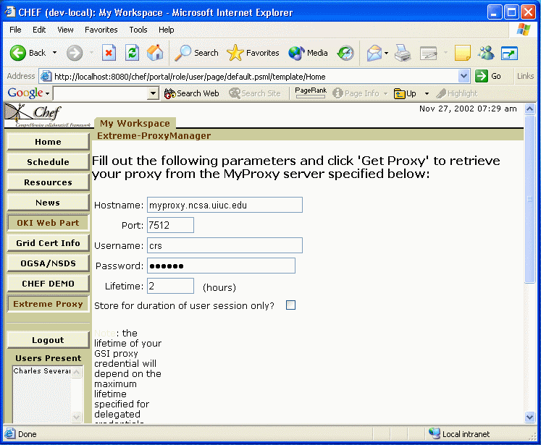
Grid portals:
MyProxy server
CHEF portal
Login
Fetch proxy
GridFTP server
Access data

Slide 6
Proxy renewal:
Workload management system
Globus
gatekeeper
Submit job
Submit job
Refresh proxy
MyProxy server
Fetch proxy

Slide 7
Long-term credential storage:
Request account
Accounting system
Obtain user’s
certificate
Certificate authority
Username, password
Load user’s
credentials
Retrieve proxy
MyProxy server
Change password

Slide 8
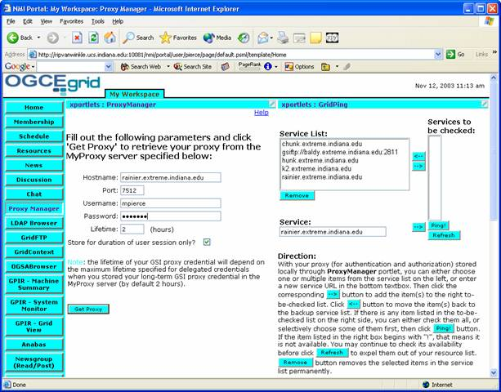
NMI integration:
MyProxy included in NMI R3 & R4
Packaged with GPT
Uses Globus Toolkit security libraries
Used by NMI components:
  OGCE NMI portal
  Condor-G
www.ogce.org

Slide 9


MyProxy OGSI implementation:
Initial release this month for GT 3.0
Designed to leverage OGSI functionality
CredentialManagerFactory
CredentialManager Instance
CredentialManager Instance

Slide 10
Hardware-secured MyProxy:
MyProxy Server
Proxy request
IBM 4758
Retrieve proxy
Proxy certificate
M. Lorch, J. Basney, and D. Kafura, "A Hardware-secured Credential Repository for Grid PKIs," 4th IEEE/ACM International Symposium on Cluster Computing and the Grid, April 2004.

Slide 11
Ongoing work:
Continued OGSA development
Credential access control (XACML, SAML)
Credential exchange protocols (WS-Trust)
Audit logging, monitoring, and
event notification
Additional authentication methods (Kerberos, PAM, OTP, SRP)
Managing multiple credentials

Slide 12
Acknowledgements:
Shiva Chetan
Sumin Song
Feng Qin
Xiao Tu
Shaun Arnold
Jun Wang
Greg Mattes
Glenn Wasson
Jarek Gawor
Daniel Kouril
Jason Novotny
Miroslav Ruda
Benjamin Temko
Von Welch
Markus Lorch
Charles Severance
Supported by NSF Middleware Initiative

