Slide 1
TeraGrid Science Gateways:
Scaling TeraGrid Access
Aaron Shelmire¹, Jim Basney², Jim Marsteller¹, Von Welch², Tom Scavo², Terry Fleury², and
Nancy Wilkins-Diehr³
¹Pittsburgh Supercomputing Center,
²National Center for Supercomputing Applications,
and ³San Diego Supercomputer Center
http://www.teragrid.org/programs/sci_gateways/

Slide 2
Outline
TeraGrid Science Gateways
Provide a community interface to the TeraGrid
Community Shell
Provides control over actions in community accounts
Community User Attributes
Provide information for accounting and incident response
http://www.teragrid.org/programs/sci_gateways/

Slide 3
TeraGrid Science Gateways
http://www.teragrid.org/programs/sci_gateways/

Slide 4
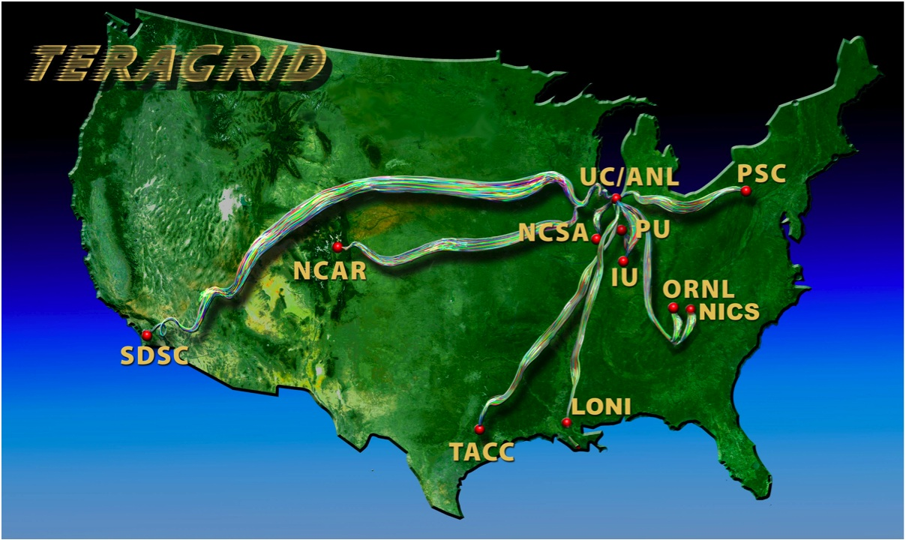
TeraGrid
NSF-funded facility to offer high end compute, data and visualization resources to the nation’s academic researchers
http://www.teragrid.org/programs/sci_gateways/

Slide 5
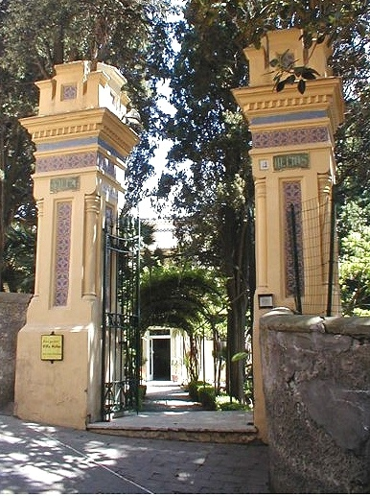
TeraGrid Science Gateways
Enable communities with a common scientific goal to use national resources through a common interface
Enable TeraGrid to scale to larger numbers of users than its current accounting mechanisms can handle
http://www.teragrid.org/programs/sci_gateways/

Slide 6
Typical Science Gateway
A science gateway is a convenient intermediary between a browser user and a grid resource provider.
Web Browser
Web
Authn
Web Interface
Java WS Container
Webapp
WS GRAM Client
WS GRAM Service
community credential
community account
Key
Science Gateway
Resource Provider
http://www.teragrid.org/programs/sci_gateways/

Slide 7
Typical Science Gateway
Each gateway is issued a community credential that uniquely identifies the gateway.
Web Browser
Web
Authn
Web Interface
Java WS Container
Webapp
WS GRAM Client
WS GRAM Service
community credential
community account
Key
Science Gateway
Resource Provider
http://www.teragrid.org/programs/sci_gateways/

Slide 8
Typical Science Gateway
Resource providers associate the community credential with a local community account.
Web Browser
Web
Authn
Web Interface
Java WS Container
Webapp
WS GRAM Client
WS GRAM Service
community credential
community account
Key
Science Gateway
Resource Provider
http://www.teragrid.org/programs/sci_gateways/

Slide 9
Typical Science Gateway
To submit a job, a browser user typically authenticates to the gateway by presenting a username and password.
Web Browser
Web
Authn
Web Interface
Java WS Container
Webapp
WS GRAM Client
WS GRAM Service
community credential
community account
Key
Science Gateway
Resource Provider
http://www.teragrid.org/programs/sci_gateways/

Slide 10
Typical Science Gateway
The gateway then issues a short-lived proxy credential signed by its community credential.
Web Browser
Web
Authn
Web Interface
Java WS Container
Webapp
WS GRAM Client
WS GRAM Service
community credential
proxy credential
community account
Key
Key
Science Gateway
Resource Provider
http://www.teragrid.org/programs/sci_gateways/

Slide 11
Typical Science Gateway
The gateway submits the job on the user’s behalf, authenticating as itself to the resource.
Web Browser
Web
Authn
Web Interface
Java WS Container
Webapp
WS GRAM Client
WS GRAM Service
proxy certificate
community credential
proxy credential
community account
Key
Key
Science Gateway
Resource Provider
http://www.teragrid.org/programs/sci_gateways/

Slide 12
Typical Science Gateway
The resource authenticates the gateway and maps the request to the community account based on the identity in the proxy certificate.
Web Browser
Web
Authn
Web Interface
Java WS Container
Webapp
WS GRAM Client
WS GRAM Service
proxy certificate
community credential
proxy credential
community account
Key
Key
Science Gateway
Resource Provider
http://www.teragrid.org/programs/sci_gateways/

Slide 13
Typical Science Gateway
After the job is executed, the result is returned to the browser user via the gateway web interface.
Web Browser
Web
Authn
Web Interface
Java WS Container
Webapp
WS GRAM Client
WS GRAM Service
proxy certificate
community credential
proxy credential
community account
Key
Key
Science Gateway
Resource Provider
http://www.teragrid.org/programs/sci_gateways/

Slide 14
Community Shell
http://www.teragrid.org/programs/sci_gateways/

Slide 15
Community Shell: Motivation
Many TeraGrid Science Gateways use community accounts, a form of shared account
Shared accounts are a potential weak point in resource security
  Increased risk of attack
  Greater degree of anonymity
Science Gateways typically use community accounts in predictable ways
  Small set of applications
http://www.teragrid.org/programs/sci_gateways/

Slide 16
Community Shell: Implementation
Community Shell software is configured as the system shell and enabled in Globus GRAM
System administrator sets community shell policy
  Can allow applications from a trusted directory
  Can limit to specific commands (regular expression)
Gateway developer provides applications that run in the community account
http://www.teragrid.org/programs/sci_gateways/

Slide 17
Community Shell Configuration at PSC
Community Account uses “scratch” space for input/output
$HOME/.commshrc determines access
Community Account no longer owns the home directory, but can write to it
Job Scripts are in home directory, but are owned by the group developers, only readable and executable by gateway account.
http://www.teragrid.org/programs/sci_gateways/

Slide 18

Science Gateway Process
Science Gateway Development team creates application and tests it in the “normal” environment
Resource Provider’s Infrastructure
Gateway Application
WS GRAM Service
Gateway Application
Scratch File Space
Science Gateway
Developers Account
Science Gateway
Community Account
http://www.teragrid.org/programs/sci_gateways/

Slide 19
Science Gateway Process
The application is placed into the Community Shell Restricted Account
Resource Provider’s Infrastructure
Gateway Application
WS GRAM Service
Gateway Application
Scratch File Space
Science Gateway
Developers Account
Science Gateway
Community Account
http://www.teragrid.org/programs/sci_gateways/

Slide 20
Science Gatways at PSC
Nanohub - Lemieux and BigBen
GridChem - Pople
http://www.teragrid.org/programs/sci_gateways/

Slide 21
Community User Attributes
http://www.teragrid.org/programs/sci_gateways/

Slide 22
Science Gateway
So what’s wrong with this science gateway scenario
?
Web Browser
Web
Authn
Web Interface
Java WS Container
Webapp
WS GRAM Client
WS GRAM Service
proxy certificate
community credential
proxy credential
community account
Key
Key
Science Gateway
Resource Provider
http://www.teragrid.org/programs/sci_gateways/

Slide 23
Science Gateway
jsmith
mjones
All requests look exactly the same to the resource provider
!
Web Browser
Web
Authn
Web Interface
Java WS Container
commacct
Webapp
WS GRAM Client
WS GRAM Service
proxy certificate
community credential
proxy credential
community account
Key
Key
Science Gateway
Resource Provider
http://www.teragrid.org/programs/sci_gateways/

Slide 24
Resource Providers need
gateway user information
for accounting and
incident response.
http://www.teragrid.org/programs/sci_gateways/

Slide 25
Grid Authorization Model for Gateways
An enhancement to the community account model increases the information flow between the gateway and the resource provider.
Web Browser
Web
Authn
Web Interface
Java WS Container
(with GridShib for GT)
attributes
Webapp
WS GRAM Client
GridShib
for GT
WS GRAM Service
username
community credential
GridShib SAML Tools
Key
Science Gateway
Resource Provider
http://www.teragrid.org/programs/sci_gateways/

Slide 26
Grid Authorization Model for Gateways
Two new GridShib software components produce and consume Security Assertion Markup Language (SAML) tokens.
Web Browser
Web
Authn
Web Interface
Java WS Container
(with GridShib for GT)
attributes
Webapp
WS GRAM Client
GridShib
for GT
WS GRAM Service
username
GridShib SAML Tools
community credential
Key
Science Gateway
Resource Provider
http://www.teragrid.org/programs/sci_gateways/

Slide 27
Grid Authorization Model for Gateways
Again the browser user authenticates to the gateway by presenting a username and password.
Web Browser
Web
Authn
Web Interface
Java WS Container
(with GridShib for GT)
attributes
Webapp
WS GRAM Client
GridShib
for GT
WS GRAM Service
username
GridShib SAML Tools
community credential
Key
Science Gateway
Resource Provider
http://www.teragrid.org/programs/sci_gateways/

Slide 28
Grid Authorization Model for Gateways
This time the gateway uses the GridShib SAML Tools to issue an X.509-bound SAML token.
Web Browser
Web
Authn
Web Interface
Java WS Container
(with GridShib for GT)
attributes
Webapp
WS GRAM Client
GridShib
for GT
WS GRAM Service
username
GridShib SAML Tools
proxy credential
SAML
Key
community credential
Key
Science Gateway
Resource Provider
http://www.teragrid.org/programs/sci_gateways/

Slide 29
Grid Authorization Model for Gateways
The SAML token bound to the proxy certificate contains the name of the end user and other user attributes (e.g., e-mail).
Web Browser
Web
Authn
Web Interface
Java WS Container
(with GridShib for GT)
attributes
Webapp
WS GRAM Client
GridShib
for GT
WS GRAM Service
username
X.509 Proxy Credential
Issuer: Science Gateway
Subject: Science Gateway+
X509v3 extension:
1.3.6.1.4.1.3536.1.1.1.12:
GridShib SAML Tools
proxy credential
SAML
Key
community credential
Key
<saml:Assertion>
<saml:NameID>
trscavo
</saml:NameID>
</saml:Assertion>
Science Gateway
Resource Provider
Key
http://www.teragrid.org/programs/sci_gateways/

Slide 30
Grid Authorization Model for Gateways
The gateway authenticates as itself to the resource provider, presenting the proxy certificate with bound SAML token.
Web Browser
Web
Authn
Web Interface
Java WS Container
(with GridShib for GT)
attributes
Webapp
WS GRAM Client
GridShib
for GT
WS GRAM Service
proxy certificate
SAML
username
GridShib SAML Tools
proxy credential
SAML
Key
community credential
Key
Science Gateway
Resource Provider
http://www.teragrid.org/programs/sci_gateways/

Slide 31
Grid Authorization Model for Gateways
GridShib for GT extracts the SAML token from the proxy certificate and writes the information to a log file.
Web Browser
Web
Authn
Web Interface
Java WS Container
(with GridShib for GT)
attributes
Webapp
WS GRAM Client
GridShib
for GT
WS GRAM Service
proxy certificate
SAML
username
GridShib SAML Tools
proxy credential
Security Context
SAML
Key
community credential
Logs
Key
Science Gateway
Resource Provider
http://www.teragrid.org/programs/sci_gateways/

Slide 32
Grid Authorization Model for Gateways
GridShib for GT compares the information in the security context to the blacklist, denying access if any request info is on the blacklist.
Web Browser
Web
Authn
Web Interface
Java WS Container
(with GridShib for GT)
attributes
Webapp
WS GRAM Client
GridShib
for GT
WS GRAM Service
proxy certificate
SAML
username
GridShib SAML Tools
proxy credential
Security Context
SAML
Key
community credential
Logs
Blacklist
Policy
Key
Science Gateway
Resource Provider
http://www.teragrid.org/programs/sci_gateways/

Slide 33
Grid Authorization Model for Gateways
As before, after the service executes the job, the result is returned to the browser user via the gateway web interface.
Web Browser
Web
Authn
Web Interface
Java WS Container
(with GridShib for GT)
attributes
Webapp
WS GRAM Client
GridShib
for GT
WS GRAM Service
proxy certificate
SAML
username
GridShib SAML Tools
proxy credential
Security Context
SAML
Key
community credential
Logs
Blacklist
Policy
Key
Science Gateway
Resource Provider
http://www.teragrid.org/programs/sci_gateways/

Slide 34
Integration with TeraGrid Central Database
Resource Provider
The GridShib-enhanced community account model permits fine-grained access control and effective incident response at the resource.
Java WS Container
(with GridShib for GT)
GridShib
for GT
WS GRAM Service
Security Context
Since each request is now associated with a unique end user, we push job info to TeraGrid Central for improved auditing and accounting.
Logs
Blacklist
Policy
AMIE
upload
Security table
GRAM audit table
TGCDB
http://www.teragrid.org/programs/sci_gateways/

Slide 35
Conclusion
Science Gateways provide a community interface to the TeraGrid
Community shell provides control over actions in community accounts used by Science Gateways
Community user attributes provide information for accounting and incident response
http://www.teragrid.org/programs/sci_gateways/

Slide 36
For More Information
Science Gateways
http://www.teragrid.org/programs/sci_gateways/
Community Shell
http://www.teragridforum.org/mediawiki/index.php?title=Community_Shell
Science Gateway User Attributes
http://www.teragridforum.org/mediawiki/index.php?title=Science_Gateway_User_Attributes
http://www.teragrid.org/programs/sci_gateways/

Slide 37
Acknowledgments
This material is based upon work supported by the United States National Science Foundation. Any opinions, findings, and conclusions or recommendations expressed in this material are those of the authors and do not necessarily reflect the views of the National Science Foundation.
Thank You!
http://www.teragrid.org/programs/sci_gateways/

