Slide 1
Sonosthesia
Immersive sound worlds, June 2017

Slide 2
Overview
DAWs, Synthesizers
Audio visual arts
VR game engines
Connecting software using a common language
Sonosthesia architecture and protocol
Example applications and setups

Slide 3
DAWs and Synths

Slide 4
DAWs, Synths and MIDI controllers
Pros
Many robust, mature commercial products
Very good for building structure
Very good for sound processing
Huge amount of sound libraries and sound synthesizers
Cons
Sound only
Limited protocols, 1 or 2 dimensional controllers
Low audience engagement during live performances
Notes:
Very good for building structure (sequencing, orchestrating, loops, scores, automation, metadata...)
Very good for sound processing (dynamics, EQs, effects, routing, mixing, mastering...)
Huge amount of professional sound libraries, sophisticated sound synthesizers, from low level to high level control

Slide 5
Audio visual arts

Slide 6
Notes:
I could throw lots of academic jargon at you,
Audiovisual art
Interactive art
Generative art
Creative coding
Computational creativity
Procedural generation
Algorithmic composition
but at the end of the day it’s just about using computers as tools to create interactive audio visual environments

Slide 7
Tools
Pure Data
Max MSP
Processing
openFrameworks
Cinder
Vvvv

Slide 8
Examples of audio visual art
Memo Atken
Amoeba dance: http://www.memo.tv/amoeba-dance/
Glastonbury pi: http://www.memo.tv/glastonbury-pi/
Equilibrium: http://www.memo.tv/equilibrium/
Paul Prudence
Cyclone http://www.paulprudence.com/?p=553
Lumophore II http://www.paulprudence.com/?p=589
Sphaerae Acoustic Study http://www.paulprudence.com/?p=468

Slide 9
Real-time interaction
Imogen Heap: https://www.youtube.com/watch?v=N0lCL2hpRPM
Notes:
New Interfaces for Musical Expression: http://www.nime.org/archives/
novel controllers and interfaces for musical expression
live performance and composition using novel controllers
perceptual & cognitive issues in the design of musical controllers
musical mapping algorithms and intelligent controllers
real-time gestural control in musical performance

Slide 10
VR / AR

Slide 11
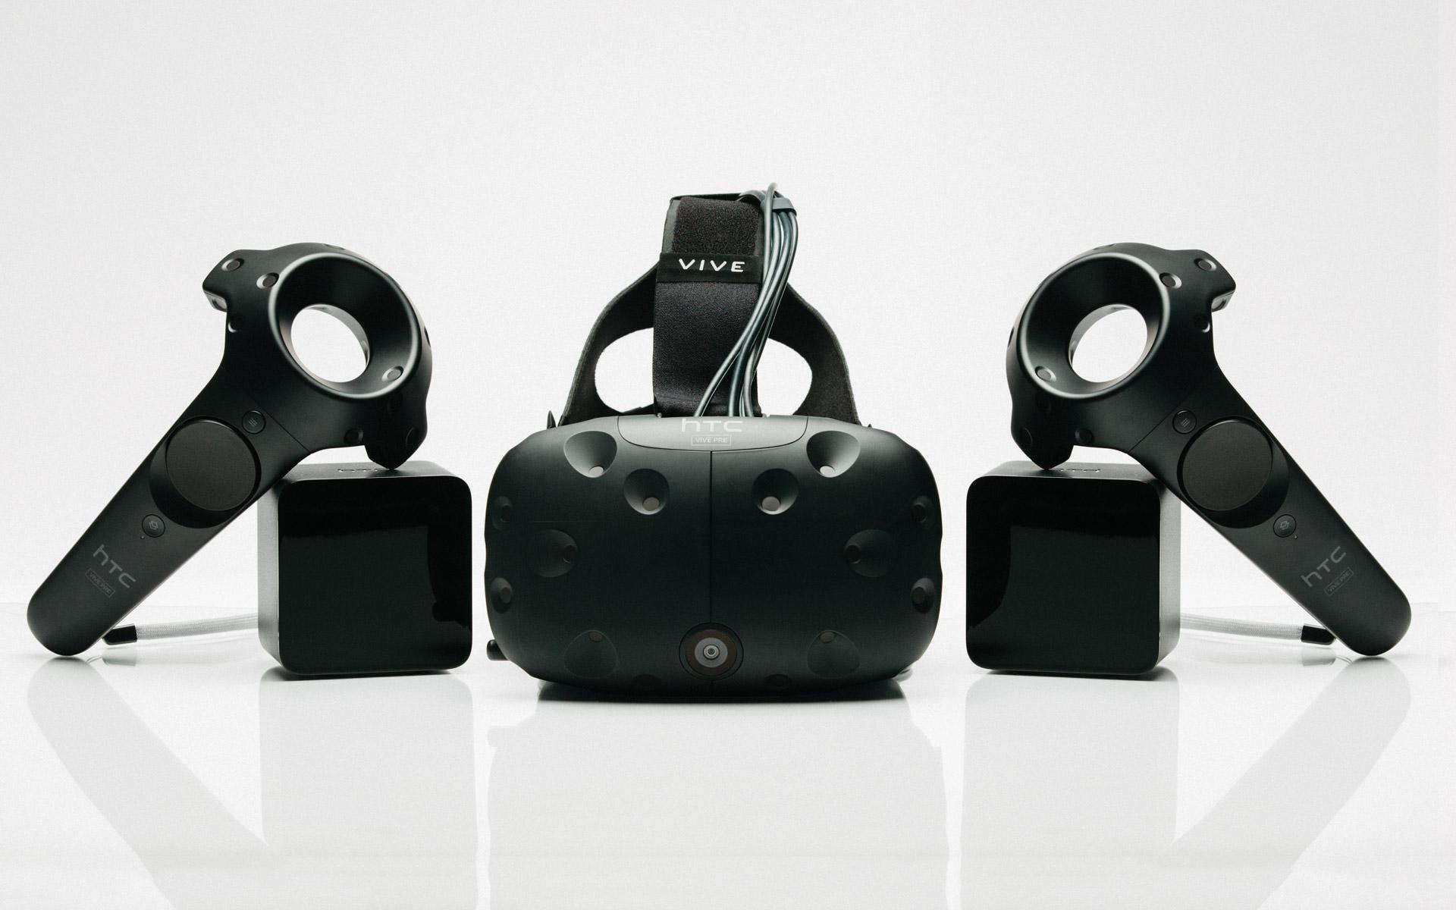

Slide 12
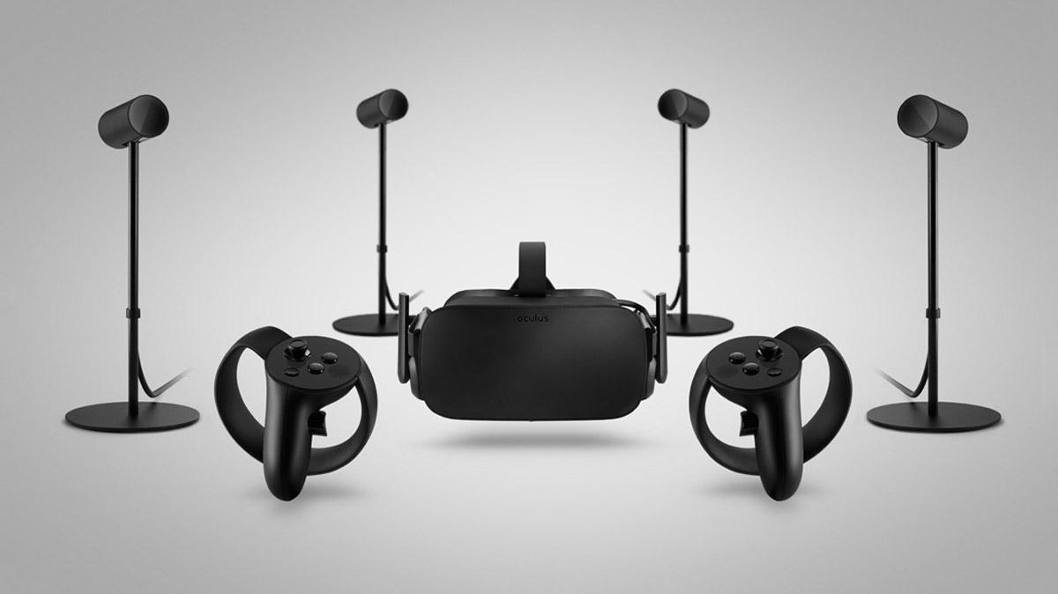

Slide 13









