Slide 1
Machine Learning for Flight Delay Prediction: A Cost-Optimization Approach
Group 1: Jack Baxter, Zach Artman, Greg Moore
University of San Diego
AAI-510: Machine learning: Fundamentals and Applications
Professor David Friesen, MS
6/23/2025
https://github.com/jbaxterusd/AAI510-FP-GRP1

Slide 2
Table of Contents
Business Understanding
Data Understanding (EDA)
Data Preparation & Feature Engineering
Modeling and Training
Logistic Regression
Random Forest
XGBoost
Evaluation Metrics
Deployment
Summary/Conclusion
Collaboration Chart
References

Slide 3
Business Understanding

Slide 4
Data Understanding (EDA)

Slide 5
Data Preparation & Feature Engineering

Slide 6
Model/Training: Logistic Regression

Slide 7
Model/Training: Random Forest

Slide 8
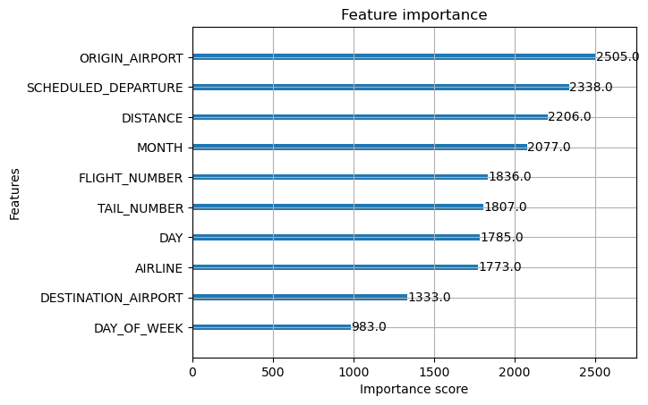
Model/Training: XGBoost
Text
precision recall f1-score support
0 0.66 0.85 0.74 655590
1 0.62 0.45 0.52 425124
2 0.33 0.00 0.00 65872
accuracy 0.65 1146586
macro avg 0.54 0.43 0.42 1146586
weighted avg 0.63 0.65 0.62 1146586
ROC AUC (ovr): 0.6838031716409025

Slide 9
Evaluation Metrics

Slide 10
Deployment

Slide 11
Summary/Conclusion

Slide 12
Group 1 Collaboration Chart
Team Member 1 (Jack Baxter) | Team Member 2 (Zach Artman) | Team Member 3 (Greg Moore)
List of contributions: GitHub Creation Data EDA Summary/Conclusion Presentation slides Presentation | List of contributions: Logistic Regression Model implementation and code Random Forest Model implementation and code Evaluation Metrics Presentation slides Presentation | List of contributions: XGBoost Model implementation and code Evaluation Metrics Deployment Presentation slides Presentation

Slide 13
References
https://www.kaggle.com/datasets/usdot/flight-delay

