Slide 1
Allocating Water Cuts
April 29, 2026
Analysts

Slide 2

We need to cut water allocations by 15%
Regional drought means less water this year
The question is how
Two options
Cut all allocations by 15%
Target cuts to achieve 15% reduction

Slide 3
Last year’s data to determine allocation
Farm | Crop | Zone | Water Use (ac ft) | Yield (per acre)
Farm 1 | corn | North | 185.3 | 103.2
Farm 2 | corn | North | 151.2 | 112
Farm 3 | corn | North | 122.2 | 136.1
Farm 4 | corn | North | 164 | 102.6
Farm 5 | corn | North | 162.2 | 111.6
Farm 6 | corn | North | 100.3 | 145.2
Farm 7 | soybeans | Central | 105.9 | 128.1
Farm 8 | soybeans | Central | 117.4 | 133.4
Farm 9 | soybeans | Central | 168.3 | 124.4
Farm 10 | soybeans | Central | 165.3 | 102
Farm 11 | soybeans | Central | 169 | 99.3
Farm 12 | soybeans | Central | 155.1 | 107.7
Farm 13 | alfalfa | South | 161.2 | 120.9
Farm 14 | alfalfa | South | 145.5 | 104.2
Farm 15 | alfalfa | South | 138.6 | 120.3
Farm 16 | alfalfa | South | 129.9 | 125.4
Farm 17 | alfalfa | South | 157.6 | 89.6
Farm 18 | alfalfa | South | 163.4 | 103.9
Corn: $5 per bushel
Soybeans: $6 per bushel
Alfalfa: $7 per bushel equivalent ($210/ton)

Slide 4
Our goal is to maximize crop value within the district

Slide 5
Construct two scenarios…
Scenario 1: Uniform cut
All farms receive 15% cut
Farm production value falls by 15%
Scenario 2: Targeted cut
Target cuts to the least productive farms by value
Some farms endure full cut while others no cuts
Assumptions: Yield declines by the same percent as water allocation declines

Slide 6
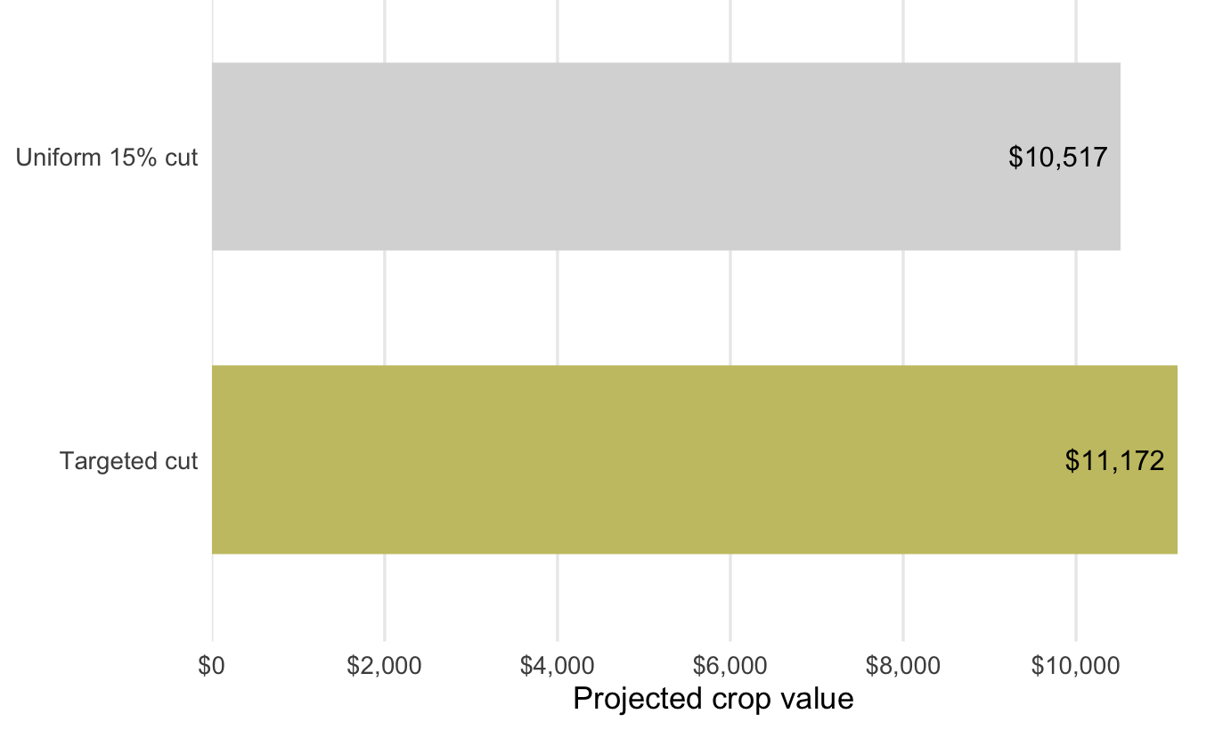
Targeted cut preserves $655 in value

Slide 7
Conclusions
Targeted cuts preserve more production value than uniform cuts
Targeted cuts may appear unfair
Are there other objectives?

Slide 8
Jude Bayham​
Email: jbayham@colostate.edu​
Web: https://sites.google.com/site/judebayham/home​
GitHub: https://github.com/jbayham​

