Slide 1
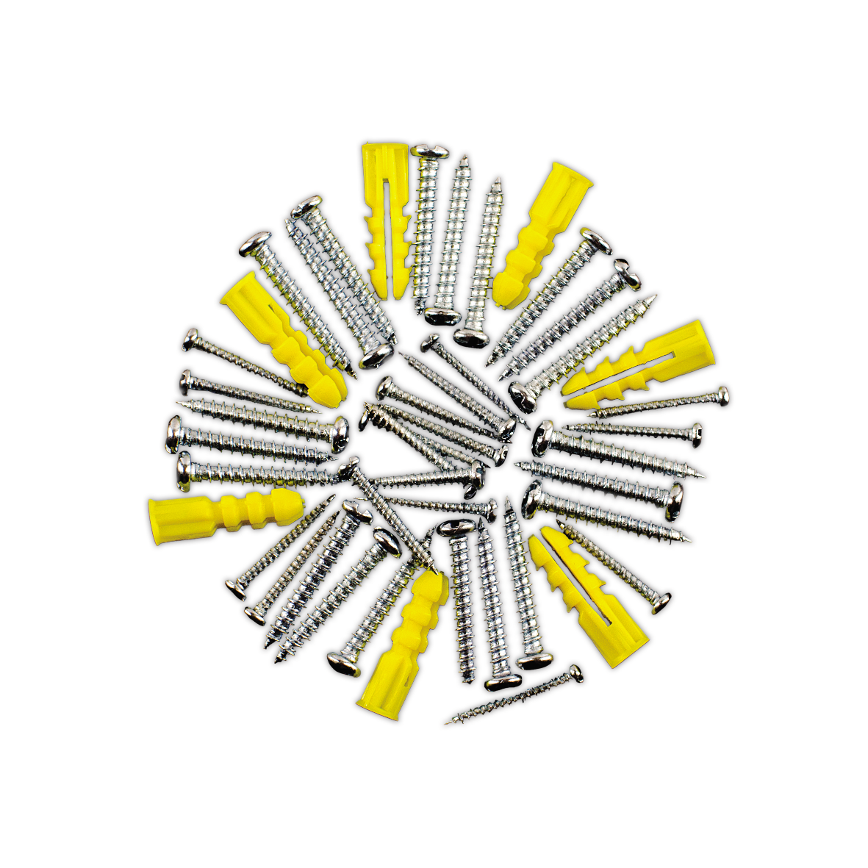
Microservices from the ground up
Systems Engineering

Slide 2
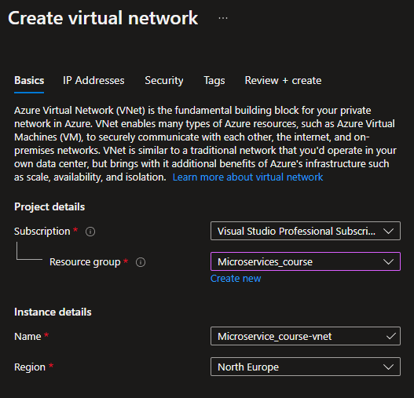
Terraform – Instead of using the GUI

Slide 3
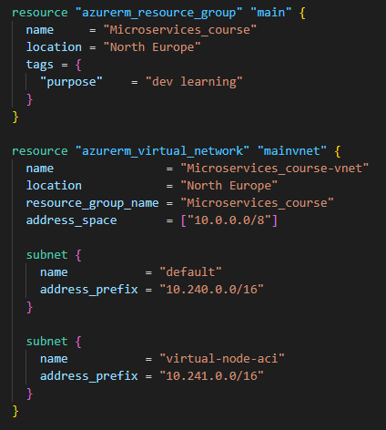
Terraform – Instead of using the GUI

Slide 4
Terraform – Instead of using the GUI

Slide 5
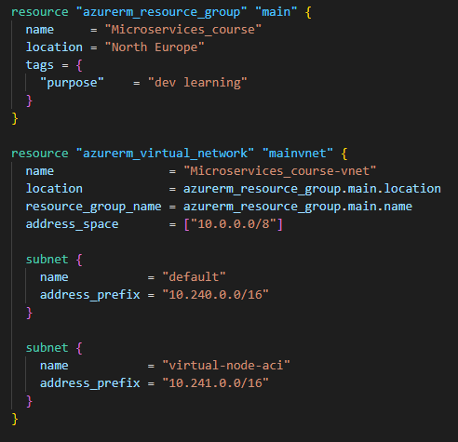
Terraform – Instead of using the GUI

Slide 6
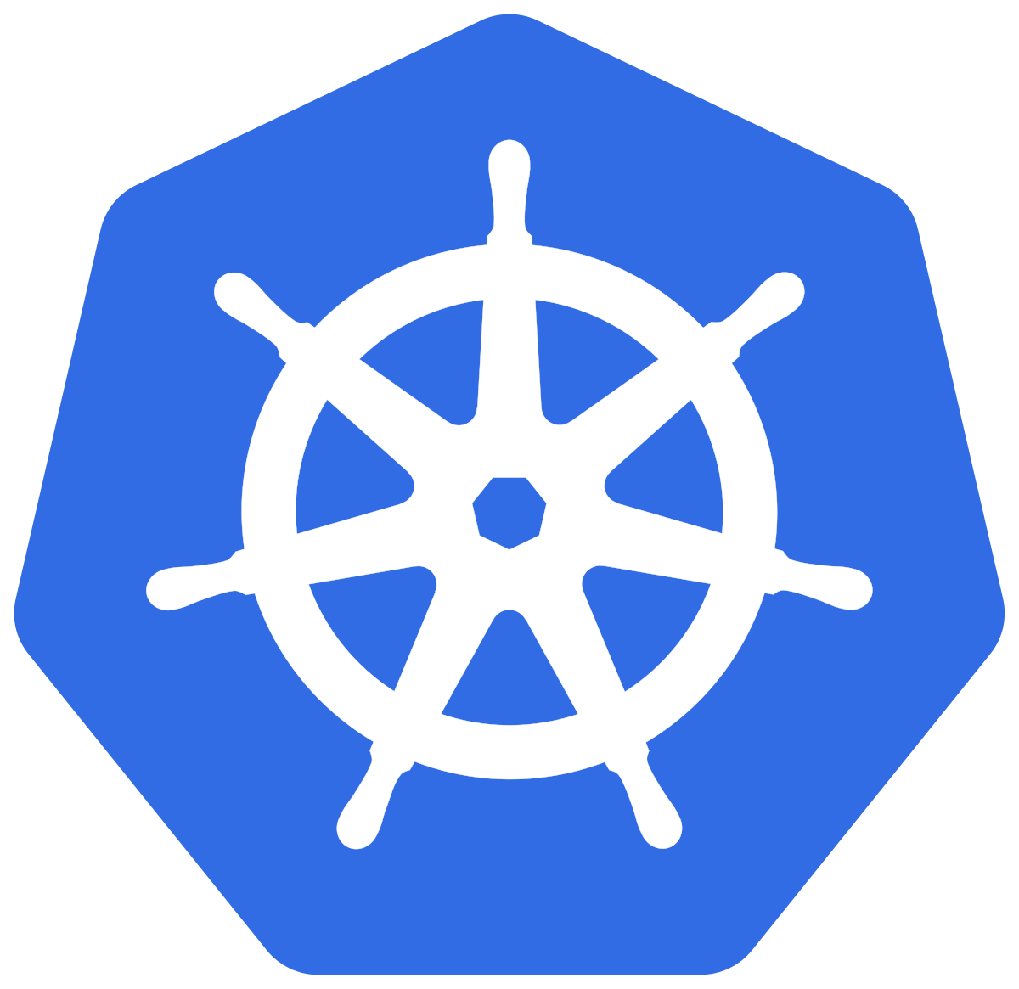
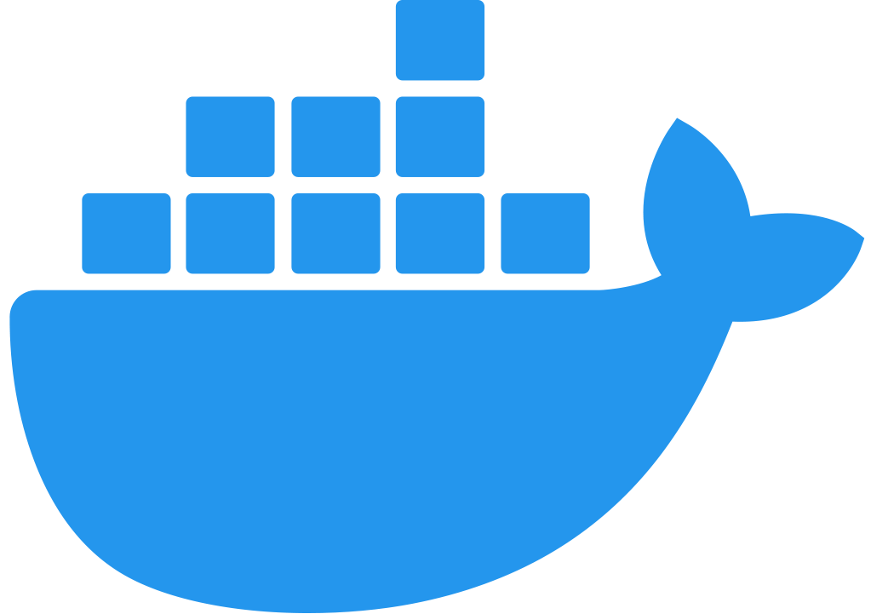
Kubernetes cluster
Logging
Kubernetes Dashboard
Azure Application Insights
Azure Ingress Controller
Service
elastic
Artifact Repo
HPA
Ingress
Azure Container Registry
Pod
Service
HTTP
elastic
Pod
HPA
HTTP
Client
AQMP
AQMP
RabbitMQ
Azure Managed services
Fault-tolerant
Elastic

