Slide 1
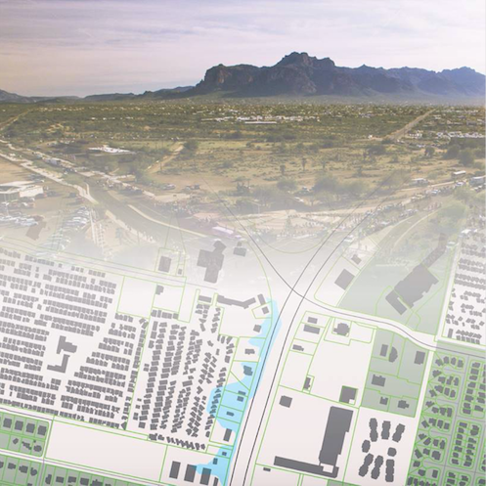
The Design of an Enterprise Geographic Information System for the City of Apache Junction, AZ
John Bonifas
MS Applied Geospatial Sciences
Dept. of Geography, Planning, and Recreation
Northern Arizona University

Slide 2

Overview
AJ GIS uses ArcGIS SDE and Desktop software
AJ city currently HAS NOT purchased the Enterprise License Agreement, allowing use of ArcGIS Extensions

Slide 3
History
4/2016 – City Council approves hiring of GIS coordinator
5/2016 – GIS development approved; data entry begun
Summer 2017 – City Council approves writing of 5 yr GIS Plan
11/2017 – GIS coordinator authorizes GIS simulation ONLY – no access to city’s GIS systems or data, but can use the schema

Slide 4
Plan
Because the city cannot use the ArcGIS extensions, advanced constructs such as networks, spatial analyses, and the like, will all have to be simulated or not included
Because use of real data from the GIS system is prohibited, datasets will have to be simulated

