Slide 1
Investigating GIS applications in Meteorology
Ana Ordonez
John Bonifas

Slide 2
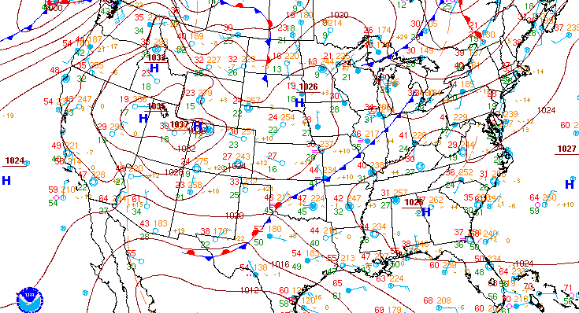
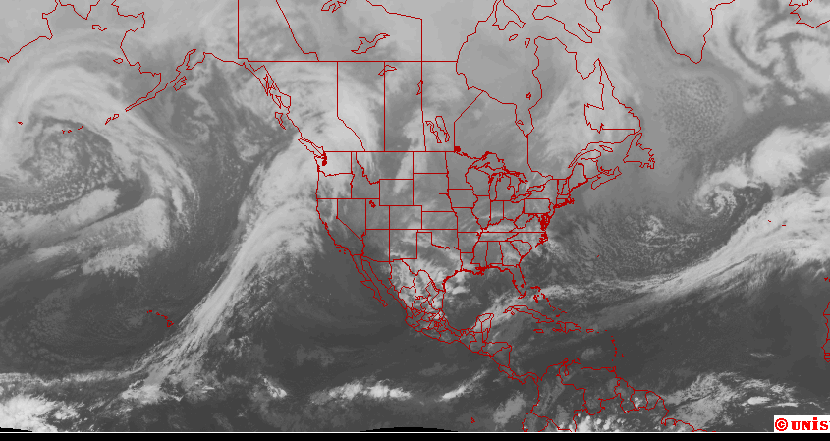
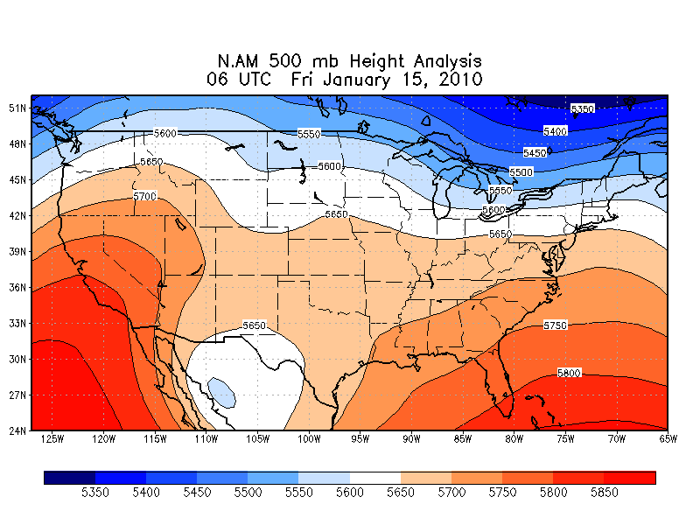
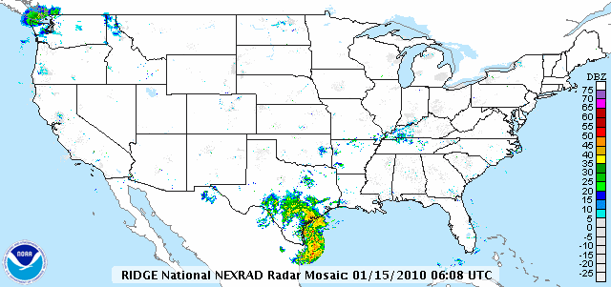
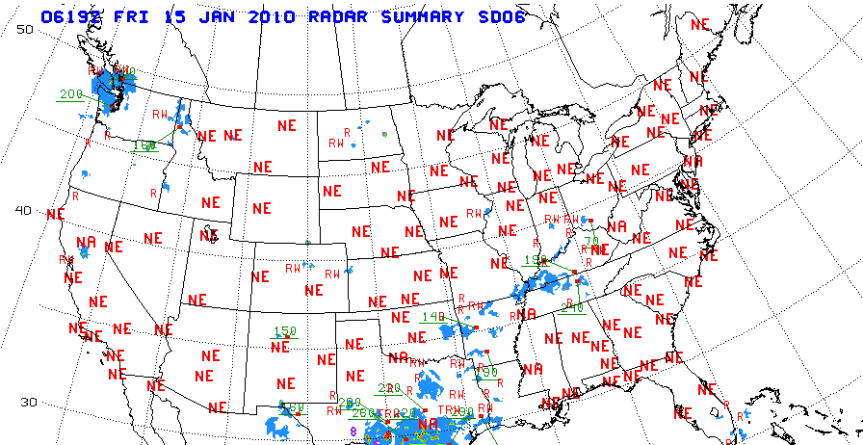
Topic: Weather
Synoptic Meteorology
Snapshot of atmosphere, 100’s – 1000’s of miles
See larger weather systems
How can weather be mapped and analyzed with GIS?

Slide 3
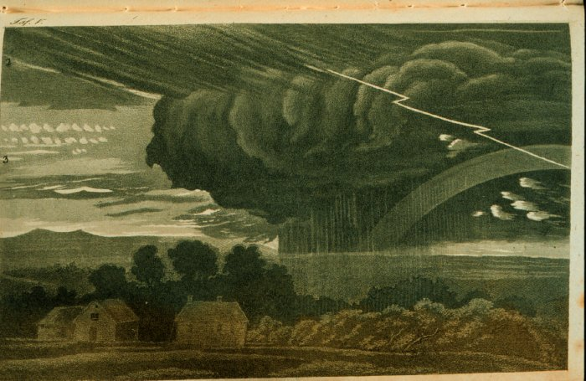
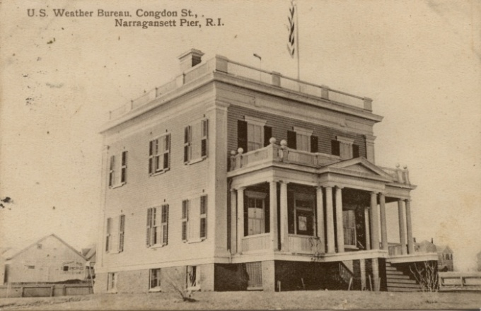
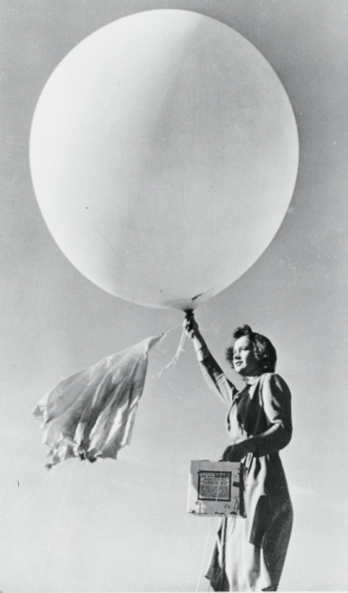
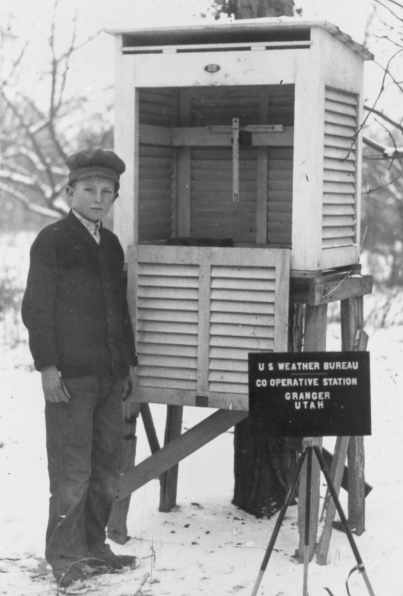
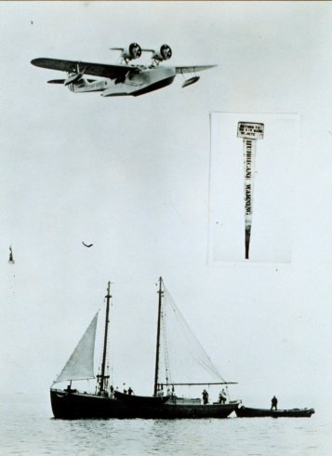
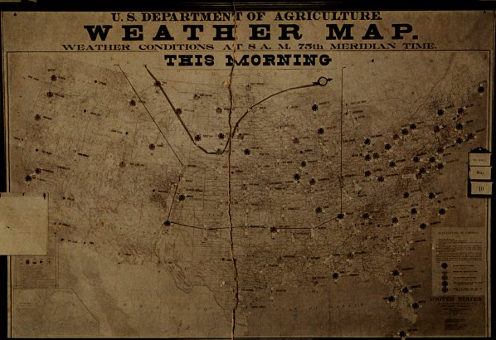
Background
Weather!
NWS Office
Measurement
Warnings
Maps
Images from NWS archives

Slide 4
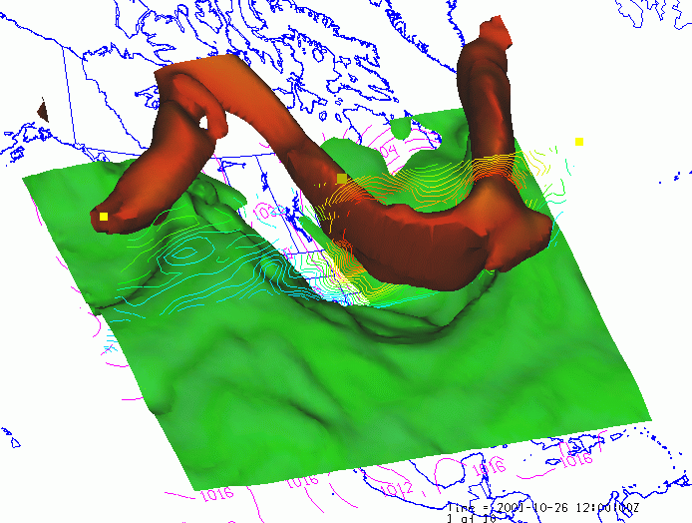
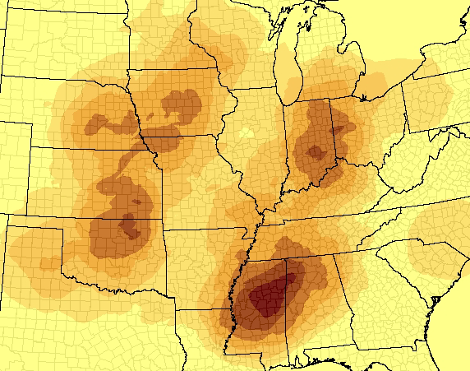
Background
Weather is dynamic
How to incorporate 3 spatial dimensions plus time?
Atmospheric Scientists use other data structure, models
Current uses
NWS storm warnings and verification, climate studies, severe weather analysis
Jet Stream Model
Violent Tornado Track Density
Sources
Jet Stream: Nativi, Stefano et al. “Differences Among the Data Models Used by the Geographic Information Systems and Atmospheric Sciences Communities.” Atmospheric Data Model. ESRI. 3 Nov. 2003. Web. 21 Jul. 2011.
Tornados: Smith, Brian T. “SVRGIS: Geographic Information System (GIS) Graphical Database of Tornado, Large Hail, and Damaging Wind Reports in the United States (1950-2005).” Muncie, Indiana: Ball State University. Google. Web. 27 Jul. 2011.

Slide 5
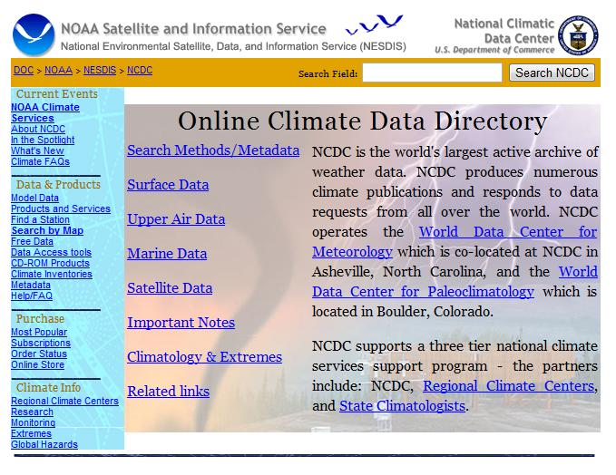
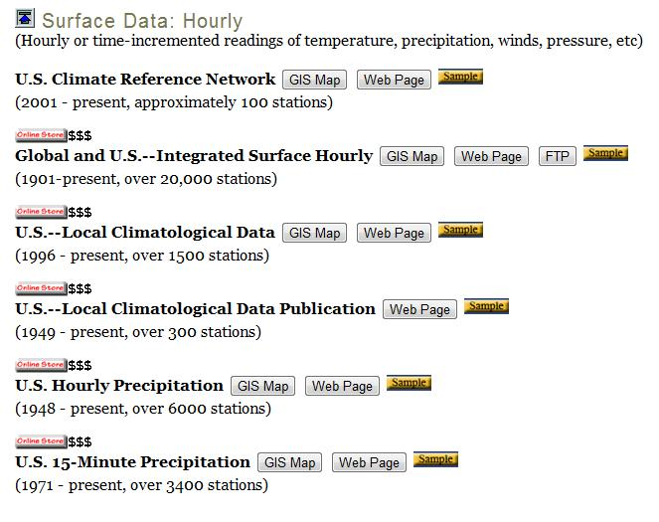
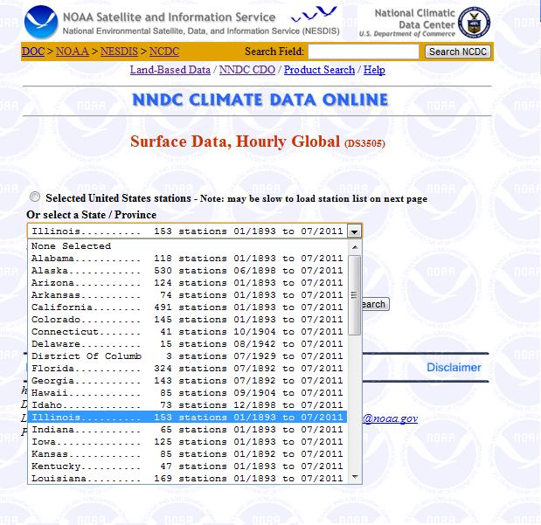
Data Collection
National Climatic Data Center
“World’s archive of weather data”

Slide 6
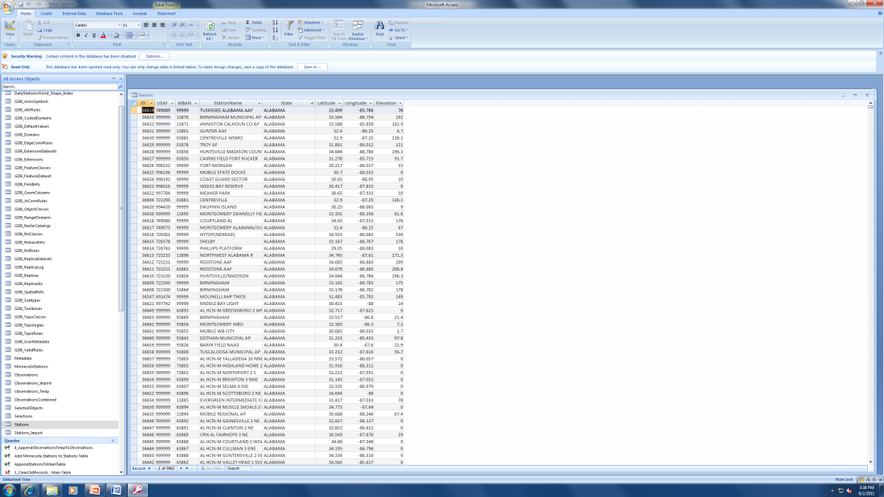
Data Processing: The Challenge
Chose to make four maps, one per season
48 states x 4 = 192 flatfiles to process
Tedious to import each fixed-width flatfile manually into the geodatabase

Slide 7
Data Processing: The Solution
Macros!
Windows Scripting Host + Access VBA scripting
Loop through flatfiles, import data in minutes
Used Access queries to polish data before importing into ArcMap

Slide 8
Data Processing: The Code
Function ImportData()
cstrVBDQ = Chr(34)
strThePath = "C:\inetpub\Yahoo\homework\courses\GPH473\GroupProject\Flatfiles\Observations\"
ToUser = SysCmd(acSysCmdSetStatus, "Deleting old data from Import table and importing new data...")
CurrentDb.Execute "DELETE * FROM Observations_Import;"
Set objFSO = New Scripting.FileSystemObject
Set objFolder = objFSO.GetFolder(strThePath)
For Each objFile In objFolder.Files
strState = Left(objFile.Name, InStr(1, objFile.Name, "_", vbTextCompare) - 1)
'import the flatfile
ToUser = SysCmd(acSysCmdSetStatus, "Importing data from " & objFile.Name & " ...")
DoCmd.TransferText acImportFixed, "Observations_Import_Spec", "Observations_Import", strThePath & objFile.Name, False
'update the state field
CurrentDb.Execute "Update Observations_Import Set State = " & cstrVBDQ & strState & cstrVBDQ & " WHERE State Is Null;"
'update the date field
CurrentDb.Execute "UPDATE Observations_Import Set ObsYear = Mid$([Field3],1,4), " & _
"ObsMonth = Mid$([Field3],5,2), " & _
"ObsDay = Mid$([Field3],7,2), " & _
"ObsHour = Right$([Field3],4);"
Next
' refresh the Main table
ToUser = SysCmd(acSysCmdSetStatus, "Deleting old data from main table and importing new data...")
CurrentDb.Execute "DELETE * FROM Observations;"
'CurrentDb.Execute "INSERT INTO Observations " & _
"( USAF, WBAN, FieldCode, WindDir, WindSpd, WindGust, CloudClng, CoverSky, CoverLow, CoverMid, CoverHigh, " & _
"Visibility, WW1, WW2, WW3, W, TempF, DewPoint, BPressure, AltSetting, StatPressure, MaxT, MinT, Precip1, " & _
"Precip6, Precip24, PrecipOther, SnowDepth, State, ObsYear, ObsMonth, ObsDay, ObsHour ) " & _
"SELECT * FROM Observations_Import; "
ToUser = SysCmd(acSysCmdClearStatus)
ToUser = MsgBox("Done. " & objFolder.Files.Count & " files processed.", vbInformation, "GPH 473 Group Project Import Data Macro")
End Function

Slide 9
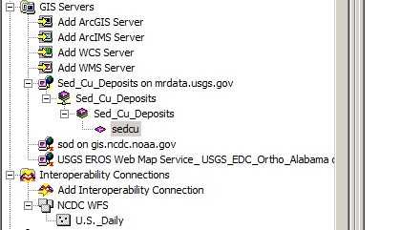
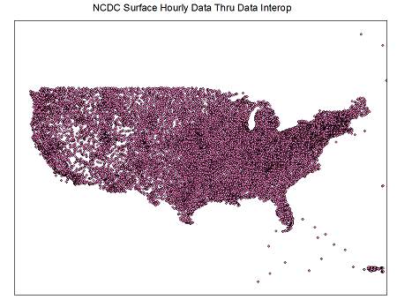
The Better Way...
Getting the Data Thru Web Services

Slide 10

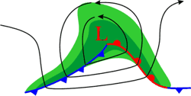
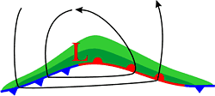
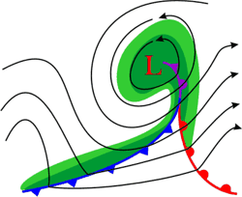
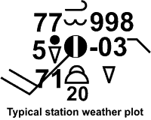
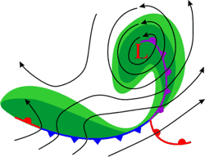
Results
Created four weather maps
Interpolate contours – pressure and temperature
Create station model symbols
Draw fronts and pressure centers
Not shown: georeferenced satellite images, 500 mb heights, radar overlay
Image Source
NWS Jetsream Online School for Weather: Synoptic Weather

Slide 11
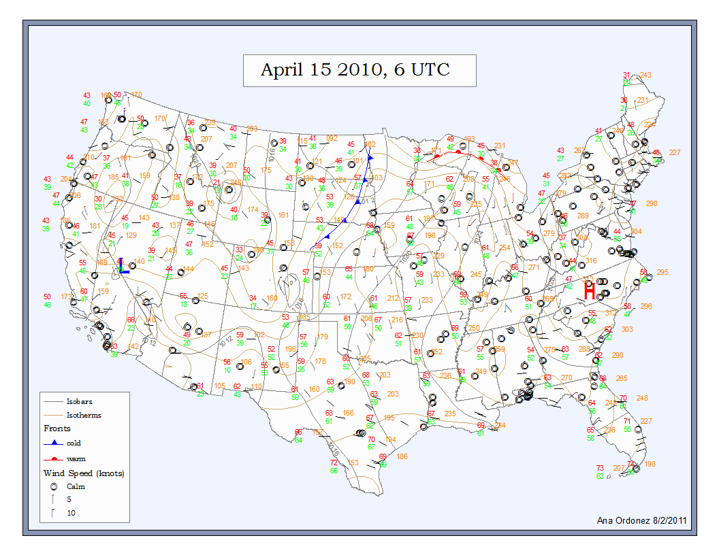

Slide 12
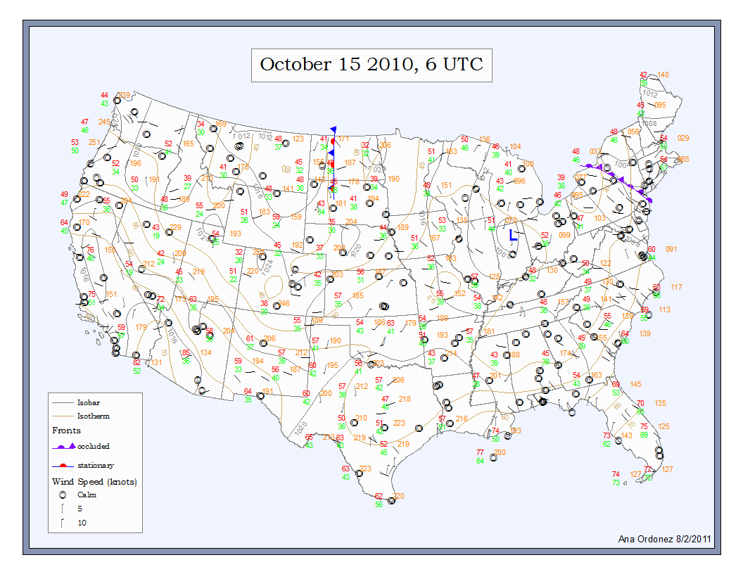

Slide 13
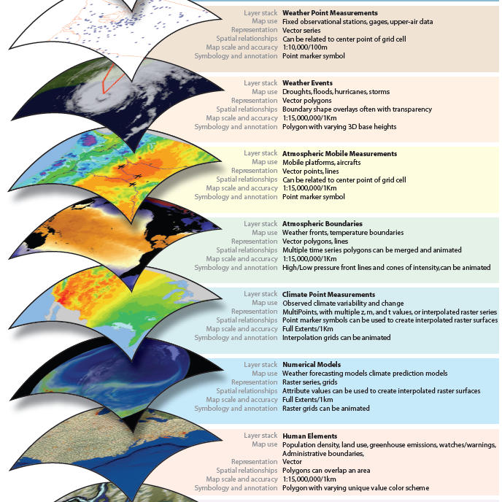
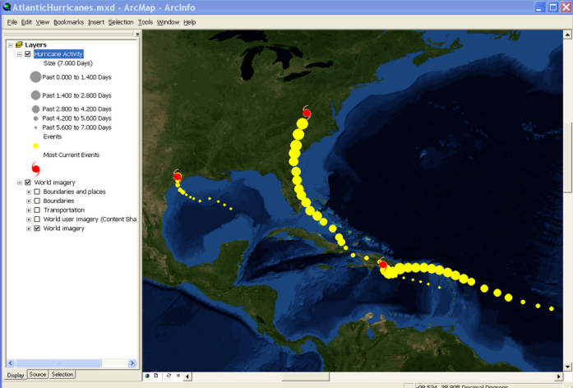
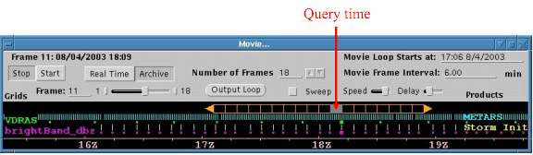
Developments in Atmospheric GIS
Atmospheric Data Model?
How to handle time?
How to handle data volumes?

