Slide 1
MODEL AUDIT + AI WORKFLOW
Wildfire carbon feedbacks in the social cost of carbon
Two purposes
1. Present the model result.
2. Show how an AI collaborator helped audit code, search literature, implement a transparent extension, run diagnostics, and produce research artifacts.
A GIVE model extension, a climate-economics audit, and a case study in AI-assisted academic research programming.
100
+5.65%
+74.62%
paired validation draws
mean SCC change, high residual case
mean SCC change, largest gross stress case
Preliminary research deck. Results are validation-scale unless noted.
01

Slide 2
HYPOTHESIS
The question is whether the marginal tonne can trigger additional fire CO2.
Marginal CO2 pulse
Higher CO2 stock
More warming
More wildfire CO2
Damages and SCC
One extra tonne in 2020.
->
Atmospheric concentration and forcing change.
->
Temperature path rises slightly.
->
Climate-sensitive fire carbon adds to emissions.
->
Marginal damages are monetized and discounted.
feedback loop
Key distinction: total added wildfire emissions are not the SCC. The SCC changes only if the extra tonne changes future emissions, climate response, damages, or discounting.
Conceptual framing for the wildfire-carbon feedback experiment.
02

Slide 3
MODEL ARCHITECTURE
GIVE samples exogenous pathways; it does not generate the fire feedback internally.
Exogenous scenarios
FaIR
Damage modules
Discounting
SCC
Emissions, GDP and population are sampled from external pathways.
->
CO2 cycle, forcing and temperature.
->
Mortality, energy, agriculture and sea level.
->
Present value of marginal damages.
->
Dollars per tonne CO2.
Kaya-style, in one line
Missing endogenous loop
CO2 = Population x GDP/person x Energy/GDP x CO2/Energy.
GIVE does not solve an endogenous economy around that identity; it takes pathways as inputs.
warming -> more wildfire -> more CO2 -> more warming is not generated unless it is embedded exogenously or added as an extension.
Code audit: MimiGIVE + MimiFAIR wiring; no attributed correspondence included.
03

Slide 4
DOUBLE COUNTING
The hard problem is not adding fire carbon; it is deciding what is not already counted.
Atmospheric persistence
Already in baseline?
Likely embedded
Likely missing
Do not add
Stress test only
Gross / short-run
Fire carbon may be in AFOLU/LULUCF or natural-stock expectations.
Gross missing fire emissions can show mechanism but risk overstatement.
Possible decomposition
Preferred first pass
Net / persistent
Useful for accounting, but not a clean additive SCC experiment.
Residual, net persistent, not-already-embedded wildfire CO2.
Our extension samples two protection factors: net persistence and not-already-embedded share. That is the double-counting defense.
Interpretation framework used in WildfireGIVE.jl and manuscript.
04

Slide 5
LITERATURE SEARCH
The literature was organized by role, not dumped into one emissions number.
Role
Source
How it entered this project
Baseline model
Rennert et al.; RFF-SP
GIVE architecture, scenarios, SCC definition
Smoke damages
Qiu et al.
Complementary mortality channel, not carbon input
Magnitude anchor
Byrne et al. Canada 2023
2.4-3.0 GtCO2 event scale; boreal plausibility
Projection scaler
Val Martin / Pierce / Heald USDA-CESM
CO emissions and burned-area ratios by RCP
Stress-scale theory
RESFire / CESM literature
High-end forest-fire feedback scale
Next data targets
Park, Tian, Phillips
Global fire carbon, warming levels, gross-vs-net boreal fire
Literature review and data triage; full citations in manuscript reference list.
05

Slide 6
METHOD
The extension is deliberately reduced-form and transparent.
E_fire,t = E_ref x beta x max(T[t-1] - T[2020], 0) x phi_net x phi_missing
E_ref
beta
phi_net
phi_missing
gross reference global fire carbon
fractional gross fire-emissions response per deg C
share that becomes persistent net atmospheric CO2
share not already embedded in baseline aggregate CO2
Placement: added before the SCC pulse enters FAIR, so the marginal tonne can induce marginal wildfire CO2 while the baseline remains comparable.
Implementation: wildfire_extension/WildfireGIVE.jl.
06

Slide 7
REPRODUCIBILITY
The work started as a replication package, then became a separated extension.
1
2
3
4
5
6
Download
Runtime
Audit
Extend
Run
Package
Rennert et al. Zenodo archive and GitHub replication code references
>
Local Julia installs in /tools plus archived Project.toml and Manifest.toml
>
Search RFF-SP, MimiGIVE and MimiFAIR for fire/LULUCF/emissions wiring
>
Add wildfire_extension/ without overwriting original replication files
>
Deterministic checks, 100 paired Monte Carlo draws, sectoral diagnostics
>
Memo, manuscript, figures, run scripts and GitHub-ready folder
GitHub status: local package is ready to commit/push once a remote repository is created.
Local paths: /Users/jbb/Dropbox/GIVE and paper-2022-scc-give-zenodo/wildfire_extension.
07

Slide 8
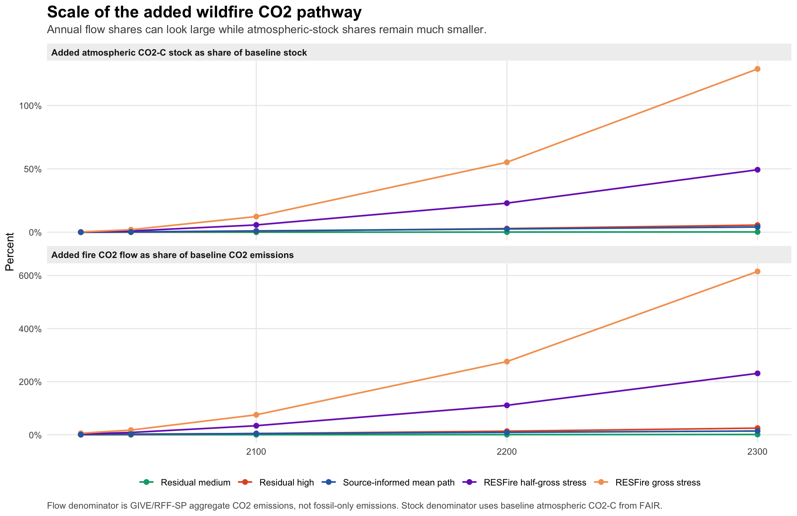
SCALE CHECK
Fire CO2 can be a visible annual flow without dominating the atmospheric stock.
How to read it
Residual-high reaches 1.27 GtCO2/yr by 2100: 4.63% of baseline annual emissions, but 0.80% of atmospheric CO2-C stock.
The gross stress case is intentionally much larger and not double-counting safe.
Figure generated from deterministic fire_scale_check_deterministic.csv.
08

Slide 9
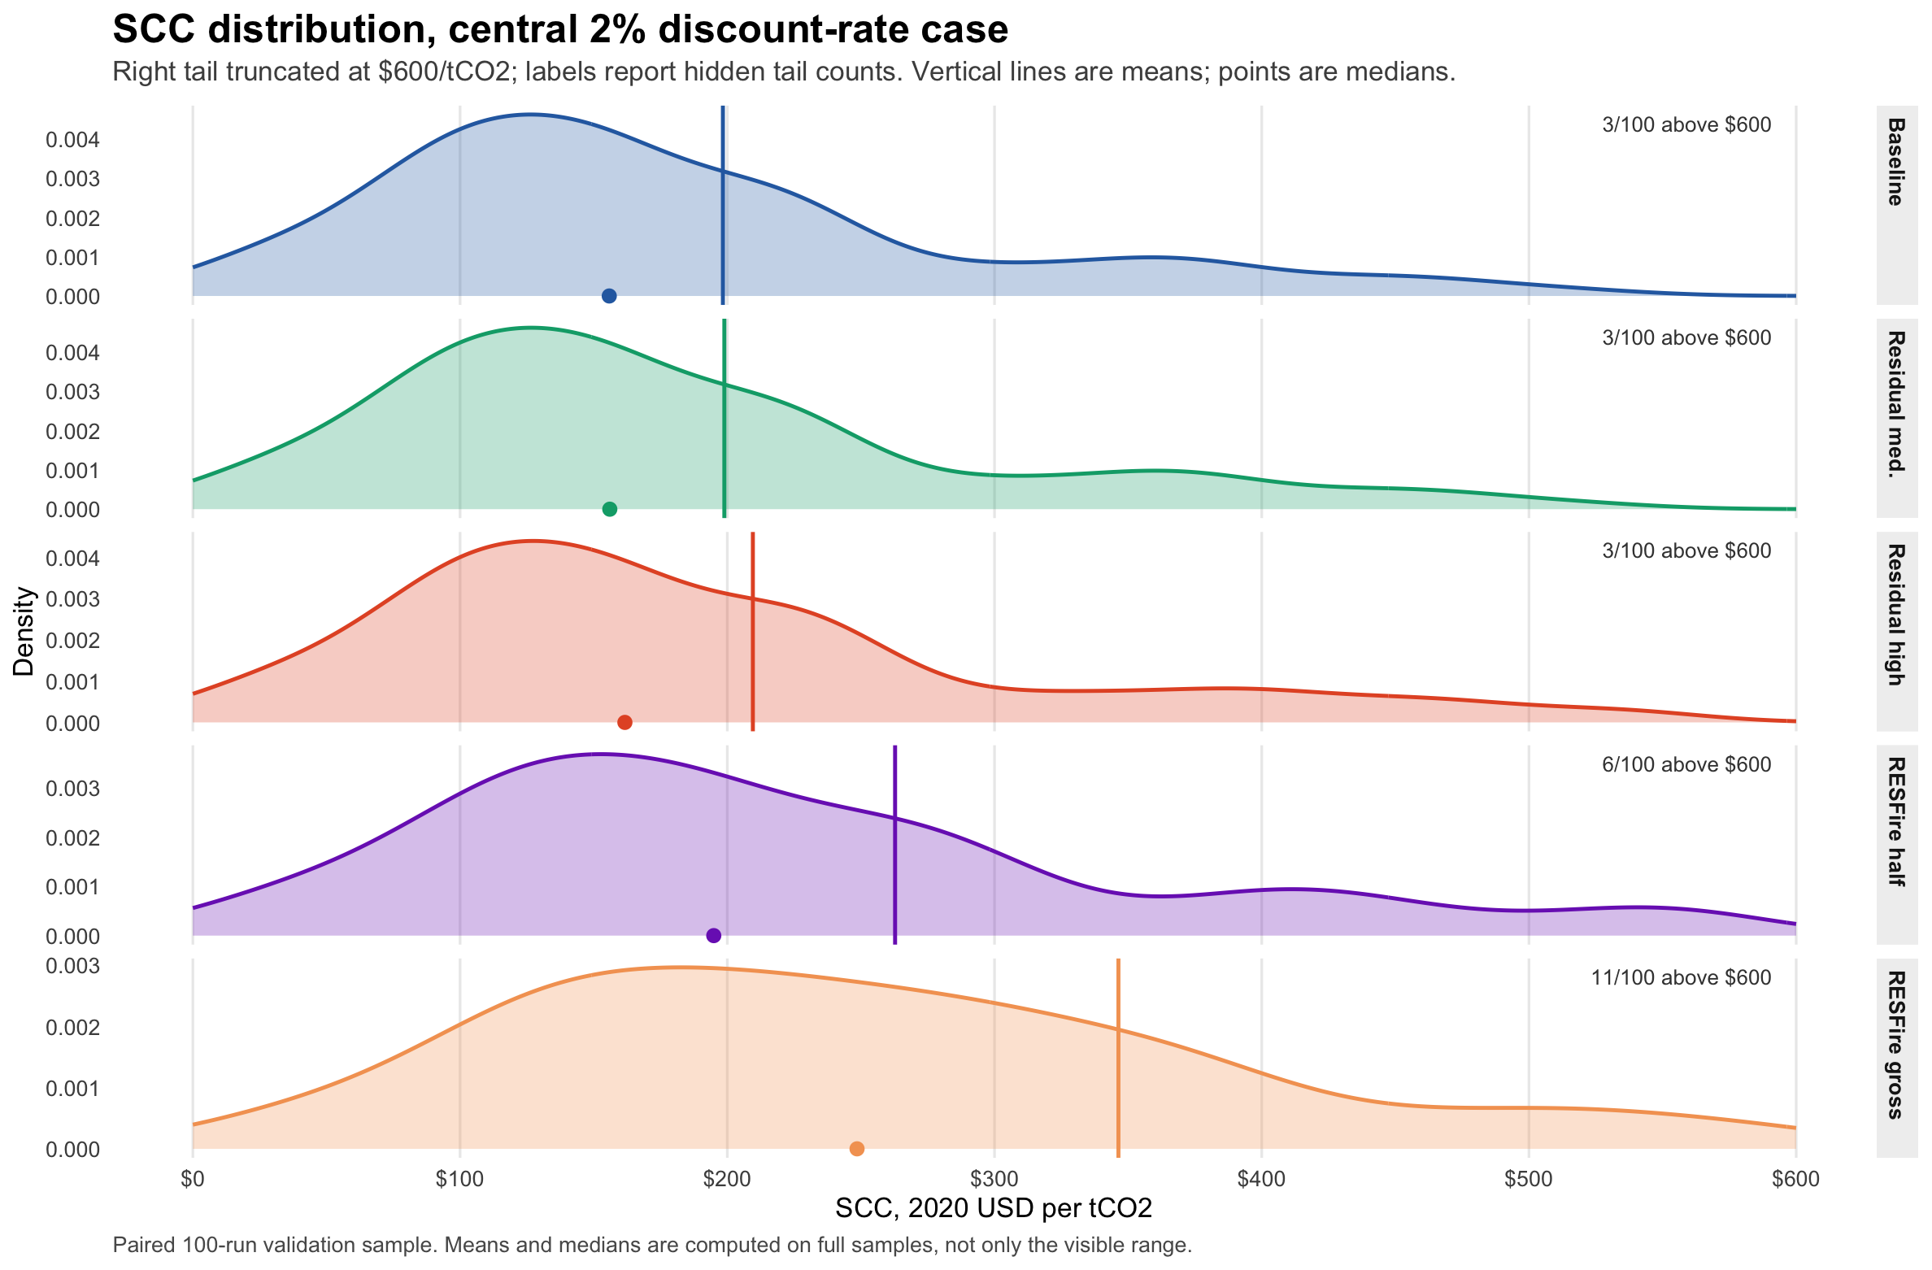
SCC DISTRIBUTION
The SCC distribution shifts only modestly for conservative residual feedbacks.
Main read
Means and medians are computed on full samples; the display truncates the right tail at $600/tCO2.
This is a 100-draw validation run, not the final 10,000-draw Monte Carlo.
Output: wildfire_temperature_feedback_mcs_100_paired/all_scc_samples.csv.
09

Slide 10
RESULTS
The central result is conditional: residual feedbacks are small; gross missing fire carbon is not.
Scenario
Mean
Median
5th
95th
Delta
Delta %
Baseline
198.35
155.82
33.39
464.21
0.00
0.00%
Residual medium
198.89
156.03
33.46
465.23
+0.54
+0.27%
Residual high
209.57
161.67
35.80
485.26
+11.21
+5.65%
High-end half-gross
262.79
194.93
45.45
646.43
+64.44
+32.49%
High-end gross
346.37
248.55
84.63
785.47
+148.02
+74.62%
Units: 2020 USD/tCO2. Central 2.0% discount-rate case. Paired 100-draw validation sample.
Interpretation: stress cases prove the mechanism can be large, not that gross fire emissions should be added without accounting safeguards.
Output: scc_summary.csv.
10

Slide 11
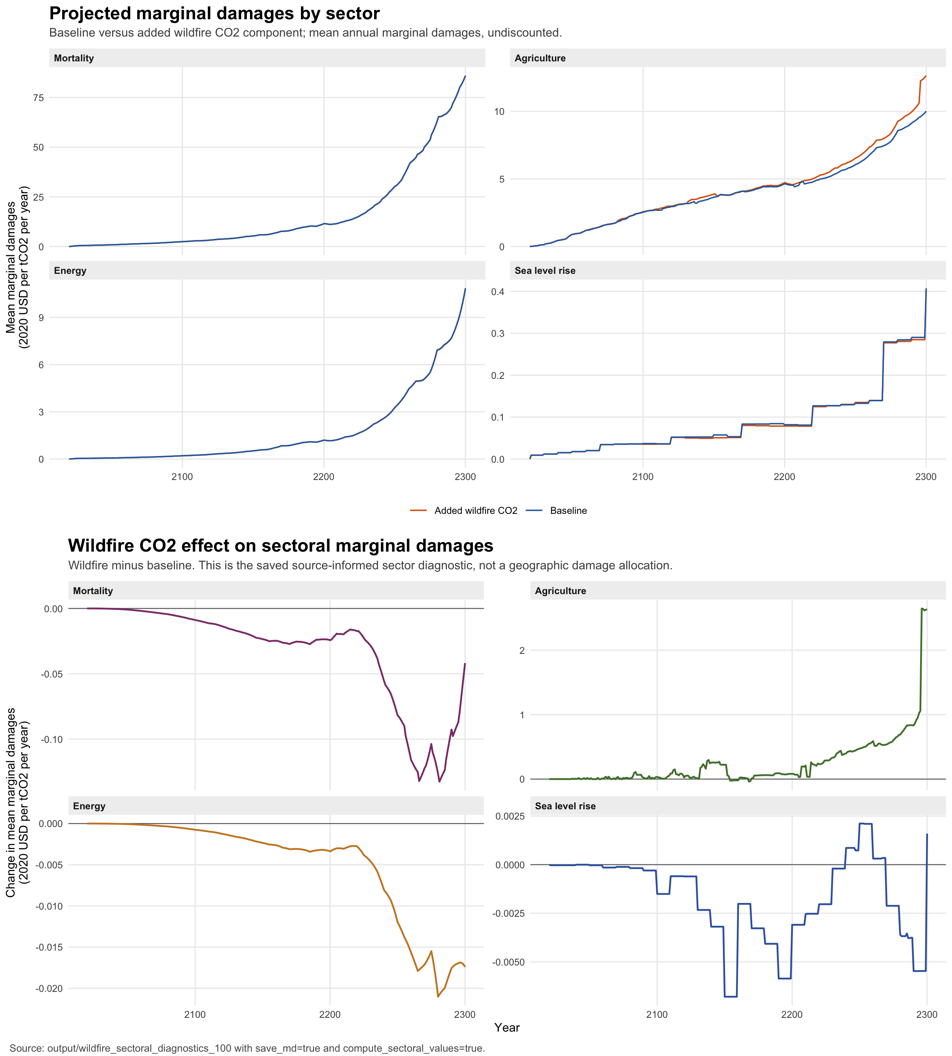
MECHANISM
Some sectors can show lower marginal damages even as total damages rise.
Why this happens
CO2 forcing is logarithmic.
Mortality and energy are locally close to linear in temperature.
Agriculture and sea-level channels are more nonlinear and delayed.
Discounting suppresses far-future increments.
Sectoral diagnostic: save_md=true and compute_sectoral_values=true.
11

Slide 12
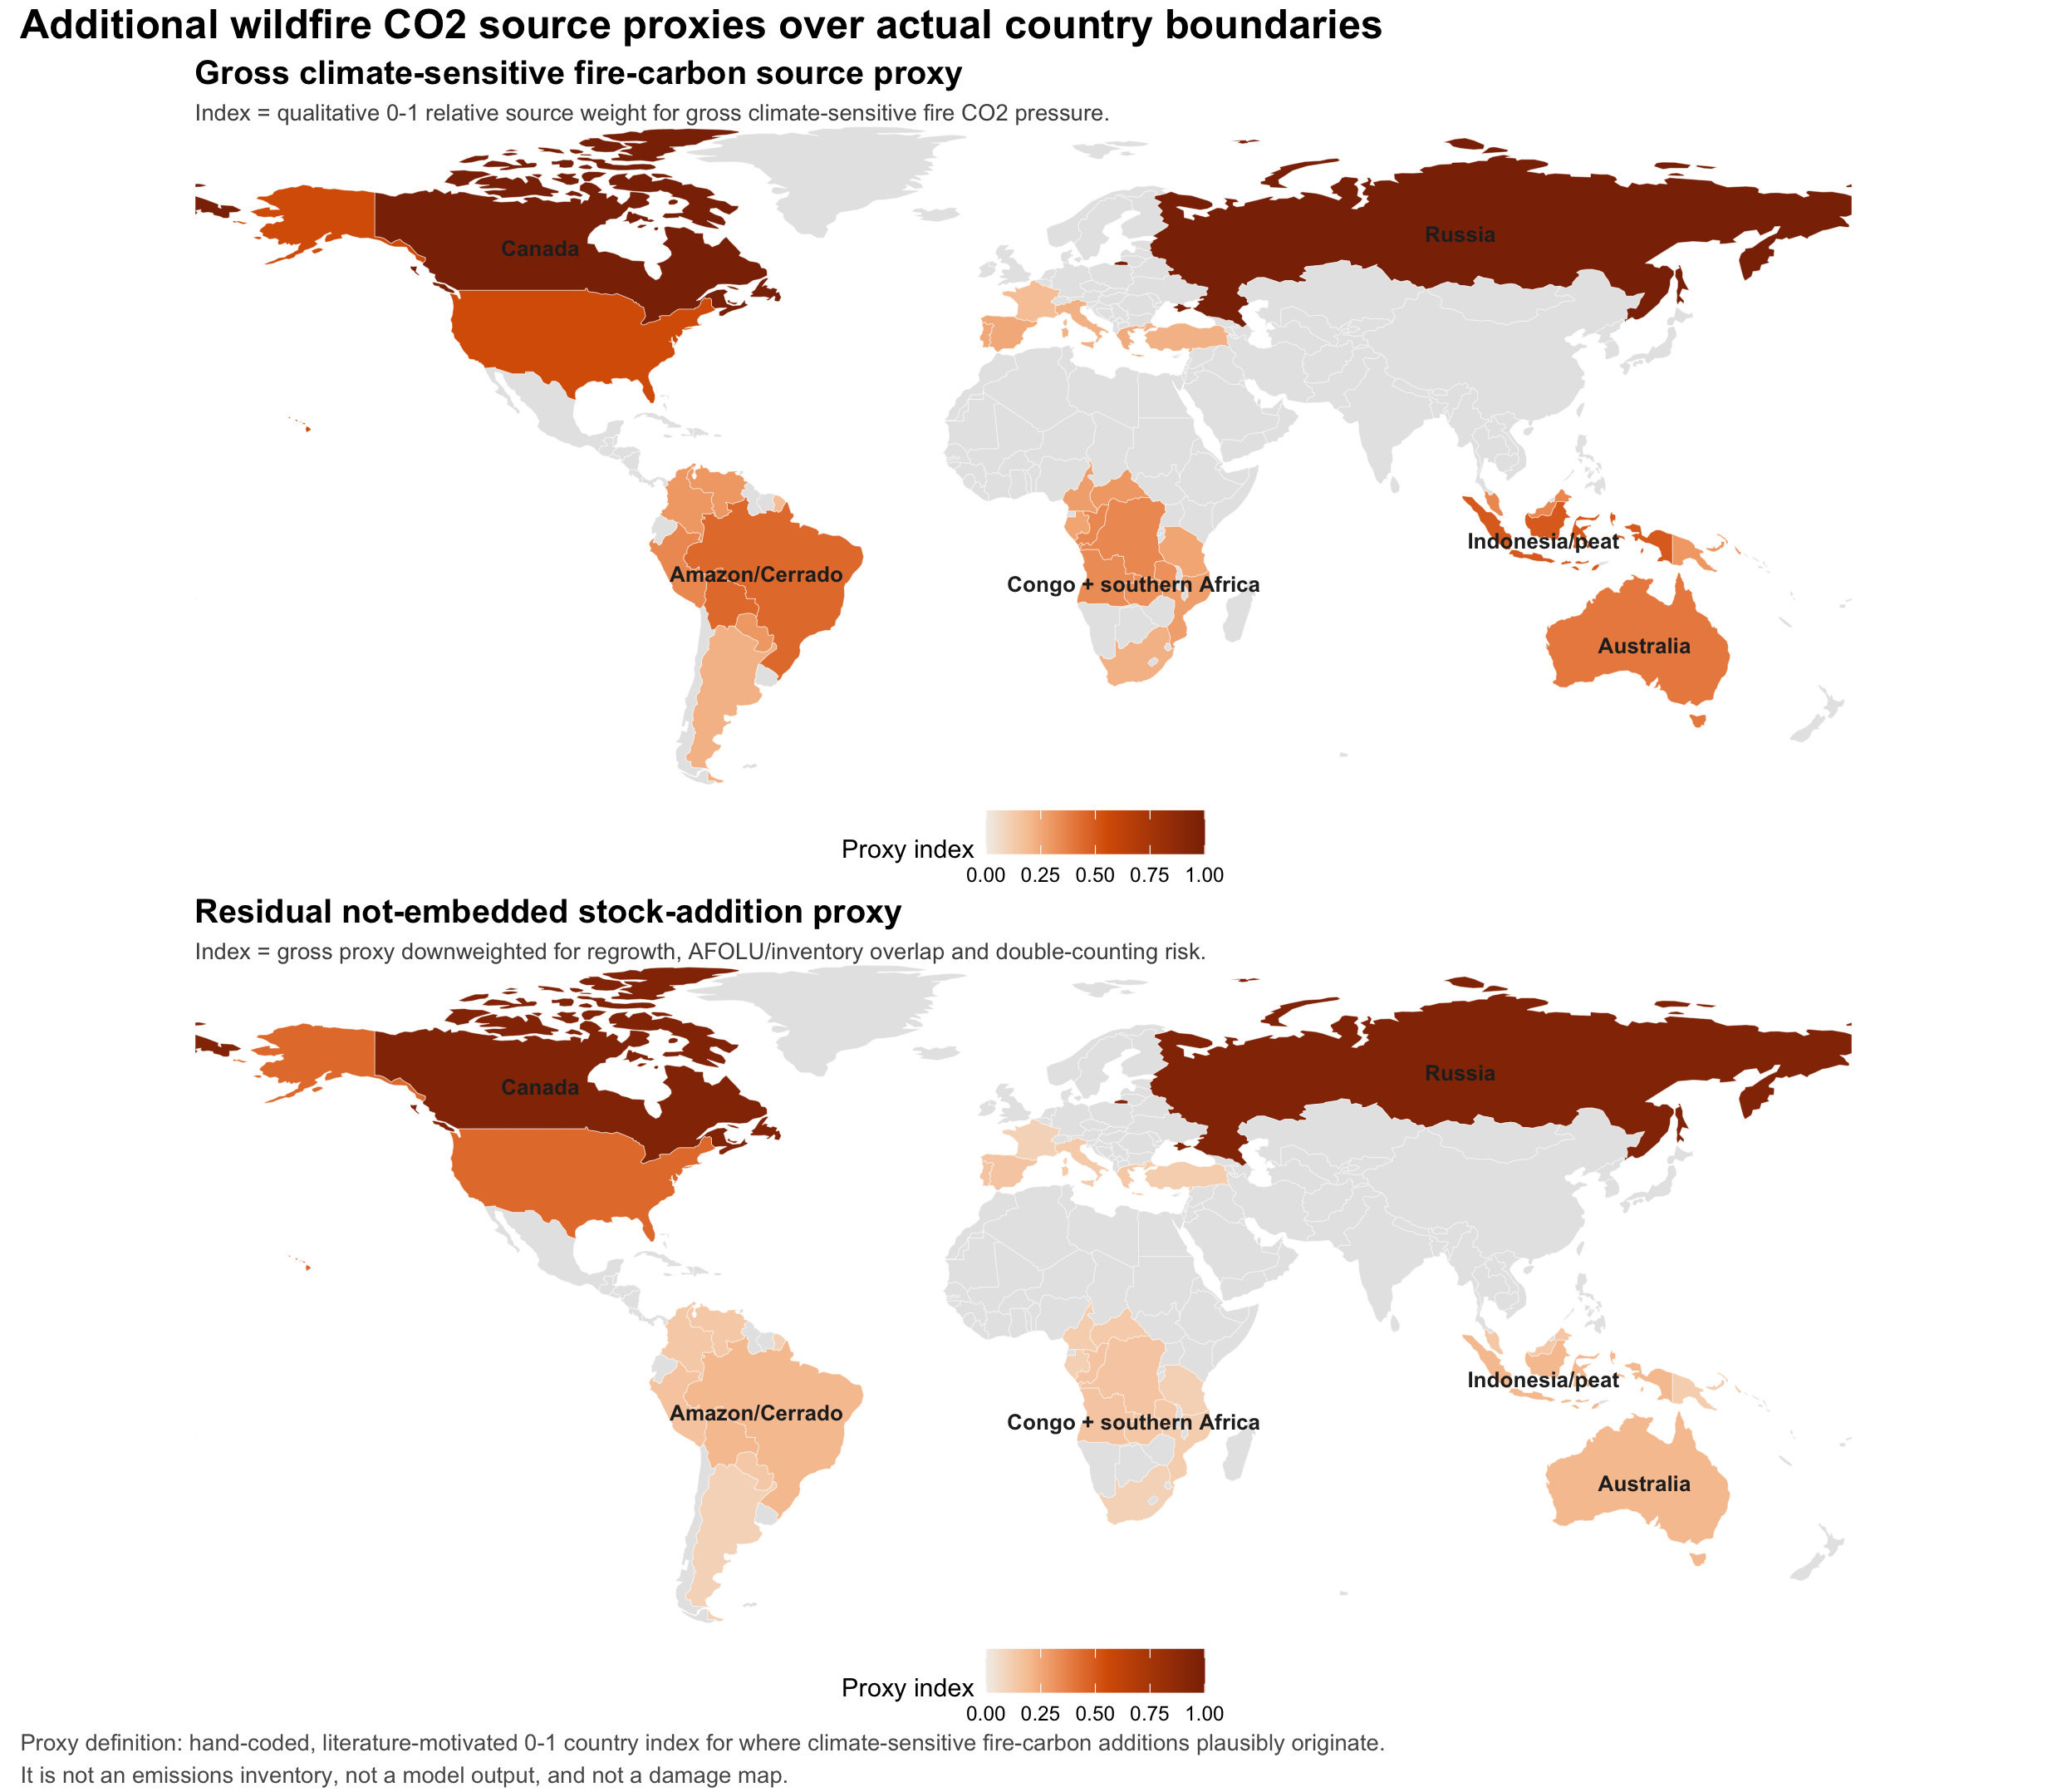
SOURCE ATTRIBUTION
The source map is an assumption ledger, not a model output.
Proxy definition
A hand-coded 0-1 country index for plausible climate-sensitive fire-carbon source regions.
Gross proxy: source plausibility.
Residual proxy: downweighted for regrowth, AFOLU overlap and double-counting risk.
Source proxy CSV: wildfire_extension/manuscript/figures/png_pdf/fire_source_country_proxy.csv.
12

Slide 13
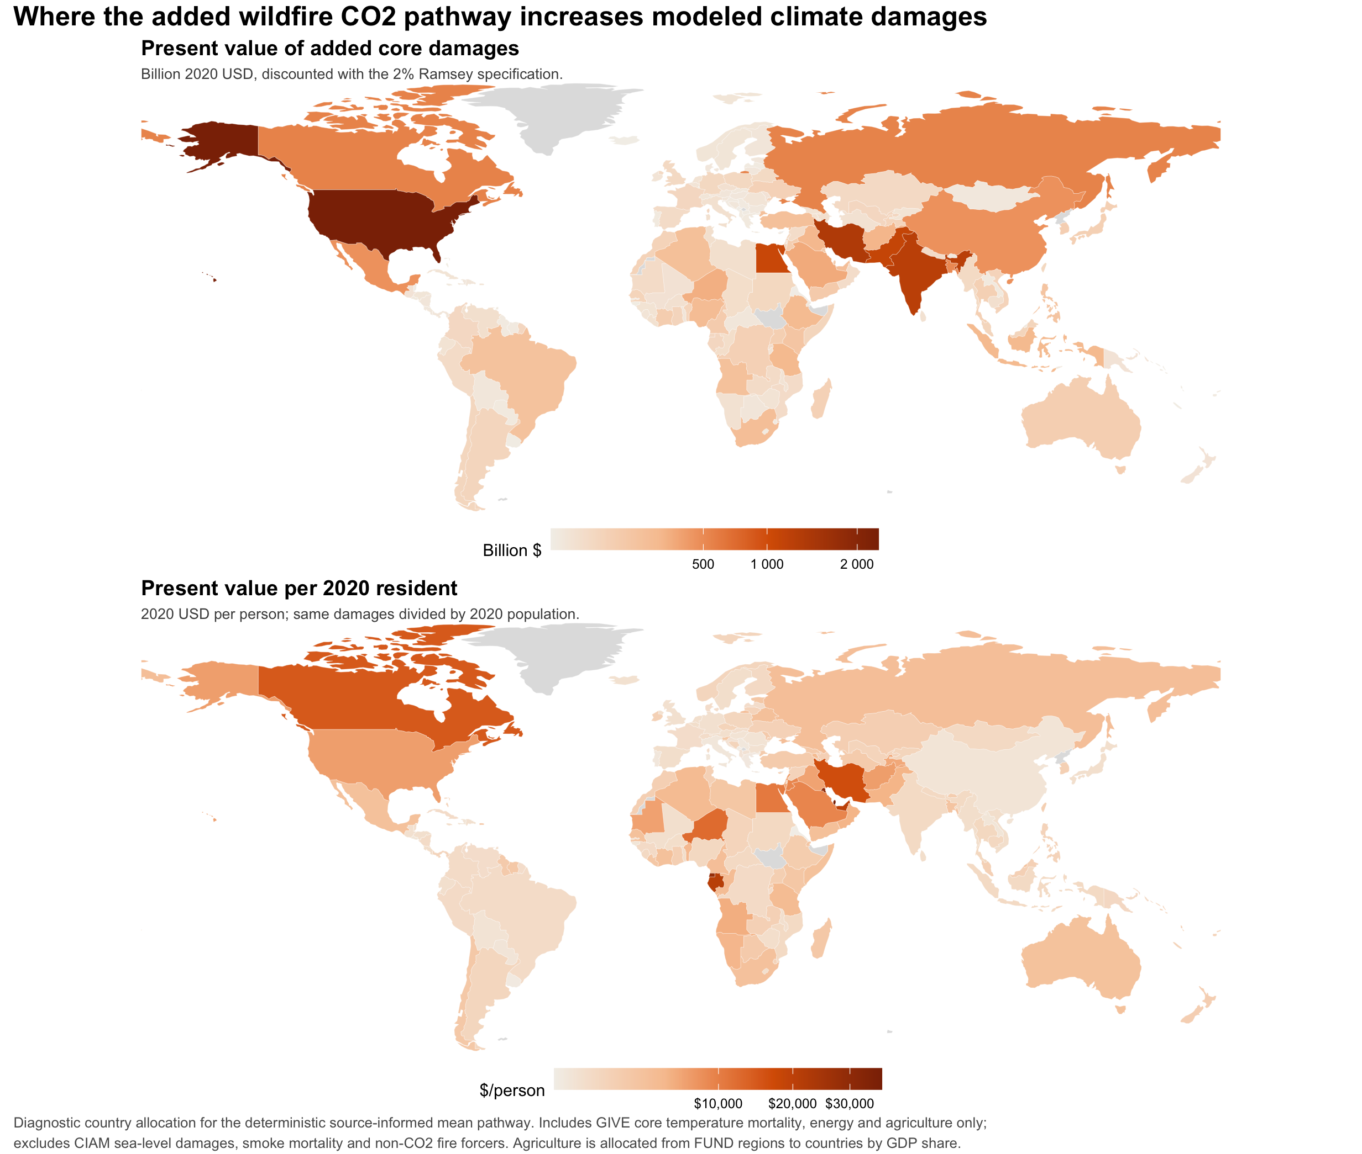
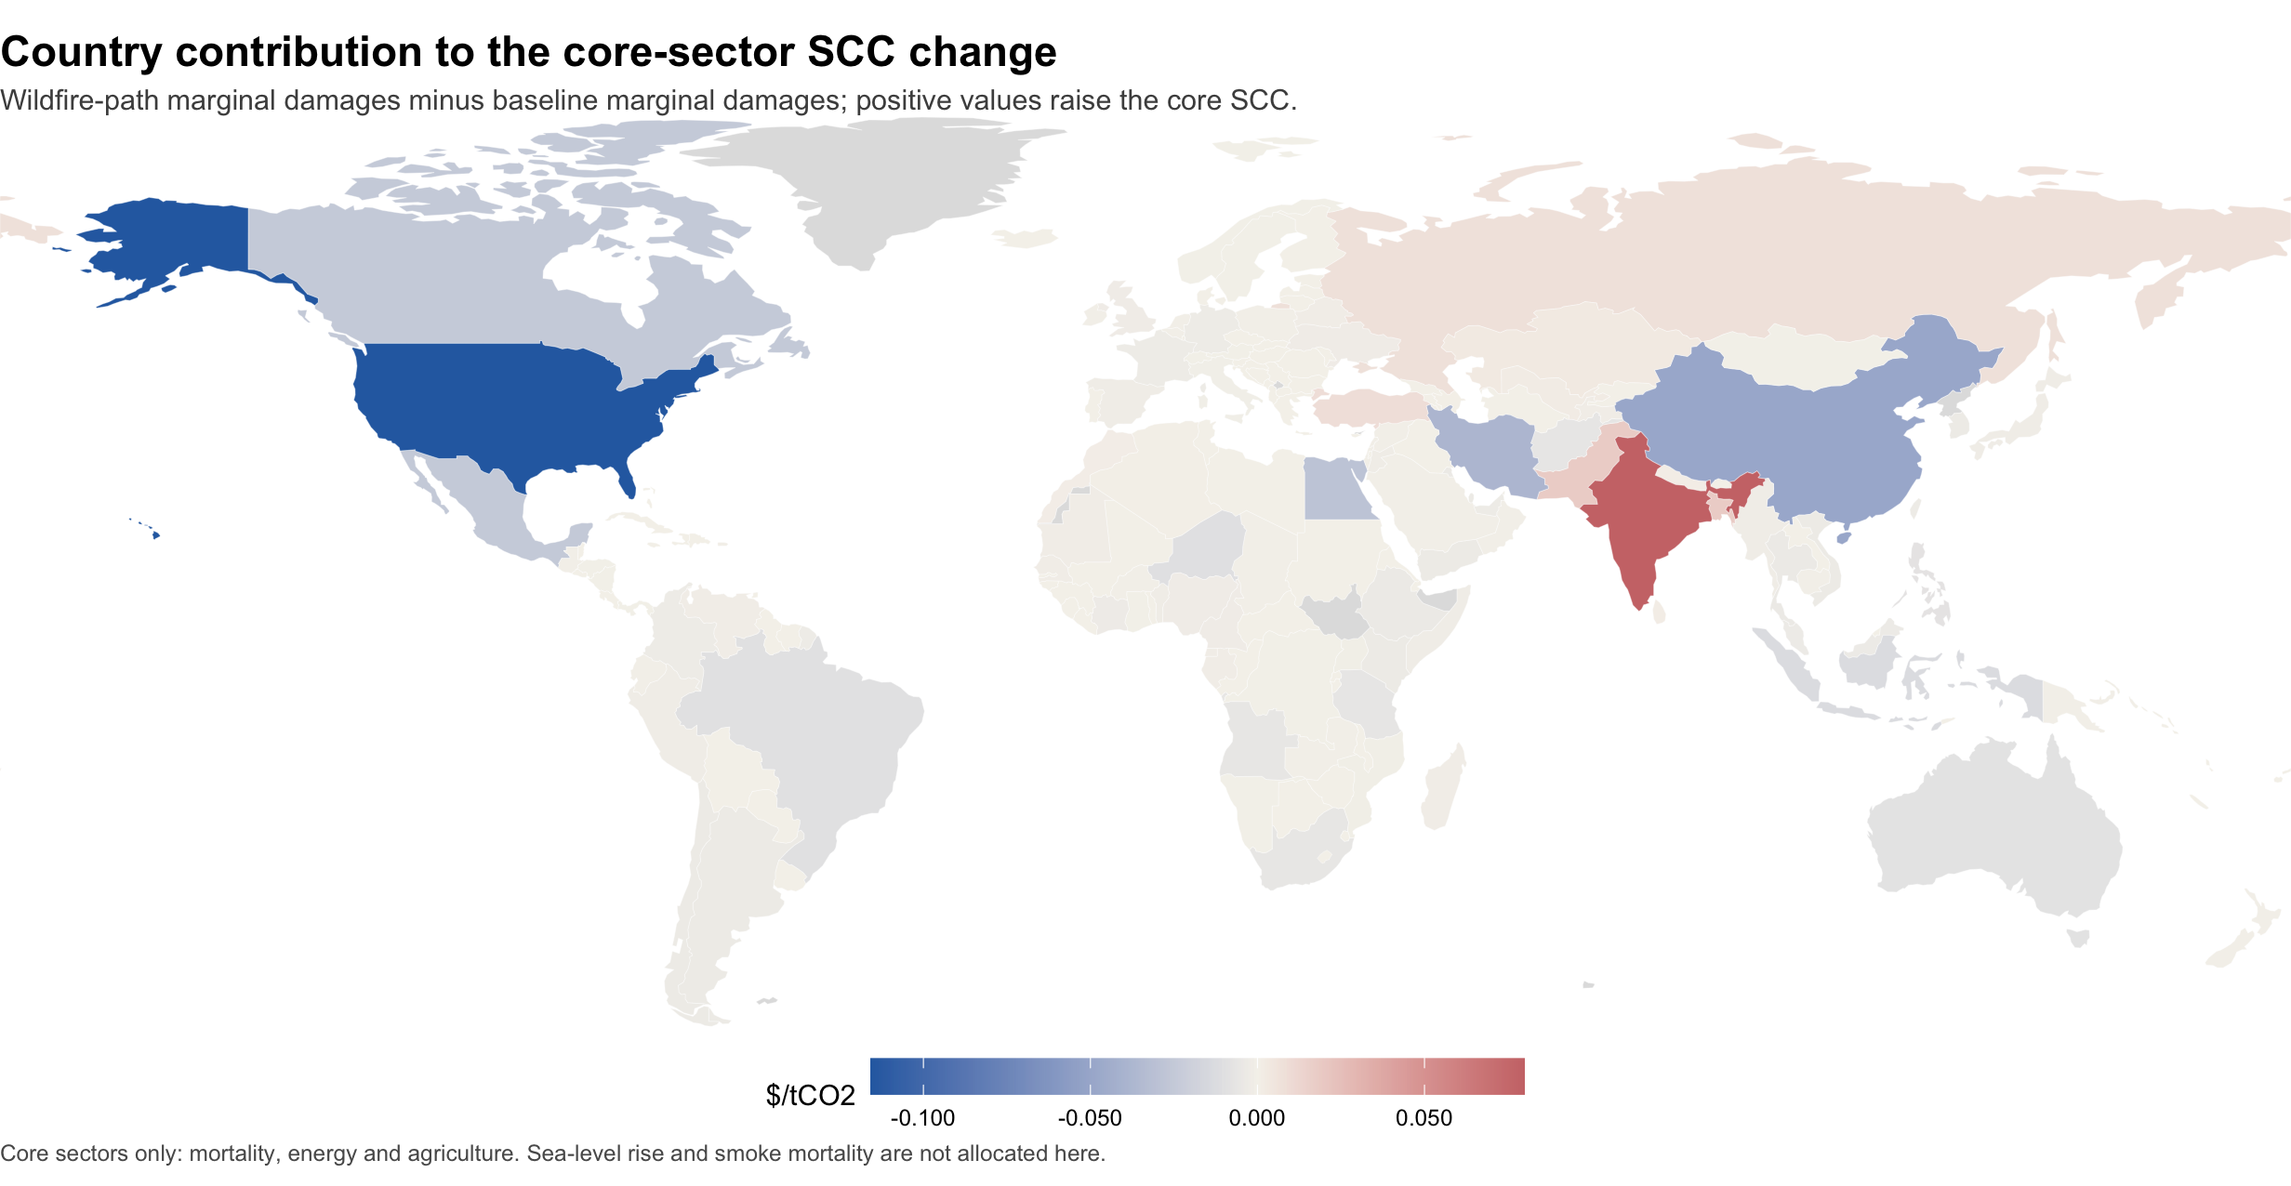
DIAGNOSTICS
Source geography and damage geography answer different questions.
Incremental core damages
Incremental core-sector SCC contribution
Diagnostics only: these exclude sea-level rise, smoke mortality, non-CO2 fire forcers and within-country distribution.
Regional diagnostics generated with Natural Earth country boundaries.
13

Slide 14
REPLICATION PACKAGE
The extension is isolated from the original replication code and ready for a GitHub remote.
/Users/jbb/Dropbox/GIVE
RennertEtAl2022ReplicationCodeData.zip
tools/
julia-1.6.4/
julia-1.8.5/
paper-2022-scc-give-zenodo/
Project.toml / Manifest.toml
packages/MimiGIVE / MimiFAIR / MimiRFFSPs
wildfire_extension/
WildfireGIVE.jl
run_temperature_feedback_mcs.jl
run_sectoral_diagnostics.jl
run_regional_damage_map_diagnostics.jl
make_png_pdf_figures.R
manuscript/ replication/ teaching_module/
output/
What is reproducible now
Deterministic runs, 100-draw validation, figures, manuscript, memo, teaching module and scripts.
What remains before public release
Create the GitHub repository, push the package, then run or parallelize the full 10,000-draw Monte Carlo.
Local workspace inventory; no GitHub remote has been created yet.
14

Slide 15
AI COLLABORATION
The AI was most useful as a persistent research programmer and auditor.
You
Framed hypotheses; challenged units and double counting; redirected toward diagnostics; judged figure usefulness.
AI agent
Searched code and literature; implemented the extension; ran checks; generated plots; drafted manuscript and deck.
Shared workspace
All claims tied back to files, runs, figures, tables, and scripts on the same machine.
Bootcamp lesson: the leverage came from tight feedback loops, visible files, skeptical checks, and refusing to treat the first model output as the answer.
Collaboration pattern from this thread and local workspace history.
15

Slide 16
INTERPRETATION
The preliminary result is useful, but the theory and data choices carry the result.
Finding
Result
Caveat
Next
GIVE lacks an endogenous warming -> wildfire -> CO2 feedback; any baseline fire carbon is exogenous and aggregated.
Residual net feedbacks are modest in 100 paired draws; gross missing fire-carbon stress tests can be large.
Gross fire emissions are not persistent net atmospheric additions, and baseline pathways may already embed some fire/AFOLU expectations.
Ingest gridded fire-carbon projections, characterize net persistence, avoid double counting, then run the full 10,000-draw Monte Carlo.
A good AI-assisted research workflow made the uncertainty more visible, not less.
Interpretation checkpoint: results are preliminary and intended to guide the next empirical iteration.
16

Slide 17
AUDIT TRAIL
The audit separated what is known, unknown and definitely missing.
1
Pathway input
MimiRFFSPs loads one aggregate global CO2 emissions pathway, not fossil / AFOLU / fire splits.
MimiRFFSPs: SPs.jl
2
Model connection
GIVE passes aggregate CO2 into FaIR, where the carbon cycle, forcing and temperature are calculated.
MimiGIVE: main_model.jl
3
Fallback pathways
For non-RFF runs, GIVE uses AR6-style fossil plus other CO2 pathway inputs.
main_model.jl fallback branch
4
Definite gap
No internal loop makes higher temperature produce extra wildfire CO2 emissions during the SCC pulse run.
wildfire feedback absent unless added
Audit conclusion: we cannot prove every historical or projected fire emission is absent from the baseline, but we can test an additional temperature-driven feedback as a residual mechanism.
Code-audit summary; detailed file paths belong in the appendix/technical memo.
17

Slide 18
CODE CHANGES
The implementation is a wrapper extension, not a rewrite of GIVE.
Original replication
Extension wrapper
RFF-SP CO2 pathway
-> FaIR carbon cycle
-> forcing and temperature
-> sector damages
-> SCC
Same baseline path
+ wildfire feedback
-> FaIR carbon cycle
-> same damage modules
-> paired SCC comparison
Changed files live under wildfire_extension/: WildfireGIVE.jl | run_temperature_feedback_mcs.jl | run_sectoral_diagnostics.jl | run_regional_damage_map_diagnostics.jl | make_png_pdf_figures.R
Original replication code preserved; extension files are isolated for review and rollback.
18

Slide 19
FROM LITERATURE TO PARAMETERS
The papers inform separate parameters rather than a single magic number.
Source
Parameter role
Interpretation guardrail
Byrne et al. Canada 2023
Event-scale sanity check
Large boreal events can reach multi-GtCO2 annual scale.
Val Martin / Pierce / Heald
Temperature response
Used to motivate a gross fire-emissions sensitivity to warming.
RESFire / CESM fire-feedback studies
Stress bounds
High-end missing-feedback cases show mechanism sensitivity.
Qiu et al.
Complementary damage channel
Smoke mortality is important but not included in this carbon-only extension.
RFF-SP / GIVE / FaIR
Accounting boundary
Defines where aggregate CO2 enters and where double-counting can occur.
This structure keeps the model honest: magnitude, persistence, missing share and damages are distinct judgments.
Literature synthesis used for the current validation-scale model extension.
19

Slide 20
UNCERTAINTY DESIGN
Paired sampling isolates the wildfire effect from GIVE's existing uncertainty.
Hold fixed across pair
Sample for wildfire
Compare within draw
Climate sensitivity, socioeconomic path, damage parameters, discounting and baseline SCC draw.
>
Reference fire scale, temperature response, net persistence and missing-share adjustment.
>
SCC_wildfire - SCC_baseline gives the incremental effect under the same GIVE world.
Why this matters: a noisy Monte Carlo can hide small effects. Paired draws make the wildfire increment visible without pretending the 100-draw validation is the final 10,000-run result.
Method used in run_temperature_feedback_mcs.jl and planned for the full Monte Carlo.
20

Slide 21
WHAT REMAINS
The next run should be bigger only after the data boundary is locked.
1
Freeze accounting
Decide what counts as net, persistent, not-already-embedded wildfire CO2.
2
Upgrade data
Replace heuristic source weights with gridded or regional fire-carbon projections.
3
Run 10,000 pairs
Parallelize baseline and wildfire scenarios with identical GIVE draws.
4
Stress-test mechanisms
Check temperature, forcing, sector damages, discounting and sea-level timing.
5
Publish package
Create remote GitHub repository, tag version and include run logs.
Reason for stopping at validation scale: avoid spending compute on a parameterization we may revise.
21

Slide 22
BOOTCAMP CLOSE
The collaboration pattern is the portable lesson.
Make the question falsifiable
Can we show the feedback is absent, embedded or ambiguous?
Keep files visible
Every claim should point to code, data, output or a figure.
Run small before large
One draw, diagnostics, then paired Monte Carlo.
Use skepticism as steering
Unit checks and double-counting questions improved the model.
Publish the trail
Memo, manuscript, figures, scripts and repository before policy claims.
For academics: the AI is strongest when treated as a tireless collaborator inside a disciplined research design.
End: results and workflow are both part of the presentation.
22

Slide 23
EPISTEMIC CHECKS
How I judged whether the work was on solid ground.
Code over vibes
Unit discipline
I traced where CO2 enters GIVE, how FaIR receives it, and whether a warming-to-fire-to-CO2 loop exists.
I checked CO2 vs carbon, annual flows vs atmospheric stocks, and event-scale anchors such as Canada 2023.
Mechanism tests
Literature triangulation
We used one-draw checks, a 1000% stress case, sectoral marginal damages and temperature-path diagnostics.
I separated smoke mortality, gross fire emissions, net persistence and double-counting risk.
Correct means a defensible conditional experiment, not proof that wildfire carbon is absent from every baseline pathway.
Epistemic slide added after the 22-slide deck: methods for deciding whether the extension was justified.
23

Slide 24
ROLES AND DEFERENCE
This was a team process, but not a symmetric one.
Your role
My role
Where I deferred
You set the hypothesis, challenged the scale, rejected weak figures, forced diagnostics and decided what mattered scientifically.
I acted as research programmer, model auditor, literature scout and skeptical calculator: fast execution plus an evidence ledger.
I ran experiments you asked for, including high-end stress tests, but labeled them as diagnostics when the accounting was not defensible.
I should not knowingly take a wrong path. If a run is useful but scientifically dubious, my job is to name it as a stress test, not launder it into a result.
Role framing: PI/domain judgment from the human researcher; audit, implementation and challenge from the AI collaborator.
24

Slide 25
WHAT RESEARCHERS MISS
The best next questions are about boundaries, not just bigger runs.
Accounting
What share of projected fire carbon is already embedded in AFOLU, LULUCF or aggregate scenario expectations?
Physics
What is net persistent CO2 after regrowth, combustion completeness and biome-specific recovery times?
Data
Can gridded fire-carbon projections replace hand-coded country source proxies?
Damages
Should smoke mortality and non-CO2 fire forcing be modeled as separate SCC channels?
Uncertainty
Can we sample uncertainty over model structure, not only over parameters?
Team description: you are in charge of the research aims and norms; I expand the search space, execute carefully and surface objections you may not yet know to ask.
Reflective close: the AI should make hidden uncertainty visible, not merely comply.
25

