Slide 1
Basic Description
Cross section is discretized into “fibers”
Each fiber has a specified strain
Stress is computed according to stress-strain constitutive relations
The force contribution from each fiber is the product of its stress and area
For a given curvature, the strain profile is determined such that ΣF=0
Total section moment is sum of moments from each fiber

Slide 2
Software Implementation (MATLAB)
User Input
Software Translation
Optimization to solve ΣF=0
Structural Parameters
Defect Definition
Preprocessing
Moment Curvature

Slide 3
User Input
Assign bridge geometry
Span length
Girder spacing
Specify deck thickness
Choose rebar size and spacing
Specify material properties
Stress-strain relationship
Density
Steel:
Select wide-flange section
Prestressed:
Select AASHTO or Bulb-Tee section
Specify diameter and number of prestressing strands

Slide 4
Defect Definition
Delamination or section loss
Specify size, shape, and location of defect
Remove contribution of corresponding fibers (i.e. stress=0)
Loss of composite action
Specify elevation where strain is discontinuous (i.e. shear release)

Slide 5
Preprocessing
Retrieve girder geometry and section properties from library
Compute initial demands
Steel: dead load
Prestressed: dead load and prestressing force (including losses)
Compute initial strain and curvature
Mesh cross-section into “fibers” that inherit appropriate material properties

Slide 6
Computation of Moment from Curvature
Optimization Algorithm
Curvature is specified
Strain in each fiber is computed (based on curvature and neutral-axis)
Stress in each fiber is computed using material constitutive relations
Forces are computed and summed
If ΣF≠0, adjust neutral axis
If ΣF=0, compute sum of fiber moments about section centroid
Repeat for various curvature values to generate moment-curvature curve

Slide 7
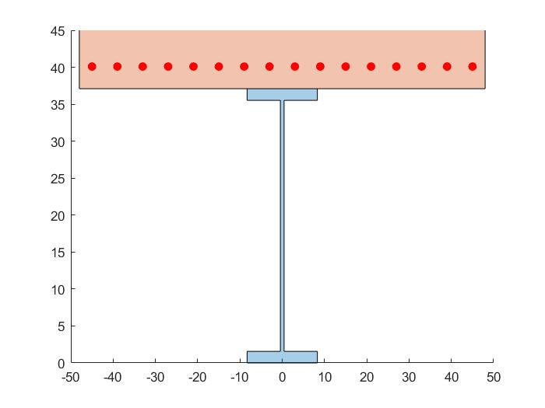
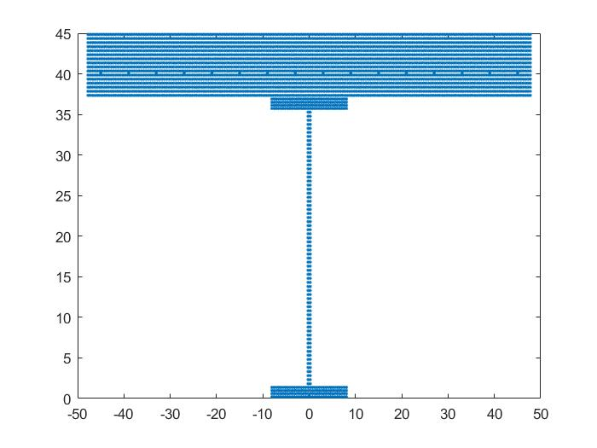
Demonstration
50ft. Span length
8ft. Girder spacing
Girder: W36X282
8in. Deck w/ #6 rebar @ 6in.
Steel Material: Elasto-plastic
Concrete Material: Hognestad Model
Defect: Full-width delamination of varying depth
Assume concrete crushing at strain = 0.0038

