Slide 1
Proposed Instrumentation Plans

Slide 2
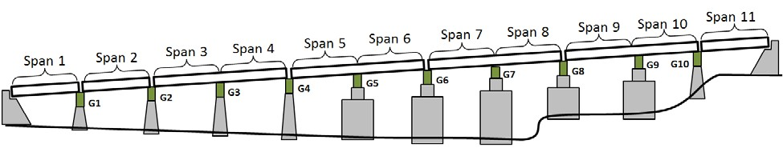
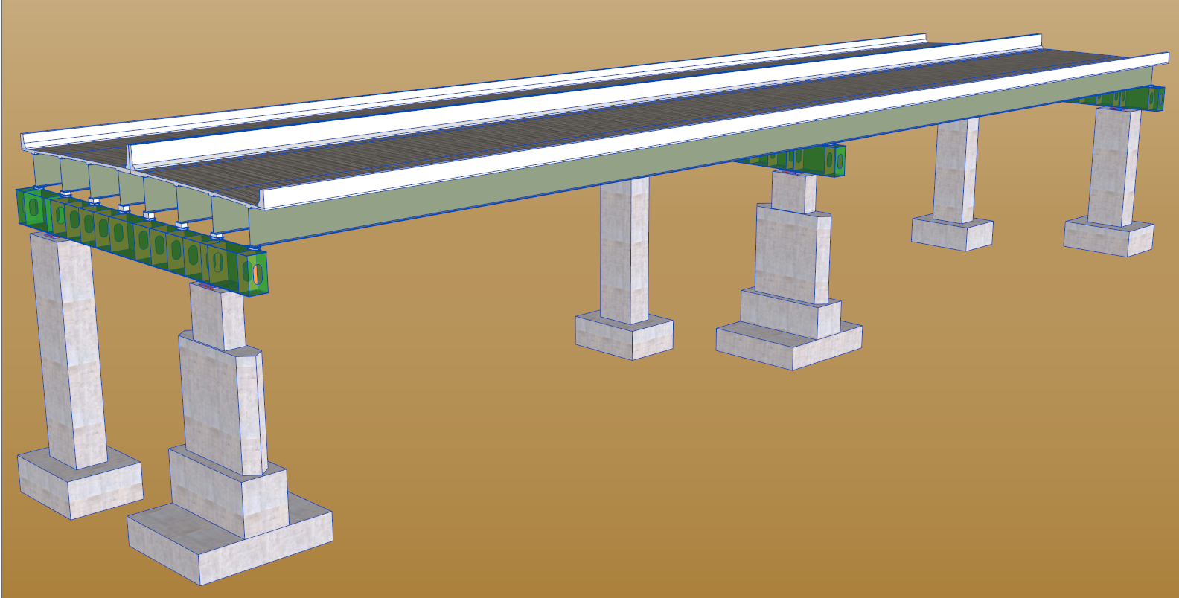
Chosen Section
Span 8
G8
G7
Span 7
G6

Slide 3
Instrumentation Plan
32 Accelerometers:
20 vertically oriented accels
5 transversely oriented accels
7 longitudinally oriented accels
12 Strain Gauges
9 on W-Beams. 3 on Box Girder
3’
15’
X-Section
h/3
h/3
h/3
Accel.
Strain
6”
Span 7
Span 8
2’
1/4
Midspan
3/4
1/4

Slide 4
Instrumentation Plan
32 Accelerometers:
20 vertically oriented accels
5 transversely oriented accels
7 longitudinally oriented accels
12 Strain Gauges
9 on W-Beams. 3 on Box Girder
3’
15’
X-Section
h/3
h/3
h/3
Accel.
Strain
6”
Span 7
Span 8
2’
1/4
Midspan
3/4
1/4

Slide 5
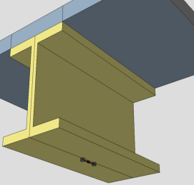
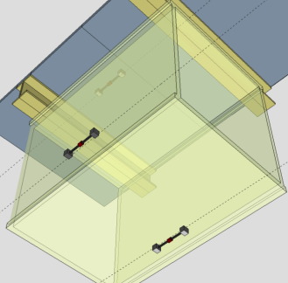
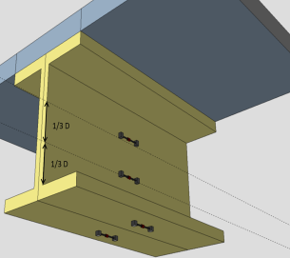
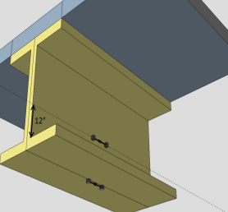
Span 7
Span 8
Span 7
Span 8
Typ. Gauge Loc.
Typ. Gauge Loc.
Mid-span
Mid-span
Span 7
Span 8
Gauge Loc’s.
2’
Span 7
Span 8
Gauge Loc’s.
Mid-span
Mid-span
Span 7
Span 8
Gauge Loc’s.
Mid-span
Span 7
Span 8
Typ. Gauge Loc.
Mid-span

Slide 6
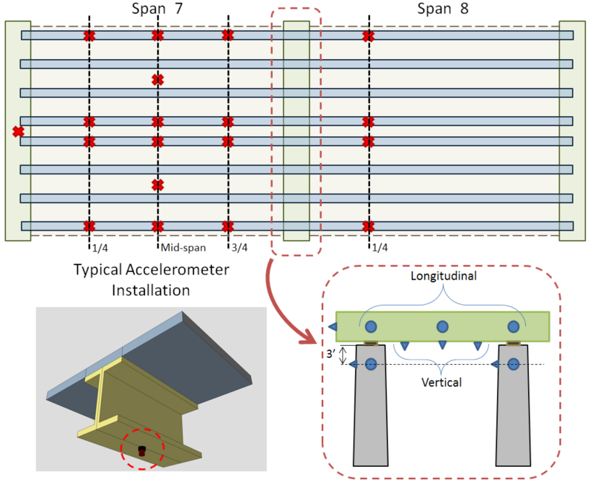
1
2
3
15
Girder 1
Girder 2
4
Girder 3
28
5
6
7
16
Girder 4
8
9
10
17
Girder 5
Girder 6
11
Girder 7
12
13
14
18
Girder 8
19
20
21
23
29
22
30
25
24
27
26

Slide 7
 | Tue | Wed | Thur | Fri
Attach Accels on Girders
Glue Accels on Piers
Run Cables
Record Data
Breakdown
Contingency
Item | Quantity
NI 9234 Cards | 8
Campbell DAQ system | 1
NI DAQ System | 1
Video Camera | 1
Torch | 2
Hot Glue Sticks | 5
Strain Relief Tabs | 10
Zip Ties | 100
Extension Pole | 1
Generator | 1
Folding Table | 1
Epoxy (2oz) | 6
Duct Tape (Rolls) | 4
Angle Grinder | 1
Grinding Disks | 4
Cable Length | Quantity
100’ Extensions | 11
100’ PCB Cables | 32
Accelerometers | 32
Magnets | 24
Strain Gauges | 12
Geokon Cable (100’) | 12

