Slide 1
Instrumentation - Deck
Sensor | Number | Symbol
Strain (& Temperature) | Rebar T&B (36) + Deck Bottom (4)
Humidity | Top-Middle-Bottom (6)
Steel girder
Wheel line
Exp
Fix
Emb: 1, Surf: 0
Emb: 1, Surf: 0
Emb: 2, Surf: 2
Emb: 2, Surf: 2
Emb: 4, Surf: 0
Emb: 3, Surf: 0
Emb: 4, Surf: 0
Emb: 1, Surf: 0
Emb: 4, Surf: 0
Emb: 3, Surf: 0
Emb: 4, Surf: 0
Emb: 4, Surf: 0
Emb: 1, Surf: 0
Emb: 1, Surf: 0
Emb: 1, Surf: 0
Int. girders
Over girders
Between girders

Slide 2
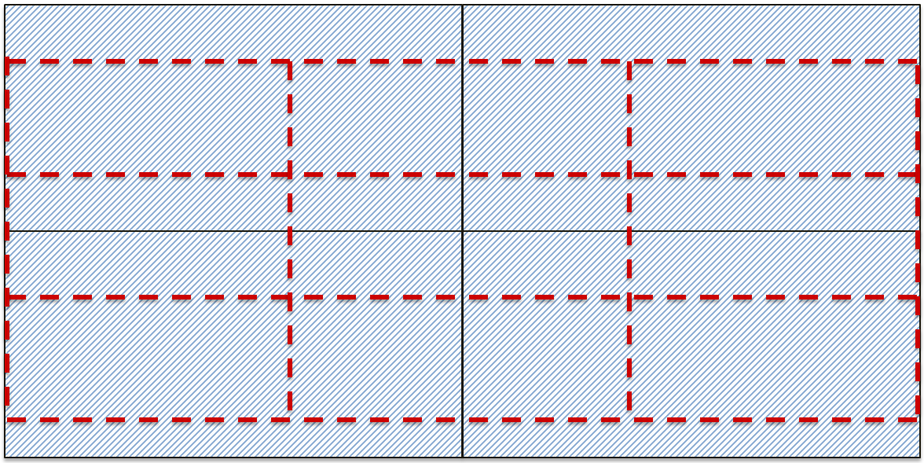
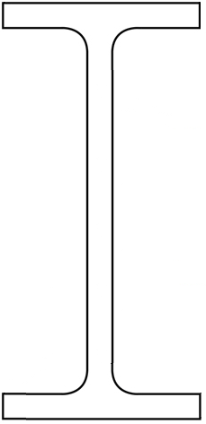
Sensor | Number | Symbol
Strain (& Temperature) | Girder (flexure and shear – 18+6+16Total)
Acceleration | Girder (12 Total)
Displacement | Girder (12 Total)
Displacement | Expansion joint (2 girders)
Instrumentation - Girder
Steel girder
Exp
Fix
L/4
L/4
L/4
L/4
Ext. mid-span flexural strain gages
Other flexural strain gages

Slide 3
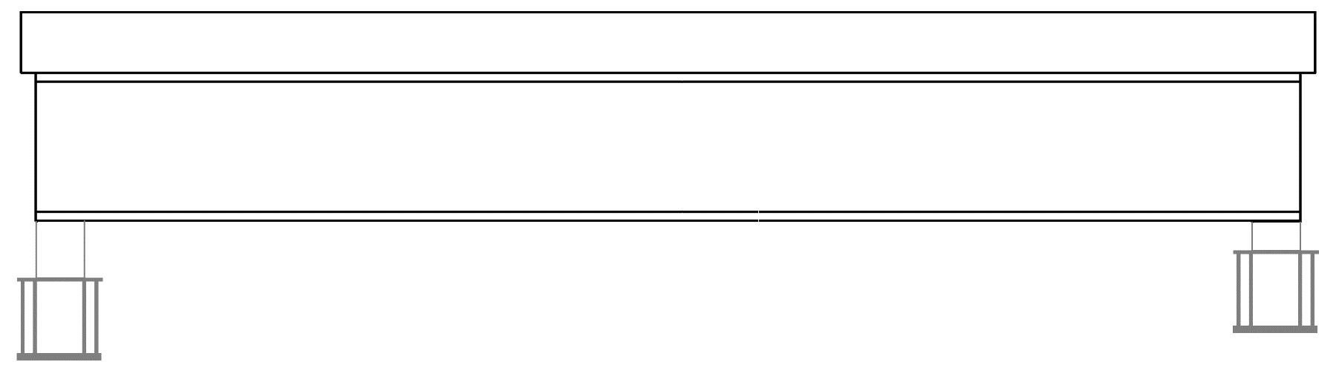
Instrumentation - Girder
Sensor | Number | Symbol
Strain (& Temperature) | Girder & Pedestal (max 14 per girder/pedestal)
Displacement | Totally 4 per girder (including expansion)
Acceleration | Totally 3 per girder
Exp
Fix
L/4
L/4
L/4
L/4

