Slide 1
Instrumentation Summary
Deck Instrumentation
(36) Rebar strain gauges
Mounted to 36” #4 sister bar, vibrating wire
(4) Surface mounted strain gauges
6” gauge length with surface mounting tabs, vibrating wire
(6) Embedded humidity sensors
Girder Instrumentation
(40) Strain gauges
2” gauge length with covers, vibrating wire
(12) Displacement gauges
String potentiometers, 5” full stroke range
(12) Accelerometers
±5G, AC coupled, piezoelectric
Additional Instrumentation
(2) joint displacement
(TML gauges)
(16) pedestal strain
2” gauge length, spot weldable, vibrating wire
(4) Reaction frame strain
2” gauge length, spot weldable, vibrating wire

Slide 2
Instrumentation - Deck
Sensor | Number | Symbol
Strain (& Temperature) | Rebar T&B (36) + Deck Bottom (4)
Humidity | Top-Middle-Bottom (6)
Steel girder
Wheel line
Exp
Fix
Emb: 1, Surf: 0
Emb: 1, Surf: 0
Emb: 2, Surf: 2
Emb: 2, Surf: 2
Emb: 4, Surf: 0
Emb: 3, Surf: 0
Emb: 4, Surf: 0
Emb: 1, Surf: 0
Emb: 4, Surf: 0
Emb: 3, Surf: 0
Emb: 4, Surf: 0
Emb: 4, Surf: 0
Emb: 1, Surf: 0
Emb: 1, Surf: 0
Emb: 1, Surf: 0
Int. girders
Over girders
Between girders

Slide 3
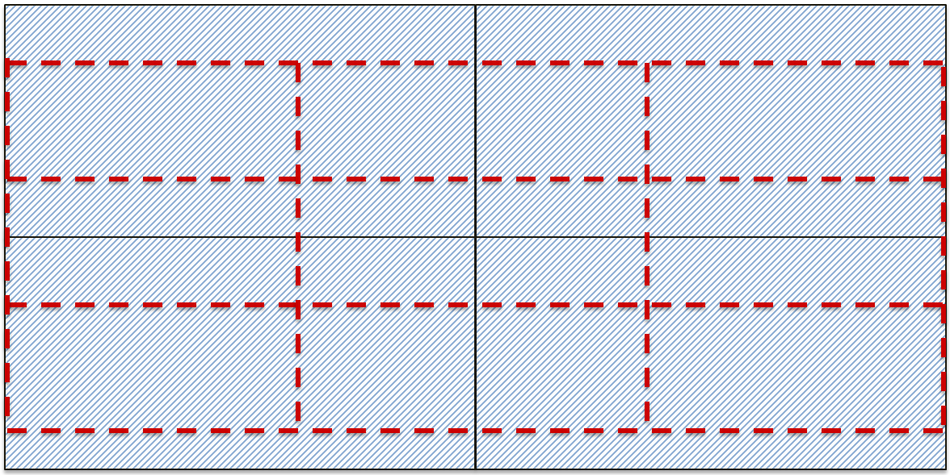
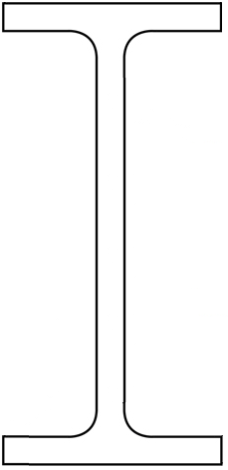
Sensor | Number | Symbol
Strain (& Temperature) | Girder (flexure and shear – 18+6+16Total)
Acceleration | Girder (12 Total)
Displacement | Girder (12 Total)
Displacement | Expansion joint (2 girders)
Instrumentation - Girder
Steel girder
Exp
Fix
L/4
L/4
L/4
L/4
Ext. mid-span flexural strain gages
Other flexural strain gages

Slide 4
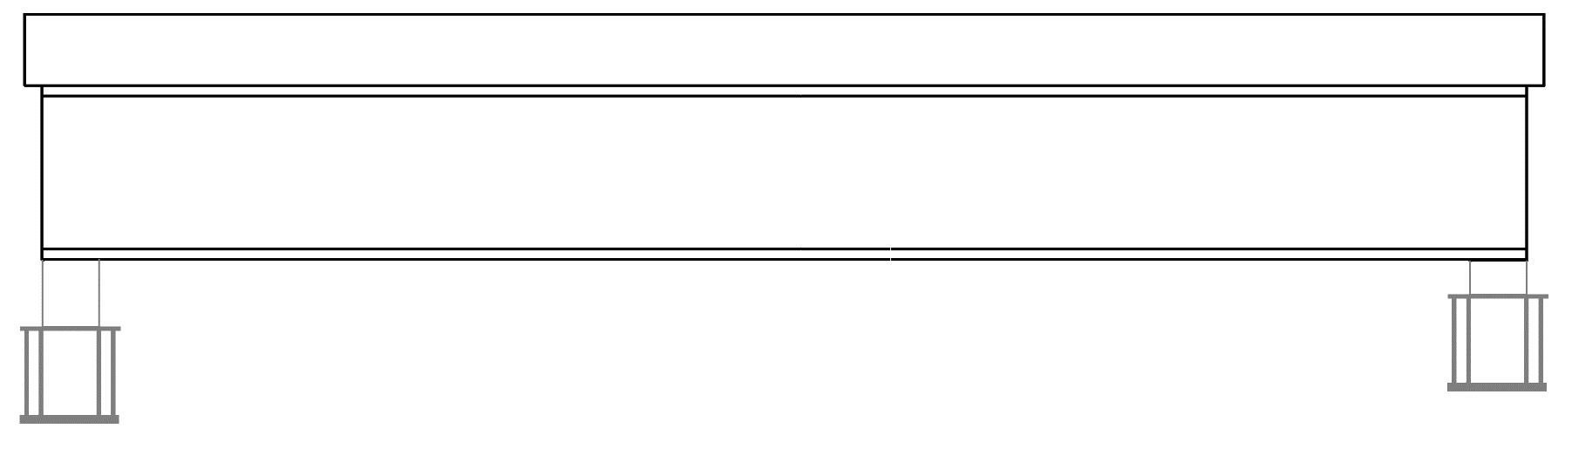
Instrumentation - Girder
Sensor | Number | Symbol
Strain (& Temperature) | Girder & Pedestal (max 14 per girder/pedestal)
Displacement | Totally 4 per girder (including expansion)
Acceleration | Totally 3 per girder
Exp
Fix
L/4
L/4
L/4
L/4

