Slide 1
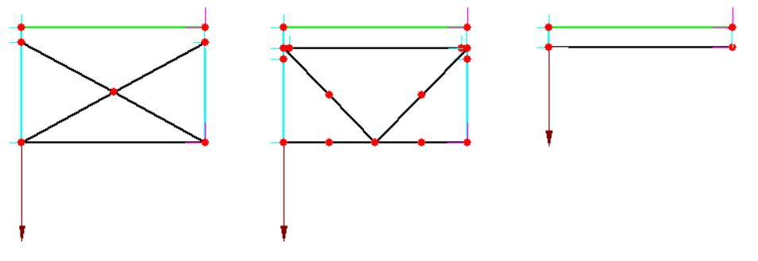
Pinned Links
Pinned Link
Beam Element
Beam Elements (typ.)
Rigid Links (typ.)
3D Element-Level Representation
Equivalent Beam

