Slide 1

PhD Proposal
Understanding Vehicle-Bridge Interaction through Field Measurements and Model-Based Simulations
John B. Braley
Department of Civil & Environmental Engineering
School of Engineering
Rutgers, The State University of New Jersey

Slide 2
Research Need
State of US Bridges *
Majority approaching or exceeding design life
Traffic restrictions imposed on 10% (choke points)
$123 billion required
Stewardship Objectives
Continued performance of existing bridges
Improved performance of new bridges
Informed resource allocation
Required Knowledge
Realistic demands
Factors affecting performance
Bridge deterioration
* 2017 ASCE Infrastructure Report Card

Slide 3

State of Industry
Live load demands principally consist of truck loads
Static analysis prescribed
Dynamic component reduced to “amplification” factor
Question: Is this simplification adequate?
m
m
m
m
m
m
VS

Slide 4

Dynamic Amplification Factors
Static loads used in highway bridge design and evaluation
Amplification factors to account for additional load effect from VBI applied to loading model

Slide 5
Dynamic Amplification in Codes
Different countries use different factors
Range from 0.05 to 0.40 (AASHTO: 0.33)
Dependent on:
  road roughness, no. axles, 1st natural freq, span length
Developed through surveys of existing bridge stock
Experimental evaluation of IM’s
  High variability
  Not uncommon to exceed prescribed value

Slide 6
Knowledge Gaps & Vulnerabilities
Dynamic effect of traffic on highway bridges is poorly understood
  Inadequacy of current codes has been demonstrated by field experiments (i.e. outliers)
  Simulation studies on influential parameters have failed to reach actionable conclusions
    Simple models with limited parameters
    No consensus on role of influential parameters or how to incorporate into prediction methodologies
  Interdependency of influential parameters has been largely overlooked
Established methodologies were developed through statistical means
  How has the bridge population changed?
  How has traffic changed?
Effect of truck platoons on highway bridges
Notes:
Field experiments are limited to the population subset and only serve to demonstrate shortcomings, rather than propose improvements
Simulations have been mostly with simplified models (i.e. single-line girder), and with only a few parameters to be investigated and no assurance that the models are capable of simulating VBI

Slide 7
Objectives
Characterize the mechanisms behind VBI
  Role of influential parameters
Identify any shortcomings with current design and assessment methodologies
  In which situations are their treatment of dynamic amplification inadequate
  Propose modifications
Identify bridge vulnerabilities associated with truck platooning
  “Problematic” platoon patterns and vulnerable bridges
  Make recommendations related to implementation strategies and policies
Notes:
Difference from previous studies:
Field testing and model calibration will ensure the models are capable of simulating VBI
All influential parameters will be examined simultaneously
Develop actionable conclusions

Slide 8
Research Strategy
Phase 1 – Identify and characterize “learning” structure through field testing. Develop FE model.
Phase 2 – Perform detailed characterization of VBI on test structure. Refine FE model.
Phase 3 – Investigate VBI mechanisms with sensitivity analysis of FE model parameters
Phase 4 – Assess capability of established methods to predict dynamic amplification with FE parametric studies
Phase 5 – Characterize vulnerability of bridges exposed to platooned trucks with FE parametric studies

Slide 9
Research Strategy – Completed Work
Phase 1 – Identify and characterize “learning” structure through field testing. Develop FE model.
Phase 2 – Perform detailed characterization of VBI on test structure. Refine FE model.
Phase 3 – Investigate VBI mechanisms with sensitivity analysis of FE model parameters
Phase 4 – Assess capability of established methods to predict dynamic amplification with FE parametric studies
Phase 5 – Characterize vulnerability of bridges exposed to platooned trucks with FE parametric studies

Slide 10
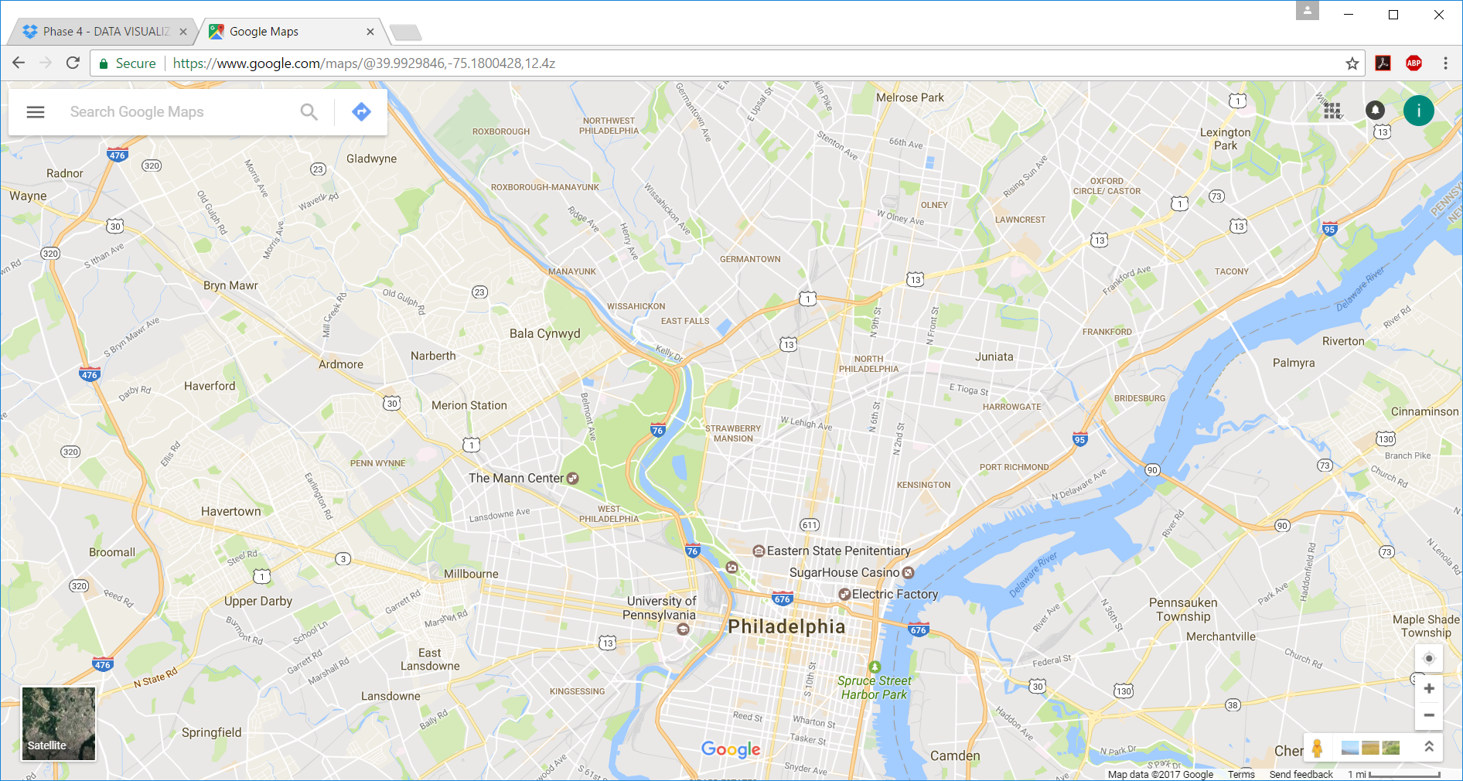
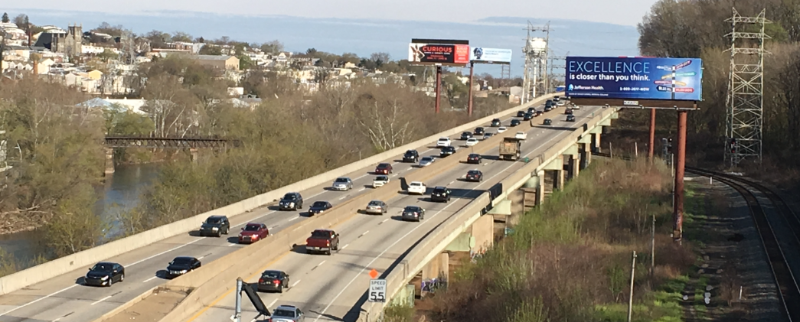
Completed Work – Phase 1
I-76 PENCOYD VIADUCT (1986)

Slide 11
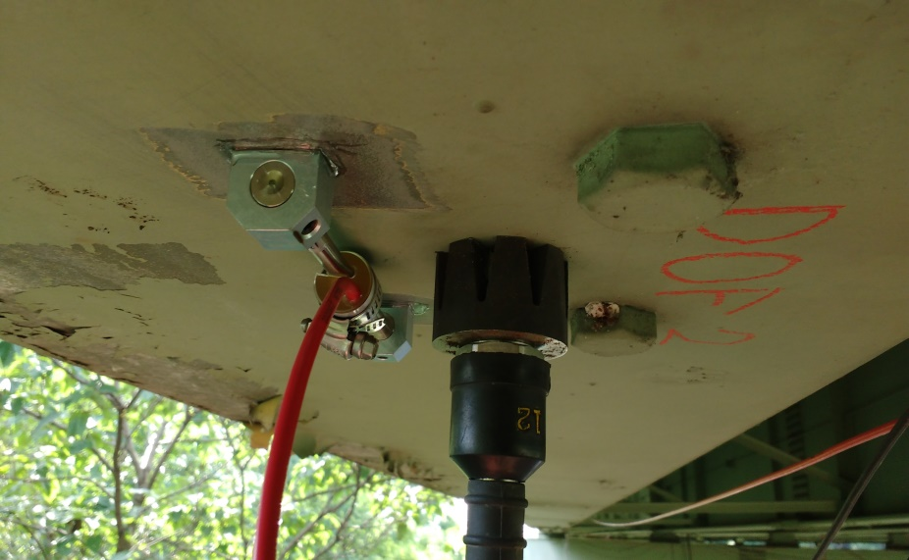
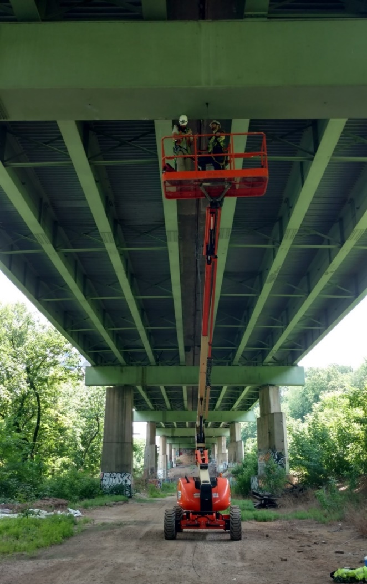
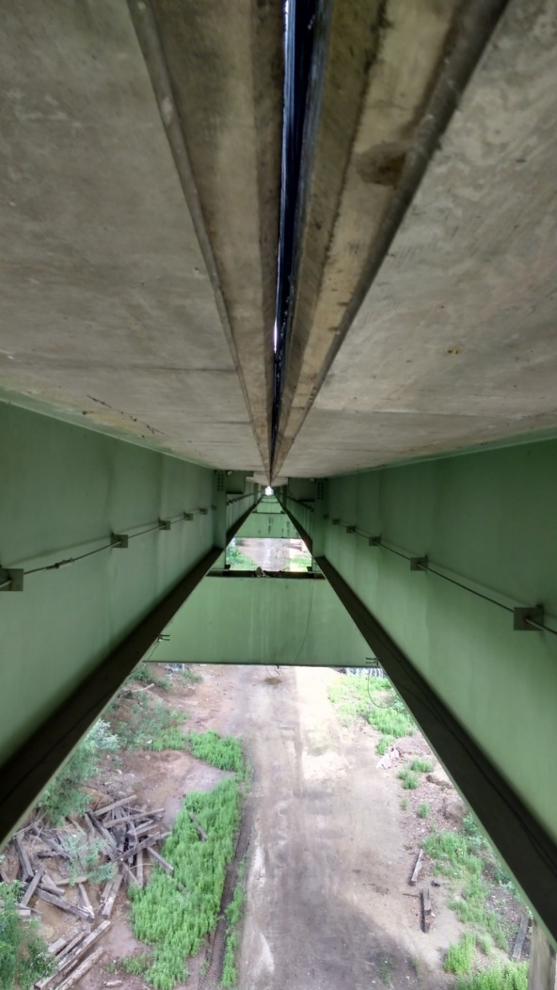
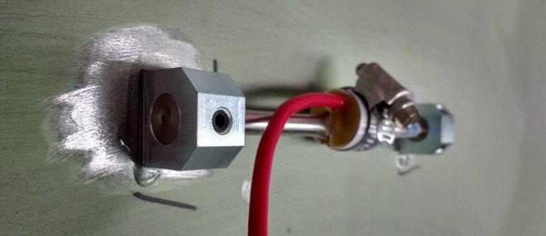
Completed Work – Phase 1: First Field Test
Spans 7 & 8 selected for testing
INSTRUMENTATION PLAN
30 Accelerometers
12 Strain Gauges
24 hours of data collected

Slide 12
Completed Work – Phase 1: Outcomes
Primary objectives:
  Mode shapes and frequencies obtained
  FE model created and calibrated
Additional Observations
  Vibration levels are similar for different spans
  Operational peak strains 100 - 200 με
  Vibration levels as high as 25%G: “very disturbing” for human comfort criterion
  Vibration results in large amplifications

Slide 13
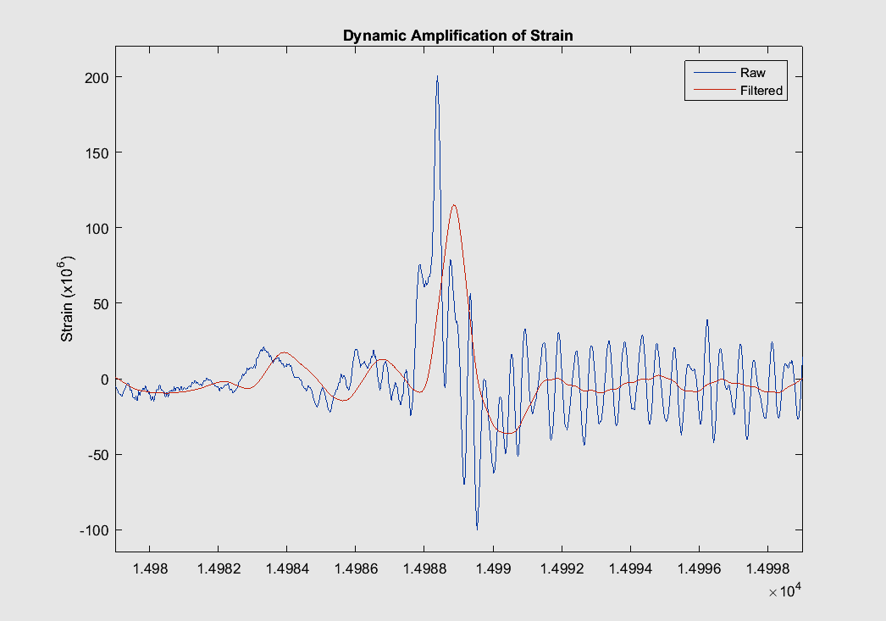
Completed Work – Phase 1: Outcomes
Dynamic amplification ≈ 1.75-2.0 =
Dynamic response
Static response

Slide 14
Research Strategy – Completed Work
Phase 1 – Identify and characterize “learning” structure through field testing. Develop FE model.
Phase 2 – Perform detailed characterization of VBI on test structure. Refine FE model.
Phase 3 – Investigate VBI mechanisms with sensitivity analysis of FE model parameters
Phase 4 – Assess capability of established methods to predict dynamic amplification with FE parametric studies
Phase 5 – Characterize vulnerability of bridges exposed to platooned trucks with FE parametric studies

Slide 15
Completed Work – Phase 2: Test Objectives
Characterize Vehicle-Bridge Interaction
Capture motion of vehicle over bridge
  Roll, pitch, bounce
  In all lanes; at different speeds, traffic conditions
Capture resulting response of bridge
  Acceleration and strain
  At different locations along structure
  Able to be synchronized with truck motion data
Recreate testing “scenarios” with FE simulation
  Collect all necessary data/info for model creation

Slide 16
Completed Work – Phase 2: Test Execution
Instrumentation
Accelerometers (4) on 4 corners of dump body (sync)
Accelerometers (36) on spans 2, 3, 4, 7 & 8 (sync)
Strain gauges (2) on span 3
3 video cameras
Test Activity
14 passes were made by the test truck over the bridge
Truck velocity ranged from 10 mph to 60 mph
Both sides of the bridge and all 4 lanes were traversed
Passes were made in various traffic conditions (light traffic, medium traffic, heavy traffic)

Slide 17
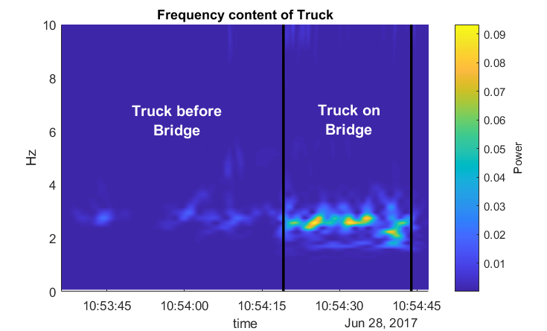
Completed Work – Phase 2: Test Observations
Off Bridge
The magnitude of vertical acceleration greatly increases as soon as the truck enters the bridge
The first mode between 2 and 3 Hz is excited when traversing the bridge
Acceleration magnitude quickly drops after exiting the bridge

Slide 18

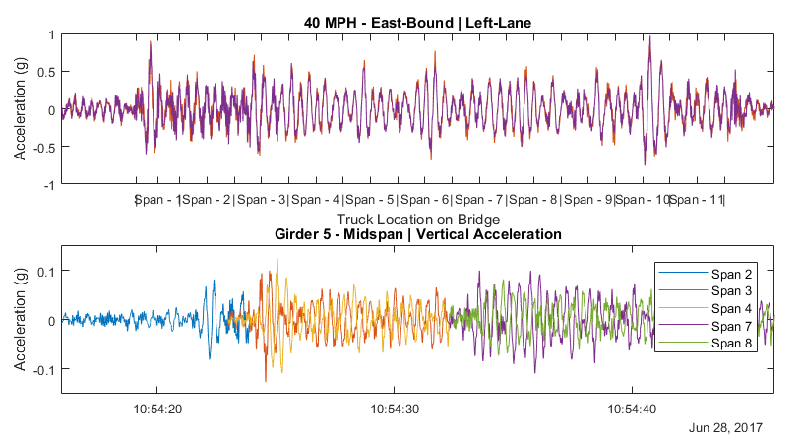
Completed Work – Phase 2: Test Observations
Span 1
Span 2
Span 3
Span 4
Span 5
Span 6
Span 7
Span 8
Span 9
Span 10
Span 11

Slide 19
Completed Work – Phase 2: Test Conclusions
Observations from test data
The test truck was readily excited when traversing the bridge
Magnitude of truck acceleration increased with speed
Even a single truck can cause significant bridge vibration
Initial Simulation Efforts (LUSAS model of 11 spans)
Simulation unable to replicate magnitude of acceleration
Roadway profile must be included

Slide 20
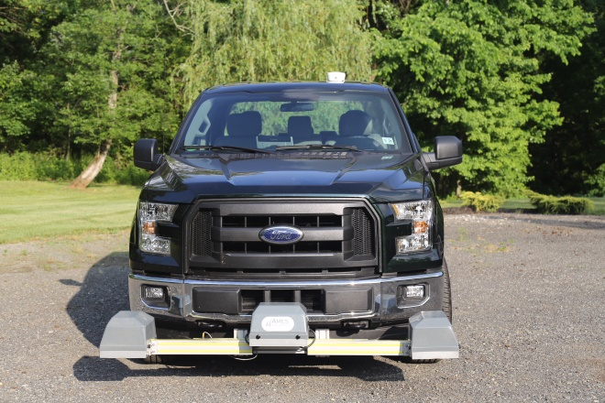
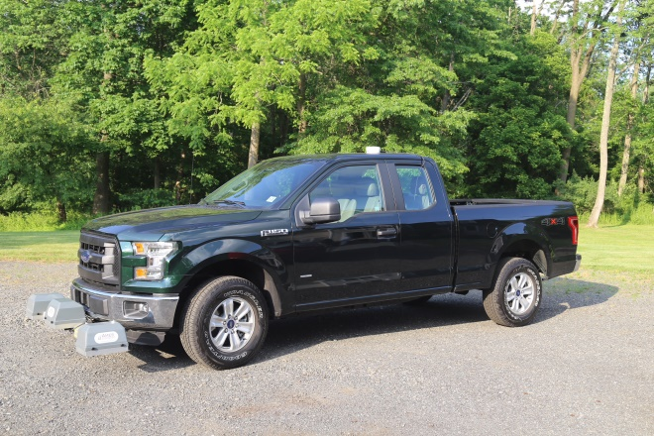
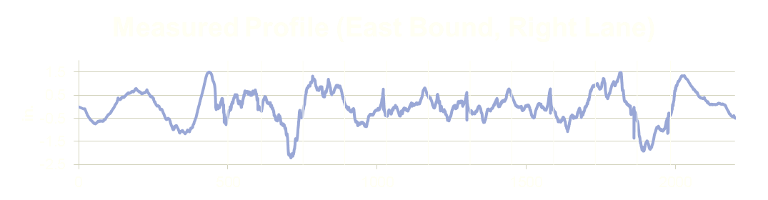
Completed Work – Phase 2: Detailed Field Characterization
The profile of the bridge was measured by RWS Consulting.
Ames Engineering Model 8300 Portable Profiler
2 passes in each lane
Captured left and right wheel lines

Slide 21
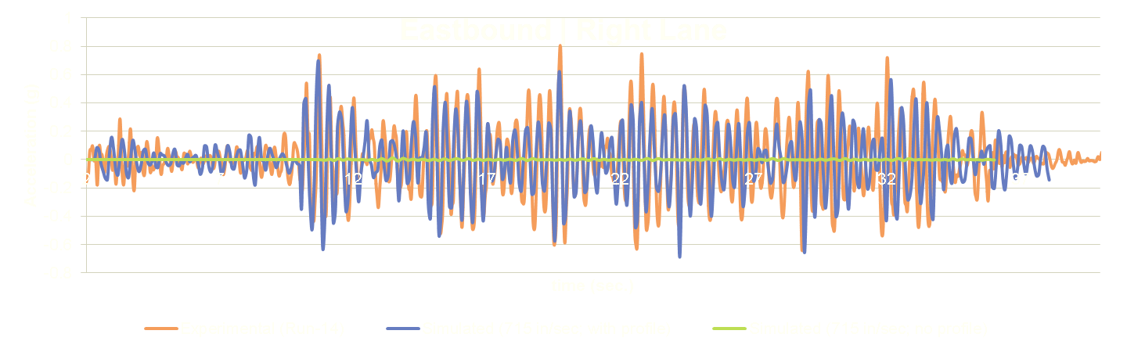
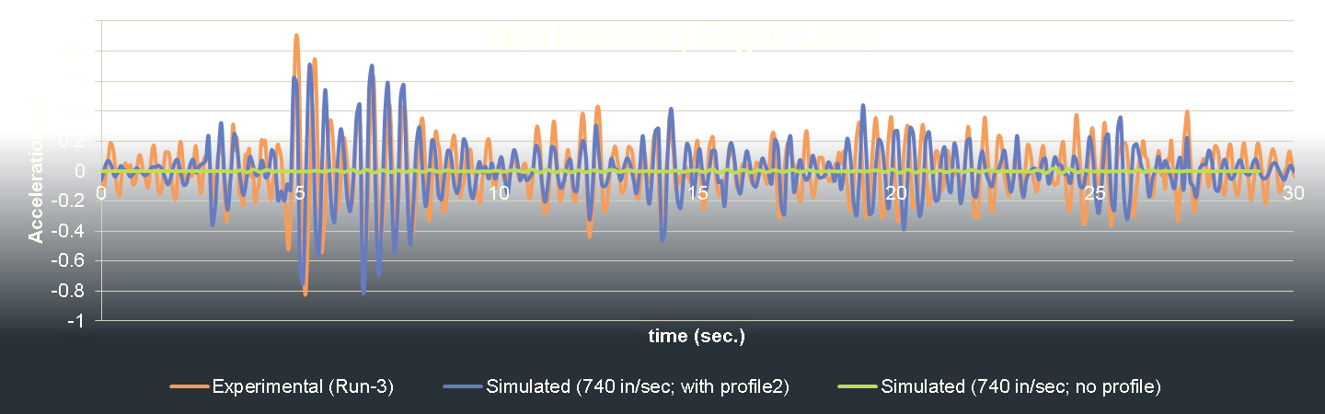
Completed Work – Phase 2: Simulation of test scenarios
Simulation vs Experimental - Truck Acceleration

Slide 22
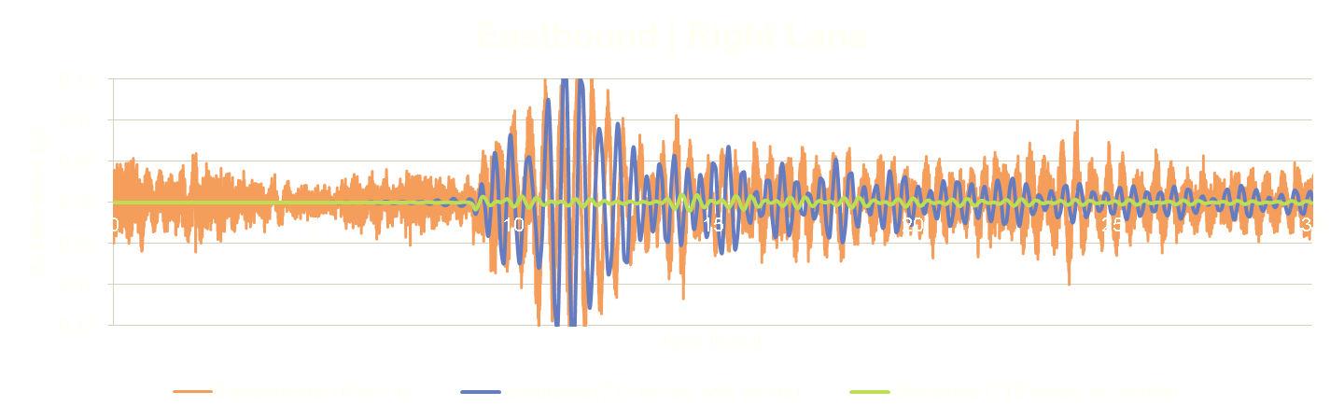
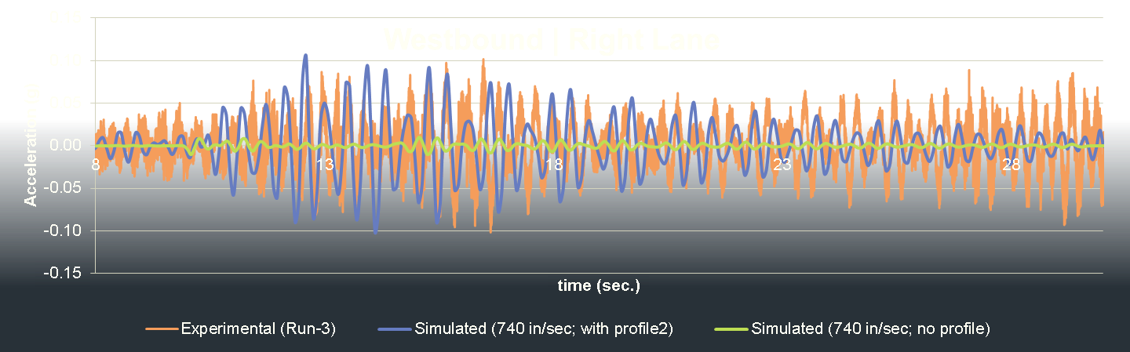
Completed Work – Phase 2: Simulation of test scenarios
Simulation vs Experimental – Bridge Acceleration
SPAN 3
SPAN 8

Slide 23
Completed Work: Summary
“Test” structure has been characterized through field testing, modal parameter identification, and FE model creation and calibration.
Monitoring of bridge and truck accelerations has revealed characteristic VBI behavior
Measurement of the profile was necessary for accurate simulation
An FE model has been developed that can replicate the characteristic accelerations and thus shown capable of simulating VBI

Slide 24
Research Strategy
Phase 1 – Identify and characterize “learning” structure through field testing. Develop FE model.
Phase 2 – Perform detailed characterization of VBI on test structure. Refine FE model.
Phase 3 – Investigate VBI mechanisms with sensitivity analysis of FE model parameters
Phase 4 – Assess capability of established methods to predict dynamic amplification with FE parametric studies
Phase 5 – Characterize vulnerability of bridges exposed to platooned trucks with FE parametric studies

Slide 25
Objectives
Characterize the mechanisms behind VBI
  Role of influential parameters
Identify any shortcomings with current design and assessment methodologies
  In which situations are their treatment of dynamic amplification inadequate
  Propose modifications
Identify bridge vulnerabilities associated with truck platooning
  “Problematic” platoon patterns and vulnerable bridges
  Make recommendations related to implementation strategies and policies
Notes:
Difference from previous studies:
Field testing and model calibration will ensure the models are capable of simulating VBI
All influential parameters will be examined simultaneously

Slide 26
Future Work – Phase 3: Identification of VBI Parameters
The FE model that has been shown to be capable of simulating VBI, can now be leveraged to study which parameters are influential through sensitivity studies.
Task Processes:
Reduce model complexity
Identify sensitive parameters
Develop parameter ranges
Examine and refine parameters and ranges
Document the final set of parameters and their relation to vehicle or structural mechanisms
Add’l Det.

Slide 27
Objectives
Characterize the mechanisms behind VBI
  Role of influential parameters
Identify any shortcomings with current design and assessment methodologies
  In which situations are their treatment of dynamic amplification inadequate
  Propose modifications
Identify bridge vulnerabilities associated with truck platooning
  “Problematic” platoon patterns and vulnerable bridges
  Make recommendations related to implementation strategies and policies
Notes:
Difference from previous studies:
Field testing and model calibration will ensure the models are capable of simulating VBI
All influential parameters will be examined simultaneously

Slide 28
Future Work – Phase 4: Assess Current Methodologies
A parametric study will be performed that examines the affect of the previously identified parameters on dynamic amplification. These results will be compared with the factors specified by current codes.
Task Processes
Design and perform parametric study
Identify structures with DAF greater than predicted
Identify better methods of predicting amplification factors
Identify alternative methods of modeling VBI
Add’l Det.

Slide 29
Objectives
Characterize the mechanisms behind VBI
  Role of influential parameters
Identify any shortcomings with current design and assessment methodologies
  In which situations are their treatment of dynamic amplification inadequate
  Propose modifications
Identify bridge vulnerabilities associated with truck platooning
  “Problematic” platoon patterns and vulnerable bridges
  Make recommendations related to implementation strategies and policies
Notes:
Difference from previous studies:
Field testing and model calibration will ensure the models are capable of simulating VBI
All influential parameters will be examined simultaneously

Slide 30
Future Work – Phase 5: Investigation of Truck Platoons
The results from the previous parametric study will be used to choose a set of structures for which platoon parameters will be investigated.
This second parametric study will focus on the effect of platoon parameters on bridge response and dynamic amplification.
Task Processes:
Conduct parametric study to identify “problematic” platoon parameter values
Identify “best-case” platoon parameters
Develop truck platooning policy recommendations
Add’l Det.

Slide 31
Future Work: Summary
Perform sensitivity studies to identify parameters and mechanisms that affect VBI.
Perform parametric study to characterize the influence of various parameters on actual dynamic amplification compared to current specified factors.
Perform parametric study to identify situations for which truck platoons result in large structural response.

Slide 32
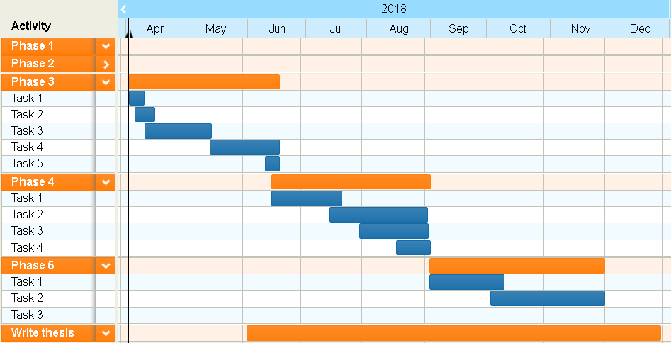
Future Work - Schedule

Slide 33
Research Strategy
Demonstrate Comprehensive Understanding of VBI
Phase 1 – Identify and characterize “learning” structure through field testing. Develop FE model.
Phase 2 – Perform detailed characterization of VBI on test structure. Refine FE model.
Phase 3 – Investigate VBI mechanisms with sensitivity analysis of FE model parameters
Phase 4 – Assess capability of established methods to predict dynamic amplification with FE parametric studies
Phase 5 – Characterize vulnerability of bridges exposed to platooned trucks with FE parametric studies
Develop Actionable Knowledge of Live Load Demands

Slide 34
End

Slide 35
Objectives
Characterize the mechanisms behind VBI
  Role of influential parameters
Identify any shortcomings with current design and assessment methodologies
  In which situations are their treatment of dynamic amplification inadequate
  Propose modifications
Identify bridge vulnerabilities associated with truck platooning
  “Problematic” platoon patterns and vulnerable bridges
  Make recommendations related to implementation strategies and policies
Notes:
Difference from previous studies:
Field testing and model calibration will ensure the models are capable of simulating VBI
All influential parameters will be examined simultaneously
Develop actionable conclusions

Slide 36
Background – Vehicle Bridge Interaction
Two dynamic systems
Energy transfer at wheel contact
Motion of one system influences other
Computationally expensive analysis
Highway bridges -amplification factors
m
m
m
m
m
m
VS

Slide 37
State of the Art – Dynamic Amplification
Dynamic Amplification Factors in Codes
Applied to loading model
Developed through survey of existing bridge stock
AASHTO: road roughness – 0.1 to 0.3
Canada/MTO: no. axles – 0.25 (3 or more)
China: 1st natural freq. – 0.05 to 0.40
New Zealand: span length – < 0.30
Europe: span length & no. lanes – 0.1 to 0.3
Japan: span length & bridge type – < 0.35

Slide 38
State of the Art – Dynamic Amplification
Experimental Evaluation
1950’s: AASHTO sponsored testing of 18 bridges
  IM dependent on vehicle speed
1956-1957: 52 bridges tested in Canada
  IM dependent on road surface irregularities
1958-1981: >200 bridges tested in Switzerland
  IM as high as 0.7 for 1st freq. 2-4 Hz.
1980s: 27 bridges tested for OHBDC
  High variation in IM’s
Single-subject tests measured IM > code IM

Slide 39
State of Research– Influential Parameters
Vehicle Speed
  ↑ speed → ↑ DAF
Vehicle Mass
  ↑ mass → ↓ DAF
Vehicle Suspension
  ↑ stiffness → ↑ DAF
  ↑ damping → ↓ DAF
Road Surface Roughness
  ↑ roughness → ↑ DAF
Span Length
Natural Frequency
Bridge Type
Even though some of these parameters exhibited great influence over dynamic amplification, inconsistent relationships have inhibited revisions to current methodologies.
Poor Correlation

Slide 40
State of the Art – Platooned Vehicles
Lack of research on the effect of platoons on highway bridges
Similar to loading on railway bridges
Large dynamic amplification on railway bridges
  Dependent on:
    Wheel Spacing
    Train Speed
    Bridge Span Length
    1st Fundamental Frequency (Bridge’s)
Highway bridges are very different from railway bridges

Slide 41
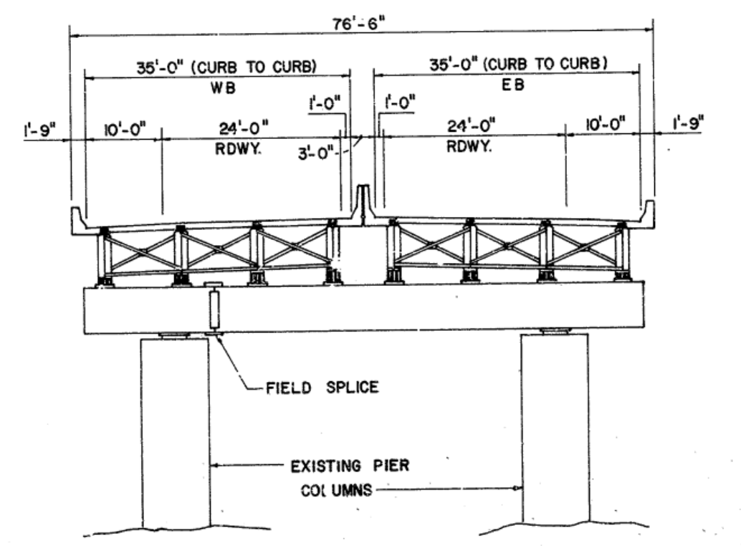
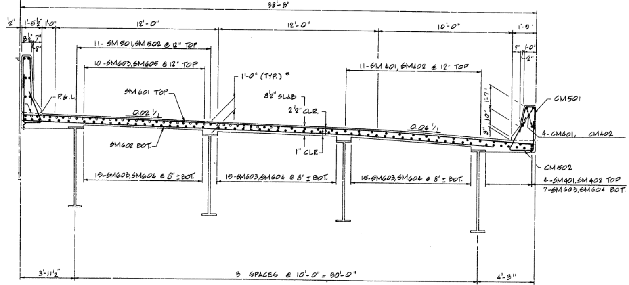
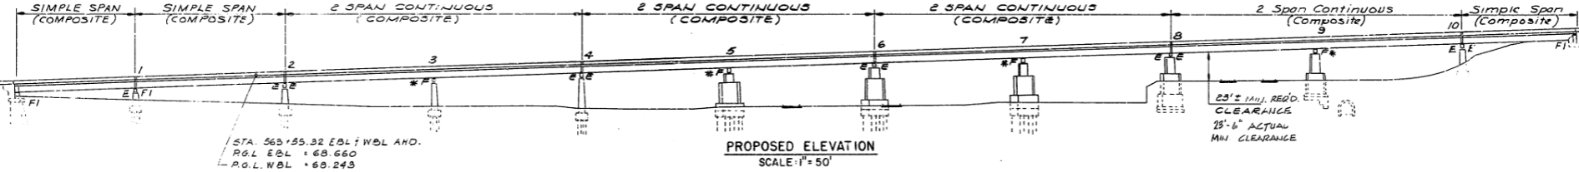
Completed Work – Phase 1
I-76 PENCOYD VIADUCT (1986)
Half section Span 7 and 8
Cross section
Elevation

Slide 42
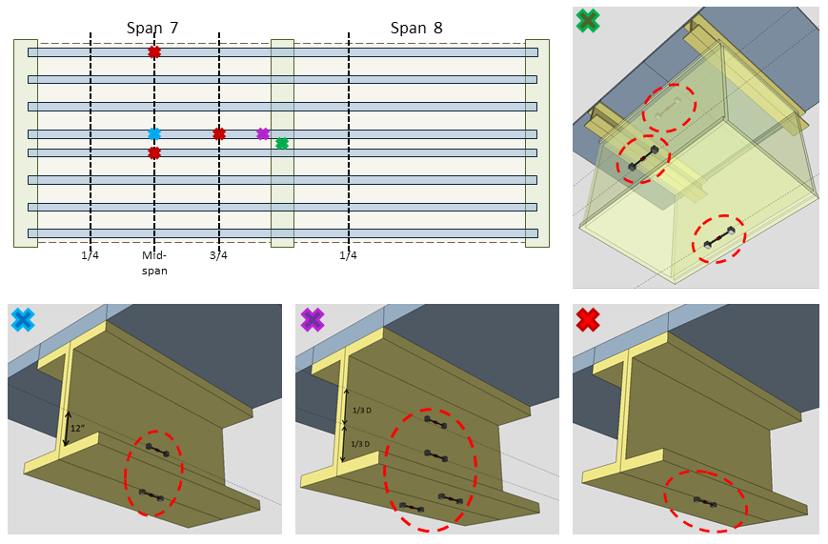
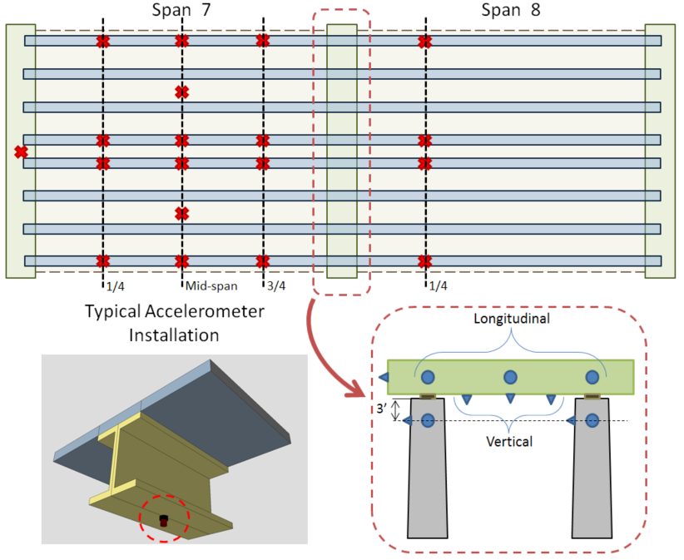
Completed Work – Phase 1: First Field Test

Slide 43
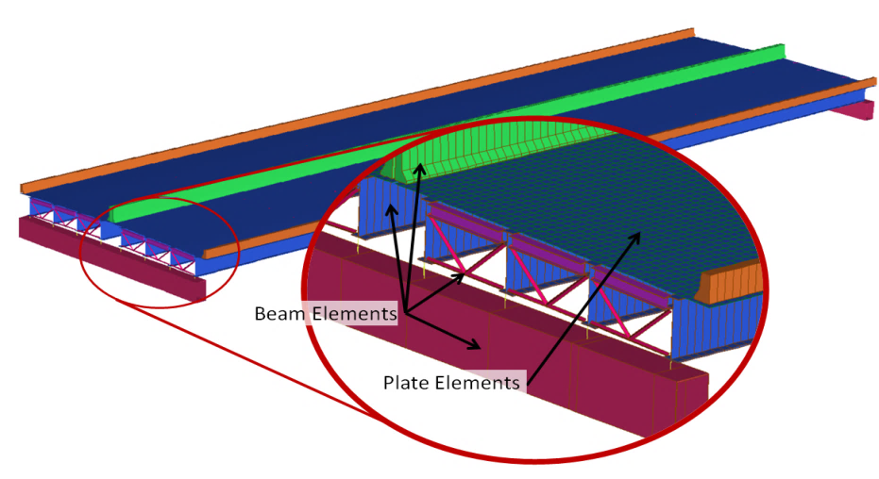
Completed Work – Phase 1: First Field Test
A 3D “Element-level” FE model of Spans 7 & 8 was constructed and calibrated
  Girders, diaphragms, and barriers represented as beam elements
  Deck represented as plate elements
  Deck material properties and barrier stiffness updated

Slide 44
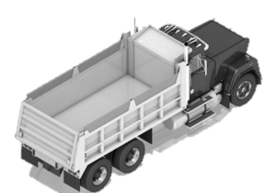
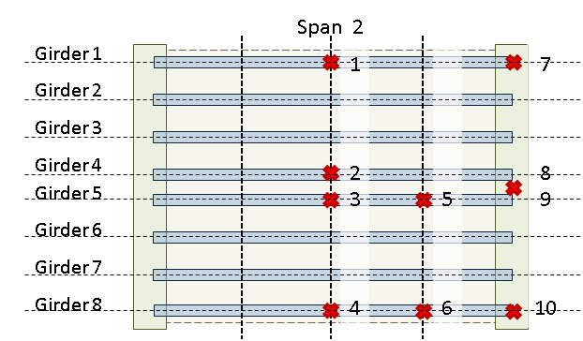
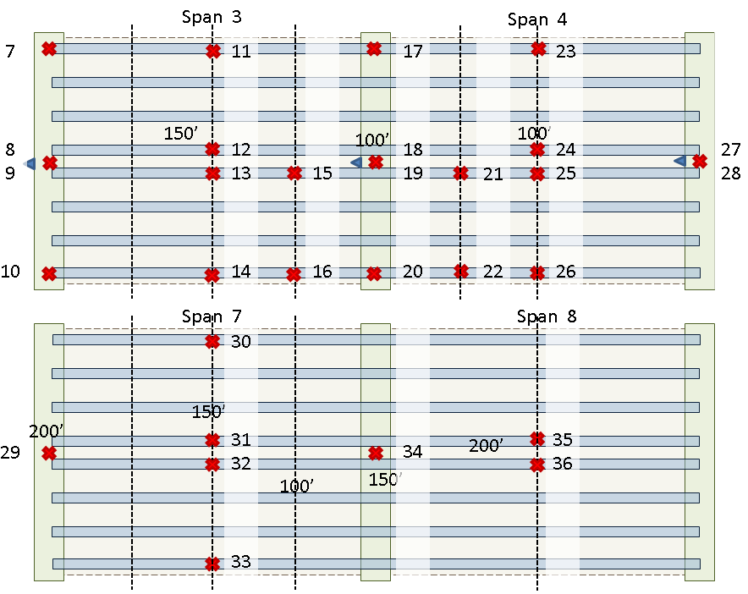
Completed Work – Phase 2: Detailed Field Characterization
Accelerometers were installed on bridge and test truck.
Data was recorded synchronously.
36 accelerometers on bridge
4 accelerometers on truck
14 passes were made by the test truck over the bridge
Truck velocity ranged from 10 mph to 60 mph
Both sides of the bridge and all 4 lanes were traversed
Passes were made in various traffic conditions (light traffic, medium traffic, heavy traffic)

Slide 45
Future Work – Phase 3: Identification of VBI Parameters
Reduce model complexity
Identify sensitive parameters
  Uncertain parameters
  Parameters that vary between bridges
  Does altering parameter effect solution results
  Reduce where appropriate
Develop parameter ranges
  Sensitivity studies
Examine and refine parameters and ranges
  Regression analysis to identify trends
  Combine parameters into a single variable
  Address multi-variate/non-scalar parameters

Slide 46
Future Work – Phase 4: Assess Current Methodologies
Design and perform parametric study
  Latin hypercube sampling of continuous parameters
  Fractional factorial design for categorical parameters
  Compute quantities of interest (e.g. DAF) from model results
Identify structures with DAF greater than predicted
  Separate samples into “performance” categories
  ANOVA to identify important parameters
  Regression analysis to better understand effect of parameters

Slide 47
Future Work – Phase 4: Assess Current Methodologies
Identify better methods of predicting amplification factors
  Can a simple relationship be identified through regression analysis
  Possibly limited to bridge-type
Identify alternative methods of modeling VBI
  Simplified model types (e.g. single line or grillage)
  Separation of solution
    Vehicle Response
    Bridge Response

Slide 48
Future Work – Phase 5: Investigation of Truck Platoons
Identify “problematic” platoon parameter values
  “Sensitive” models selected from previous study
  Parametric study
    Vehicle spacing
    Vehicle speed
    Vehicle suspension stiffness & damping
  Trends in maximum bridge response and maximum dynamic amplification
  Check trends against other models

Slide 49
Future Work – Phase 5: Investigation of Truck Platoons
Identify “best-case” platoon parameters
  Parameters that are under operational control
  Previous parametric study data reused
  Develop ideal range of parameters
    i.e. How can an operator mitigate dynamic amplification
Develop truck platooning policy recommendations

