Slide 1

CONNECT John Caridad Erwin Garcia

Slide 2
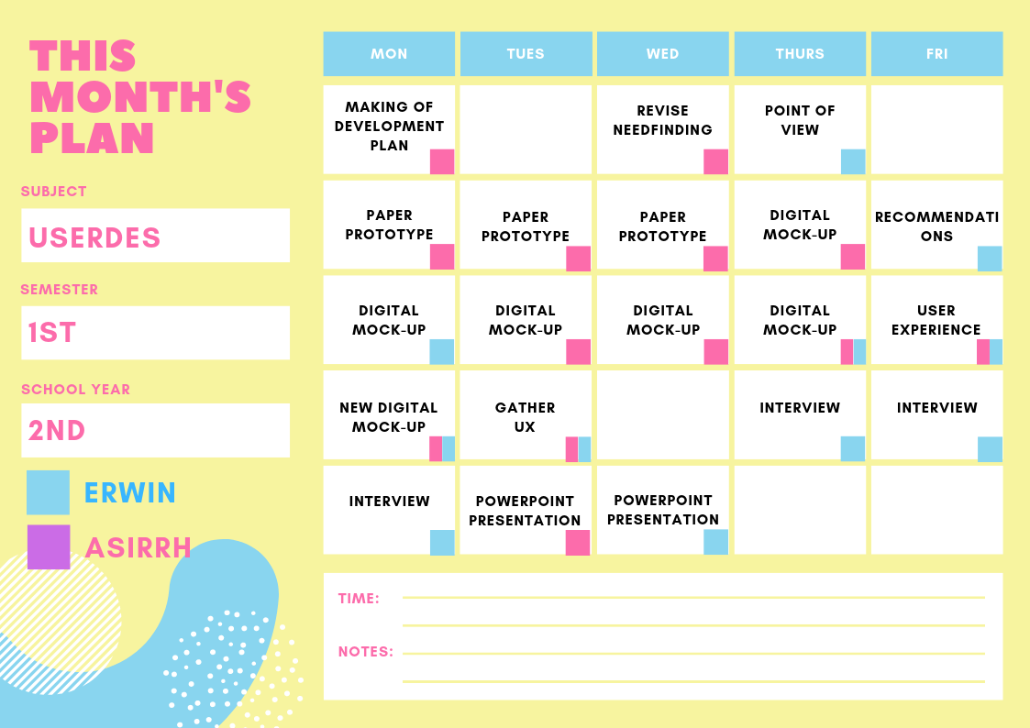

Slide 3
1
NEED FINDING
What Users want

Slide 4
Café users need to know whether there are available seats

Slide 5
Café users need to foresee the information of the Internet Café before going there

Slide 6
Café users need to have an online reservation

Slide 7
2
POINT OF VIEW
User’s POV

Slide 8
Café users are having a hard time renting computer shop because of comfortability, price and time

Slide 9
BIG CONCEPT
Paper prototype first then
Go Big with Digital Mockup

Slide 10
https://youtu.be/7kVFSy2Us0E

Slide 11
https://youtu.be/qiFNTVrEoK0

Slide 12
https://youtu.be/6GxCtybw45E

Slide 13

RECOMMENDATIONS
first
second
third

Slide 14
DIGITAL MOCKUP

Slide 15
https://wze6a2.axshare.com/#id=f4c3vb&p=lading_page

Slide 16
https://xd.adobe.com/spec/6e2f7e6e-ea24-41fd-6554-fa967b9e0913-181e/

Slide 17
That’s all!
THE PAIR IS NOW READY FOR THE QUESTIONS

