Slide 1
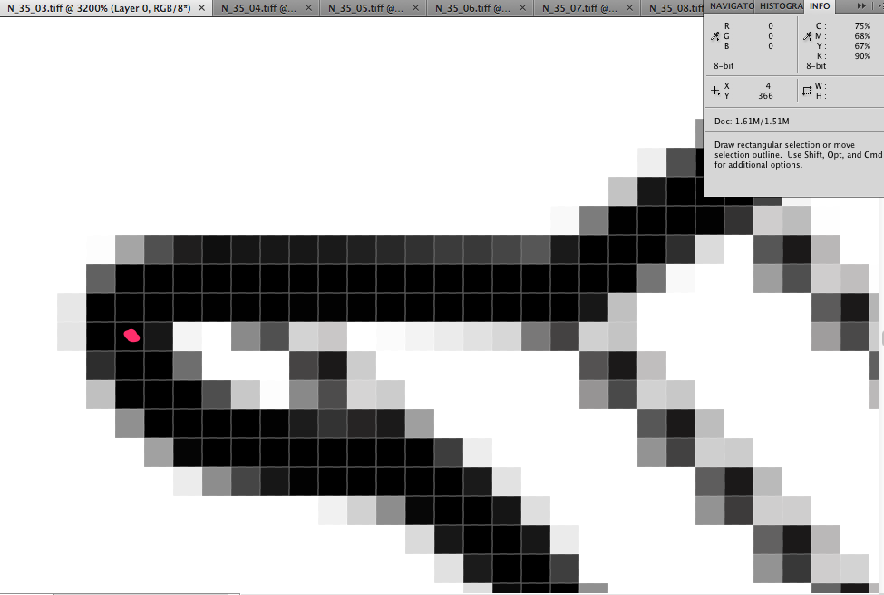
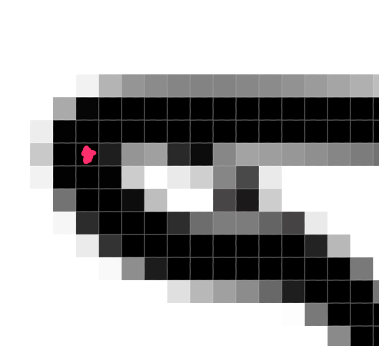
Ground Control Points
Point 1 is 4, 366 (x, y). Usually found by going four rows down (below the 3 dark rows) and then it is the 2nd pixel from the right in a row of 4 (but sometimes it looks slightly different (see inset)).

Slide 2
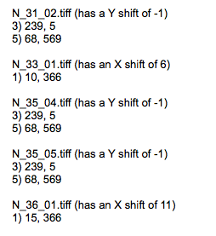
Ground Control Points
Much of what I’m doing now involves looking at one or two control points to see if they are different from the standard set. Standard images are as shown in the table (points 1-6). If a point has different coordinates, I make a note of the image name and shift in Evernote.
Table of Standard Image Coordinates
4, 366
586, 167
239, 6
287, 507
5) 68, 570
6) 19, 256

Slide 3
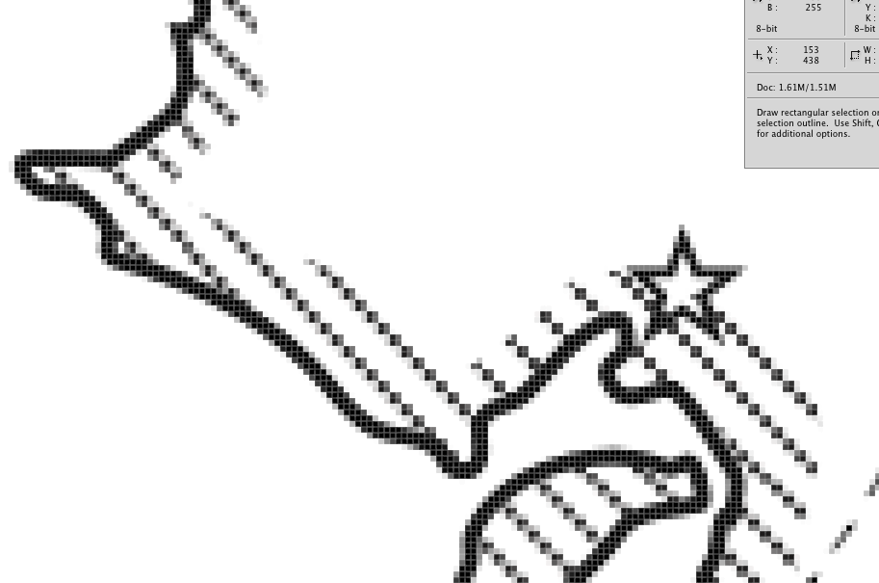
Problematic Symbology
Stars (these can be masked out)
Circles (black or with an “H”)
Stripes

Slide 4
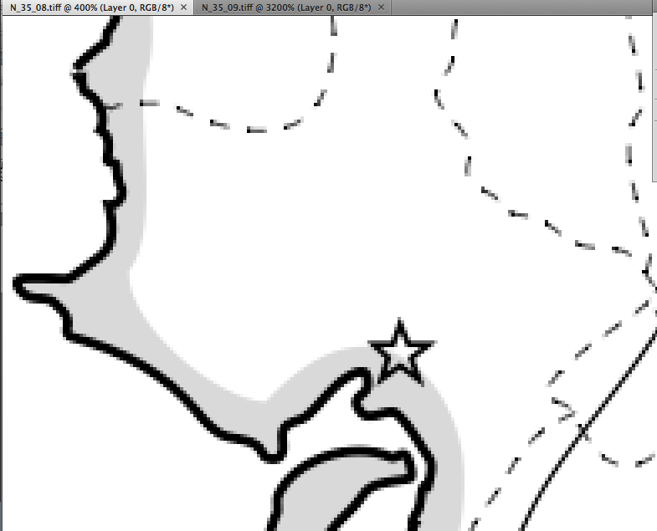
Working Symbology
Light Gray solid works great!

Slide 5
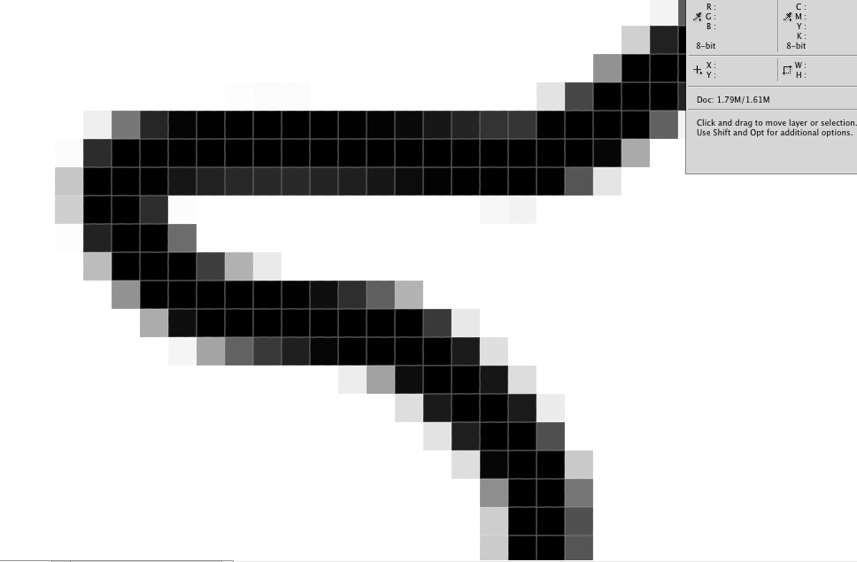
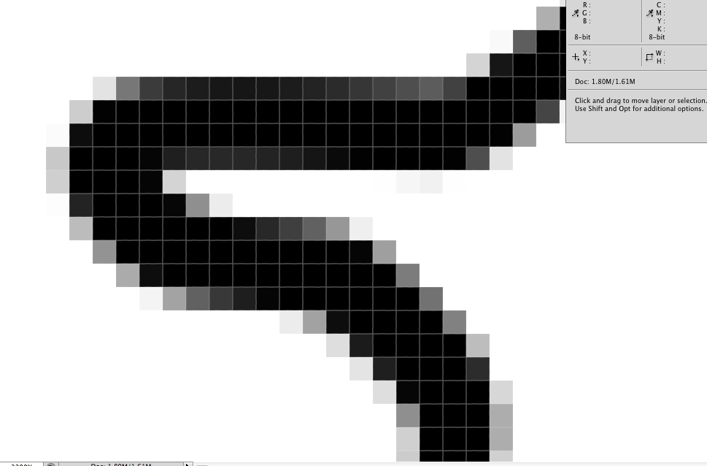
Differences in Line Thickness
N_73_02.tiff (Thrush-like Wren)
N_73_01.tiff (Black-capped Donacobius)

