Slide 1
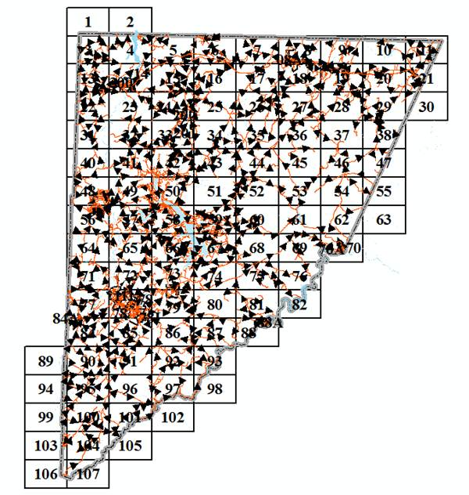

Lessons Learned – Mapping with the ESRI javascript API
J.B. Churchill, GISP
GIS Specialist
Garrett County, MD
Department of Planning & Land Management
Notes:
Lessons Learned – Explain the title. I took this stuff on largely on my own so there were setbacks (like launching w/o keeping IT in the loop).
My maps tend to look a lot like the samples they were taken from. Standardization needed.

Slide 2


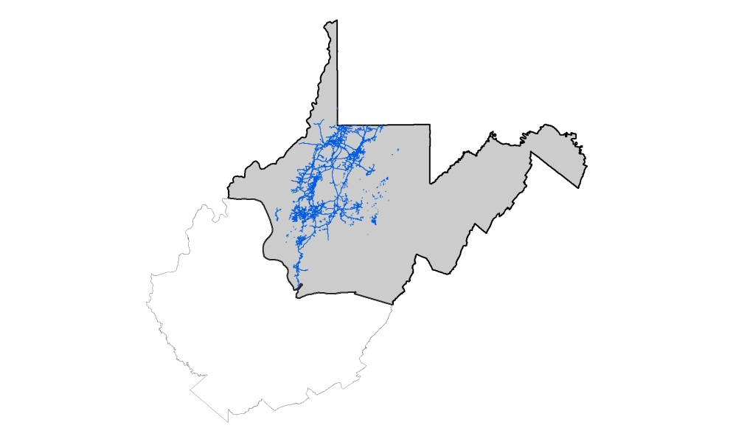

Background
Land Surveying - Landtech
Wildlife Management – Frostburg State Univ. – BS
Wildlife Management – WVU – MS
Natural Resource Analysis Center at WVU
Appalachian Laboratory (UMCES)
Contract w/ USGS
Adjunct teaching ACM, FSU, FCC
EQT Midstream
Garrett County

Slide 3

Programming Background
Triangulation Program
Home Range Estimation
GIS inputs (IDW)
QBASIC
VB6 (Extensions w/ ArcObjects)
Perl
Python
js
Web Development
MapServer
Drupal
PHP & MySQL
js
Notes:
I learned that programming comes in handy when a Triangulation Program creates an output that is not exactly what is needed for input to a Home Range Program that creates output that is not exactly what is needed as input to GIS … and so on. I wrote QBASIC programs to help that workflow (stuff I would probably do with Perl or Python anymore). I really got into the programming and even wrote some extensions for ArcMap and did some cool Hydrologic Modeling stuff in Python for my contract with USGS.
I also like wearing cool T-shirts.

Slide 4







Notes:
A few options – ArcGIS Server already installed – Lots of samples available for the ArcGIS javascript API.
Leaflet is thought to be more lightweight (OpenLayers may be too). I have used MapServer and currently test my maps using MS4W.

Slide 5


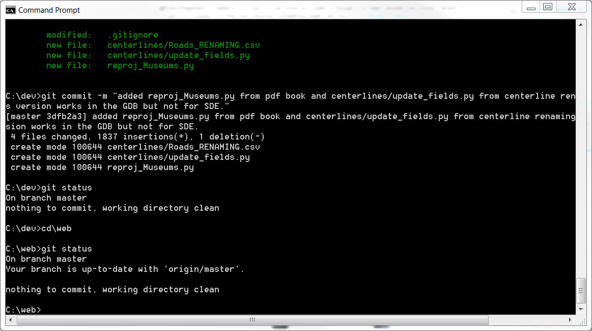

Version Control with “Git”
Notes:
Allows you to go back if you totally destroy something.
Allows you to stash changes if you think you were “on to something”.
Creates a usable log of what was changed and when.
Took the lynda.com course, bought the pocket guide and often search for answers on online forums.

Slide 6
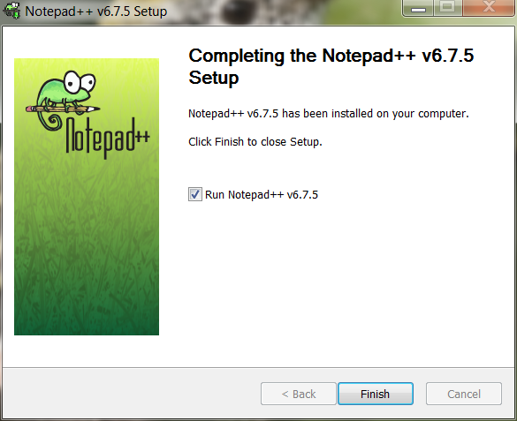

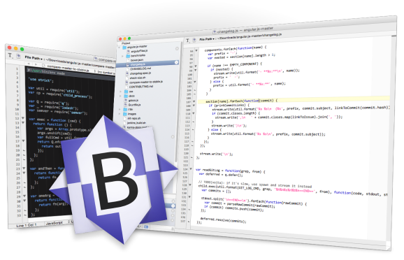

Editors
Free can still be good!
To use an IDE or not ?
Notes:
I tried Aptana as an Integrated Development Environment but I prefer to use my MS4W installation as a testing environment.
I’m not a VIM Ninja
I really like Notepad++
BBEdit is my editor of choice when working at home on my mac (not free).

Slide 7
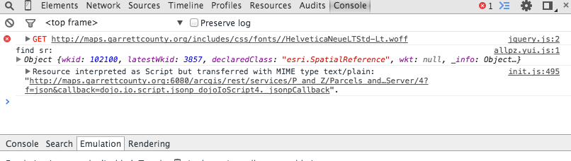
Developer Tools
Chrome has “Developer Tools” (shown below).
Firefox has the “Developer Toolbar”.
Print variable values to console.log
Determine line numbers where errors occur.
Determine whether errors occur “before” or “after” some point.
Notes:
Some kind of developer tool that allows you to debug is ESSENTIAL!
All the browsers should have something that you can use or at least a plug-in that you can get.

Slide 8
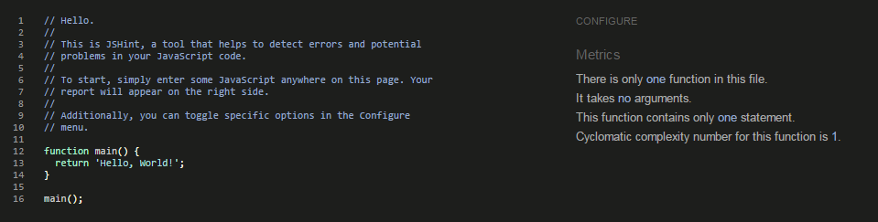
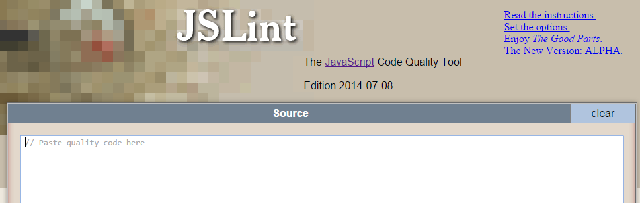
Code Linting
jshint.com
jslint.com
Notes:
After create some code in NP++, I want to check to see if it is good. Jslint is picky but has lots of options for customization.
It will let you know about …
Undefined variables (it even gets you to define them at the beginning).
Unused variables
Forgotton semicolons

Slide 9
Minification
The Compressorator will tell you which tool compresses your code the best out of yui, scriptaculous, packer, JSMin, dojo shrinksafe. Copy and Paste - http://compressorrater.thruhere.net/
Other online tools can do the job (http://jscompress.com/).
Removes unnecessary characters such as whitespace, newline characters, comments, and some block delimiters.
You can also add gzip compression to further compress code.
Command Line java -jar yuicompressor-2.4.8.jar C:\ms4w\Apache\htdocs\javascript\fema.js > C:\ms4w\Apache\htdocs\javascript\fema.yui.js
Notes:
Compressorator asks “which tool is best?” which is a complicated question.

Slide 10
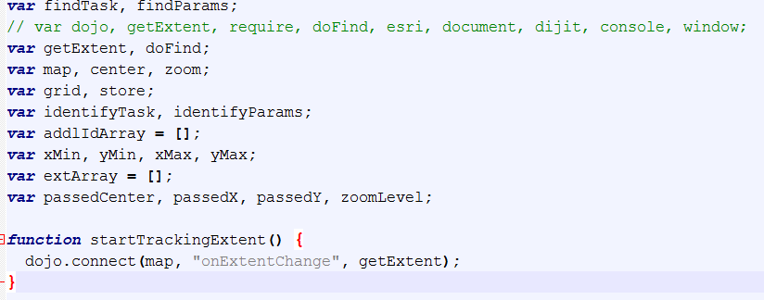
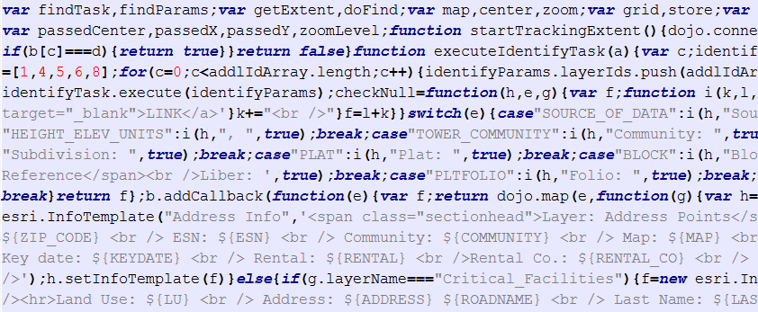
Minification
Notes:
Turn this into this (showing results of minification). You can see that it renames (or shortens) variables as a part of eliminating unneeded characters.

Slide 11
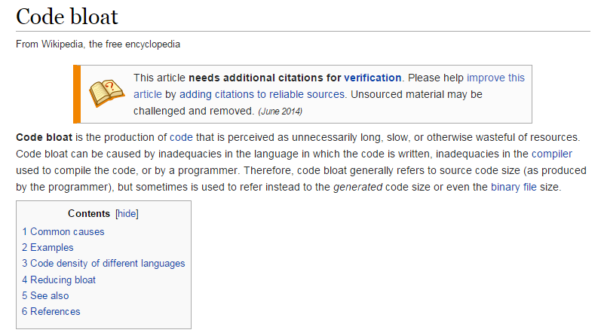
Code Bloat
How to make things work without making it over-complicated?
This led to a Unique Solution …
Notes:
Code base was getting longer (line 850 ?) and more involved (code stops working). Also I didn’t need all functionality in one map. But I DID want a unified mapping experience.

Slide 12
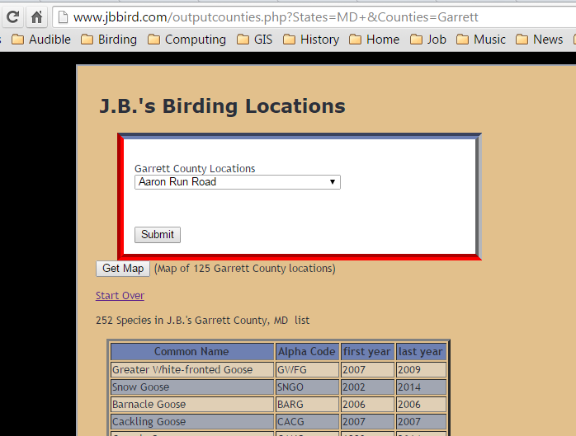
A Unique Solution
If I can pass in variables like X, Y, and Z, I can keep my place and continue with a new workflow.
I have done this sort of thing with PHP and $_GET.
Notes:
I’ve passed in variables “across the wire” before with $_GET. Having one map that does only one thing could be an advantage and being able to access each map from the other maps enhances that “unified experience” that I mentioned.

Slide 13
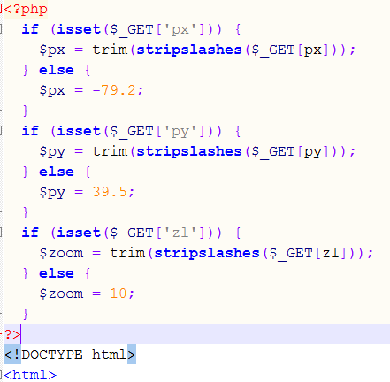
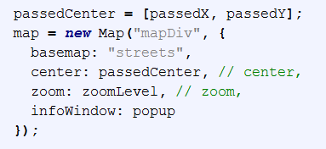
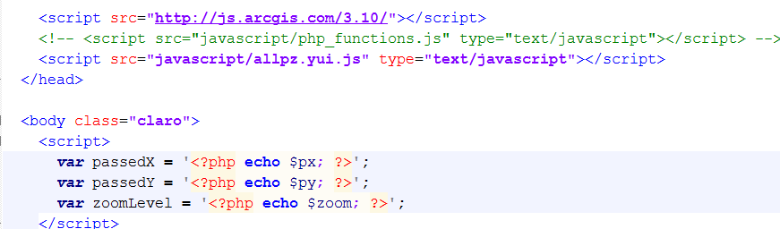
PHP and $_GET
javascript
PHP
http://maps.garrettcounty.org/arcgis/pz_map.php?px=-79.00608&py=39.67927&zl=19
Notes:
As an environment PHP and HTML work together very well (you write html in the php file).
The PHP at the top is where it intercepts the data in the address bar.
The PHP at the bottom converts the php variables into javascript variables

Slide 14
Live Demo
Notes:
Live Demo of the Webmaps covering Navigation between maps (showing the previously mentioned php variables).
PZ Map - the most comprehensive map, with "additional layers".
Measurement map - basically works just like the sample.
Flood Hazard map - gives some basic information about the zones (informative legend).
Sensitive Areas map - PFA's, Sourcewater Protection, Protected Species.
Printable map - providing a way for someone to make a map using only the data that they want to include.
Go Over the Help section.

Slide 15
What’s Next ?
An “infowindow” that can access multiple services.
use a different geocoder (like the one iMap offers?).
use the geometry server / geometry service for things like buffers to select features and clip & ship.
get some training in some area related to this (ArcGIS Server or js).
Further standardization of the “look and feel” of the maps for that “unified experience”.
Notes:
I’ve seen samples that use a dojo “deferred” callback to split click events into two possible services. I was unable to get that to work.
I don’t know if the iMap geocoder can be used like the one I use in the map?
I’ve got the Print Service working (though it could be more customized) but have not made my own geometry service.

Slide 16



Easy ? …
Questions …
for the caveman ?
John Churchill, GISP
@jbchurchill
http://gis.stackexchange.com/users/31115/jbchurchill
Notes:
Is the ESRI javascript API easy to use? Even an old guy from the mountains of Western MD (in Garrett County) can do it. So … draw your own conclusions.

