Slide 1
dIY aSSET MaNAGEMENT
For Public UTILITIES
J.B. Churchill Garrett County, MD
Planning & Land Management
Notes:
I Work for Garrett County in Planning & Land Management.
We are a small county (population-wise) of about 30K.
I worked for a natural gas company (EQT) in Clarksburg, WV for about 10 months prior to this
I worked in Natural Resources Science for several years prior to that AL & WVU / NRAC and USGS through IAP World Services.

Slide 2
Justification
The project was initially a request for a map.
Starting out I was going to just digitize the Business Parks.
I was surprised that we didn’t have these data layers already.
I feel that having these layers will be beneficial to DPU.
Notes:
So the County Administrator wanted to see a map of public water and sewer in the County Business Parks. WE DON’T HAVE THAT!!!
So I decided I could create it. I obtained some CAD layers (minimal) and Scans of proposed water/sewer CAD drawings. I see the VALUE in having these layers (and hopefully the department (DPU) will too).

Slide 3
Planning – Natural Planning Model
1. Defining Purpose and Principles
Create enough Point and Line Data to map the business parks.
Provide a baseline layer for DPU to improve upon.
2. Outcome Visioning
Make it easier to locate and look up information about Water/Sewer infrastructure.
Use to improve existing asset management and maintenance protocols.
Future data conflation process with GPS => better Miss Utility type locations.
Notes:
Mapping the business parks was the original purpose but I thought that creating a baseline dataset was even more important.
Outcomes include easier access to information … process improvement in asset management and … in the future we can GPS assets and more correctly locate them in the GIS which allows us to locate them in the field without even visiting to the site (in some cases).

Slide 4
Planning – Natural Planning Model
3. Brainstorming
Meetings & Phone Calls with Head of DPU (Pat)
Schema from ESRI PU Data Model & from what was symbolized on CAD Drawings.
4. Organizing
Making notes in OneNote and on my whiteboard (schema document).
5. Identifying Next Actions
Obtain and scan paper documents.
Georeference documents.
Digitize!!!
Notes:
Talked with Pat a few times about the idea I was hatching. I borrowed some from the Public Utilities Data Model but really only used what was needed (no GUIDs or anything).

Slide 5
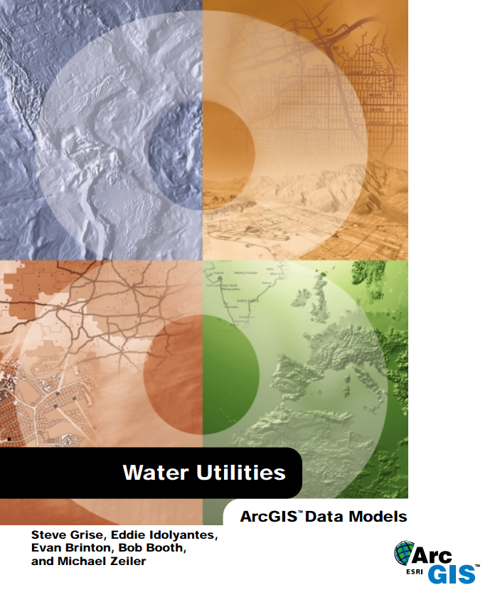
Needs Evaluation
In the Brainstorming phase (phone calls and meetings), we determined what was needed for the project.
Water Utilities Data Model
Notes:
One really good recommendation I got (Mary from Frederick County) when I mentioned that we were starting to do this, was to check out the ArcGIS Public Utilities Data Model. There is this huge PDF (free) online.
It is complex so rather than start with their template and delete fields we will never use, we built it from scratch using the fields we knew we could use.
We did not use CASE tools or a schema creation wizard but those do look like interesting tools to use.

Slide 6
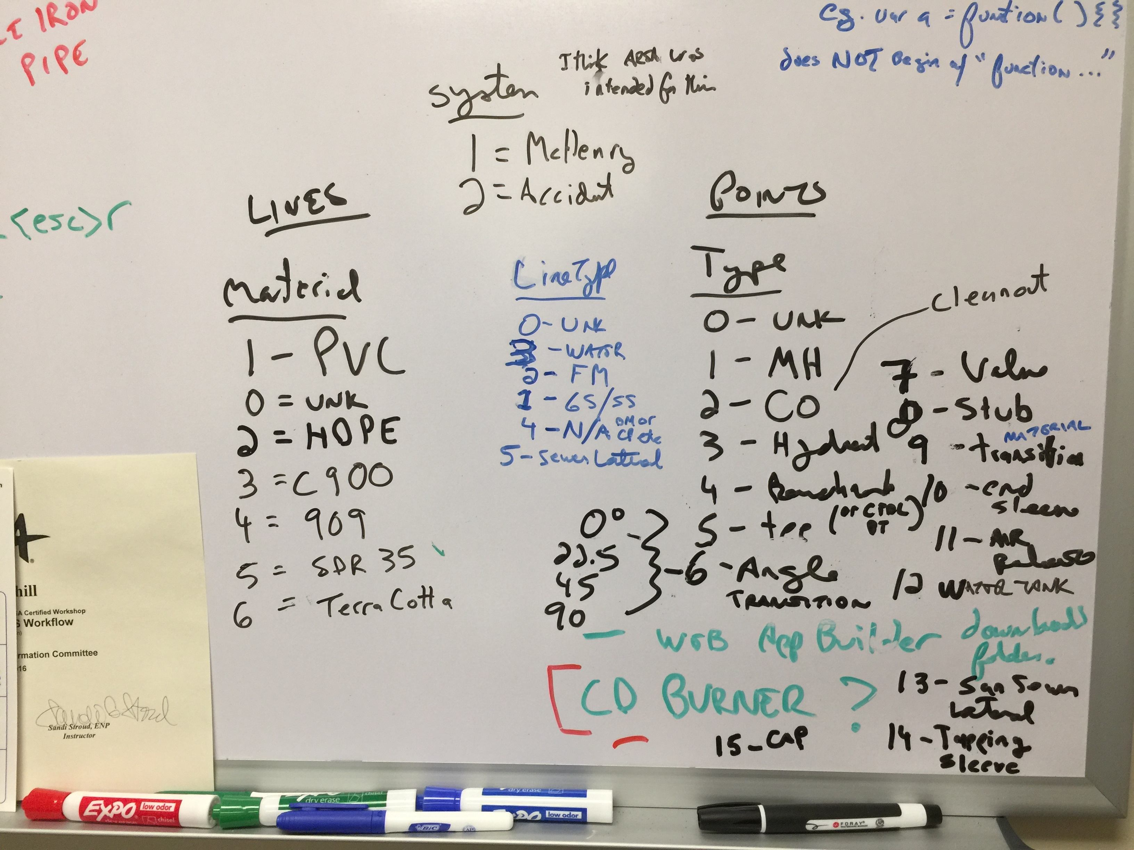
The Schema Document
Notes:
The schema document lives (still) on my whiteboard. I figured I’d better get a photo of it. I’m working on writing up this schema in a separate Power Point file.

Slide 7
Points
Lines
OBJECTID ESRI Object ID
Shape ESRI Geometry ID
Y Coordinates
X
FILE_ filename of drawing
COMMENT all-purpose comment
SOURCE Digitized (for now)
Type feature type (CVD)
LineType water / sewer (CVD)
Angle only for Type = 6 (angle)
Sheet CAD drawing number
UPDATED Editor Tracking Fields
MODIFIEDBY
CREATED
CREATEDBY
SYSTEM which area (CVD)
diameter inches (for pipe features)
OBJECTID ESRI Object ID
Shape ESRI Geometry
Shape.STLength() Double Id
Material Coordinates
CAD_Len feet (where known)
Comment all-purpose comment
diameter inches (where known)
Sheet CAD drawing number
PDFSCAN filename of drawing
SOURCE Digitized (for now)
LineType water / sewer (CVD)
Angle only for Type = 6 (angle)
UPDATED Editor Tracking Fields
MODIFIEDBY
CREATED
CREATEDBY
SYSTEM which area (CVD)
Notes:
Type is a good one to symbolize points with to show features such as manholes, valves, angles, hydrants, sleeves, caps etc. differently. I typically just use LineType for the lines to show whether they are water, gravity sewer, forced main, or laterals etc.

Slide 8
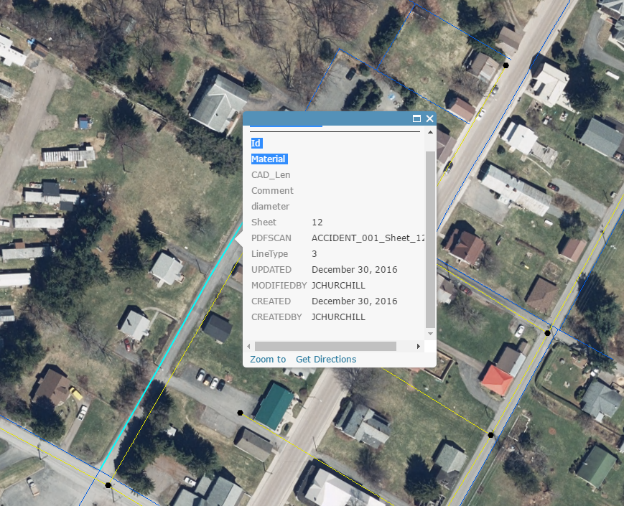
Coded Value Domains
Notes:
We are waiting to implement the CVDs with the idea that more values may be added. The downside of waiting is that in our webmaps and apps, it isn’t apparent to anyone that LineType of 3 is a water line (except that it is a blue line).

