Slide 1
Field Data Collection
AGOL, Collector, Survey 123, GeoAPPS
Notes:
Target Audience = DPU (and Engineering) – Pat, Jay, Paul Harvey, Bobby? And Brian King.

Slide 2
ArcGIS Online (AGOL) pros & cons
Easy to use
Data can be accessed & edited from Apps (Collector, Survey 123, and other Geoapps)
Some restrictions apply to editing of private layers
1 user per ArcGIS Desktop License (we have 5 total; DPU, Eng., Planning, Econ Dev. Em. Mgmt.)

Slide 3
ArcGIS Online (AGOL) Demo
Road Closure Maps (example currently being used)
Tile Grid Map (example currently being used)
Asset Mapping (not sure yet if this will be a demo or a discussion).
COLLECTOR DEMO (HERE OR LATER???)

Slide 4
SLIDE showing benefits of this and how it does the job of a failsafe (backups?)

Slide 5
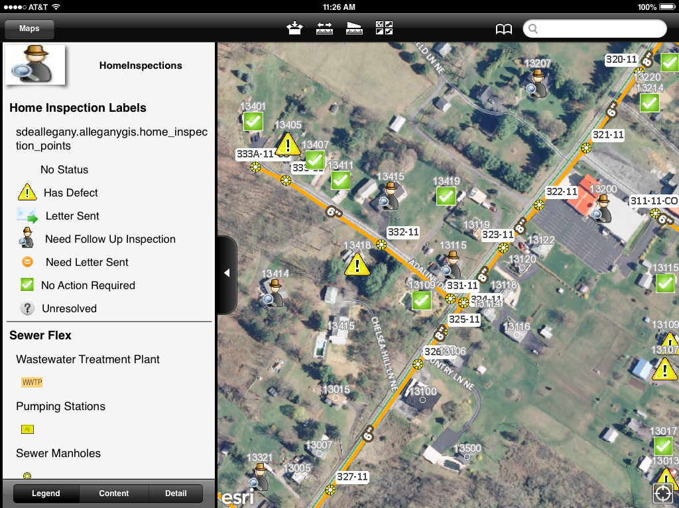
Allegany County – Home Inspections
Notes:
One deals with home inspections/smoke testing associated with county sewer (2 screenshots attached) and the other logs animal control incidents.

Slide 6
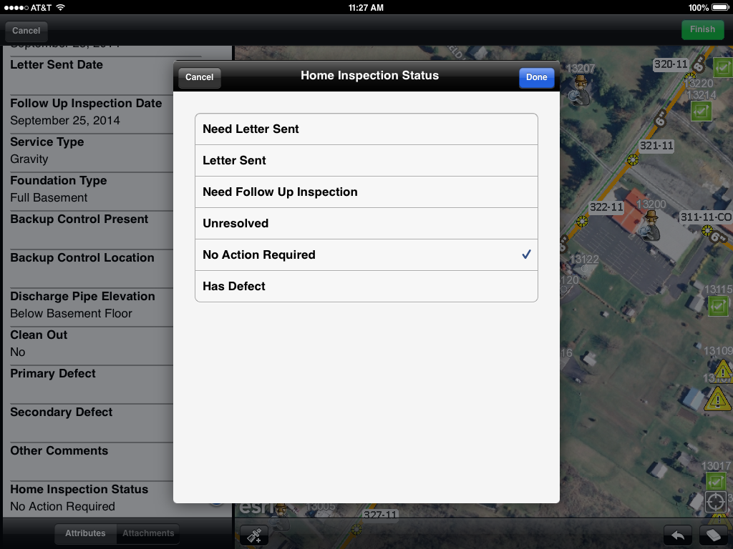
Allegany County – Home Inspections
Notes:
They are also working on a Workforce / Survey 123 application that would handle work orders.

