Slide 1
Field Data Collection
AGOL, AGS, Collector, Workforce, Survey 123, GeoAPPS
Notes:
Target Audience = DPU (and Engineering) – Pat, Jay, Paul Harvey, Bobby? And Brian King.
Explain AGOL & AGS and describe in broad strokes the others.

Slide 2
ArcGIS Online (AGOL) pros & cons
Easy to use
Data can be accessed & edited from Apps (Collector, Survey 123, and other Geoapps)
Potentially eliminates paperwork by entering data directly into the enterprise database
Some restrictions apply to editing of private layers
1 user per ArcGIS Desktop License (we have 5 total; DPU, Eng., Planning, Econ Dev. Em. Mgmt.)
Notes:
AGOL is great! because it is very easy to whip something up in no time flat. Then they can be used on mobile devices. It is the licensing that is restrictive.
We have five user accounts because we have five desktop licenses.

Slide 3
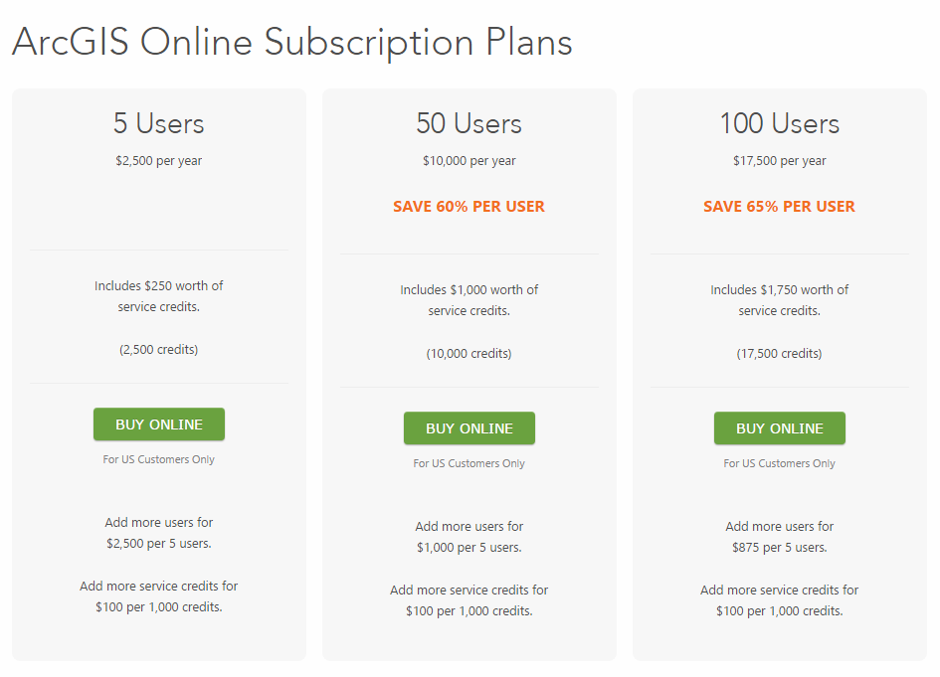
Arcgis online plans
Notes:
At $500 a pop (per user/per year) and a minimum of 5 additional users, it is a little bit restrictive.
I DON’T WANT TO TALK ABOUT THIS NOW. I WANT TO TALK ABOUT WHAT WE CAN DO WITH THE ONES WE HAVE!

Slide 4

App Flavors
Collector
Workforce
Survey 1, 2, 3
App Studio (Custom Applications)
Notes:
So ESRI has several different flavors of Apps to use with the maps made through AGOL and AGS.
Collector - Allows you to create features with full editing capabilities (Damage Assessment application demo??). The latest versions allow you to use Survey Grade GPS data collection but hardware compatibility needs to be explored.
Workforce – This is a very basic Work Order Management System
Survey 1, 2, 3 – This has nothing to do with Land Surveying. You fill out a spreadsheet with questions and it creates a form that gets filled out in the app.
App Studio – Allows all sorts of custom applications (this is an area of interest of mine). You can do GeoSpatial Analysis involving buffers and routing etc.

Slide 5
Success Stories
Prince George’s County Snow Removal Application with Collector
Prince George’s County Liquor Control Board Inspections
Allegany County Home Inspections (Smoke Testing), and Animal Control (Others too)
Notes:
PG County has a dashboard for their supervisor(s) to see where work has been started and where it has been completed. They used Collector but that was probably done before Workforce existed.
They also used a mobile application to eliminate paperwork for Liquor Board Inspections.

Slide 6
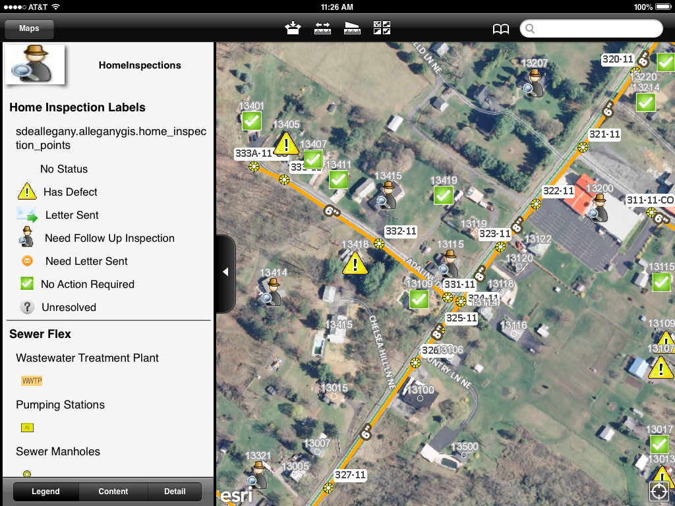
Allegany County – Home Inspections
Notes:
One application that Allegany County uses, deals with home inspections/smoke testing associated with county sewer (2 screenshots attached) and the other logs animal control incidents.
They use a duplicate of their address layer that can be accessed to provide relevant information for addresses they have checked this way.

Slide 7
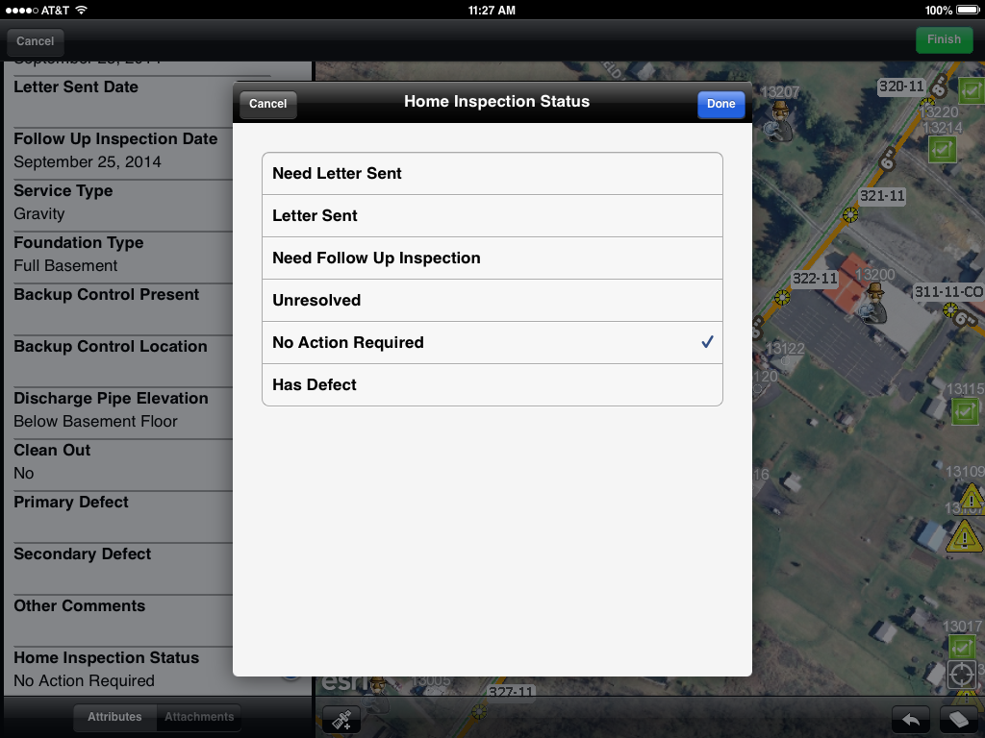
Allegany County – Home Inspections
Notes:
The data keeps things up to date so they don’t repeat testing where it has already been done.
They are also working on a Workforce / Survey 123 application that would handle work orders.

Slide 8
ArcGIS Online (AGOL) Demo
Road Closure Maps (example currently being used)
Tile Grid Map (example currently being used)
Asset Mapping (Water & Sewer) – Pipe Inspection Demo.
Collector Demo (Damage Assessment)
Notes:
Theresa Miller and I use AGOL to put the Road Closure locations on the County Website.
SHOW TILE GRID FROM COUNTY WEBSITE

