Slide 1
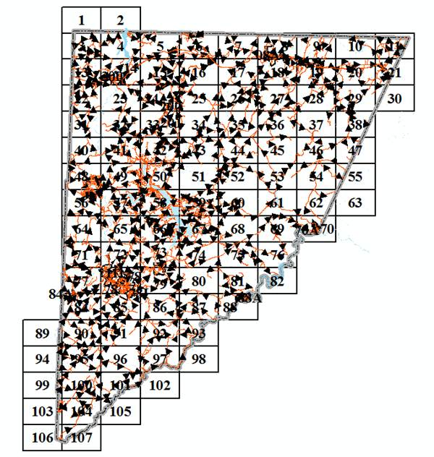

Lessons Learned – Mapping with the ESRI javascript API
J.B. Churchill, GISP
GIS Specialist
Garrett County, MD
Department of Planning & Land Management
Notes:
Lessons Learned – Explain the title. I took this stuff on largely on my own so there were setbacks (like launching w/o keeping IT in the loop).
My maps tend to look a lot like the samples they were taken from. Standardization needed.

Slide 2


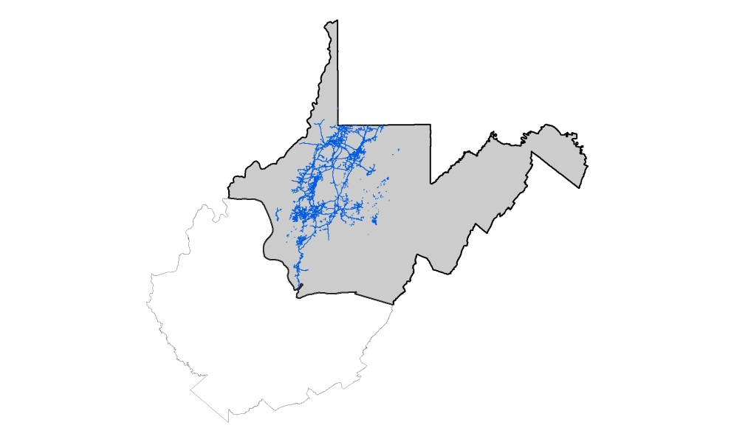

Background
FIX THIS IT SUCKS
Land Surveying - Landtech
Wildlife Management – Frostburg State Univ. – BS
Wildlife Management – WVU – MS
Natural Resource Analysis Center at WVU
Appalachian Laboratory (UMCES)
Contract w/ USGS
Adjunct teaching ACM, FSU, FCC
EQT Midstream
Garrett County

Slide 3

Programming Background
Triangulation Program
Home Range Estimation
GIS inputs (IDW)
QBASIC
VB6 (Extensions w/ ArcObjects)
Perl
Python
js
Web Development
MapServer
Drupal
PHP
js
Notes:
I learned that programming comes in handy when a Triangulation Program creates an output that is not exactly what is needed for input to a Home Range Program the creates output that is not exactly what is needed as input to GIS … and so on. I wrote QBASIC programs to help that workflow (stuff I would probably do with Perl or Python anymore). I really got into the programming and even wrote some extensions for ArcMap and did some cool Hydrologic Modeling stuff in Python for my contract with USGS.
I also like wearing cool T-shirts.

Slide 4

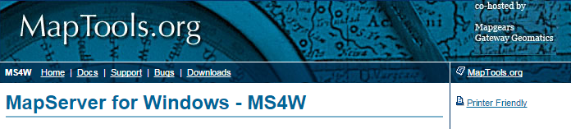





Notes:
A few options – ArcGIS Server already installed – Lots of samples available for the ArcGIS javascript API.
Leaflet is thought to be more lightweight (OpenLayers may be too). I have used MapServer and currently test my maps using MS4W.

Slide 5


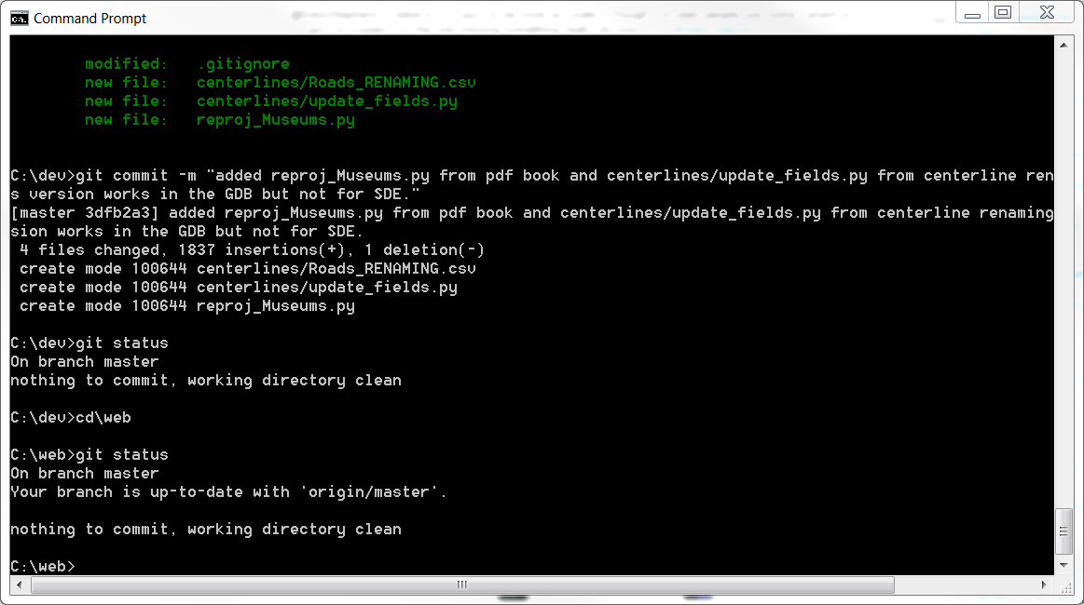

Version Control with “Git”
Notes:
Allows you to go back if you totally destroy something.
Allows you to stash changes if you think you were “on to something”.
Creates a usable log of what was changed.
Took the lynda.com course, bought the pocket guide and often search for answers on online forums.

Slide 6
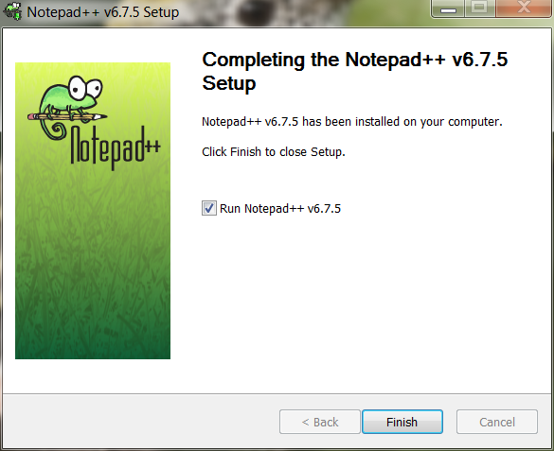



Editors
Free can still be good!
To use an IDE or not ?

Slide 7
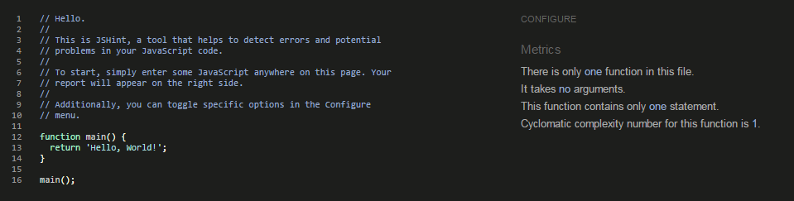
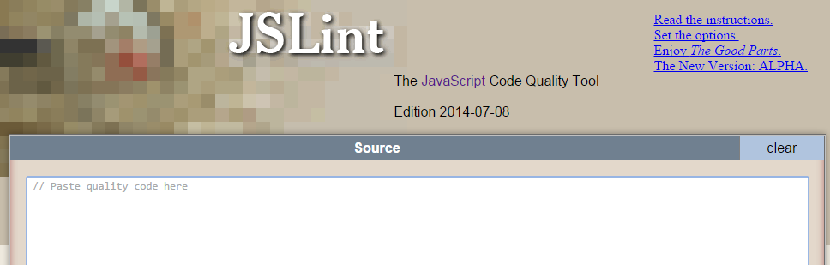
Code Linting
jshint.com
jslint.com
Notes:
After create some code in NP++, I want to check to see if it is good. Jslint is picky but has lots of options for customization.
It will let you know about …
Undefined variables (it even gets you to define them at the beginning).
Unused variables
Forgotton semicolons

Slide 8
Minification
The Compressorator will tell you which tool compresses your code the best out of yui, scriptaculous, packer, JSMin, dojo shrinksafe. Copy and Paste - http://compressorrater.thruhere.net/
Other online tools can do the job (http://jscompress.com/).
Removes unnecessary characters such as whitespace, newline characters, comments, and some block delimiters.
You can also add gzip compression to further compress code.
Command Line java -jar yuicompressor-2.4.8.jar C:\ms4w\Apache\htdocs\javascript\fema.js > C:\ms4w\Apache\htdocs\javascript\fema.yui.js
Notes:
Compressorator asks “which tool is best?” which is a complicated question.

Slide 9
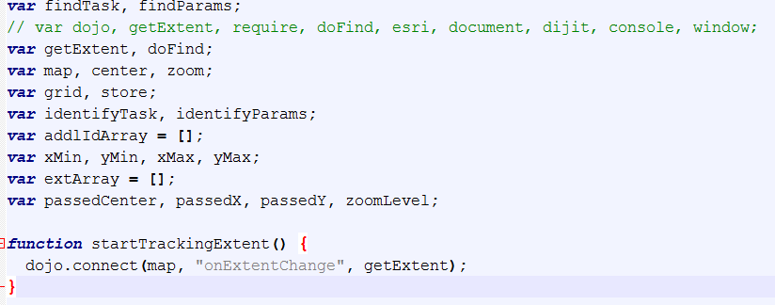
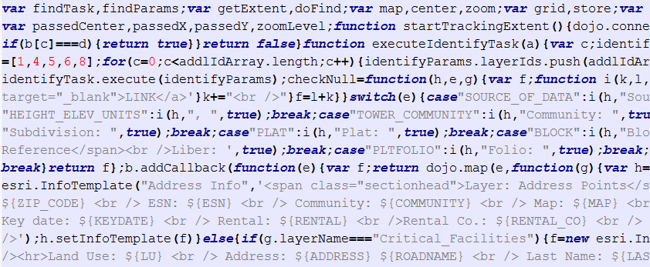
Minification
Notes:
Turn this into this (showing results of minification). You can see that it renames (or shortens) variables as a part of eliminating unneeded characters.

Slide 10
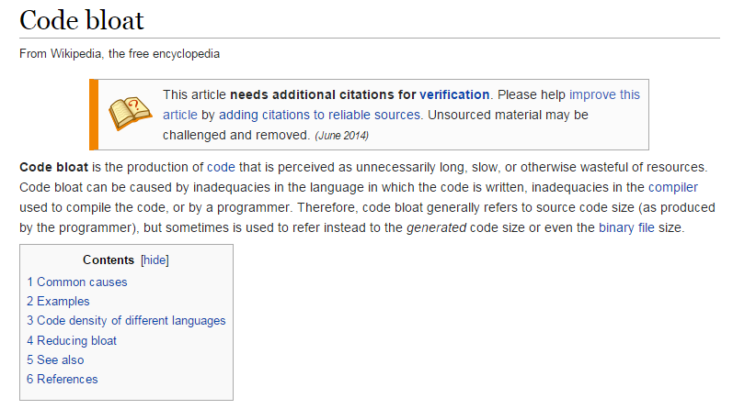
Code Bloat
How to make things work without making it over-complicated?
This led to a Unique Solution …
Notes:
Code base was getting longer (line 850 ?) and more involved (code stops working). Also I didn’t need all functionality in one map. But I DID want a unified mapping experience.

Slide 11
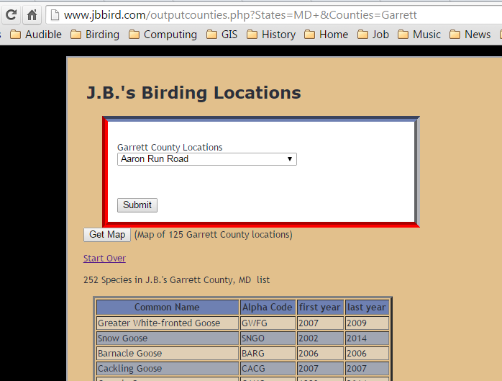
A Unique Solution
If I can pass in variables like X, Y, and Z, I can keep my place and continue with a new workflow.
I have done this sort of thing with PHP and $_GET.
Notes:
I’ve passed in variables “across the wire” before with $_GET. Having one map that does only one thing could be an advantage and being able to access each map from the other maps enhances that “unified experience” that I mentioned.

Slide 12
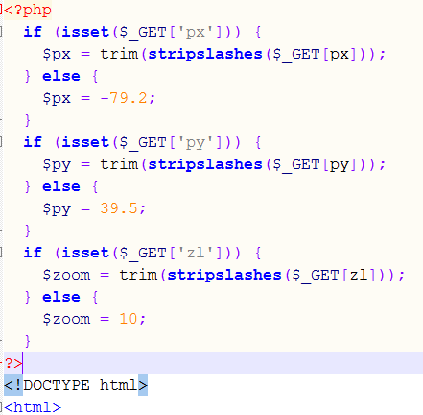
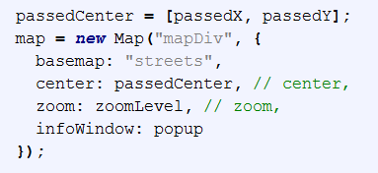
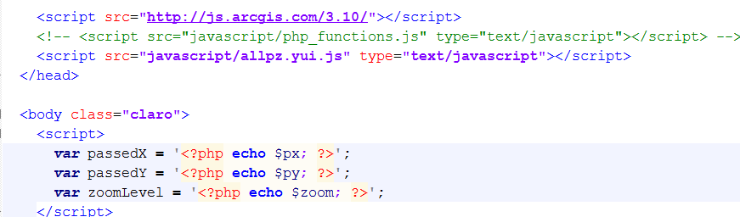
PHP and $_GET
javascript
PHP
http://maps.garrettcounty.org/arcgis/pz_map.php?px=-79.00608&py=39.67927&zl=19

Slide 13
Live Demo
Notes:
Live Demo of the Webmaps covering Navigation between maps (showing the previously mentioned php variables).
PZ Map - the most comprehensive map, with "additional layers".
Measurement map - basically works just like the sample.
Flood Hazard map - gives some basic information about the zones (informative legend).
Sensitive Areas map - PFA's, Sourcewater Protection, Protected Species.
Printable map - providing a way for someone to make a map using only the data that they want to include.
Go Over the Help section.

Slide 14
What’s Next ?
An “infowindow” that can access multiple services.
use a different geocoder (like the one iMap offers?).
use the geometry server / geometry service for things like buffers to select features and clip & ship.
get some training in some area related to this (ArcGIS Server or js).
Further standardization of the “look and feel” of the maps for that “unified experience”.
Notes:
I’ve seen samples that use a dojo “deferred” callback to split click events into two possible services. I was unable to get that to work.
I don’t know if the iMap geocoder can be used like the one I use in the map?
I’ve got the Print Service working (though it could be more customized) but have not made my own geometry service.

Slide 15



Easy ? …
Questions …
for the caveman ?
John Churchill, GISP
@jbchurchill
http://gis.stackexchange.com/users/31115/jbchurchill
Notes:
Is the ESRI javascript API easy to use? Even a guy from Garrett County can do it. So … draw your own conclusions.

