Slide 1
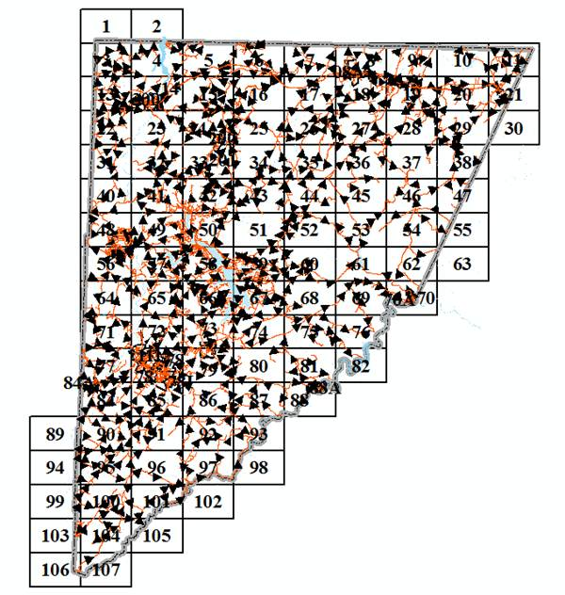

Garrett County Webmaps
Finding and using data from maps.garrettcounty.org

Slide 2
Agenda:
Short Presentation
Demonstration
Practice
Question & Answer Session

Slide 3
Goals:
Cover the intent & usage of all 5 maps.
Practice using the maps.
Develop an understanding of the information that is available and how to obtain it.
Discuss ideas for ways to improve the system.
Notes:
I don’t know what Realtors or Town Clerks do on a daily basis. You may have insight into ways of improving the system.

Slide 4
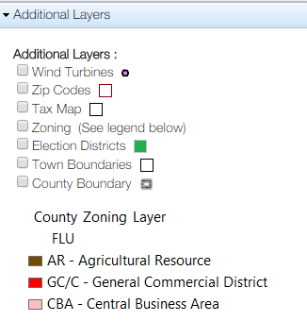
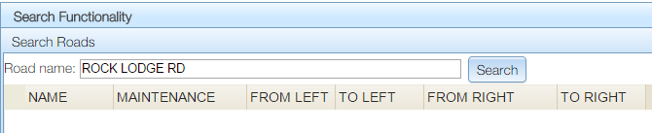
Intro Map (Planning & Zoning)
Most informative & comprehensive.
Additional Layers allow access to information above and beyond addresses, parcels, and roads.
Selection of Address Points and Parcels is possible.
Searching for Parcels and Roads is possible.
Notes:
Flood Hazard and creating a map are special use cases. Most applications will be accomplished from the Planning & Zoning Map.

Slide 5
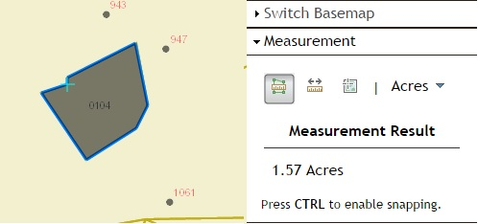
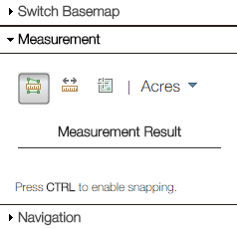
Measurement Map
Measure area, length, and locations (lat/long).
Units are interchangeable.
Snapping (to parcel boundaries) can be enabled.

Slide 6
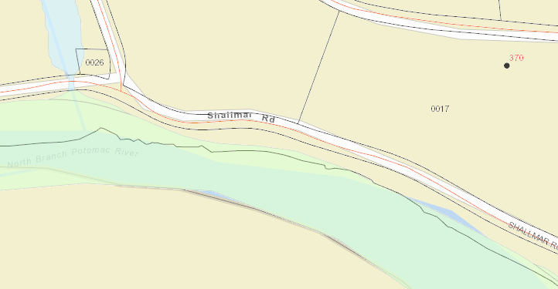
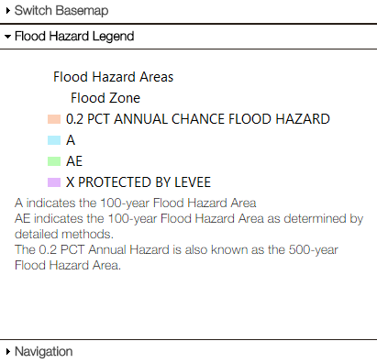
Flood Hazard Map
Determine if Flood Insurance is required for any given parcel.
Use the legend to determine flood hazard level.

Slide 7
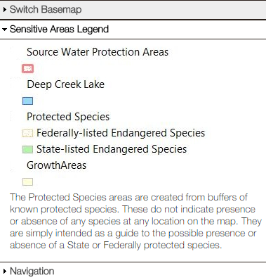
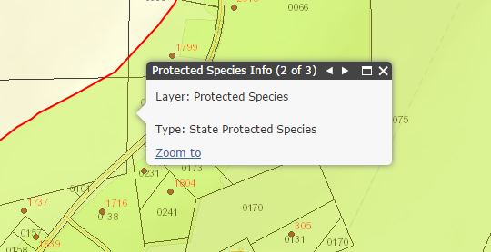
Sensitive Areas Map
Shows buffer of areas around known occurrences of State and Federally Endangered Species.
Shows Growth Areas (Priority Funding Areas).
Shows Source Water Protection Areas.

Slide 8
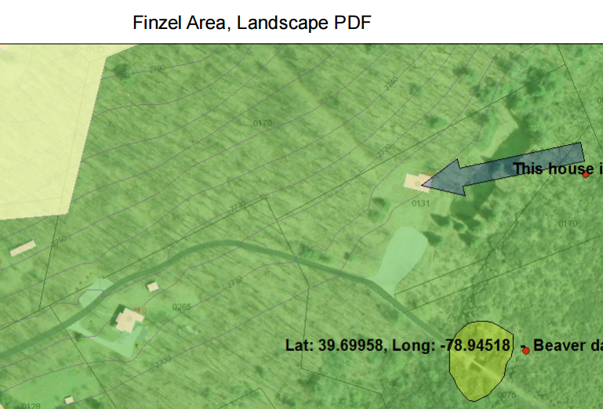
Printable Map
Add Labels (with or without coordinates)
Add graphics (circle, rectangle, line etc.)
Several Layers
Add Map Title
JPG or PDF format
Save or Print

Slide 9
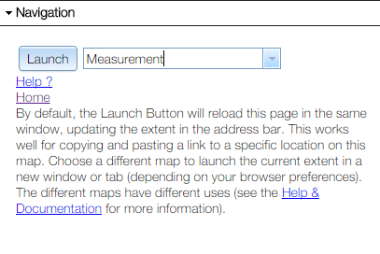
Navigation
A unique system for moving between maps.
Allows you to maintain location and zoom level.
Can be used to share map information through
e-mail using Copy & Paste.

Slide 10
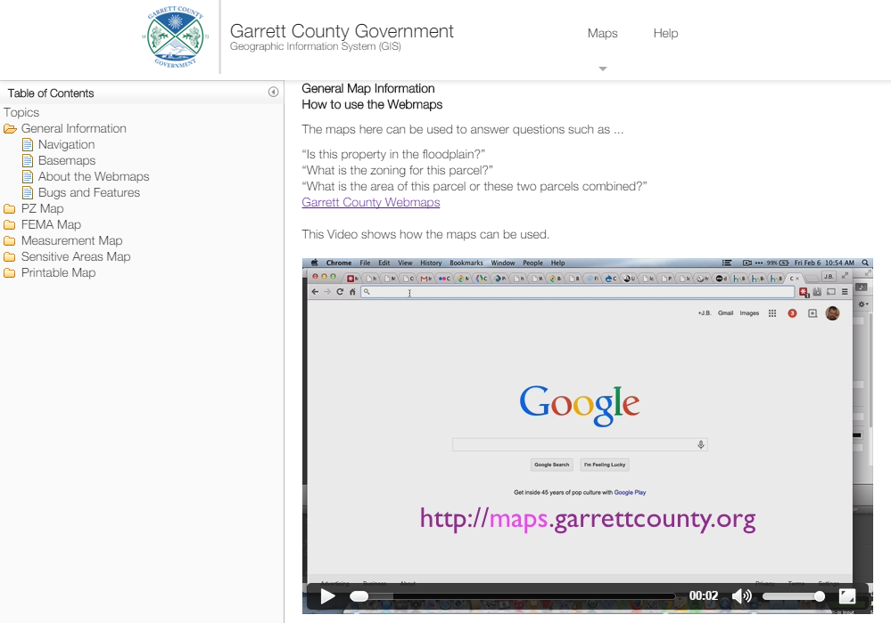
Help !!!?
Notes:
If you get stuck, the help documentation is a great resource.

