Slide 1
Flink Architecture
Zeppelin
Relational
Graph Processing
Machine Learning
Data Set
Batch Processing
Data Stream
Real Time Processing
Flink Runtime

Slide 2
Application
Dispatcher
Job Manager
Resource Manager
Task Manager
Task Manager
Task Manager
Submit app
Submit app
Request Slots
Start task
Register slots
Instruct slot
Offer Slots
Submit Tasks in Slots
Exchange
data
Notes:
The JobManager is the master process that controls the execution of a single application—each application is controlled by a different JobManager. The JobManager receives an application for execution.

Slide 3
Flink Architecture
Flink Runtime
2
Data Stream
Real Time Processing
2
0
1
3
0
1
3
Local State
Periodic Checkpoint
Remote Storage
Notes:
Apache Flink stores the application state locally in memory or in an embedded database. Since Flink is a distributed system, the local state needs to be protected against failures to avoid data loss in case of application or machine failure. Flink guarantees this by periodically writing a consistent checkpoint of the application state to a remote and durable storage.

Slide 4
Event-driven applications
2
0
1
3
Real Time Processing
2
0
1
3
Local State
Real Time Processing
2
0
1
3
Local State
12
Real Time Processing
10
11
13
2
0
1
Local State

Slide 5
State Management
Task
Task 2
12
K0
K1
10
11
13
Local State
Local State
<k1,v1>
<k0,v0>
K3
K4
K0
K1
Task 3
20
Task
K3
K4
Local State
<k3,v3>
<k4,v4>

Slide 6
Windowing examples
Tumbling
Fixed time window
2
6
2
6
0
1
3
4
5
7
0
1
3
4
5
7
t=:10 t=:20
Sliding
Fixed length slide
2
6
0
1
3
4
5
7

Slide 7
Checkpointing
2
6
Source
Sum
0
1
3
4
5
7
4
10
Local State
4
10
Job Manager
Checkpoint

Slide 8
Checkpointing
2
6
Source
Sum
0
1
3
4
5
7
5
10
Local State
4
10
Job Manager
Checkpoint
2
6
Source
Sum
0
1
3
4
5
7
4
10
Local State
4
10
Job Manager
Checkpoint
Notes:
In case of a task failure, the job manager will get new resources and task slot and recover from the checkpoint values, the state of each operator, so reread from kafka offset 4 and continue processing.

Slide 9
End to end exactly once
2
6
Source
Sum
Sink
0
1
3
4
5
7
5
10
6
10
Local State
1
3
4
10
Job Manager
Checkpoint
2
6
Source
Sum
Sink
0
1
3
4
5
7
4
10
6
10
10
1
3
Local State
4
10
Job Manager
Checkpoint
Notes:
In case of a task failure, the job manager will get new resources and task slot and recover from the checkpoint values, the state of each operator, so reread from kafka offset 4 and continue processing.

Slide 10
End to end exactly once
2
6
Source
Sum
Sink
0
1
3
4
5
7
10
reject duplicate
via trx_id
4
10
Broker partition leader
Local State
4
10
6
10
Job Manager
1
3
Checkpoint
Notes:
In case of a task failure, the job manager will get new resources and task slot and recover from the checkpoint values, the state of each operator, so reread from kafka offset 4 and continue processing.

Slide 11



Rule Engine Integration
Dev environment
Decision Management
DEVELOPER
BUSINESS
USER
Event Source
Flink Runtime
Decision Service Runtime
Data Stream
Real Time Processing
Rule Engine / Rule App
Situation detection
Rule Engine / Rule App
Next best action
Process Service
Entity Service
Kafka Runtime
RPA Service
0
n
0
n
0
n
Schema Registry
Elastic Search
Dashboard

Slide 12

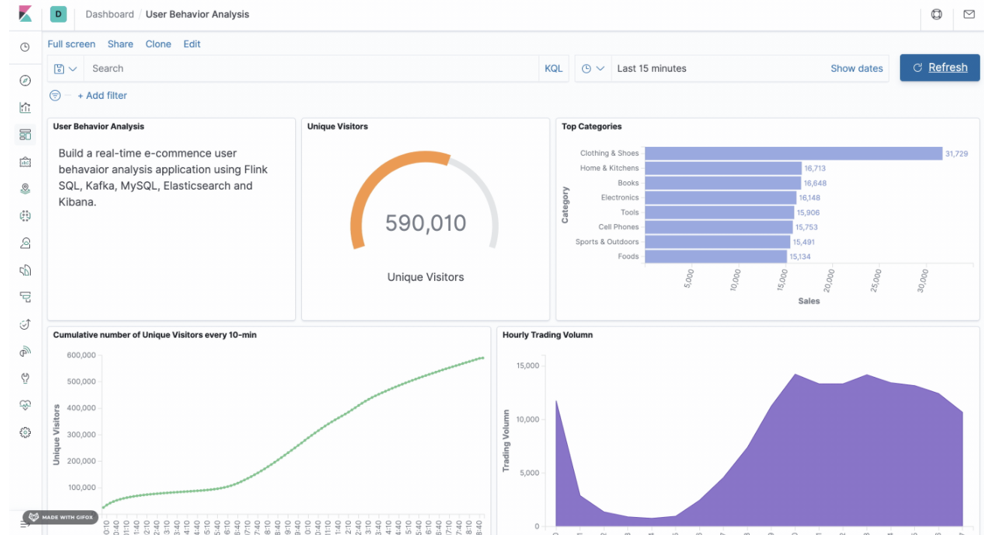

Kafka – SQL – Elastic Search – Kibana Integration
Flink Runtime
BA workstation
Flink SQL Client
Job Manager
Real Time Processing
BUSINESS
USER
e-commerce
Real Time Processing
Kibana Dashboard
DS workstation
Kafka Runtime
Elastic Search
0
n
Reference Tables
index
index
Watson Studio
user_behavior
index
DATA SCIENTIST

Slide 13
Checkpoint
Barrier - n
2
0
1
3
4
5
6
7
8
Checkpoint
n

Slide 14
Rule Engine Integration
Event Source
Flink Runtime
Decision Service Runtime
Data Stream
Real Time Processing
Rule Engine / Rule App
Rule Engine / Rule App
Next best action
Process Service
Entity Service
Kafka Runtime
RPA Service
0
n
0
n
0
n
Schema Registry
Elastic Search
Dashboard

