Slide 1
Different Data Models
API / DTO
SQL Tables
Documents
Single Page Application
µService
Entity
User Interface Data model
JSON Documents
tuples
Event Backbone
Enterprise Service Bus
Predictive Scoring Service
Event Model
Message Model
API / DTO / Message
ASBO
External App CRM / ERP)
RBO
Process Automation
Decision Service
Process App Data Model

Slide 2

Stateless App
Auto Scaling Group
Account
us-west-1b
LOAD
BALANCING
IDENTITY & ACCESS MANAGEMENT
EC2 Machine
us-west-1b
LOAD
BALANCING
EC2 Machine
us-west-1c
END
USER
EDGE
SERVICES
LOAD
BALANCING
EC2 Machine
DNS
Route 53
SECURITY GROUP
EC2 Machine
SECURITY GROUP

Slide 3
Application
Write End Point
Read End Point
Availability Zone 1
Availability Zone 2
Availability Zone 3
MASTER
READER
READER
READER
READER
READER
Extensible shared storage
Data
Data
Data
Data
Data
Data

Slide 4
any tcp/ip client
1-DNS request
app.domain
DNS
Route 53
IP: 192.46.6.7
A record
2- HTTP request
http://app.domain
Application
IP: 192.45.6.7

Slide 5
Browser
DNS
Route 53
1-DNS request
app.domain
IP: 192.46.6.7
A record
2- HTTP request
http://app.domain
Application
IP: 192.45.6.7

Slide 6
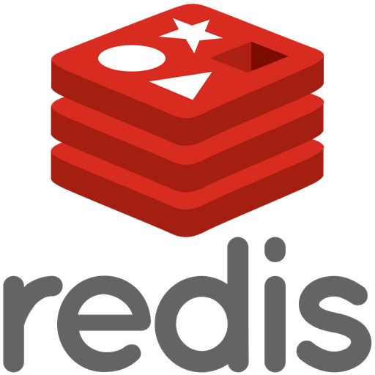
Stateful App
Auto Scaling Group
Account
us-west-1b
SECURITY GROUP
Multi AZ
IDENTITY & ACCESS MANAGEMENT
DNS
Route 53
EC2 Machine
Multi AZ
us-west-1b
END
USER
LOAD
BALANCING
EC2 Machine
Multi AZ
us-west-1c
SECURITY GROUP
EC2 Machine
RDS
SECURITY GROUP
SECURITY GROUP

Slide 7
AWS Kinesis
Source
Kinesis
Sink
Click Stream
IoT devices
S3
Event driven services
REDSHIFT
Kinesis Streams
Kinesis Analytics
Kinesis Firehose
Metrics | Logs
ELASTIC SEARCH

Slide 8

Serverless Architecture
S3
REST
Invoke
Read/ query
END
USER APP
API GATEWAY
LAMBDA
DAX
CACHING LAYER
DYNAMO
DB
Authenticate
Verify
Authentication
Cognito
IDENTITY & ACCESS MANAGEMENT

