Slide 1
Different Data Models
API / DTO
SQL Tables
Documents
Single Page Application
µService
Entity
User Interface Data model
JSON Documents
tuples
Event Backbone
Enterprise Service Bus
Predictive Scoring Service
Event Model
Message Model
API / DTO / Message
ASBO
External App CRM / ERP)
RBO
Process Automation
Decision Service
Process App Data Model

Slide 2

Stateless App
Auto Scaling Group
Account
us-west-1b
LOAD
BALANCING
IDENTITY & ACCESS MANAGEMENT
EC2 Machine
us-west-1b
LOAD
BALANCING
EC2 Machine
us-west-1c
END
USER
EDGE
SERVICES
LOAD
BALANCING
EC2 Machine
DNS
Route 53
SECURITY GROUP
EC2 Machine
SECURITY GROUP

Slide 3
Application
Write End Point
Read End Point
Availability Zone 1
Availability Zone 2
Availability Zone 3
MASTER
READER
READER
READER
READER
READER
Extensible shared storage
Data
Data
Data
Data
Data
Data

Slide 4
any tcp/ip client
1-DNS request
app.domain
DNS
Route 53
IP: 192.46.6.7
A record
2- HTTP request
http://app.domain
Application
IP: 192.45.6.7

Slide 5
Browser
DNS
Route 53
1-DNS request
app.domain
IP: 192.46.6.7
A record
2- HTTP request
http://app.domain
Application
IP: 192.45.6.7

Slide 6
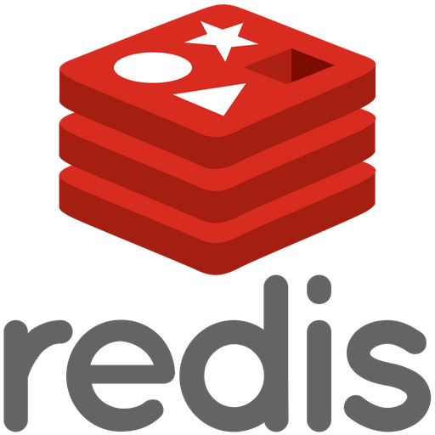
Stateful App
Auto Scaling Group
Account
us-west-1b
SECURITY GROUP
Multi AZ
IDENTITY & ACCESS MANAGEMENT
DNS
Route 53
EC2 Machine
Multi AZ
us-west-1b
END
USER
LOAD
BALANCING
EC2 Machine
Multi AZ
us-west-1c
SECURITY GROUP
EC2 Machine
RDS
SECURITY GROUP
SECURITY GROUP

Slide 7
AWS Kinesis
Source
Kinesis
Sink
Click Stream
IoT devices
S3
Event driven services
REDSHIFT
Kinesis Streams
Kinesis Analytics
Kinesis Firehose
Metrics | Logs
ELASTIC SEARCH

Slide 8

Serverless Architecture – ToDo mobile app
S3
REST
Invoke
Read/ query
END
USER APP
API GATEWAY
LAMBDA
DAX
CACHING LAYER
DYNAMO
DB
Authenticate
Verify
Authentication
Cognito
IDENTITY & ACCESS MANAGEMENT

Slide 9
Serverless Architecture - blog
OAI: Origin Access Identity
Bucket Policy
Amazon CloudFront Global distribution
S3
REST
Invoke
Read/ query
END
USER APP
API GATEWAY
LAMBDA
DAX
CACHING LAYER
DYNAMO
DB
Stream changes
DynamoDB Stream
Amazon Simple Email Service
LAMBDA
IDENTITY & ACCESS MANAGEMENT

Slide 10
Microservice
DNS
Route 53
END
USER
LOAD
BALANCING
ECS
DynamoDB
API GATEWAY
LAMBDA
LOAD
BALANCING
EC2 Machine
RDS

Slide 11
Serverless Architecture – Paid Content
OAI: Origin Access Identity
Bucket Policy
Amazon CloudFront Global distribution
S3
Signed URL
Generate CloudFront Signed URL
Query URL
Invoke
END
USER APP
API GATEWAY
LAMBDA
Verify user
Authenticate
Verify
Authentication
HTTPS
Invoke
Read/ query
Cognito
API GATEWAY
LAMBDA
DYNAMO
DB

Slide 12
Serverless Big Data Pipeline
Source
Ingest
Transform
Query
IoT devices
Kinesis Streams
Amazon
Athena
Kinesis Firehose
S3
LAMBDA
S3
LAMBDA
Amazon
QuickSight

Slide 13
Bridge digital to core
Mobile Apps
API Gateway
Container Orchestration
Cloud Provider
Cloud Services
Web Apps
Microservices
Functions
Microservice with Agile Integration
SaaS
Messaging Queue
IoT Apps
Event Backbone
Data Lake
Centralized Integration
System of Records
Transactional Systems
Legacy App

Slide 14
Bridge digital to core
Cloud Provider
Cloud or On-Premise Data Center
On-premise Data Center
SaaS
Container Orchestration
System of Records
Modernized Apps
API Gateway
APIs
Microservice with Agile Integration
Functions
Microservices
Transactional Systems
IoT channel
Messaging Queue
Legacy App
DBaaS
Event Backbone
Data Lake
High speed – high volume file transfer
B2B
AI Cloud Services

Slide 15


ADS
Cloud or On-Premise Data Center
Container Orchestration
Machine Learning Predict
Decision Designer
Embedded build service
Decision runtime
Business Automation Studio

Slide 16



KAR
Cloud or On-Premise Data Center
KAR runtime makes it easy to develop and run stateful, scalable, resilient applications for the hybrid cloud that combine microservices and managed services
Persist states in Redis
Leverage Kafka for asynchronous communication
Integrate with source and sink via Camel connectors
KAR mesh can spread between environments
Container
Container
Container
KAR runtime
KAR runtime
KAR runtime
Service app
Service app
Service app
Container
Notifier

Slide 17

Tekton
Specific
Reusable
PipelineRun
Pipeline
*
Task
*
PipelineResource
TriggerTemplate
gtihub
template
app service
*
imageRepository name for the app to build
EventListener
TriggerBinding
triggers
Map parameters from HTTP request message sent by git
so, they can be used in pipeline run
webhook
Route
Interceptors
Secrets
Webhook-secret-key

Slide 18
TLS
App
Server
https://server.dns.name
Server certificate with public key
signed by a Certificate Authority
App trusts server and sends secret key
encrypted with server public key
The two machines are the only ones who know the new secret key
All communication is encrypted with this key

Slide 19
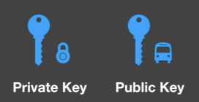
TLS: Certificate Signing Request
Server
Certificate Authority
Create a Certificate Signing Request with server key pair
Signed request by CA private key,
anyone who has CA public key can verify it is signed by me
App

Slide 20

BAI Components
IAF Deployment
BAI Operator
BAI setup Job
BAI Pillar Job
Business Performance Center
Management Service
External Dashboard
query
deploy jobs
query
Flink Cluster
Automation Event Emitters
Specific Flink Jobs
produce
Kafka
consume
produce
Notes:
Elasticsearch and kafka are deployed with IAF automation base
Flink cluster with IAF Event Processor and BAI operator

Slide 21
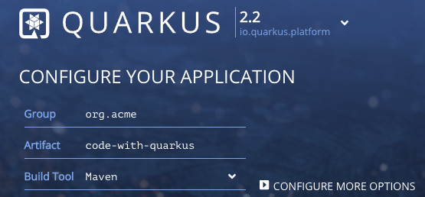

eda-demo-producer-ms
eda-demo-consumer-ms
Dev, stating, production
Services
CI pipelines, webhook
Secrets
CD
GitOps & KAM
eda-demo-order-gitops

