Slide 1
An Introduction to Massively Parallel Processing Databases
Jayson Barker
Brandon Croom
Neha Dixit

Slide 2
Problem Statement
Provide an educational overview of Massively Parallel Processing (MPP) databases

Slide 3
What is a MPP database?
A storage structure designed to handle multiple operations simultaneously by several processing units
Each processing unit (node) works independently with its dedicated resources

Slide 4
What are the advantages of a MPP Database
Scalability
I/O load balancing
Optimizer benefits
Notes:
Scalability – can easily add new nodes
I/O load balancing – data is spread across nodes
Optimizer benefits – data spreading allows for quicker results from database searches

Slide 5
How does MPP differ from traditional databases?
Better performing than symmetric multiprocessor (SMP) databases
Incremental resources and compute can be added to MPP systems
Can be more cost efficient than SMP for large data
Better throughput for read and write operations

Slide 6
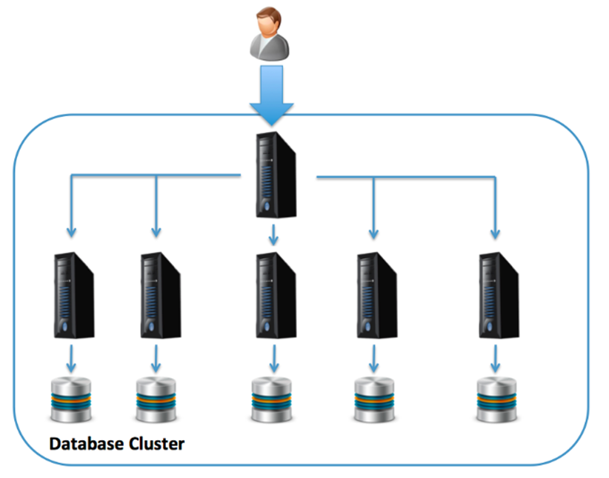
MPP Database Architecture
Notes:
The diagram above provides an illustration of an MPP architecture whereby a coordinating SMP server accepts user SQL statements, which are distributed across a number of independently running database servers that act together as a single clustered machine. Each node is a separate computer with its own CPUs, memory, and directly attached disk.
Using this solution, as data is loaded, a consistent hashing algorithm may be used to distribute the data evenly, which (if all goes well) will lead to a balanced distribution of work across the cluster. MPP architectures are an excellent solution for Data Warehouse and analytic platforms because queries can be broken into component parts, and executed in parallel across the servers with dramatic performance gains.
However, unlike SMP systems, where data placement is automatic at the disk level, it’s critical to get this step right to maximize throughput and response times. The diagram below illustrates the three MPP data distribution methods available.

Slide 7
Constraints of MPP Database
Complexity and Cost
Data distribution is critical
Need for downtime
Lack of Elasticity
Scale out only
Potential Over Capacity
Notes:
Although MPP systems have compelling advantages over the traditional SMP architecture, they do have the following drawbacks:
Complexity and cost: While the architecture appears simple on the surface, a well designed MPP solution hides a significant level of complexity, and the earliest commercial MPP database systems from Teradata and Netezza were delivered as a hardware appliance at significant cost. However, as this architecture has become more popular for large-scale analytics platforms, prices are beginning to ease.
Data Distribution is Critical: Unlike the SMP solution in which data placement at disk level is simple and can be automated, an MPP platform requires careful design of the data distribution to avoid data skew leading to processing hot-spots. If for example, a poor distribution key is selected, this can lead to a small number of nodes being over-loaded while others lie idle which will limit overall throughput and query response time. Likewise, if a reference table is not correctly placed with the associated transaction data, this can lead to excessive Data Shuffling whereby data is transferred between nodes to complete join operations which again can lead to performance issues. This is illustrated in the diagram below where reference data is shuffled between two nodes. While it’s possible to fix the problem, it typically needs a massive data reorganization effort, and potentially system downtime.
Need for downtime: Although some MPP solutions have resilience and high availability built in, many require downtime or reduced performance to support the addition of new nodes. In some cases, the entire cluster must be taken off-line to add additional nodes, and even where this is not needed, the adding nodes typically involve the re-distribution of data across the cluster to make use of the additional compute resources. This may not be ideal or even a viable option for some customers.
Lack of Elasticity: Although MPP systems can be scaled out, this typically involves the commissioning and deployment of new hardware which can take days or even weeks to complete. These systems typically don’t support elasticity – the ability to extend or reduce the compute resources on demand to meet real-time processing requirements.
Scale Out Only: To avoid an imbalanced system, it’s typically only sensible to add nodes of the exact same specification, compute power and disk storage. This means, although adding additional nodes increases the concurrency (the ability for additional users to query the data), it’s not possible to significantly increase batch throughput. In short, while it’s possible to scale out, there are few options to scale up the solution to a much more powerful system.
Potential Over Capacity: In theory, MPP systems are perfectly balanced, in that additional nodes add both storage and compute resources to the cluster. However, because these are so closely tied, if storage demands exceed the need for compute capacity, the total cost of ownership can be huge as the cost per terabyte rises disproportionately. This is especially prevalent in the popularity of Data Lake solutions which potentially store massive volumes of infrequently accessed data. In summary, using a pure MPP solution, you could be paying for 300 times more compute processing than you actually need.

Slide 8
Optimization of MPP Databases
Teradata
Compression reduces the space tables take up
Multiple types
Cost/benefit trade off between big space savings and uncompressing (processing) time
Optimizer
Evaluates a query and determines the most efficient way to execute it
Depends on user to use specific syntax (i.e., collect statistics) regularly to help optimizer decide on best path for queries
Query Tuning
EXISTS instead of IN
UNION ALL instead of UNION
DISTINCT instead of GROUP BY
Monitor resource usage during execution and compare
Notes:
Multivalue – best value in terms of processing and space savings
Algotrhytmic has hevy overhead and is best for cold tables

Slide 9
Industry Examples
Blue Cross Blue Shield of Texas and Illinois
Large Teradata shop
Data Warehouse receives data from multiple systems
Thousands of tables with billions of rows
Multiple layers of table and data structures
Granular (i.e, very segmented) to pre-defined joins (i.e., views and layers) to enable efficient access to common data models
Queries routinely return millions of rows in claims and membership data
DBAs actively monitor query efficiency to ensure no one AMP is overloaded during these large pulls

Slide 21
Last Slide
Fade to black after 15 seconds

